Slide 1
Python Basics
Gregory Brunner

Slide 2
IDE – Integrated Development Environment
Where you can write, test, debug, and run code

Slide 3
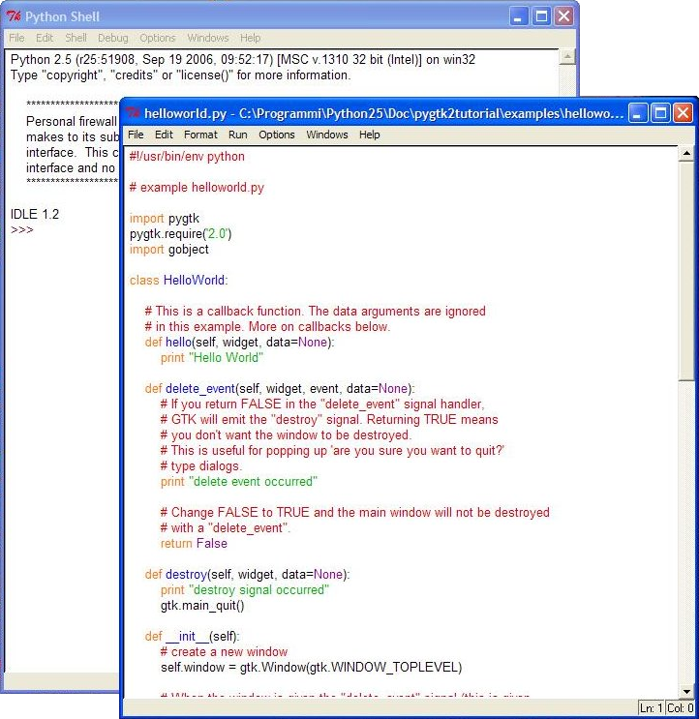
IDLE – Default IDE

Slide 4
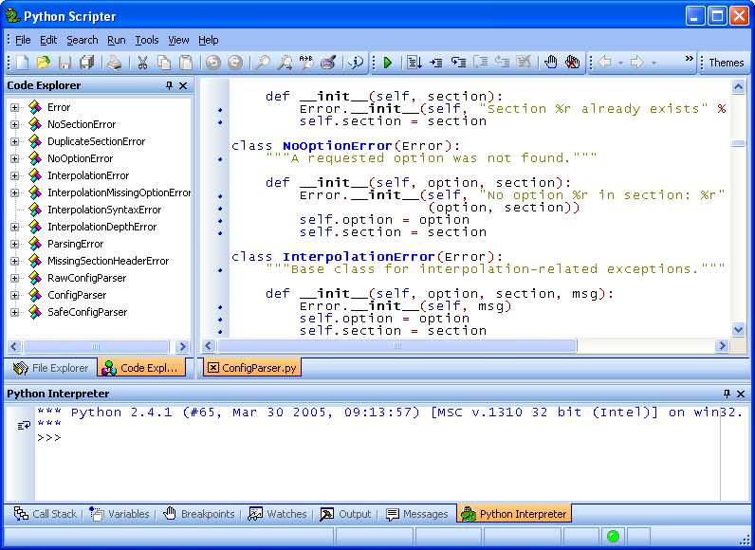
Pyscripter
More poular than IDL
Has code completion
Has debugging
https://sourceforge.net/projects/pyscripter/

Slide 5
Others
PyCharm
Eclipse
Visual Studio
Wing IDE
Spyder
Top 10 Python IDEs: http://noeticforce.com/best-python-ide-for-programmers-windows-and-mac

Slide 6
Getting Help

Slide 7
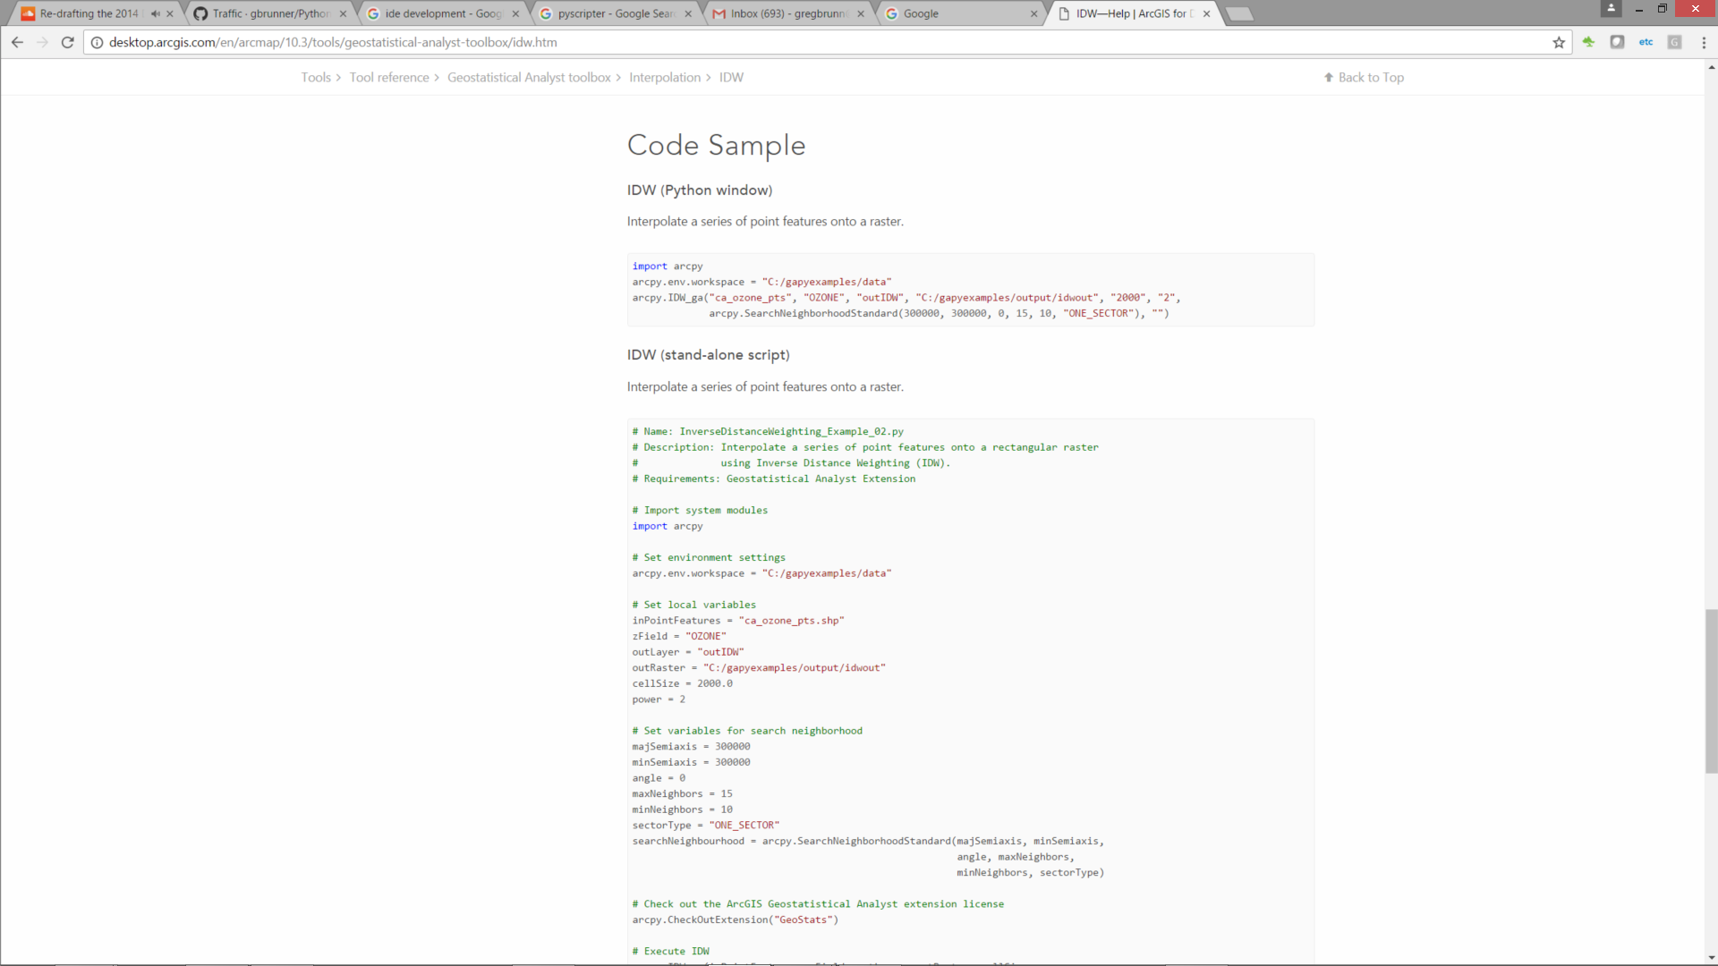
Arcgis.com

Slide 8
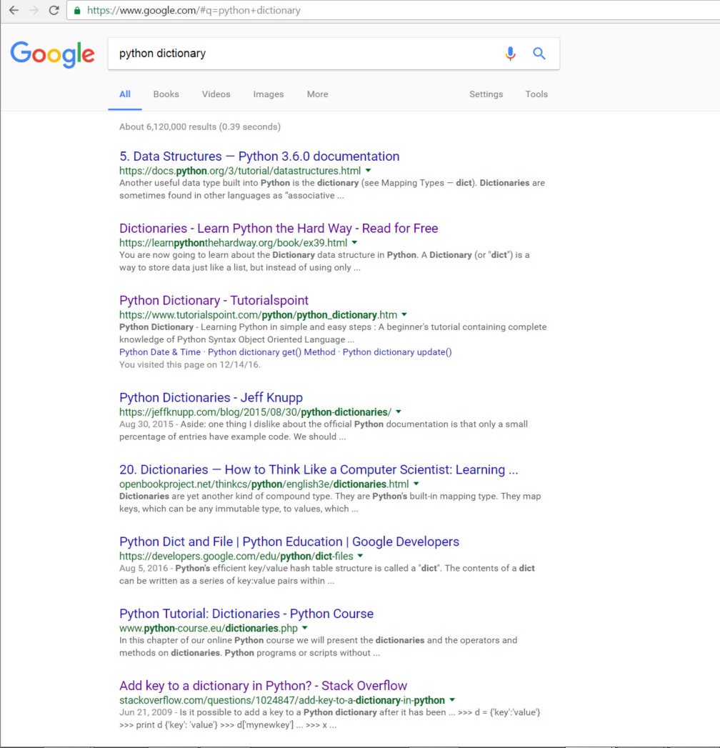
Google!
For example, Google “Python dictionary”

Slide 9
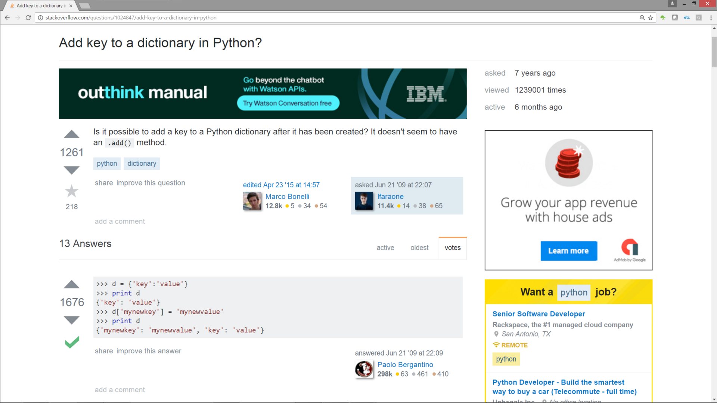
Stack Overflow

Slide 10
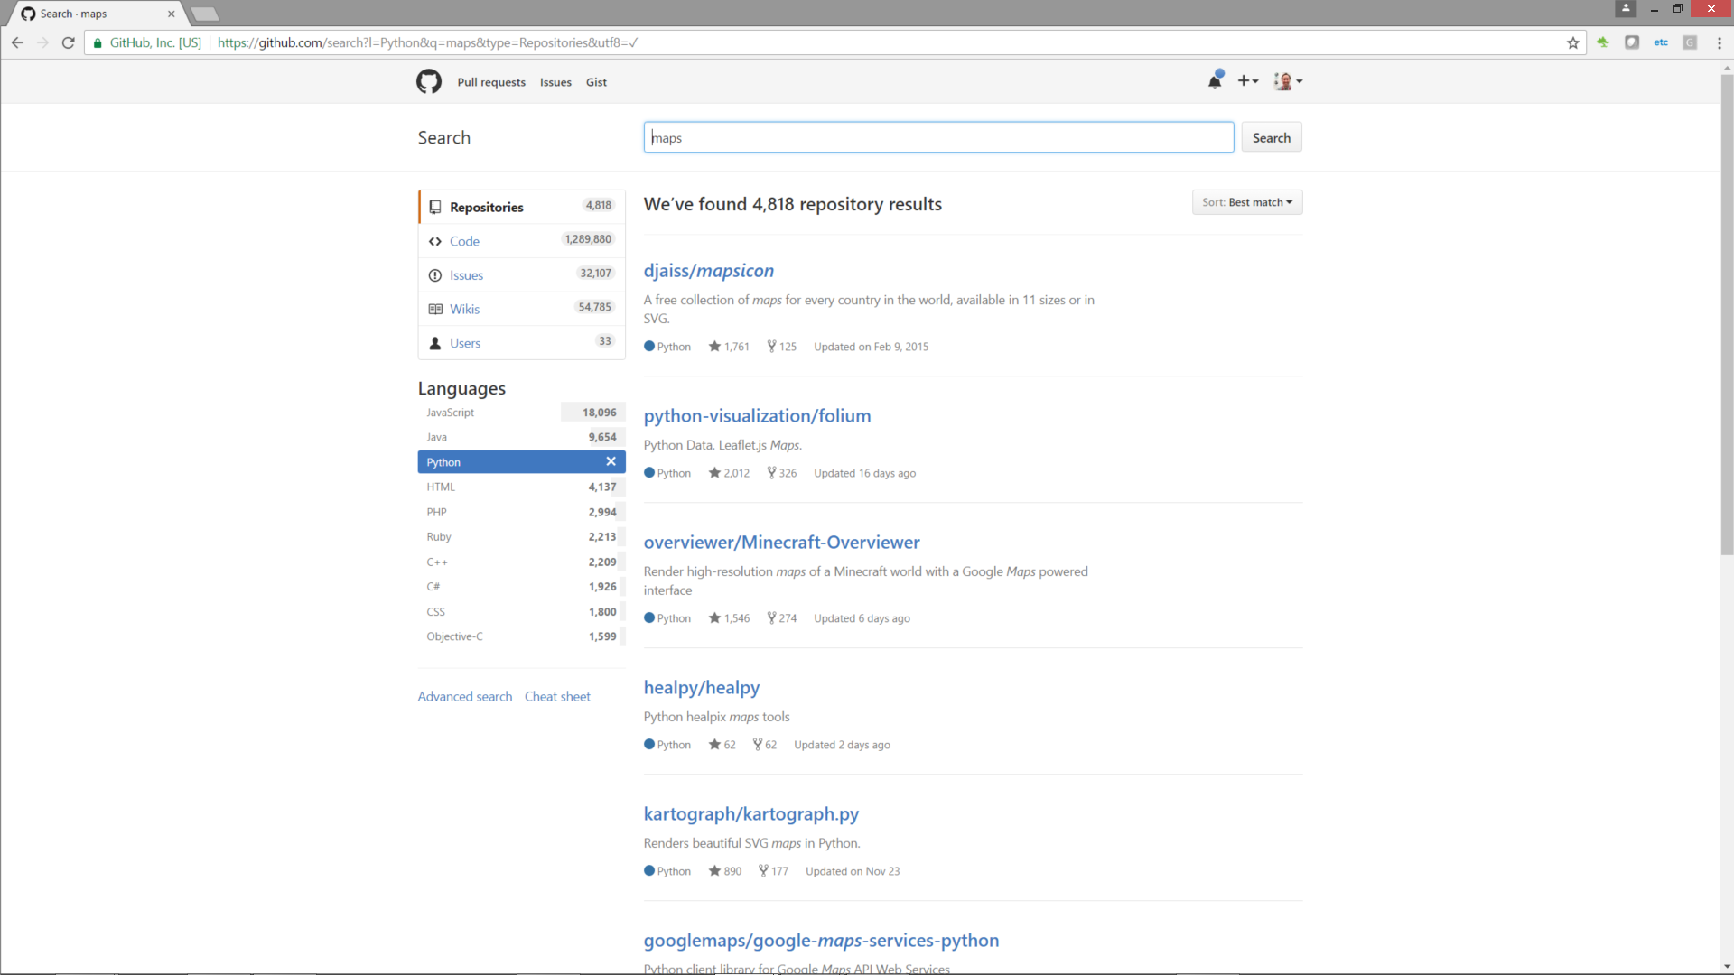
GitHub

Slide 11
Open Your IDE; Let’s Get Started!

