Slide 1
Python Programming for Remote Sensing and GIS
Gregory Brunner

Slide 2
Welcome!
I’m Greg Brunner
Scientists/developer for Esri
Programming with Python for 5+ years
Email: brunnergj@slu.edu
Office hours: Before class or upon request

Slide 3
Course Overview
This course will introduce students to python programming. Through completing this course, students will be able to use Python to perform common GIS and remote sensing analysis tasks, automate workflows, and develop custom Python tools. Topics will include describing data, manipulating data, automating spatial analysis tasks, creating Python scripts and tools, and using Python for imagery analysis.

Slide 4
Course Objectives
Learn Python and understand how to use it to solve problems in GIS and Remote Sensing
Encourage the use of Python through relevant examples and assignments
Get graduate level students implementing it in their own research projects.
This will be one of the most valuable skills you learn and develop

Slide 5
Syllabus
https://github.com/gbrunner/Python_for_GIS_and_RS/blob/master/GIS%205090%20Programming%20for%20GIS%26RS%20Syllabus%20Spring%202017.docx

Slide 6
Labs and Homework
Will be on Blackboard before class
If you are interested in looking farther into the future about what lectures, exercises, homework, and projects are coming, I am building the course at https://github.com/gbrunner/Python_for_GIS_and_RS

Slide 7
Labs
Exercises to guide you in learning Python
Please submit last week’s exercises with your homework at or before the beginning of each class through Blackboard.
Your feedback is appreciated

Slide 8
Lectures
Trying to make them interactive
If I am writing code, you should be too!

Slide 9
Homework
The objective with homework is to keep you thinking and learning about Python even outside of days in lab.
Homework is due at or before the beginning of each class.
Please submit through Blackboard

Slide 10
Projects
Projects will ensure your developing an understanding of how to use Python to solve GIS and Remote Sensing Problems
Project 1: Will likely consist of working with tabular data (CSV or text file) or generating some report based on GIS data using Python. I will give the assignment by week 4. It is due before class on week 6.
Project 2: Will likely consist of using Python to do some sort of spatial analysis or raster analysis. It will be assigned by week 9. It is due before class on week 11.

Slide 11
Final Project
You define the problem.
Before Spring Break (i.e. by Week 8), please submit to me a short write up (no more than 1 page) of what your project will be, what problem you will solve, how you will use Python to solve the problem

Slide 12
Blackboard

Slide 13
GitHub
You need to become familiar with GitHub.
My intent is for everyone to get a GitHub account and submit Projects via GitHub

Slide 14
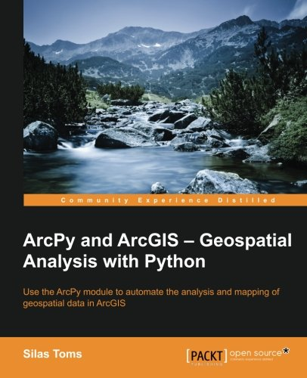
Required Textbook
Toms, Silas. Arcpy and ArcGIS – Geospatial Analysis with Python. (https://www.amazon.com/ArcPy-ArcGIS-Geospatial-Analysis-Python/dp/1783988665)

Slide 15
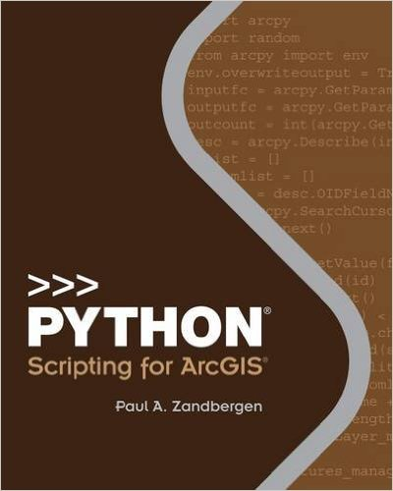
Optional Textbook
Recommended: Zandbergen, Paul A. Python Scripting for ArcGIS - http://esripress.esri.com/bookResources/index.cfm?event=catalog.book&id=9

Slide 16
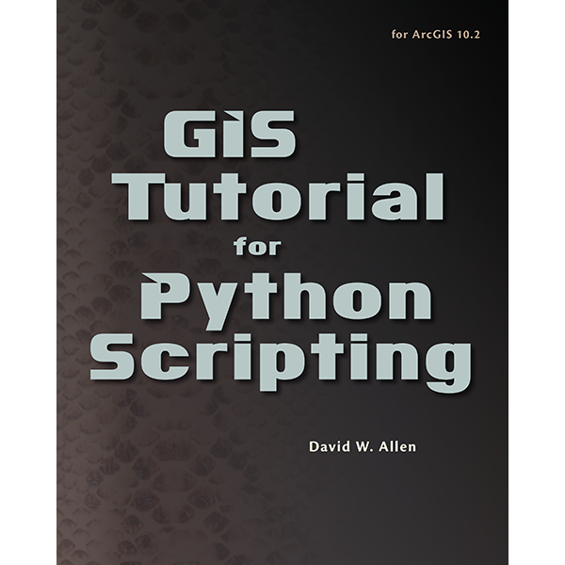
Optional Textbook
GIS Tutorial for Python® Scripting - http://esripress.esri.com/bookResources/index.cfm?event=catalog.book&id=8

Slide 17

Optional Textbook
Python For ArcGIS - http://www.springer.com/us/book/9783319183978

Slide 18
Any Questions?

Slide 19
Python
Gregory Brunner

Slide 20
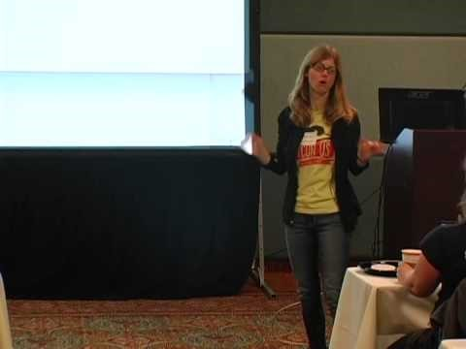
Why Python? (Jessica McKellar)

Slide 21
Quoting Jessica
Python is a versatile language: you can analyze data, build websites (*), maintain servers, make art or music.
Employers love Python: people will want to hire you.
Python is a great teaching language … a lot of educational institutions are switching to Python, e.g., MIT
It reads very much like English (it has low syntactic overhead)
It is very easy to get useful work done quickly in Python
You can do data analysis and graphing with Matplotlib (even 3D animations)

Slide 22

Why do I love Python?

Slide 23
My Favorite Examples
Basketball –
https://github.com/gbrunner/Courtside-Geography/blob/master/single_player_shotchart.py
http://ps-dbs.maps.arcgis.com/home/webmap/viewer.html?webmap=3b116735a399402eb6ee9788255a2373
Fun maps! – https://twitter.com/gregbrunn/status/718271695212126213
Notebooks - http://earthpy.org/analyzing-whale-tracks.html
Baseball - https://gavinr.com/2016/12/22/create-pitch-charts-python/

Slide 24
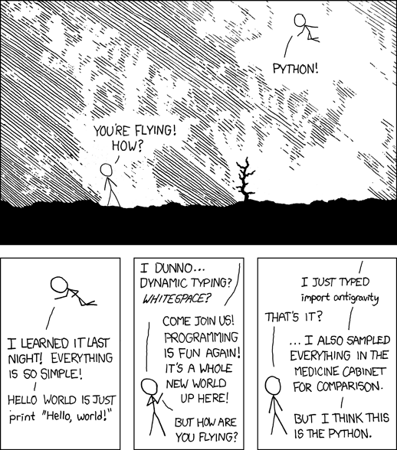
It’s so easy!

Slide 25
Let’s Get Started!

