Slide 1
Arcpy Cursors
Gregory Brunner

Slide 2
Cursors
Provide row-by-row access to feature data
3 Types
Search Cursor – Read only access to rows
Update Cursor – Update and delete rows
Insert Cursor – Insert new rows into a feature class
Used through the arcpy data access module (arcpy.da)

Slide 3
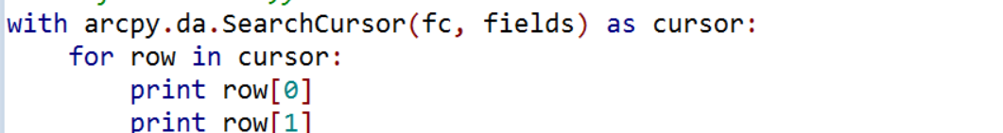
Implementation
Arcpy.da cursors opened using “with” statements
“With” denotes when feature class is opened
Row values accessed by index

Slide 4
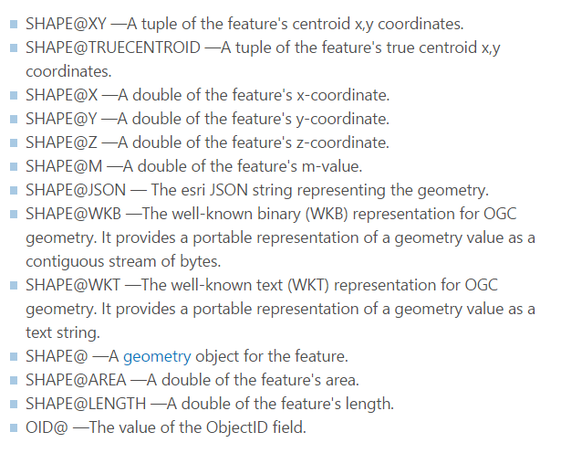
Fields and Tokens
Define only the fields in the Feature class you are interested in
Tokens give easy access to geometries and object ID

Slide 5
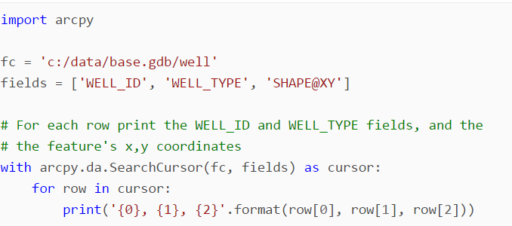
Search Cursor
http://desktop.arcgis.com/en/arcmap/10.3/analyze/arcpy-data-access/searchcursor-class.htm

Slide 6
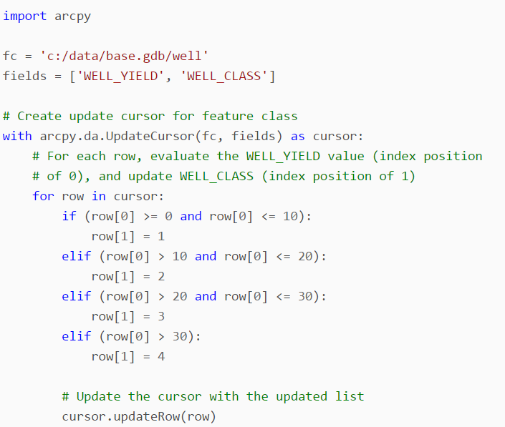
Update Cursor
http://desktop.arcgis.com/en/arcmap/10.3/analyze/arcpy-data-access/updatecursor-class.htm

Slide 7
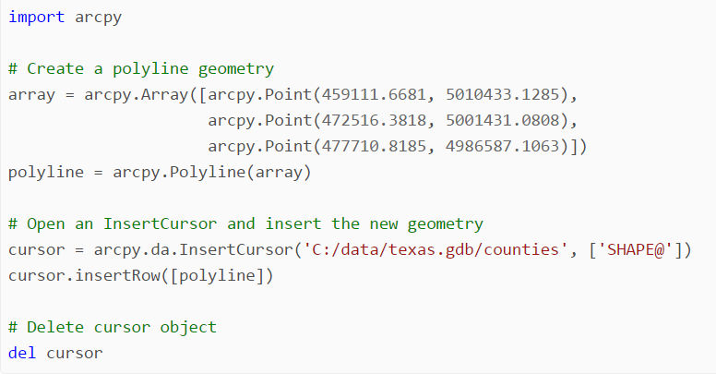
Insert Cursor
http://desktop.arcgis.com/en/arcmap/10.3/analyze/arcpy-data-access/insertcursor-class.htm

Slide 8
Examples
Gregory Brunner

Slide 9
Chapter 5 of Toms
Ignore creating and populating the CSV file (such as on page 84)
Just print results
There is an indentation error on page 85. In the for loop, print out the row
You will need to create 3 feature classes to complete the chapter
TestBusStops
TestBusLines
TestPolygon

Slide 10
Homework and Week 7
Project 1 is posted and is due next week
Proposal for your Final Project is due in 2 weeks
Next week, we’ll cover Chapter 6 of Toms and Working with JSON data.

