Slide 1
Week 12
Gregory Brunner

Slide 2
This Week
Talk about Final Project
Review Project 2
Practical Coding Advice, Debugging, Numpy, and Matplotlib
Week 13 (4/18) – Next Week
Beyond the basics
Pandas
Jupyter Notebooks and WebGIS with Python
Week 14 (4/25)
Intro to Web Development for GIS
HTML and Javascript
Led by Jacob Wasilkowski (https://jwasilgeo.github.io/)
Week 15 (5/2) – Final Projects Due and Presented

Slide 3
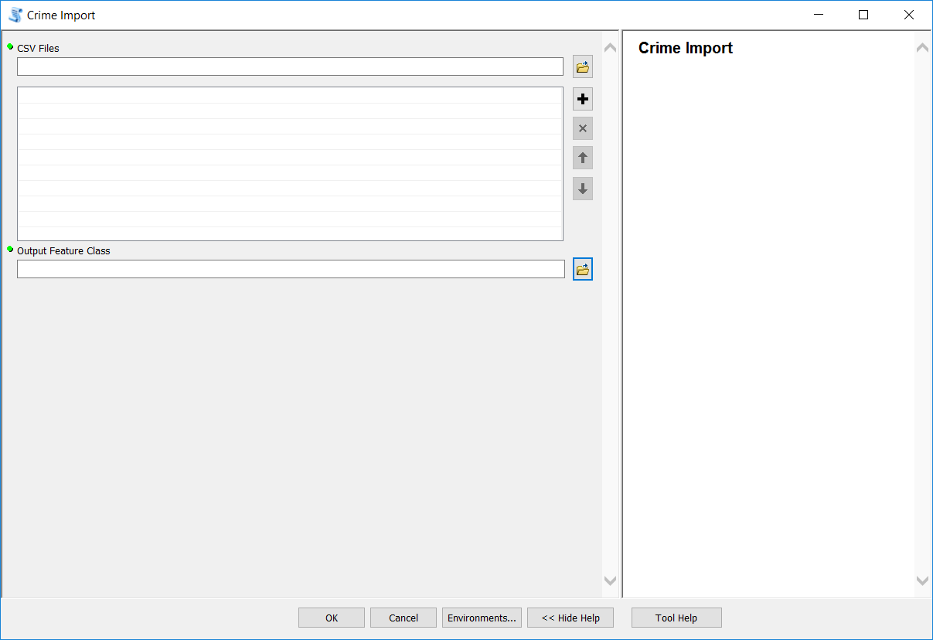
Project 2 – Option 1

Slide 4
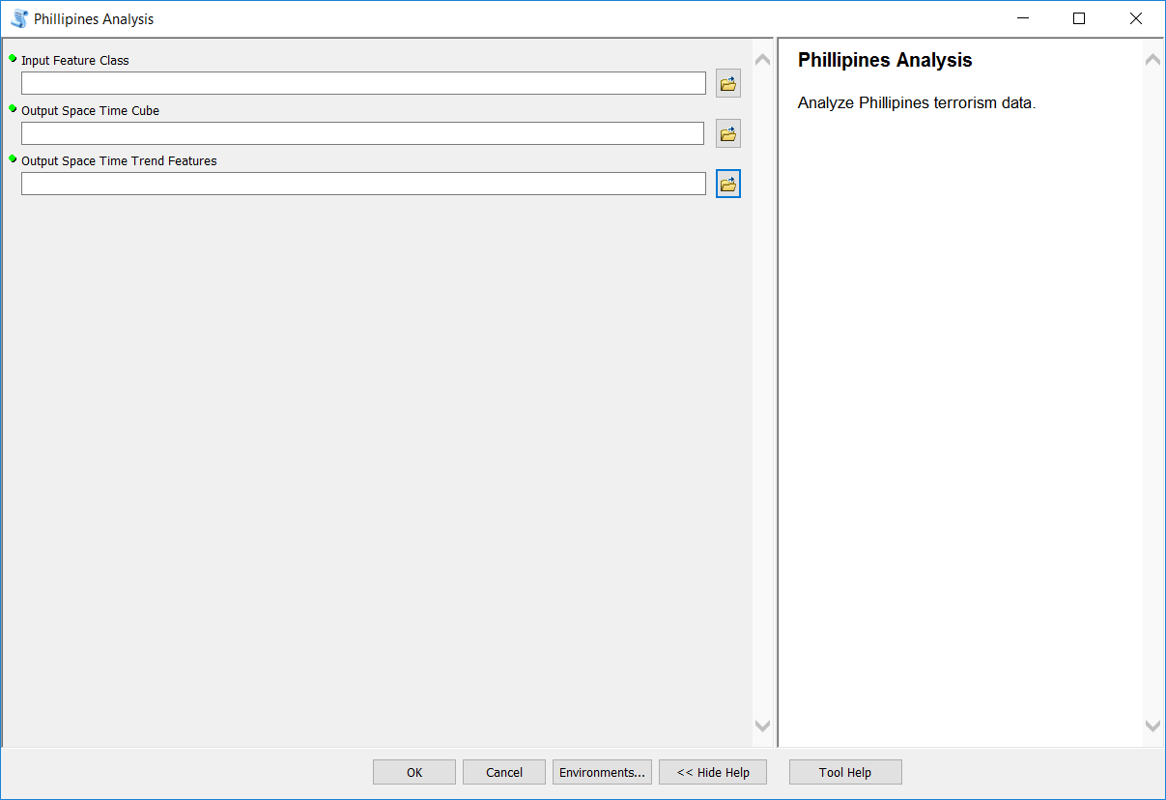
Project 2 – Option 2

Slide 5
Week 11 Homework
Seemed like everyone understood what to do.
Mistakes that I saw
Forgot to save mxd after adding layers
Only added layer to 1 datacframe instead of both

Slide 6
Practical Coding Advice

Slide 7
Use “print” statements!
Print out things like:
Variables
Files and paths
When a process finishes
The amount of time a process takes
Similarly, use arcpy.AddMessage() to add print statements to tools

Slide 8
Let your compiler yell at you!
http://www.pgbovine.net/c-programming-tips.htm#compiler-warnings
When a program fails, you want it to fail loudly
Don’t use try-except statements until your code works. Try-except statements can mask the real issues.

Slide 9
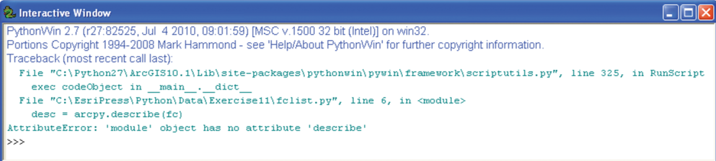
Learn to read compiler error messages
First thing to notice: what line of code the tool failed on.
From there, think about what the most likely source of error is

Slide 10
Debugging

Slide 11
Common Python Code Errors
Spelling mistakes
Forgetting to import modules
Case sensitivity
Paths
Forgetting colons (:) on if-else statements and loops
Incorrect or inconsistent indentation

Slide 12
Debugging Tips and Tricks
Remember, ArcGIS puts a lock on files that are in use
When working with large files, test code on a small sample of data
Use “print” statements ☺

Slide 13
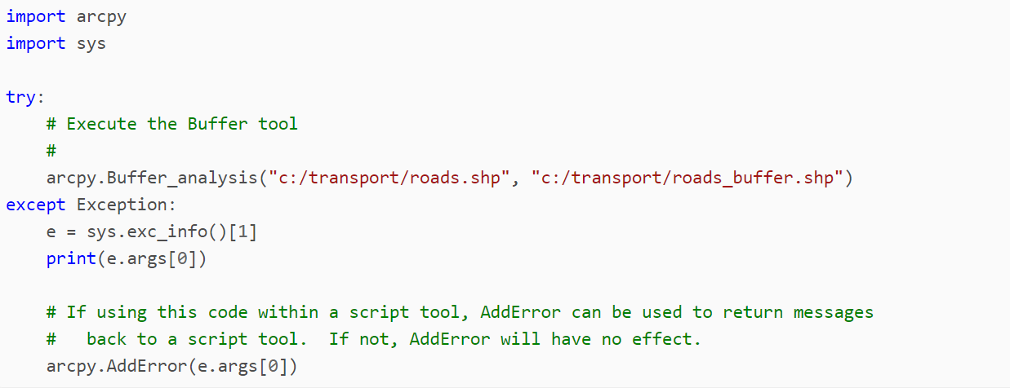
Exceptions
Try-except – Way to gracefully handle errors
http://pro.arcgis.com/en/pro-app/arcpy/get-started/error-handling-with-python.htm
If interested in learning, look at the Debugging Exercise!

Slide 14
Example – How I Use Try-Except

Slide 15
Numpy

Slide 16
Matplotlib

Slide 17
Next Week – Beyond the Basics

Slide 18
Python Notebooks and Python API
Read Chapter 12 of Toms – The End of the Beginning
ArcGIS Python Web API - https://developers.arcgis.com/python/
https://developers.arcgis.com/python/sample-notebooks/chennai-floods-analysis/
Try the samples live! We’ll look at this on Monday.

Slide 19
For this week, though…
Pick any 2 or 3 of the following and submit them in the week 12 in-class work folder:
Chapter 11 of Toms on Network and Spatial Analysis
Cursors
Debugging
Functions
Numpy
Matplotlib
Homework:
Work on Final Project
Watch two videos in the Week 13 Folder

