Slide 1
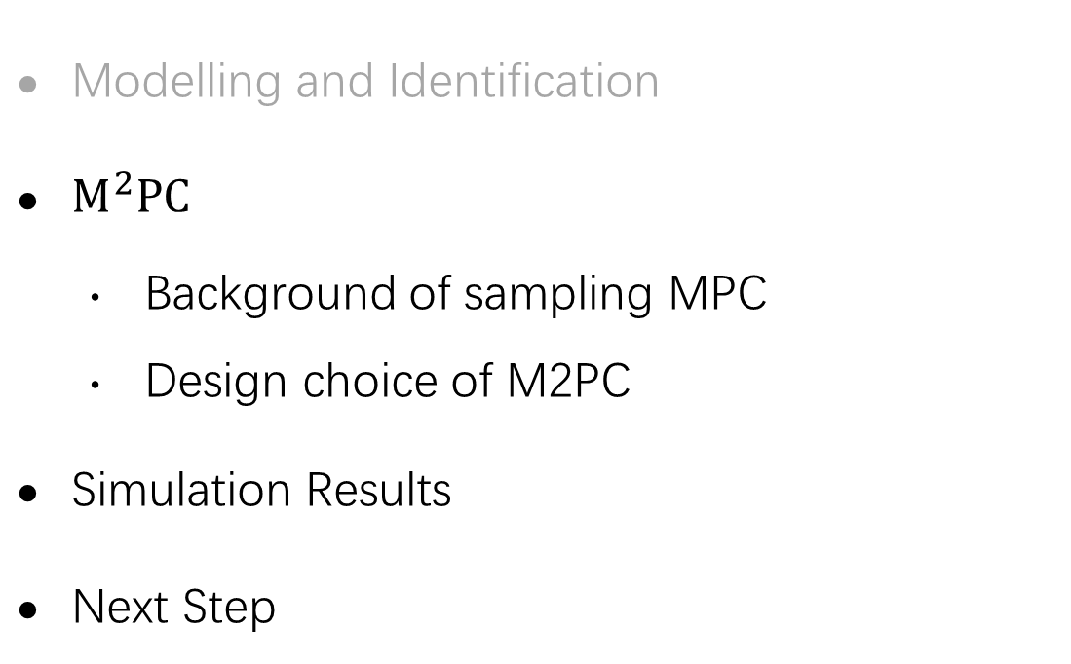
$M^{2}PC$: Multimodal Model Predictive Control
Modelling and Identification
$M^{2}PC$
  Background of sampling MPC
  Design choice of M2PC
Simulation Results
Next Step

Slide 2
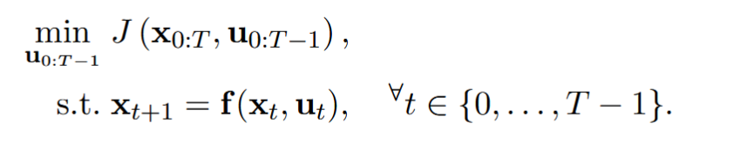
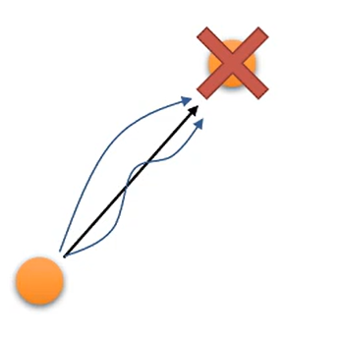
Background
• Interior-Point
• SQP
• Gauss-Newton
• …
Traditional MPC
- Solver: Iterative Gradient-Based Optimization
- Return a deterministic optimal action
MPC via Probabilistic Inference
- Solver: Sampling
-New Goal: find the distribution of the optimal action!

Slide 3
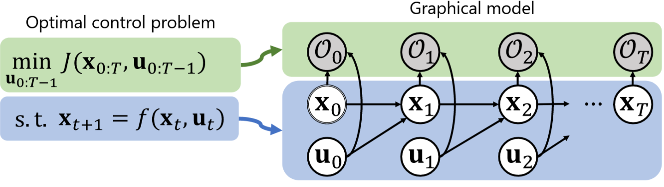
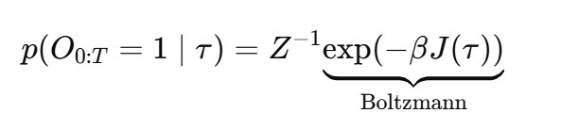


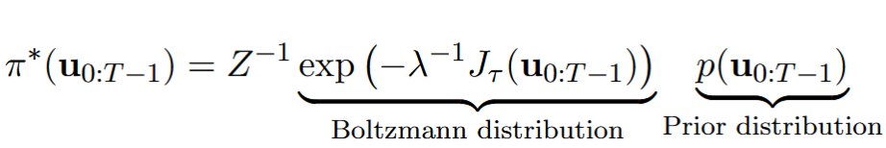
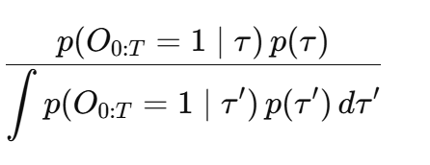

Background
-New Goal: find the distribution of the optimal action!
MPC via Probabilistic Inference
x_t+1 = f(x_t, u_t)
u typically sampled from$𝒩\left(m,v\right)$
O_t is a virtual binary variable:

Slide 4
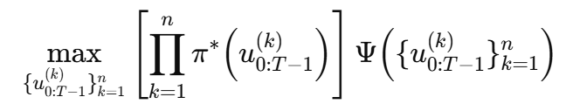
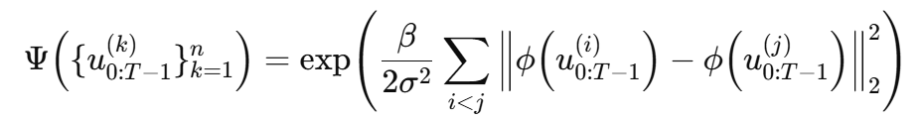
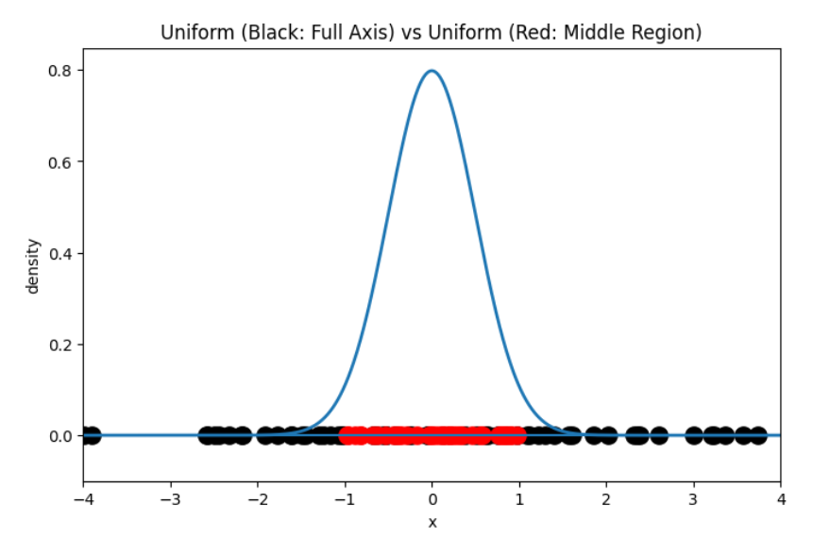
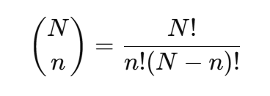
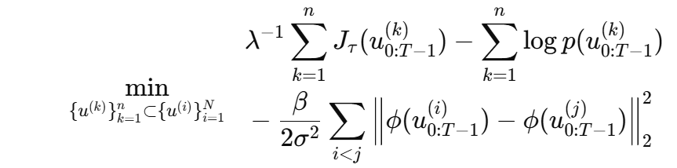
M2PC: Multimodal MPC
1. Find $n$good and sufficiently diverse actions (modeling)
Simplify
(1)
2. Select $n$action from $N$sampled actions (approximation)
(2)

Slide 5
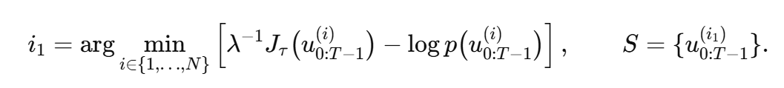
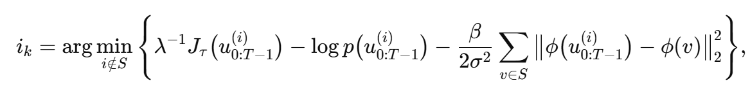

M2PC: Multimodal MPC
2. Select $n$action from $N$sampled actions (approximation)
(2)
3. Greedy method (choose action one by one)
Obj(S)
Choose first action to the set:
For k = 2, …, n iterate:
Free !

Slide 6
Simulation
Trajectory Tracking Task: control the top of the rope such that its bottom follows a desired trajectory.
Comparison with previous Method
SPiD
M2PC
Initial state collection
Need training
Fast online calculation (MLP)
30cm rope for test
No data collection
No training
Need great GPU for rollout
100cm rope for test

Slide 7
Conclusion
M2PC provides a multimodal inference framework for high-dimensional and highly nonlinear systems.
In the rope trajectory tracking task, it achieves high-quality control performance for
arbitrary reference trajectories and reasonable time durations,
without requiring any training or expert demonstration data.
Next Step
Multimodal behavior test (Collision avoidance)
Robustness to external force
Adaptive to different ropes
Real experiments for all above

Slide 8
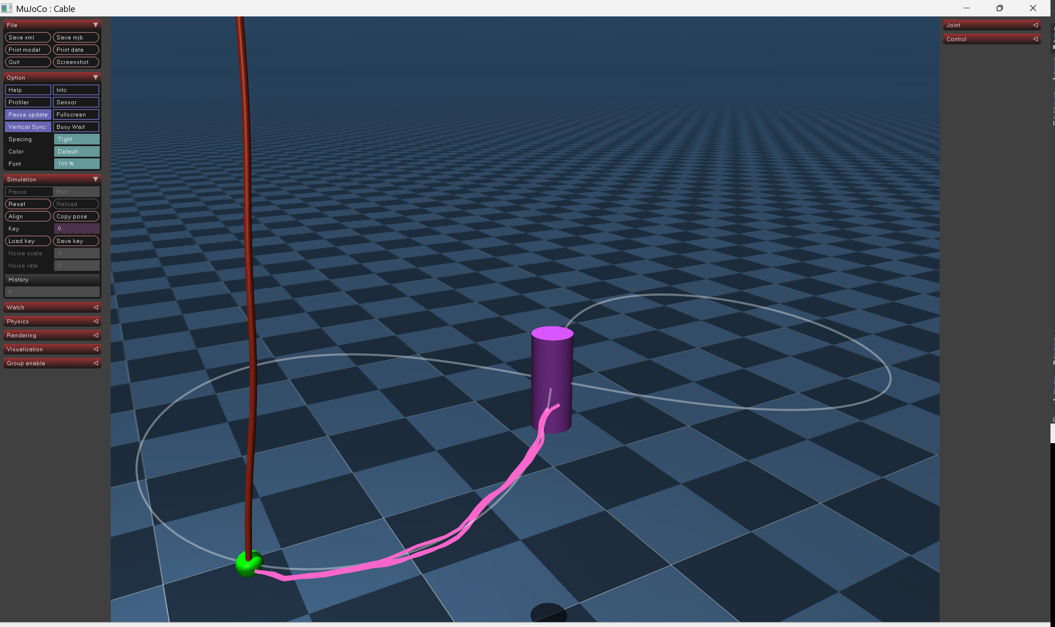
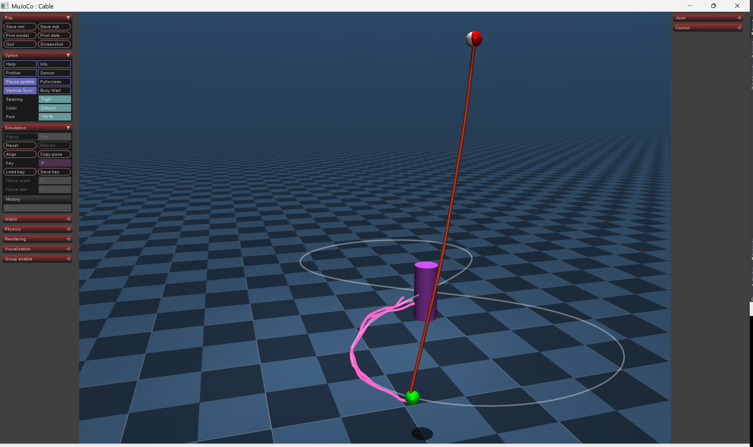
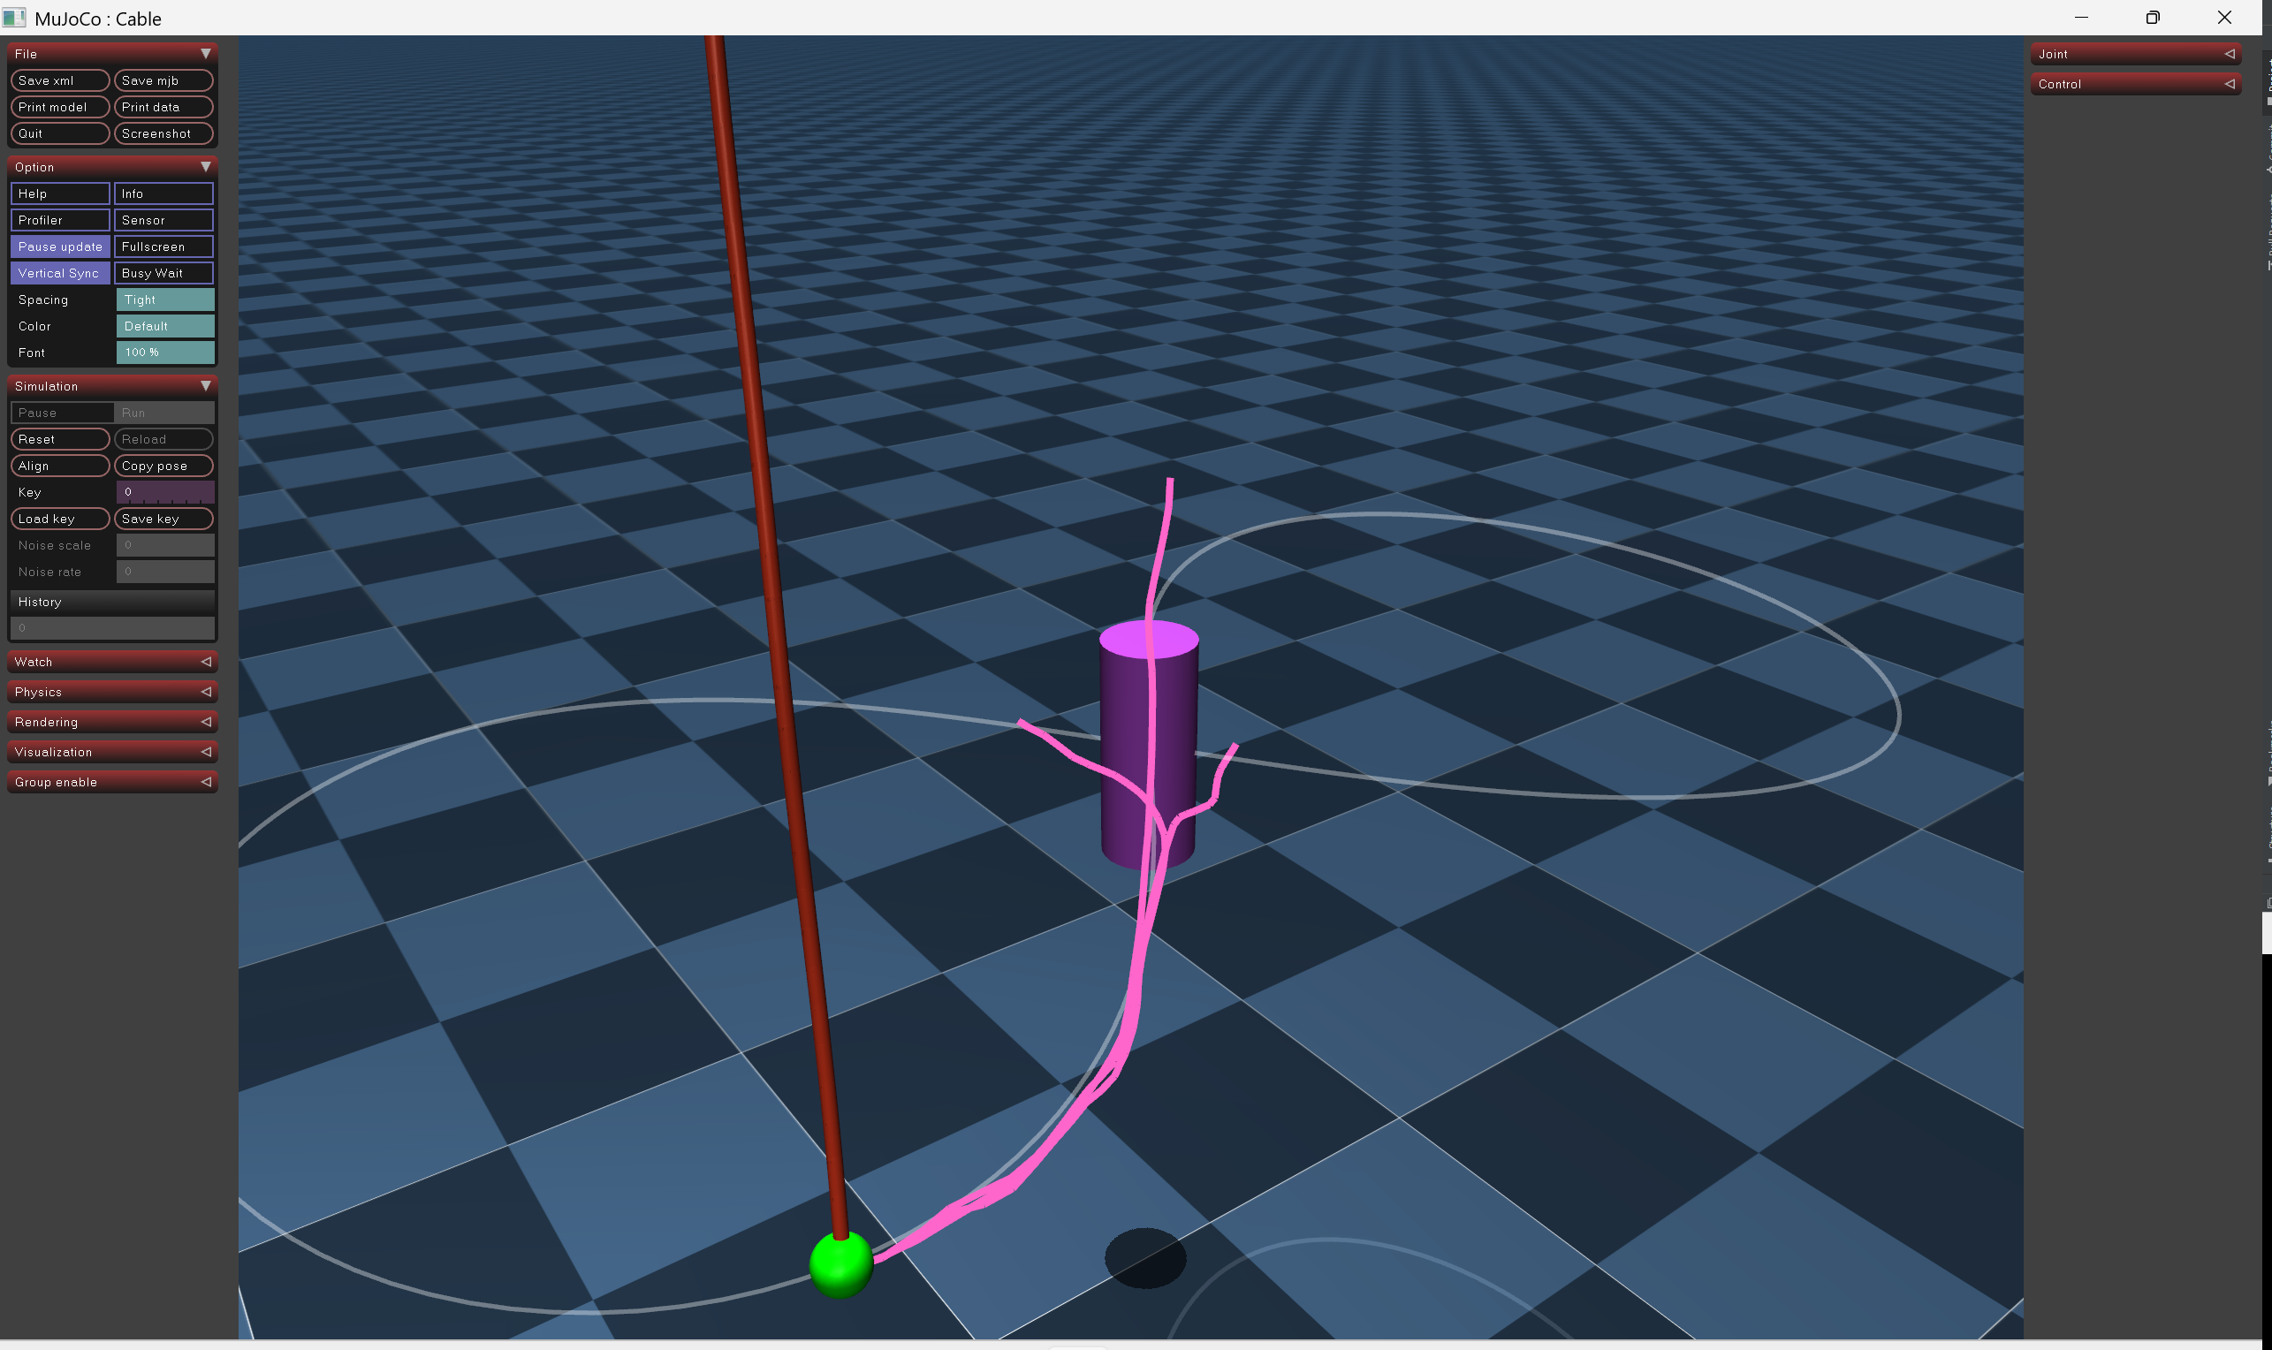
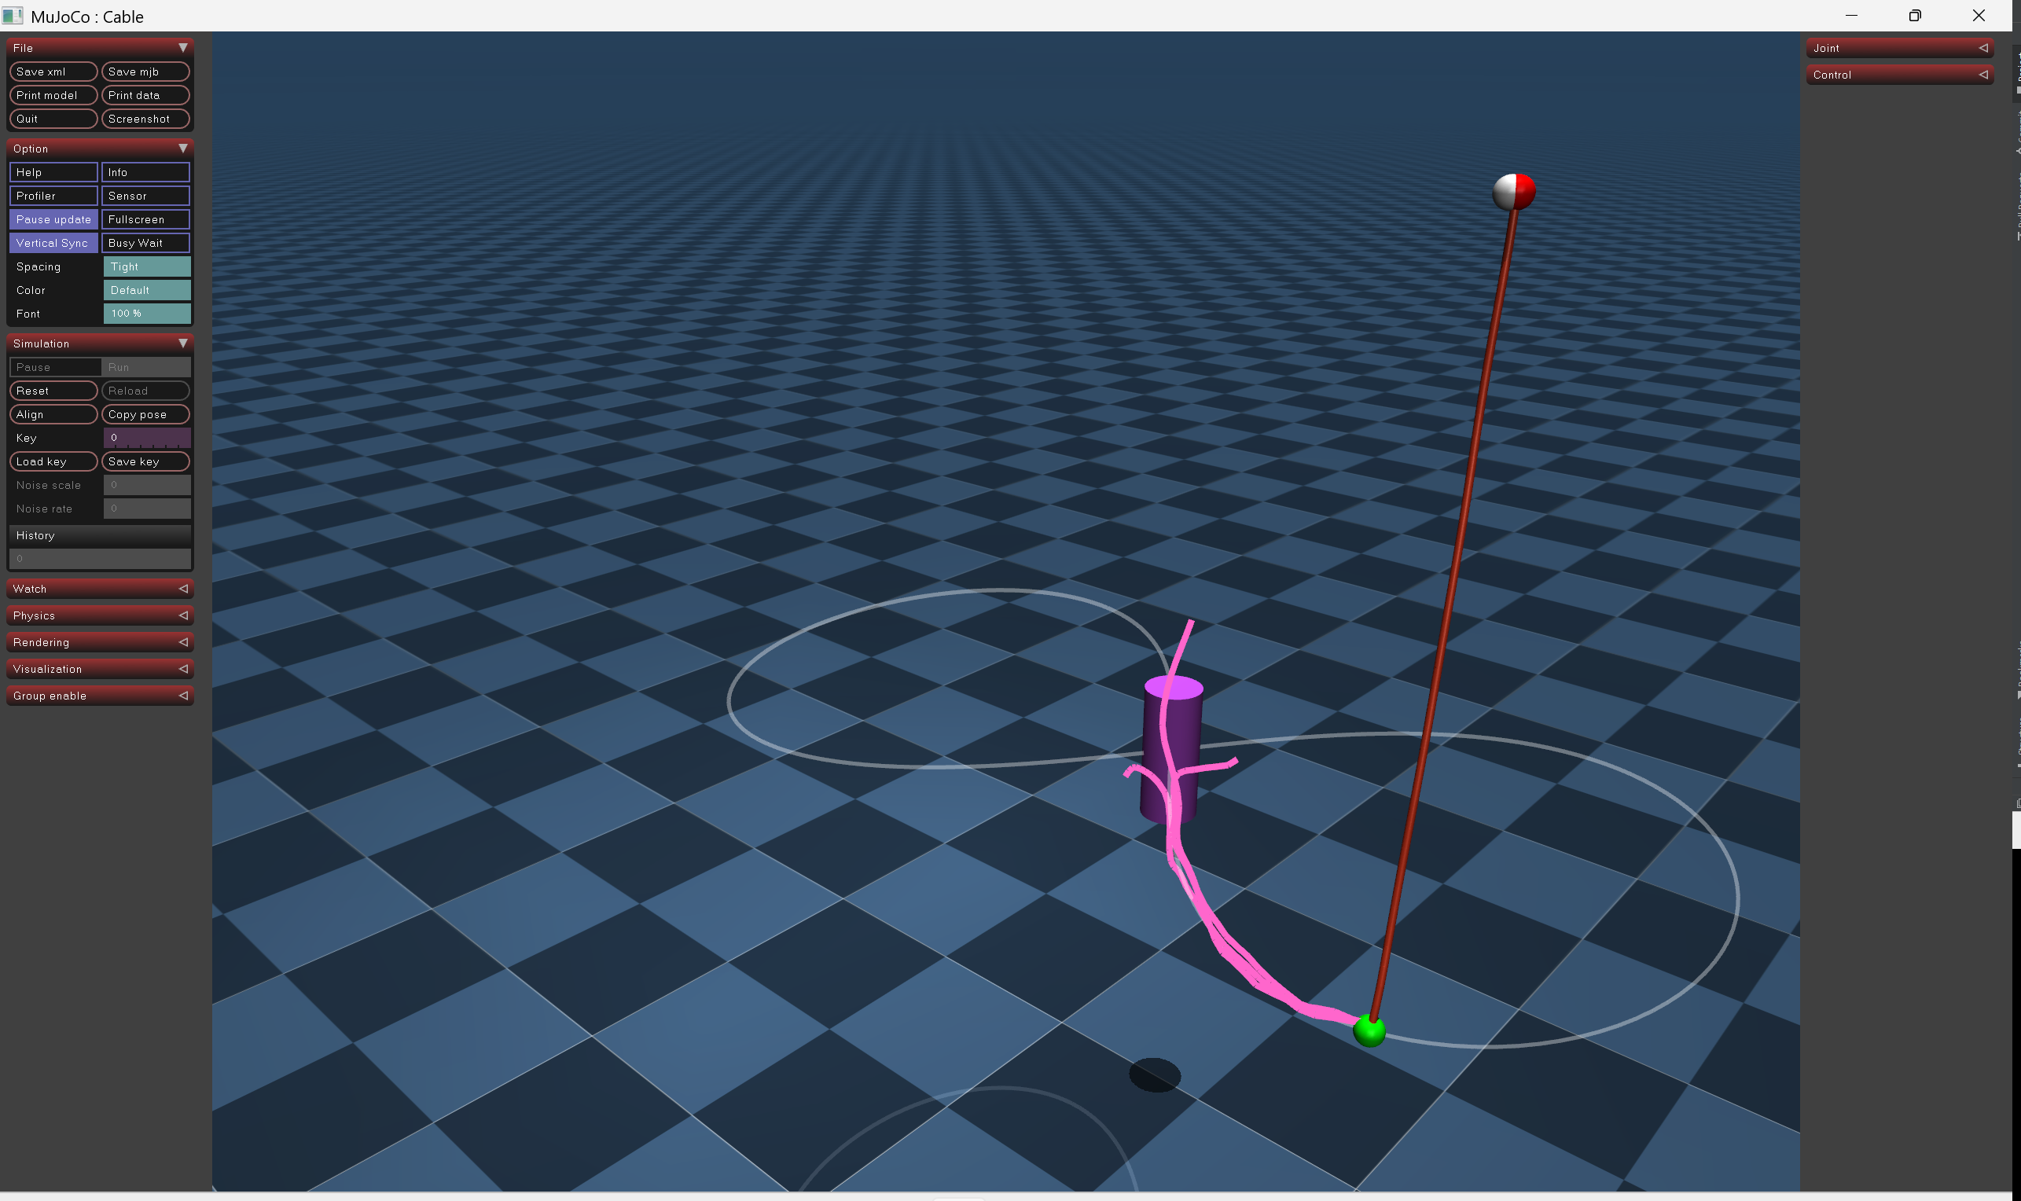
Multimodality

Slide 9
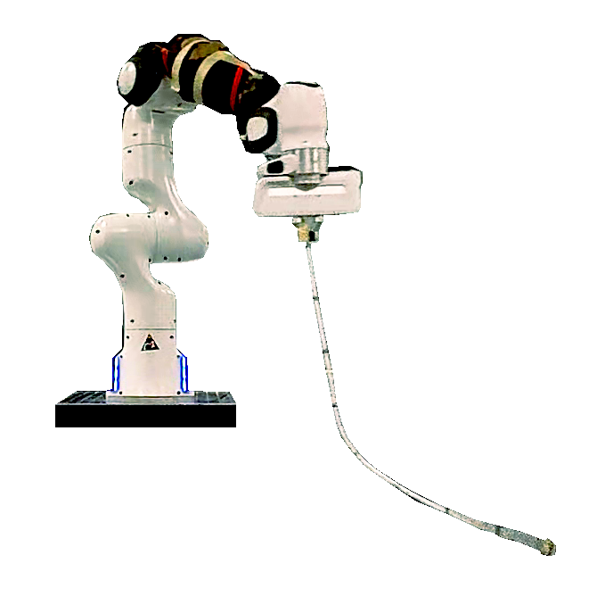
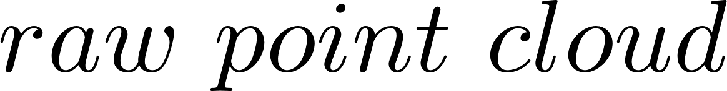
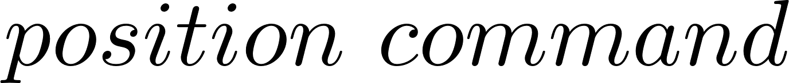
Real Experiment
Franka robot
Remote
Node-1:
- Reorder rope node positions
- Estimate node velocity via differencing + filtering
- Update new target trajectory segment
Pos
Vel
goal traj
Optitrack
Node-1
Rocco
(M2PC)
Impedance controller
Node-2
Acceleration
Rope
Model
Node-2:
-Double integrate acc command to get goal position

Slide 10
Experiment to test why the framework does not work
Franka robot
Remote
Simulation
Pos
Vel
goal traj
✔
Optitrack
Node-1
Rocco
(M2PC)
✔
Impedance controller
✔
Node-2
Acceleration
Rope
Model
✔
Time delay?
Actuator delay?

Slide 11
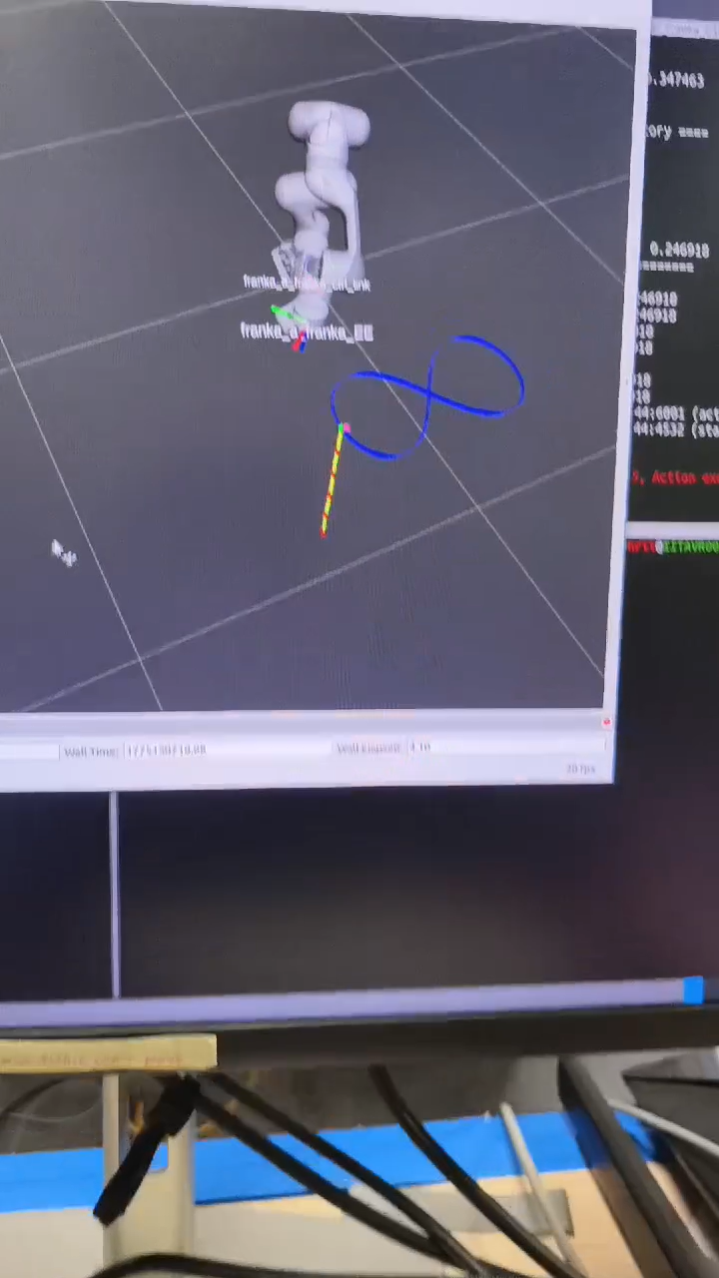

Slide 12
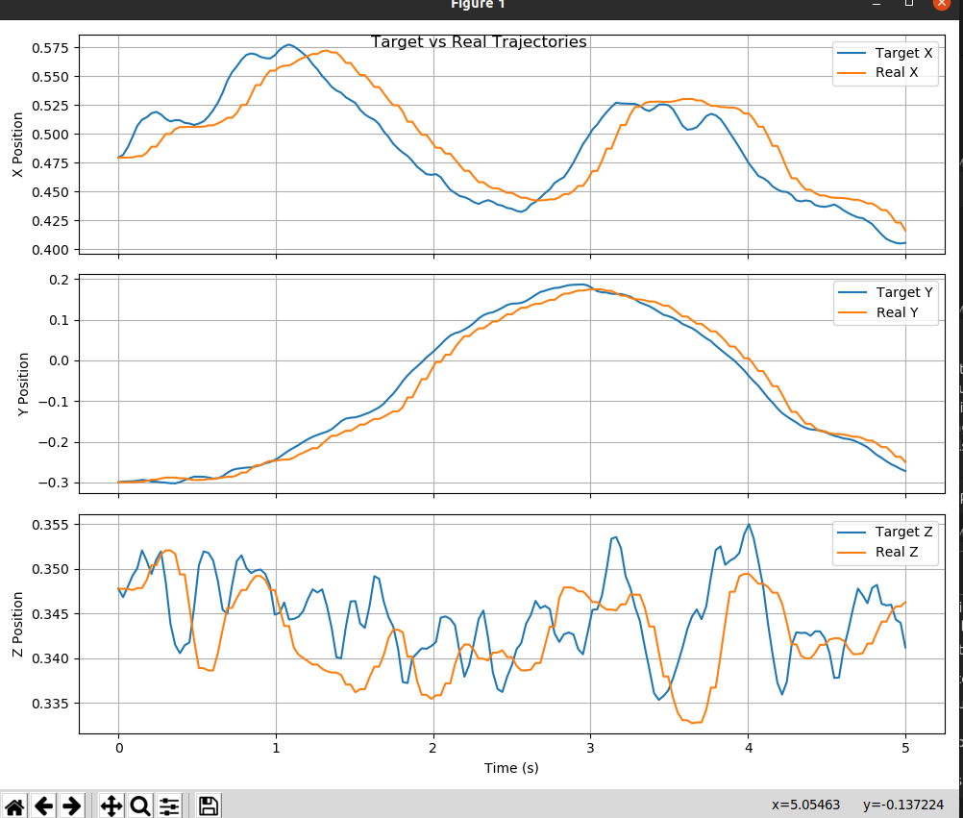
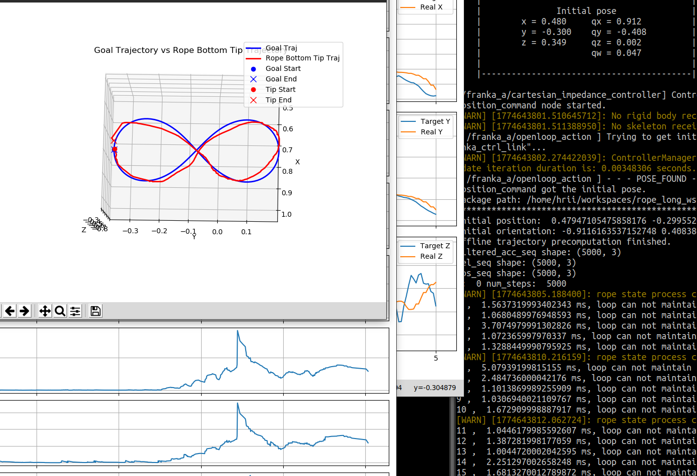
Open-loop Experiment

Slide 13
Discussion
Open-loop control
Refine the system
  Convert to C++
  Model the delay or change controller
  …

Slide 19
