Slide 1
WPS Presentation Producer Fixture
Structured slide reading
Search and precise positioning
Read-only compatibility boundary
WPS shape
Notes:
WPS speaker note evidence for slide one.

Slide 2
WPS Presentation Producer Fixture
Structured slide reading
Search and precise positioning
Read-only compatibility boundary
WPS shape
Notes:
WPS speaker note evidence for slide one.

Slide 3
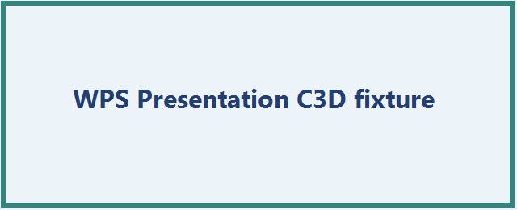
WPS images and relationships
Notes:
WPS image relationship and notes evidence.

Slide 4
WPS grouped shapes, connector and table
Rectangle
Oval
Object | Status
Table | Visible
Notes:
WPS grouped object and table evidence.

