Slide 1
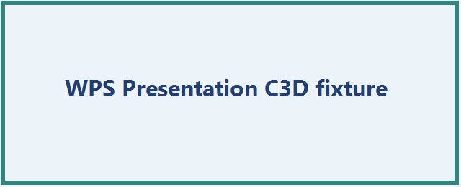
WPS images and relationships
Notes:
WPS image relationship and notes evidence.

Slide 2
WPS grouped shapes, connector and table
Rectangle
Oval
Object | Status
Table | Visible
Notes:
WPS grouped object and table evidence.

