Slide 1
LibreOffice Impress Producer Fixture
Structured slide reading
Search and notes evidence
Read-only fidelity boundary
Basic shape
Notes:
LibreOffice Impress speaker note evidence.

Slide 2
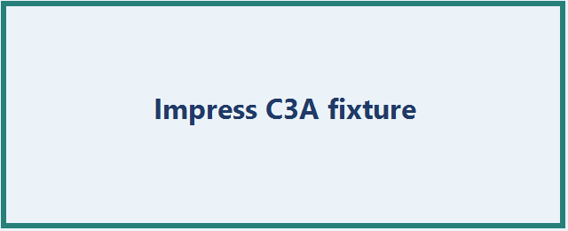
Images and relationships
Notes:
LibreOffice image relationship evidence.

