Slide 1
HW1 Report
林慶佳

Slide 2
python .\navigation.py -s basic -c pid -p rrt

Slide 3
python .\navigation.py -s diff_drive -c pid -p rrt

Slide 4
python .\navigation.py -s bicycle -c pid -p rrt

Slide 5
python .\navigation.py -s basic -c pure_pursuit -p rrt

Slide 6
python .\navigation.py -s diff_drive -c pure_pursuit -p rrt

Slide 7
python .\navigation.py -s bicycle -c pure_pursuit -p rrt

Slide 8
python .\navigation.py -s diff_drive -c pure_pursuit -p a_star

Slide 9
python .\navigation.py -s diff_drive -c pure_pursuit -p rrt_star

Slide 10
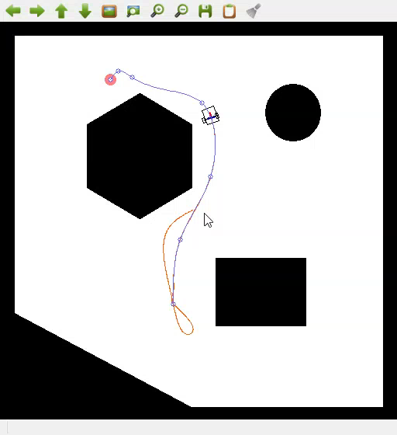
Collision Handle

