Slide 1
Review Paper: Estimation of spatially continuous daytime particulate matter concentrations under all sky conditions through the synergistic use of satellite-based AOD and numerical models, Park et.al.,2020
7/14/2020

Slide 2
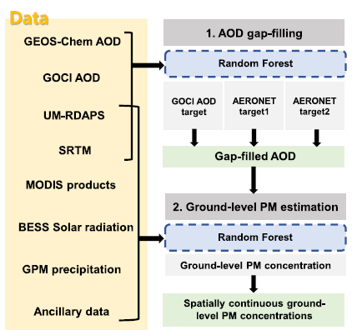
General idea
AOD is the hourly pollution data with spatial information
AOD data is from a satellite, which means a lot of data will be block by clouds
The first modeling is to fill the missing AOD data
Using the AOD data as an input to model2, which predict ground level PM
The AOD spectrum is directly correlated with the PM level, but it need to be calibrated. This is where they use the second model + linear fit
I found it strange that they need to show linear correlation in addition to the RF.
Since all satellite data is just a data from a spectrometer, extensive calibration is needed to convert the satellite PM2.5 level to the actual ground PM2.5 level.

Slide 3
Can we apply this to ASEAN?
Data in The Paper | Data in ASEAN
Ground level stations: 3387 stations Japan China Korean Taiwan | Ground level stations (less dense 1 stations/city on average) Thailand 70(mostly in BKK), Vietnam, Mymmar, Indonesia etc
Geostationary Ocean Color Imager (GOCI) : measure pollution data Need GEOS-Chem for analysis | GEMS?
MODIS: Vegetation index | MODIS
Shuttle Radar Topography Mission (SRTM) | Shuttle Radar Topography Mission (SRTM)
Global Precipitation Measurement (GPM) | Global Precipitation Measurement (GPM)
UM-RDAPS (Meteorological data)
BESS (solar radiation) | BESS
Global Roads Inventory Project (www.globio.info) | Global Roads Inventory Project (www.globio.info)
population density (SEDAC; https://sedac.ciesin.columbia.edu/) | (SEDAC; https://sedac.ciesin.columbia.edu/)

Slide 4
Open questions
We can get a spatial maps of the pollution level. Spatial resolution 6x6km.
What is the applications ?
Fundamental of PM dynamics. How fast is the movement. How long it linger in the air ?
Identify the pollution source: industry, burning, traffic, power plants
Effect of global warming

