Slide 1
Air Pollution Analysis Workflow
June 15 2020

Slide 2
Outline
Overview of analysis
How to use the end result
Code workflow

Slide 3
Air Pollution Sources
Data Analysis suggest that this is not likely the case.
Seasonal pattern
Independent of wind direction
Agricultural Burning
Traffic
Industry
Power Plants
Holiday, hour of day, weekend, traffic index
Hotspot, distance from city, weather during travel
Local weather
Wind direction
Temperature, humidity,
Wind speed
Building data for agricultural burning and traffic are tricky because we are mapping 2D to 1D data + accumulation and time lag effects
Managed to work on the agricultural burning for now
Air Pollution (PM2.5)

Slide 4
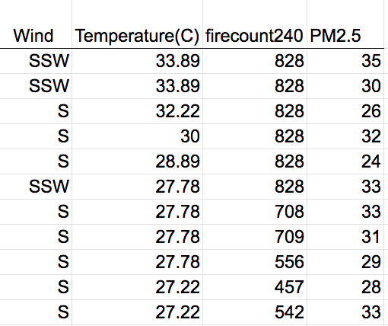
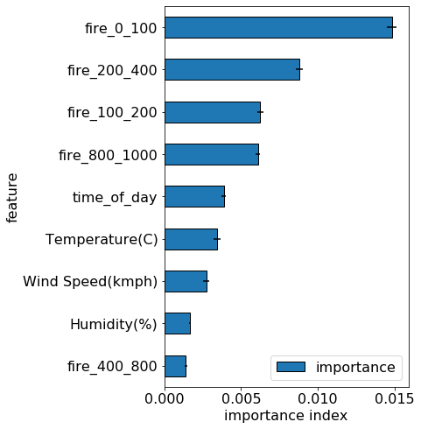
Analysis Procedure
x
y
Gathering data : air pollution data, weather, hotspot, traffic.
Exploratory data analysis (EPA): understand data, answer basics questions, fix missing data, and rule out alternative theories.
Feature engineer hotspot data: building x and y so that we can find a function f(x) = y. Each column is a feature.
Model building: the model has hyperparameter that need to be optimized and tuned.
Goal:
Obtain a model that can predict hourly pollution very well judging from accuracy metric (R2 square should be close to 1)
Model feature of importance suggest which source is the major source of air pollution. Relatively index that tell how much each feature hurt the model if it is are messed up. We can say what is the major source of pollution.
Inference: prediction of various scenario if certain policies are implemented.

Slide 5
Points in the report
City information (station location)
Describe the model and model performance
Major source conclusion and rule out other theory
Analysis of major air pollutions
Which area has most burning
What type of corps is the causes of the pollution in this area(circumstantial)
Scenario:
If cut down the burning by 25%, how much it would lower the yearly average
If cut down traffic by 25%, how much it would lower the yearly average

Slide 6
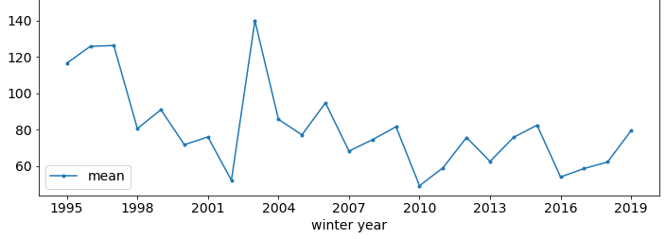
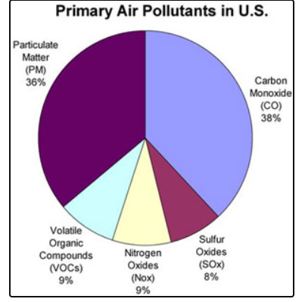
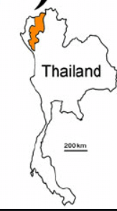
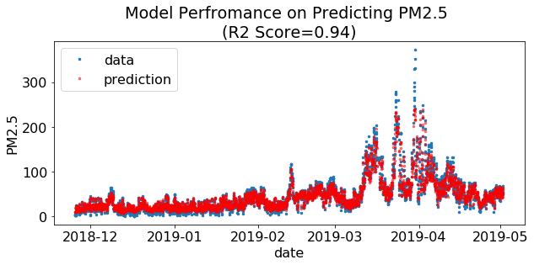

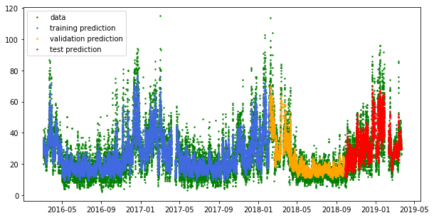
Dash Board: (possible, but will take time)
City name
Yearly Trend (3 major pollutions?)
Slider bar to adjust the feature parameters
(or a bar graph)
(alternative)
(error band)
Past date + Future date
*Building a web app is not my expertise, will take time

Slide 7
Source Code and Folder Structures
Directory Tree
aqi_thailand2
├── data: raw data and processed data for each cities
├── docs: code documentations (not built)
├── models: model files for each city
│ ├── bangkok
│ ├── chiang_mai
│ └── hanoi
├── notebooks: generate figure and experiment with codes
├── reports
│ ├── chiang_mai_report.docx (remove from public)
│ ├── figures : figure for the reports
├── src
│ ├── data: data download and clean up raw data
│ ├── features: putting raw data together and prepare for model
│ ├── models: model builder and hyperparameter searchers
│ ├── visualization: plotting data
│ ├── imports.py: import other python packages
└── gen_functions.py: functions not fit in the above folders
https://github.com/worasom/aqi_thailand2 is publicly available
Data is stored in files for now. Have not built a database
Pollution data source
Thailand DPC (=EPA)
Berkeley Earth Project (only PM2.5)
US Embassy in Hanoi and Jakarta (only PM2.5)
Hotspots: NASA FIRMS
Weather
UndergroundWeather.com 10$/city
OpenWeatherMap.org
Traffic:
BKK: traffic index
Data are update weekly by hand

Slide 8
Code Workflow
visualization
Pick a city and a pollutant to monitor (Chiang Mai, PM2.5)
Dataset = pollution data + weather data + fire data
Fire data is 2D + timestamp. Parameters used to turn this into a 1D data is treated as a hyperparameters and optimized for the best performance.
Split data into 4 sets (train, validation1, validation2, and test) to prevent overfitting
Optimize 1 : build dataset using default fire parameter and optimize for a reasonable RandomForestRegressor model (validation 1)
Optimize 2: remove lower importance features from the model (validation 1)
Optimize 3: optimize for the best fire features (validation 1) (can be combined with Op 1 using Bayesian optimization)
Optimize 4: find alternative model aside from RandomForestRegressor (validation 2)
Optimize 3 again (validation 2)
Model performance for the test set
Feature of importance and Model scenario
Past date + Future date

Slide 9
Summary/Next Step
Overview of the project
Model is used
Identify the major source of air pollution
Provide possible scenarios
Exploring data/visualization
Model robust check
Interesting cases (Chiang Mai year 2010, 2017, 2018)
Rule out alternative theories (Temperature inversion effect, El Nino)
Results Reports
Reports layout
Dashboard idea
Code Workflow
Code is publicly available, but not well commented
Code workflow: optimize parameters

