Slide 1
Prediction Workflow
27 June 2020

Slide 2
Outline
Model Performance
Statistical Inference Workflow
Data from Thailand DMV

Slide 3
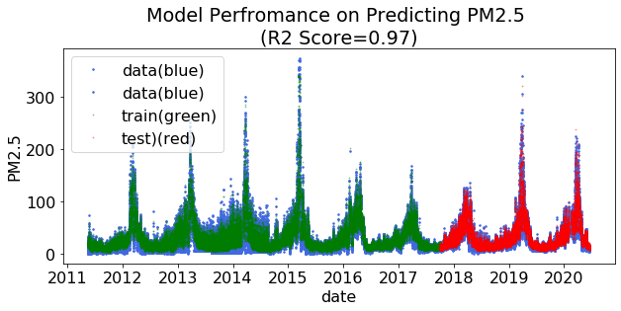
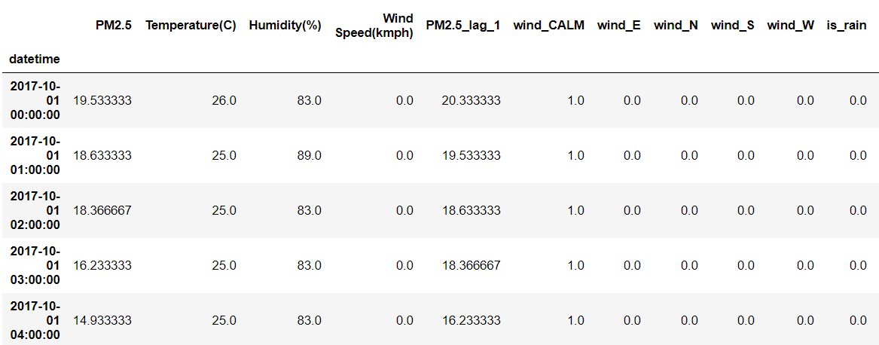
Model Performance
The model did not allow to see this data, but we still has good prediction (R2 score = 0.967). Prediction error is +/- 5 ppm.
But this model is not suitable for doing inference
Some technical issue for this col.
We won’t have this col until we predict the previous data.
Including this columns improve the model performance, but the model would rely on it too much and ignore the rest of the columns

Slide 4
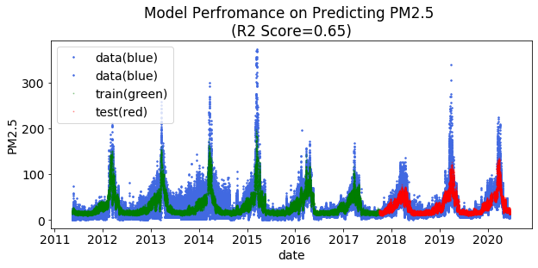
Model Performance
The model did not allow to see this data, but we still has good prediction (R2 score = 0.68). Prediction error is +/- 17 ppm. (We can absorb the error in the confident band).
We have 3 seasons of untouched data to use for inference
Model prediction is not strictly a prediction b/c we are allowed to see the weather, fire around that date
Actual prediction use historical behavior and try to predict the future without using any information about the future at all.
We have to guess the weather, fire and traffic(if existed) data based on history.
For the weather data, we should put more weight on recent year b/c of global warming

Slide 5
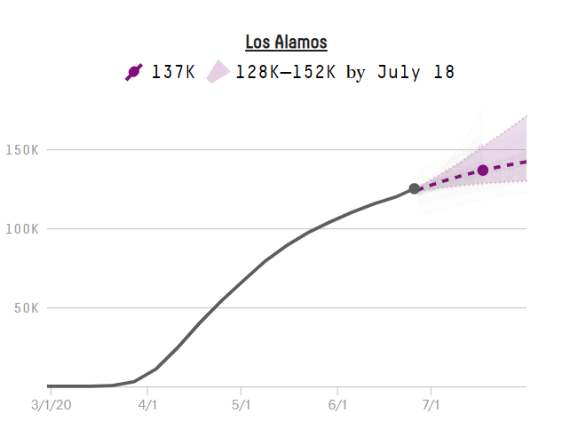
Typical Time Series Prediction
Covid prediction from fivethirtyeight.com
Time-series prediction often depends on the previous data and is updated constantly given the new data
Confident band is larger as moving further into the future
https://projects.fivethirtyeight.com/covid-forecasts/?cid=rrpromo

Slide 6
Prediction Workflow
Look for the same date and time
in previous year.
2. Generate ~ 100 – 1000 scenario of possible values
3. A bunch of generated prediction form an average an confident band

Slide 7
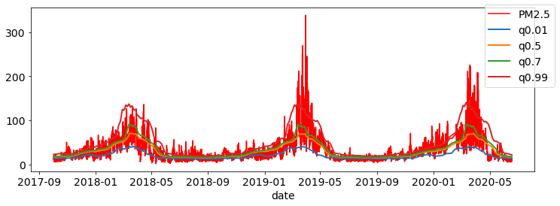
Estimation of year 2017 - 2020
Each season is the same because they are sample from the same history
The median tend to be low b/c of the smoothing function

Slide 8
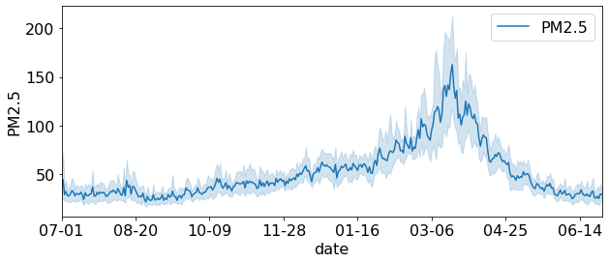
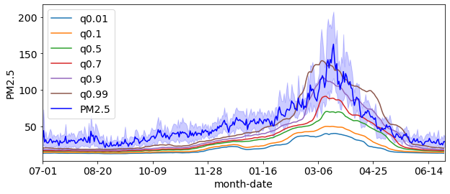
Seasonal Pattern
Q0.01 is percentile
of prediction distribution

Slide 9
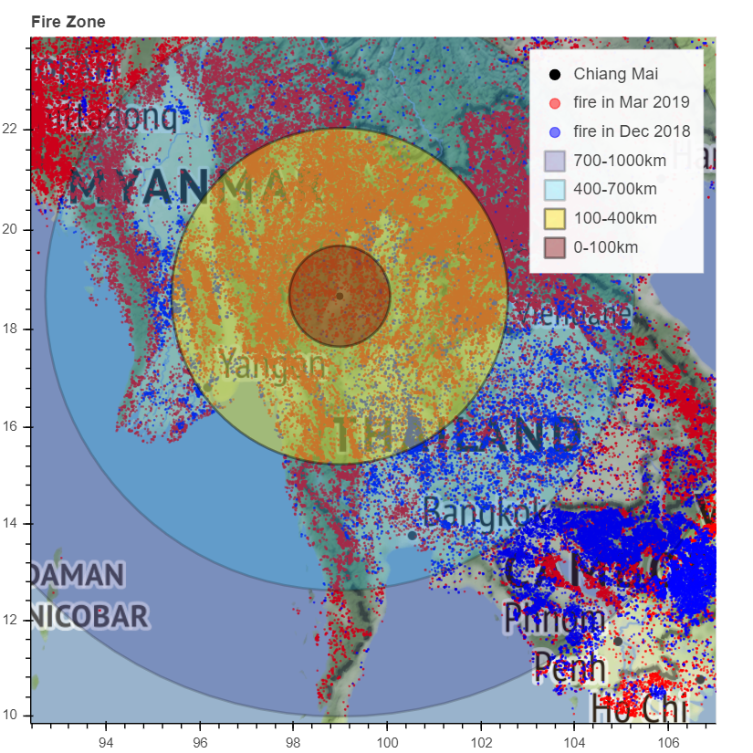
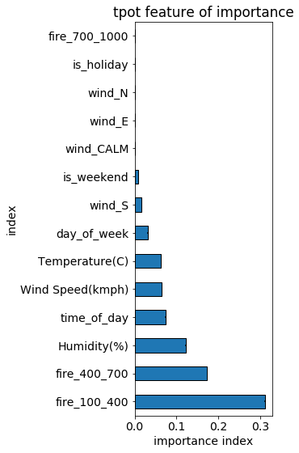
Different scenarios

Slide 10
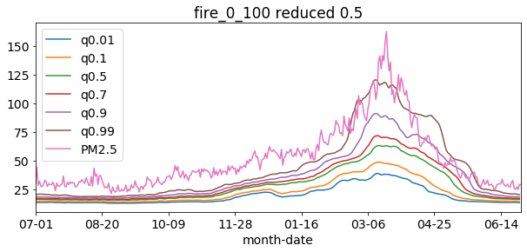
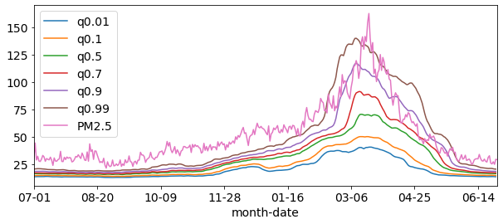
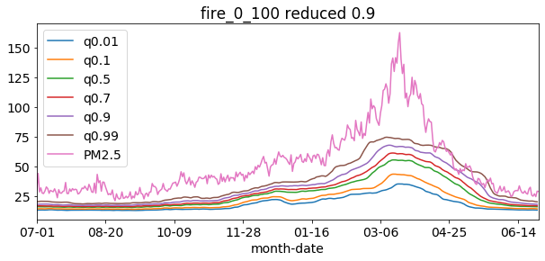
Local Fire (0 – 100km)
Normal behavior
Fire in this zone have the most effect in reducing pollution

Slide 11
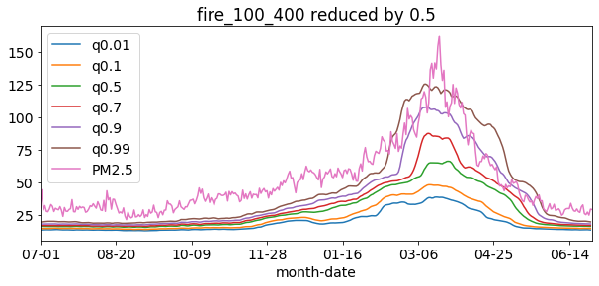
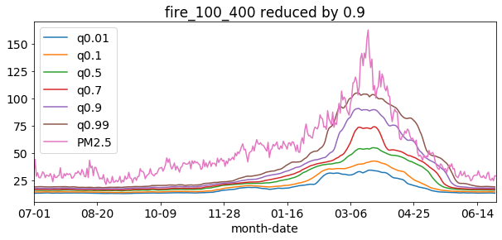
Local Fire (100 – 400km)
Normal behavior
Fire in this zone have some effect, but not large

Slide 12
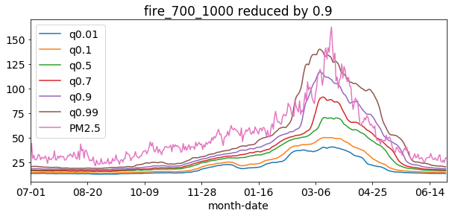
Local Fire in 700-1000 km
Normal behavior
Fire in this zone almost has no effect

Slide 13

Cutting fire in 0 – 700 zone by 0.5

Slide 14
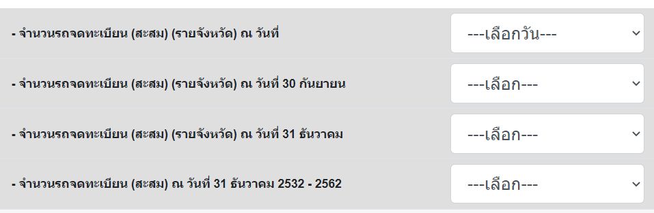
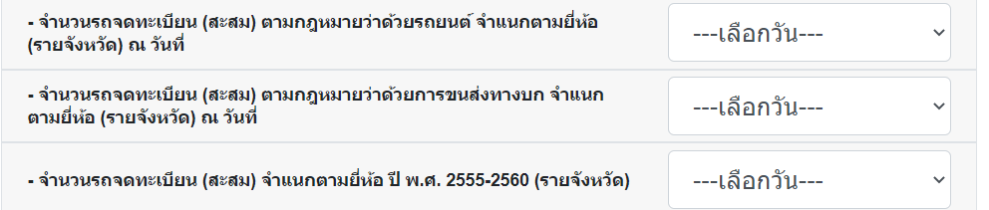

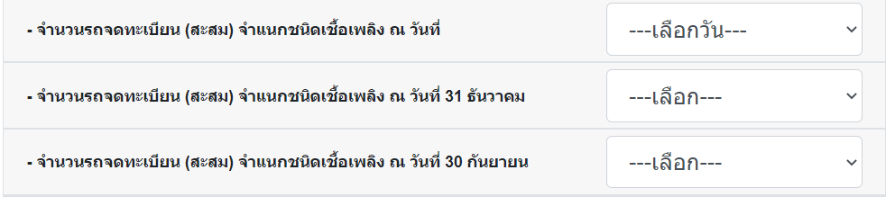
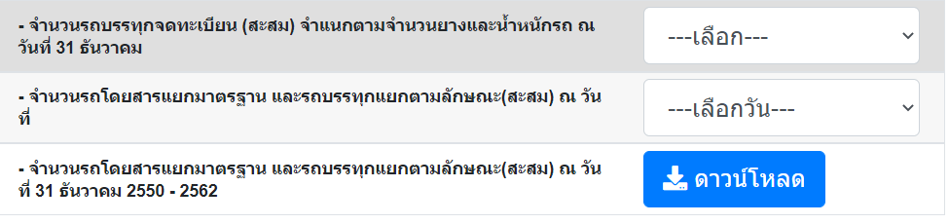
Thailand DMV stat https://web.dlt.go.th/statistics/index.php
Total number of car registration by province going back 20 years
Different choices are year or month of update
Separate by car brand
Separate by car age
Separated by oil type
Trucks separated by number of tires and weights
Bus separated by features

Slide 15
Next Step
Organize the inference/ prediction code
Automatically plot important figures
Try a different type of modeling: ex LSTM model
Going back to Chiang Mai reports

