Slide 1
Status Update
18 July 2020

Slide 2
Outline
New Model Training Workflow
Model Performance
Inference

Slide 3
Code Workflow (revised): two ML models
Pick a city and a pollutant to monitor (Chiang Mai, PM2.5)
Dataset = pollution data + weather data + fire data
Fire data is 2D + timestamp. Parameters used to turn this into a 1D data is treated as a hyperparameters and optimized for the best performance.
Optimize 1 : build dataset using default fire parameter and optimize for a reasonable RandomForestRegressor model
Optimize 2: remove lower importance features from the model
Optimize 3: optimize for the best fire features
Optimize 4: improve model performance by adding lag columns (of weather and fire)
Optimize 5: remove lower importance lag columns
Optimize 6: optimize for better model parameters again (R2 = 0.69, +16 ppm)
** possible model improvement by fixing step 5, but would like to get the code for inference out

Slide 4
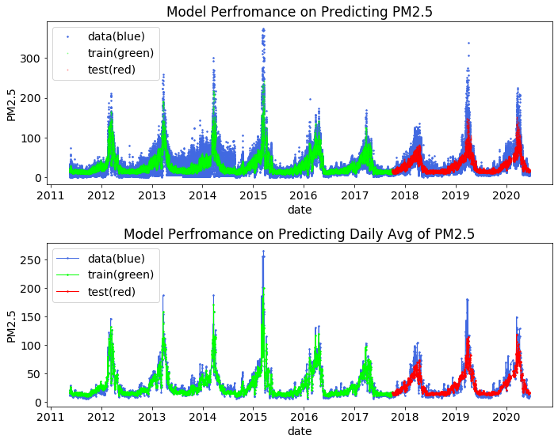
Model Performance
The model did not allow to see this data, but we still has good prediction (R2 score = 0.71or validation and 0.70 for prediction set). Prediction error is +/- 15 ppm.
Although the hourly prediction has large error, the daily average of the prediction is not bad. It has prediction error of R2=0.78, +/- 12.
This average is what we will be using for the inference
The 24 hour average is what is used for calculating AQI
Stage 1 performance (RandomForest)

Slide 5
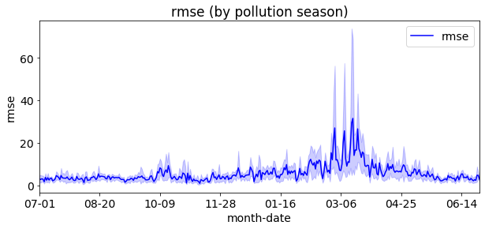
Investigate the error
Large error during the peak pollution season, this is likely from the low-wind condition, which differ from the rest of the year.
Currently, I assume the same wind parameter for the entire season for simplicity, but I can try to improve this by using the actual wind speed of that season.
This error will be added as a correction factor during inference step

Slide 6
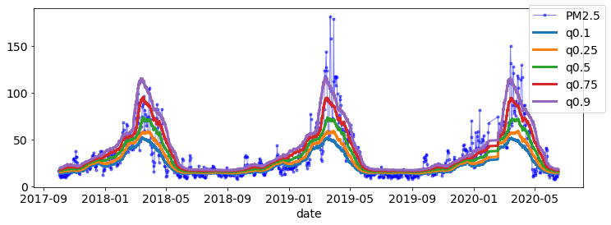
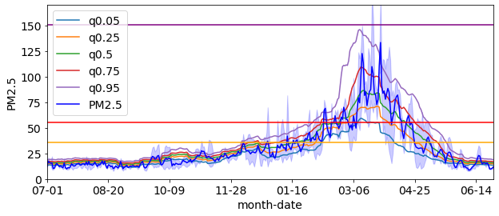
Inference for the data in the test set
Reminder: inference is done by sampling the weather and fire behaviors in the previous years. For a single hours there are 100 possible values, which we can take the average of.
The data in the test set is since
‘2017-10-01’ - current,
which has 3 pollution seasons.
The prediction statistic captures
Seasonal pattern
Peak pollution season in match
Q0.5 on average is similar to the average of actual data
The actual data sit between
10-95 percentile of the prediction distribution
Note the error in the previous slide is used
as prediction a correction factor
Pick q0.75 as representative behavior

Slide 7
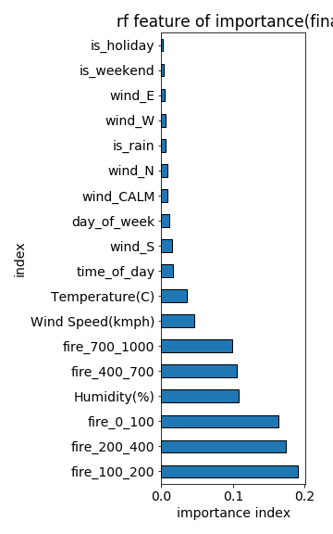
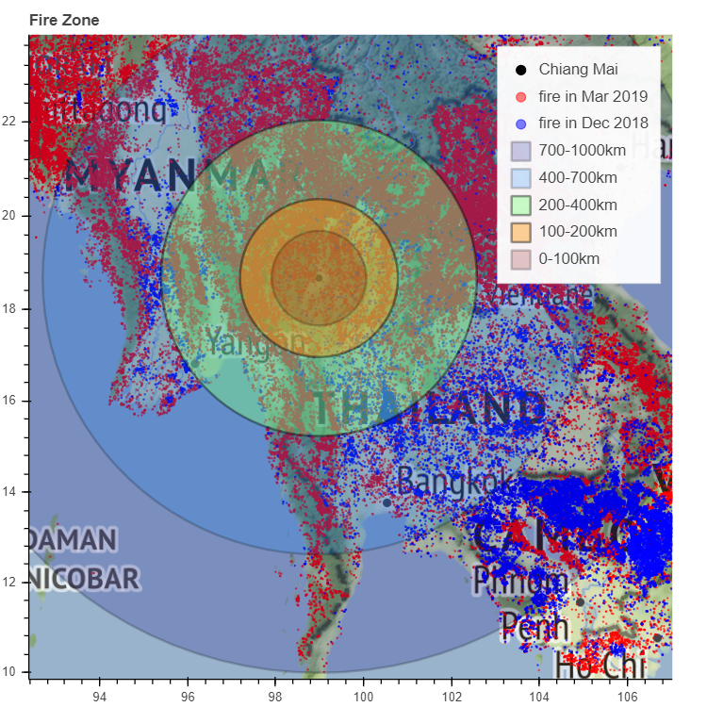
Feature we should try to reduces
Fire 0 – 100 km is within Thailand boarder
More important factors are fire in
100 – 200
200 – 400
0 – 100
Fire outside Thailand has more lag contribution and end up adding to be higher importance
The model indicate that the fire activities from neighbors countries have effect on the air pollution in Chiang Mai

Slide 8
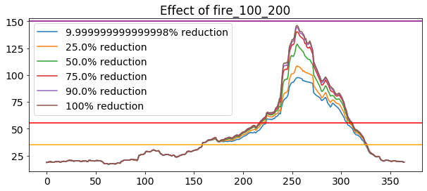
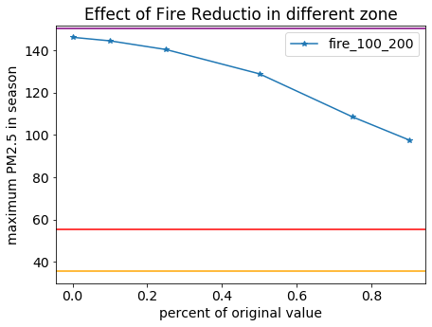
Cutting down fire 100 - 200 km zone
Use the maximum value of each scenario to calculate the effect of the feature.

Slide 9
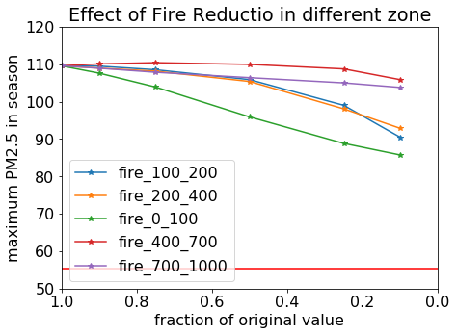
Effect of Different Fire zone
Reducing the fire in 0 – 100 (in Thailand) has the most effect.
Reducing the fire in 400-1000 has little effect
Although we managed to cut down the fire in 0-100km zone by 90%, the AQI will still not go below the unhealthy level
Need to reduce the fire in the 0 – 400 km zone
Lower Unhealthy limit

Slide 10
Other improvements
Build code for data visualization
(WIP) Explore data
ML result
Inference
Next Step
Improve ML model
Write report

