Slide 1
Status Update
25 July 2020

Slide 2
Outline
Inference results
We are trying to arrive at the effect of reducing fire activities to the seasonal pattern of pollution. I think the idea should be arranged in the following step
Step 1: Talk about the seasonal pattern
Step 2: Show the fire zone
Step 3: Show that we have a reasonable model
Step 4: Showing effect of fire reduction to the seasonal pattern
Step 5: Summarize by showing the average pollution levels if fires in different zone decreases

Slide 3
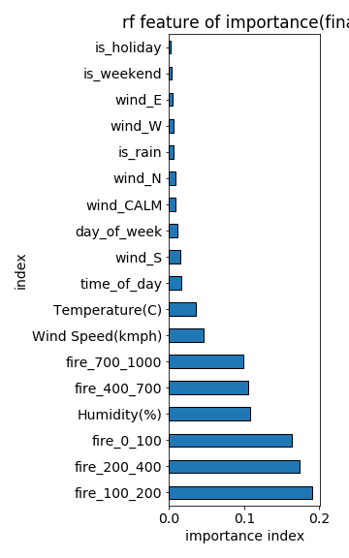
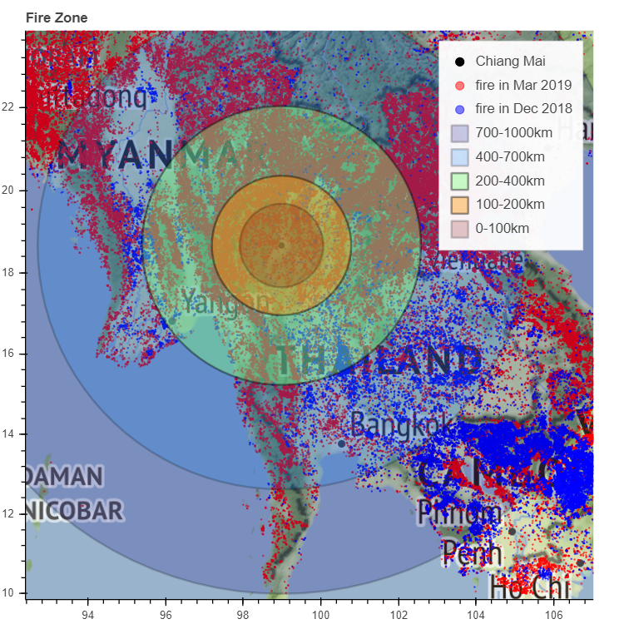
Step 2: Show the fire zone
Fire 0 – 100 km is within Thailand boarder
More important factors are fire in
0 – 100
100 – 200
200 – 400
The fires in 400 – 1000 km have lesser but finite effect.
The model indicate that the fire activities from neighbors countries have effect on the air pollution in Chiang Mai

Slide 4
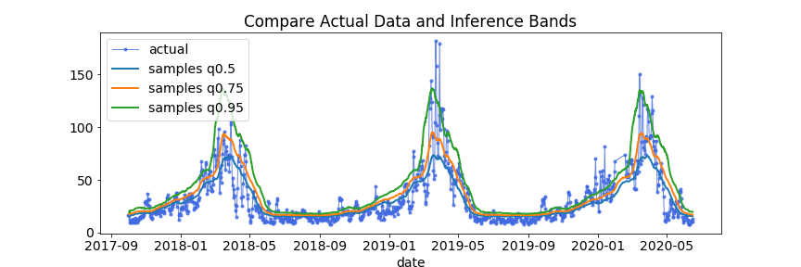
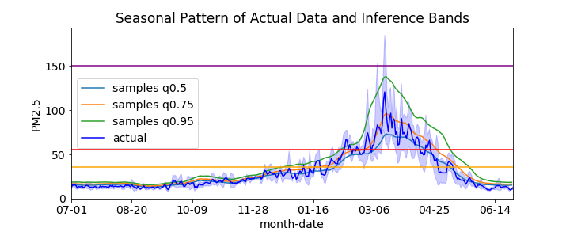
Step 3: Show that we have a reasonable model
The inference bands envelop the data in the test set (which the model has not seen).
Correct pattern and values.
The inference model capture seasonal pattern
With q=0.75 parameter closely resample the data in the test set
Unhealthy level

Slide 5
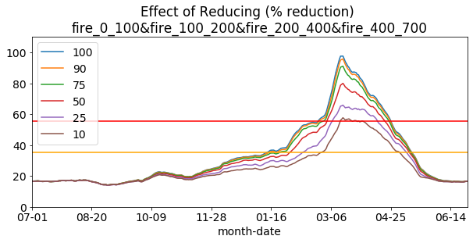
Step 4: Showing effect of fire reduction to the seasonal pattern
Effect of reducing fire activities in 0-700 km zone by different amounts
Different color indicate % of original value. 100% means no reduction.
The maximum value in March decreases below unhealthily limit if reducing the pollution level by 75% in 0 – 700km zone.

Slide 6
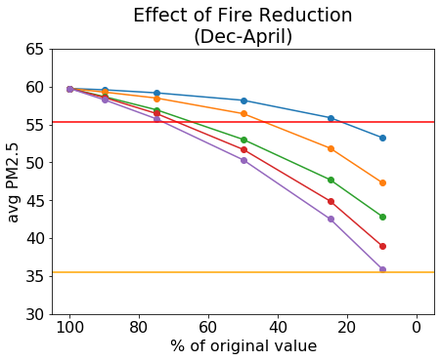
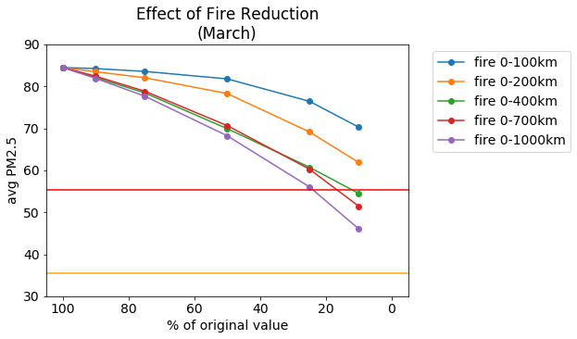
Step 5: Summarize by showing the average pollution levels if fires in different zone decreases
The blue line is the effect of reduction for zone 0 -100 km and purple line is 0 -1000km
Left figure
If reducing only 0 -100 km zone, we need to reduce the fire by 75% (25% left) until we manage to get the average PM2.5 level between Dec-April down below unhealthily limit
If reducing fire in a larger zone, only a small reduction 25% is needed to lower the pollution level to satisfactory level.
Right figure
More aggressive measure is needed during the the peek pollution month(March) to reduce the pollution level. 75% reduction between 0 – 700 km is required.

Slide 7
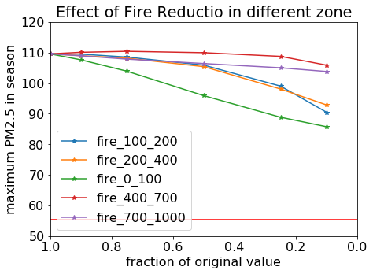
Step 4: Showing effect of fire reduction to the seasonal pattern
Reducing the fire in 0 – 700 zone different %
Reducing the fire in 400-1000 has little effect
Although we managed to cut down the fire in 0-100km zone by 90%, the AQI will still not go below the unhealthy level
Need to reduce the fire in the 0 – 400 km zone
Lower Unhealthy limit

Slide 8
Other improvements
Improve model inference code
Improve visualization code
Next Step
Update figure in the report
Revise report
We will need a better word for ‘inference model’.
Question: normally y-axis of most plots is in ppm unit. Should we convert to AQI for easy interpretation? We can then remove the horizontal line, which indicates the unhealthily limit

