Slide 1
Update Aug 9, 2020

Slide 2
Outline
Analysis hotpots to show that the hotspots are from farming activities.
Assumption: if the farming generate the hotpots. It is likely going to occur again at the same location within the same year or in another year
Sugar cane burning often takes place a few times/year at the same location.
I will count the number hotspots happened in the same location (occur at least 2 times).
We only consider the hotspots < 1000km from Chiang Mai, so we cannot say anything about the practice in each country as a whole.
Provide which countries have a lot of burning as an additional information

Slide 3
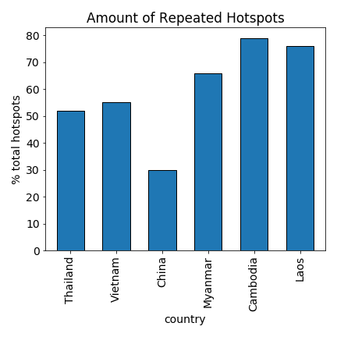
Repeating hotspots
Except for China, 50% of the hotspots occurs more than once. This suggests that they are from farm burning

Slide 4
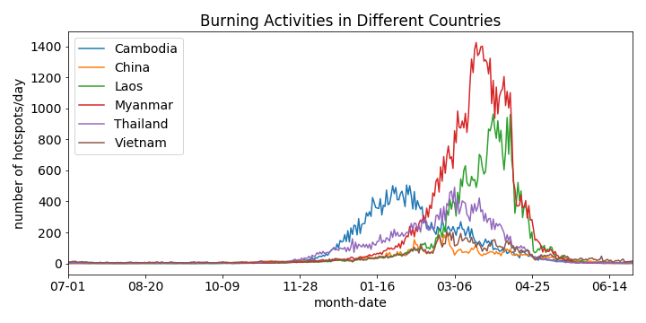
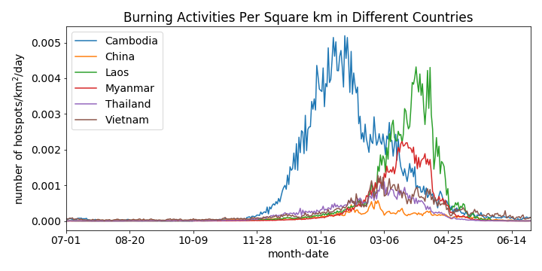
Hotspots by country
The number of hotspots is very high in Myanmar >Laos> Thailand
When account of the area of interested. Cambodia and Laos have the most burning density.

