Slide 1
How to calculate traffic index from cloud sourcing data?

Slide 2
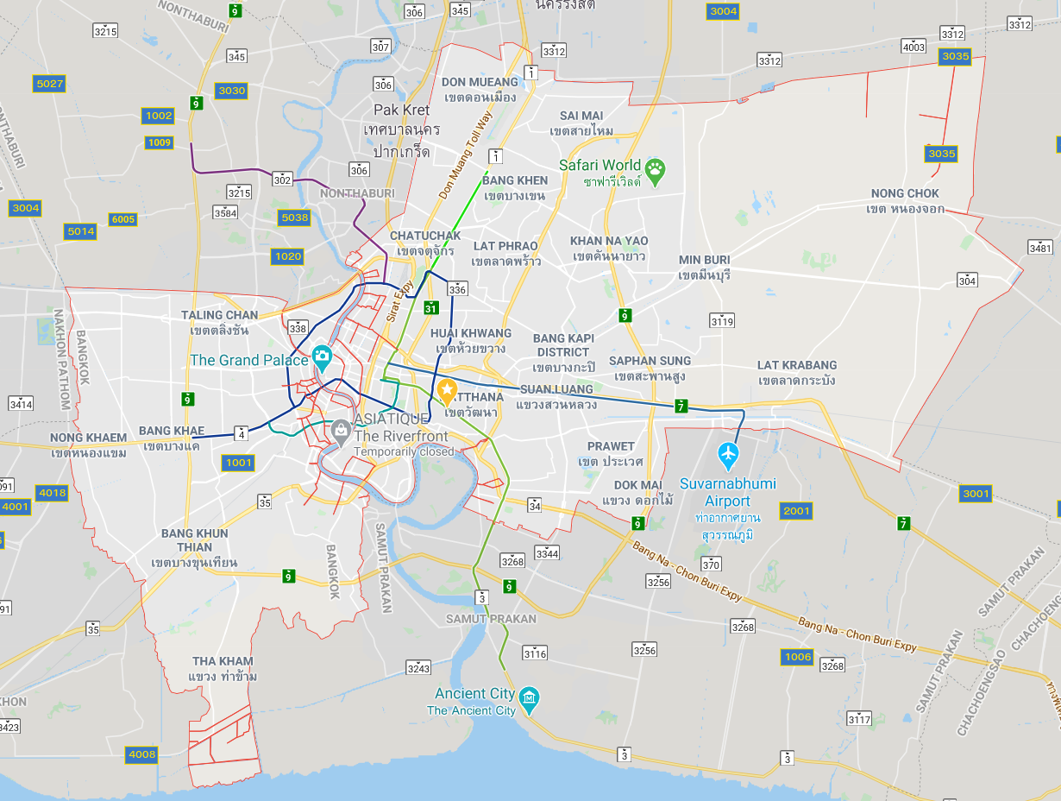
Goals: We want two things
We need to find the historical hourly congestion index for different city in ASEAN. The data should go back at least 2010.
We are also interested in local traffic within each bounding box shown below.

Slide 3
Problems
We have to compile the data ourselves using the flow information from Google traffic or Microsoft traffic
Problems about methodology:
We probably will need to include the urban areas around it. For BKK,we probably will need Nontaburi. For other cities, we do not know the scale of the city we need to include.
Say we want the congestion index in the red box.
We will have the coordinates, but not the road.
There are many roads in this box.
Which road should we use? Need to exclude small road?

