Slide 1
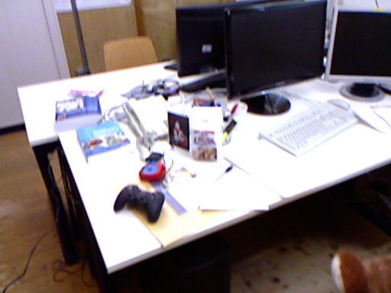
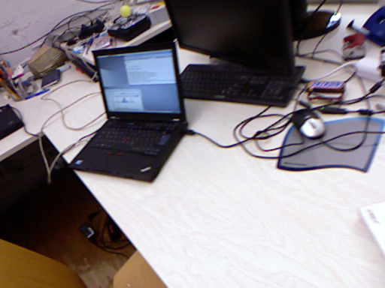
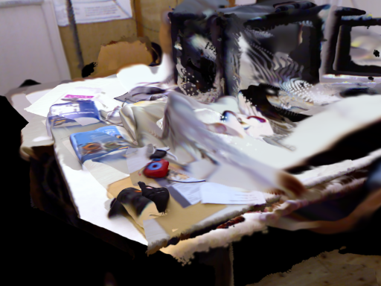
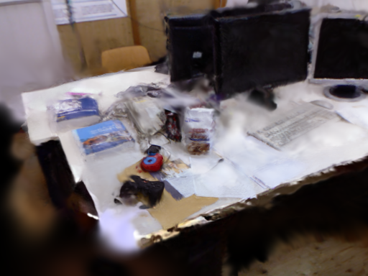
(a) Predict
(b) Anchor
(c) Refine
Sec. III-A · Eq. (1)
Sec. III-B · Eqs. (2–4)
Sec. III-C · Eq. (5)
Image pair
Geometry
Update θ
Tracker + pose graph
Adam
Shared
predictor
Anchor k: T_WCₖ
∇θ L
Splatt3R
Î
Local map Gₖ
Render
Loss
Gaussians
Tracked RGB
RGB + relative
L1 + SSIM
camera pose
I
Sample view
Before refinement
After refinement
Shared-anchor relation
T_{WCf}⁻¹ T_{WCk} = T_{CkCf}⁻¹
Pose corrections move map and cameras together.
Optional initialisation: Sec. III-D · Eqs. (7–8)

Slide 2
(a) Predict
(b) Anchor
(c) Refine
Ch. 2 · Eq. (2.7)
Ch. 4 · Eqs. (4.1–4.3)
Ch. 7 · Eq. (7.1)
Image pair
Geometry
Update θ
Tracker + pose graph
Adam
Shared
predictor
Anchor k: T_WCₖ
∇θ L
Splatt3R
Î
Local map Gₖ
Render
Loss
Gaussians
Tracked RGB
RGB + relative
L1 + SSIM
camera pose
I
Sample view
Before refinement
After refinement
Shared-anchor relation
T_{WCf}⁻¹ T_{WCk} = T_{CkCf}⁻¹
Pose corrections move map and cameras together.
Optional initialisation: Chs. 5–6 · Eq. (6.1)

Slide 3
Why the supervision camera shares the anchor
Coordinate control and refinement loop
Before a loop closure
Pose correction
Controlled 6% scale test
Local map and camera use keyframe k.
Their relative transform is fixed.
The pose graph changes T_WCk.
The map and camera move together.
Fixed world camera: refinement reverses the correction.
Shared anchor: correction remains after about 500 steps.
Desk + room controls
T_WCf^-1 T_WCk = T_CkCf^-1
shared anchor: relation preserved
REFINEMENT LOOP
sample RGB
compose pose
render map
L1 + SSIM
Adam update
Only Gaussian scale, rotation, opacity, and DC color receive gradients.

Slide 4
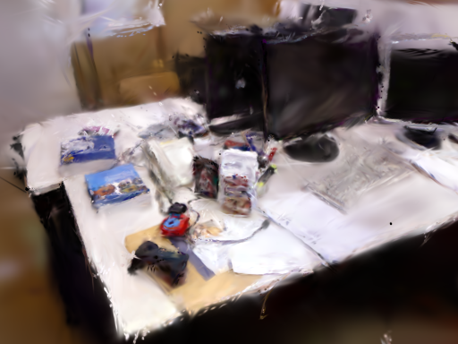
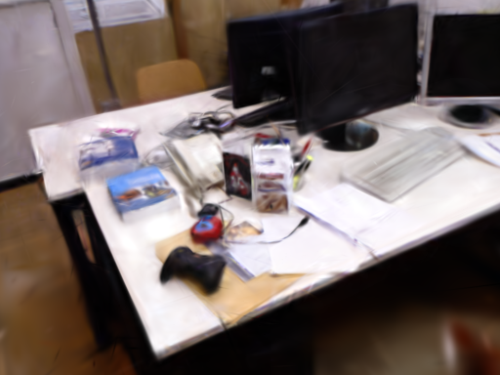
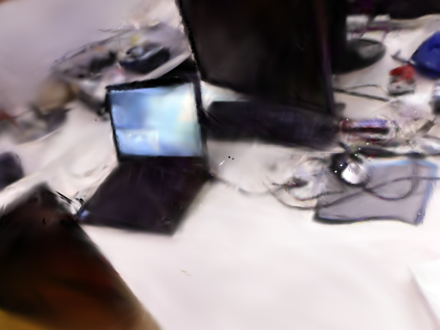
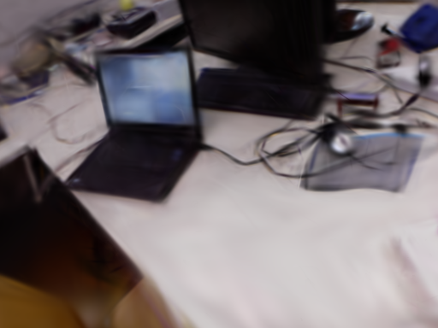
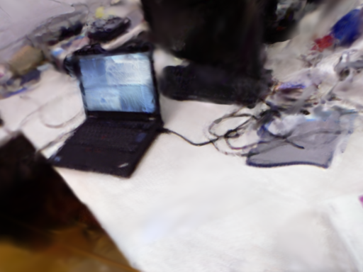
Qualitative reconstruction at common cameras
Measured renders; identical crops and scales
Ground truth
Photo-SLAM
MonoGS
Ours
TUM desk: two middle-ranked Ours-minus-MonoGS PSNR views
Orange panels are identical pixel crops across all methods.

Slide 5
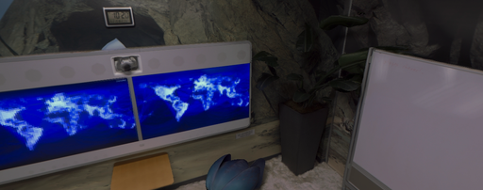
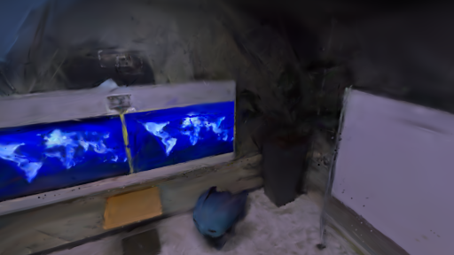
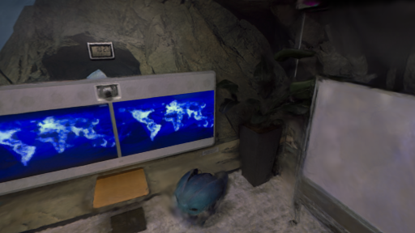
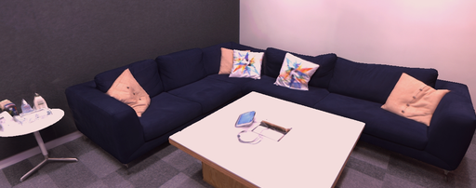
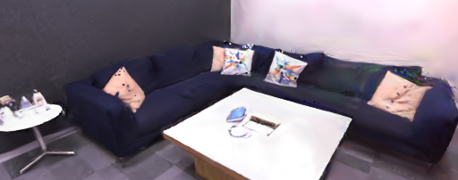
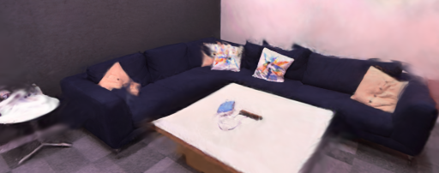
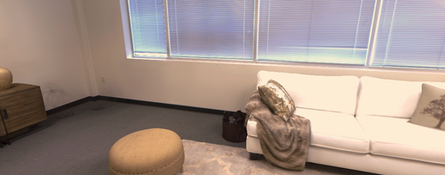
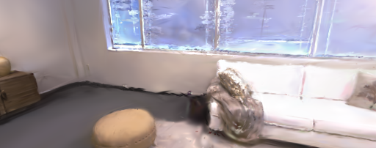
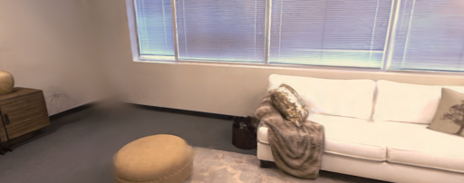
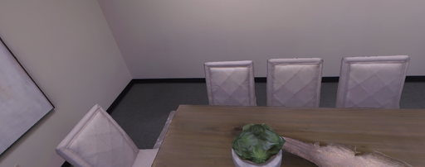
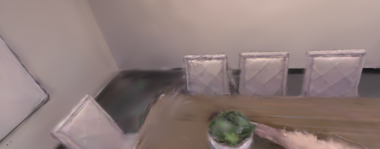
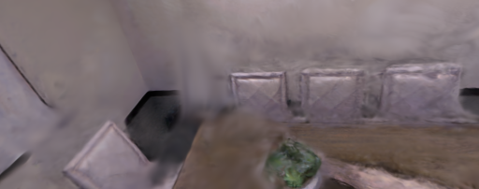
Replica reconstruction across scenes
No monocular MonoGS artifact was available
Ground truth
Photo-SLAM
Ours
office0
office2
room0
room2
All images use the same selected camera within each scene.

Slide 6
Component evidence
All recorded attenuation cells and refinement controls
Opacity attenuation: relative LPIPS change (%)
Refiner on vs. off: PSNR gain (dB)
o3
-13
ETH3D sofa_1
+8.69
o0
-13
o2
-10
Replica office0
+4.62
r0
-8.9
r1
-7.1
o1
-1.6
TUM desk
+3.52
o0-k.9
-5.3
o0-k.6
-1.8
EuRoC V1_01
+1.00
TUM-rel
-6.4
TUM-adapt
-0.6
EuRoC
-5.6
Interpretation
7S
+0.16
Refinement gives the largest controlled gain.
Opacity reduction is robust; confidence allocation is not.
External baseline comparison uses the released head with attenuation off.

Slide 7
(a) Shared anchor
(b) Same-camera reconstruction
(c) Replica
Pose correction
k′
Photo-SLAM
Splatt3R-SLAM
Mean PSNR (dB) ↑
k
23.02
19.48
20
local map
10
camera
0
Photo
Ours
Map + cameras move together
+3.54 dB
Identical crop · representative office0 view
8/8 scene PSNR wins

