Slide 1
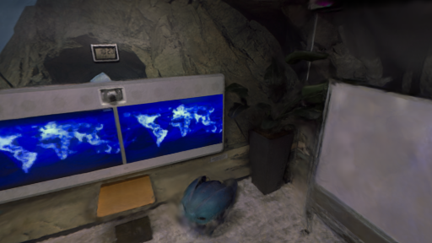
MASTER'S THESIS DEFENSE
Splatt3R-SLAM:
From Image Pairs
to Persistent Maps
Fast local predictions.
One map that survives pose correction.
Zelong Li
MSc Computer Science | University of Amsterdam
Supervisors: Prof. Martin Oswald | Dr. Qi Zhang
OPENING
1

Slide 2
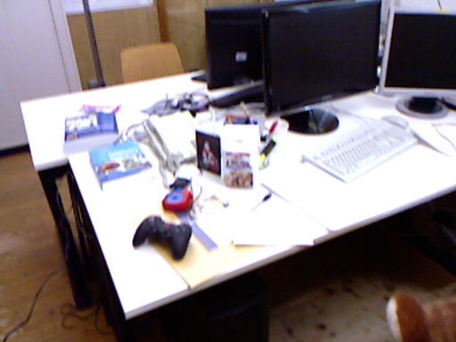
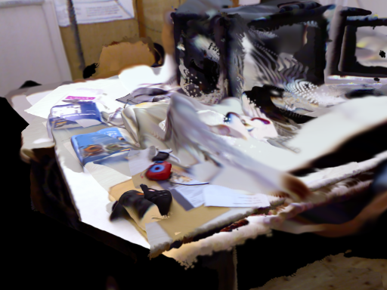
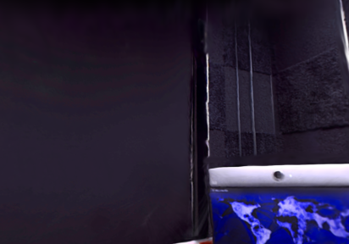
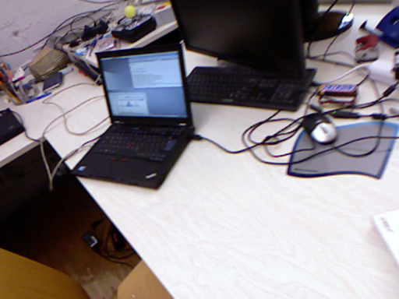
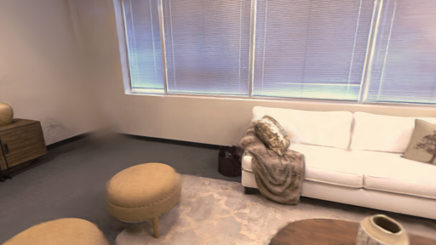
A pair is not a map
The gap between a local prediction and a lasting scene
ONE IMAGE PAIR
ONE LOCAL MAP
A VIDEO SEQUENCE
Useful immediately
Many local frames
Many overlapping surfaces
The research question: how can pairwise predictions become one persistent map?
PROBLEM
2

Slide 3
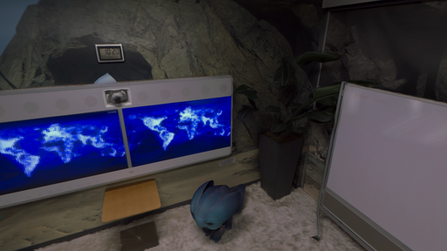
A persistent map must survive change
Three requirements for a useful appearance map
REVISIT
CORRECT
RENDER
k
A later camera must still localise.
Loop closure must move old content.
A new view must look like the scene.
Tracking, correction, and rendering must agree on the same scene.
PROBLEM
3

Slide 4
Why direct accumulation fails
The sequence adds problems that a two-view model never sees
1
Different coordinates
2
Repeated surfaces
3
Pose corrections
k
Each pair predicts in its own camera frame.
Several keyframes place colour and opacity on one ray.
Loop closure changes where old predictions belong.
Concatenation is not sequence-level mapping.
PROBLEM
4

Slide 5
The thesis: share the anchor
Move the local scene and its observation cameras together
Before pose correction
After pose correction
anchor k'
anchor k
camera + local Gaussian map
the same relative relation
T_WCf^-1 T_WCk = T_CkCf^-1
IDEA
5

Slide 6
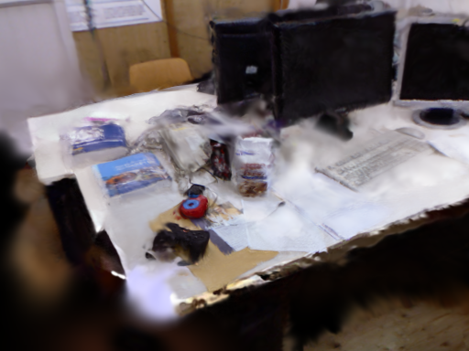
One theory, three contributions
Each contribution supports the same persistent-map claim
PREDICT
ANCHOR
REFINE
Dense local map
Coordinate consistency
Sequence evidence
k
One forward pass gives geometry and appearance.
Map and supervision follow the pose graph.
Tracked RGB improves appearance without changing poses.
The experiments ask whether each step preserves the claim.
IDEA
6

Slide 7
Where this work sits
Prediction-first initialization plus sequence-level SLAM
FULL
SEQUENCE
Splatt3R-SLAM
Splat-SLAM
shared anchors
+ refinement
SEGS-SLAM
Photo-SLAM
LOCAL
PAIR
MonoGS
Splatt3R
OPTIMIZATION-FIRST
PREDICTION-FIRST
Positioning diagram only. Quantitative ranking requires a common protocol.
POSITION
7

Slide 8
(a) Predict
(b) Anchor
(c) Refine
Ch. 2 · Eq. (2.7)
Ch. 4 · Eqs. (4.1–4.3)
Ch. 7 · Eq. (7.1)
Image pair
Geometry
Update θ
Tracker + pose graph
Adam
Shared
predictor
Anchor k: T_WCₖ
∇θ L
Splatt3R
Î
Local map Gₖ
Render
Loss
Gaussians
Tracked RGB
RGB + relative
L1 + SSIM
camera pose
I
Sample view
Before refinement
After refinement
Shared-anchor relation
T_{WCf}⁻¹ T_{WCk} = T_{CkCf}⁻¹
Pose corrections move map and cameras together.
Optional initialisation: Chs. 5–6 · Eq. (6.1)
METHOD
8

Slide 9
Predict: one pass, two lanes
A shared network supports tracking and appearance mapping
Geometry lane
Tracker
Shared predictor
pointmaps
matching features
pose + keyframes + graph
Frozen MASt3R encoder + decoder
Gaussian DPT head
Gaussian lane
Local map
mean, scale, rotation
opacity, SH colour
one Gaussian per valid pixel
mu_n = x_n + Delta_n | Sigma_n = R(q_n) diag(s_n^2) R(q_n)^T
Paper Sec. III-A / Eq. (1) | Thesis Ch. 2 / Eq. (2.7)
METHOD
9

Slide 10
Why the supervision camera shares the anchor
Coordinate control and refinement loop
Before a loop closure
Pose correction
Controlled 6% scale test
Local map and camera use keyframe k.
Their relative transform is fixed.
The pose graph changes T_WCk.
The map and camera move together.
Fixed world camera: refinement reverses the correction.
Shared anchor: correction remains after about 500 steps.
Desk + room controls
T_WCf^-1 T_WCk = T_CkCf^-1
shared anchor: relation preserved
REFINEMENT LOOP
sample RGB
compose pose
render map
L1 + SSIM
Adam update
Only Gaussian scale, rotation, opacity, and DC color receive gradients.
METHOD
10

Slide 11
Refine: use the sequence without moving the tracker
The real control loop is sampling, rendering, and Adam
SUPERVISION POOL
repeat with another tracked view
Render
Loss + Adam
Reservoir + recent ring
compose live anchors
render one RGB view
0.8 L1 + 0.2 D-SSIM
update appearance
same camera
200 historical | 64 recent
30% recent sampling
Gradients update Gaussian appearance. They never update poses or tracking weights.
Paper Sec. III-C / Eq. (5) | Thesis Ch. 7 / Eq. (7.1)
METHOD
11

Slide 12
Improve the starting point
Two optional interventions act before sequence refinement
PREDICTION
INSERTION
Head-only adaptation
Opacity attenuation
Frozen
Trainable
encoder
decoder
Gaussian DPT head
Changes pairwise appearance
without changing tracking features
Lower initial opacity
for low-confidence predictions
MSE + 0.25 LPIPS-VGG
alpha' = alpha clip(1 - 2 lambda (1 - rank), 0.1, 1)
External baseline comparison: released head, attenuation off.
METHOD
12

Slide 13
Every claim has a matching experiment
The evaluation follows the theory, not a list of unrelated scores
CLAIM
CONTROL
EVIDENCE
Shared anchors preserve relations
6% block pose correction
correction survives refinement
Refinement stays downstream
refiner on/off + ATE
1.00-8.69 dB; ATE unchanged
Initialization matters
head + 12 thinning cells
10/12 LPIPS gains
The full system improves maps
common renderer + common cameras
+3.54 dB; 8/8 Replica wins
RQ1-RQ4 in the thesis use this same chain.
EXPERIMENTS
13

Slide 14
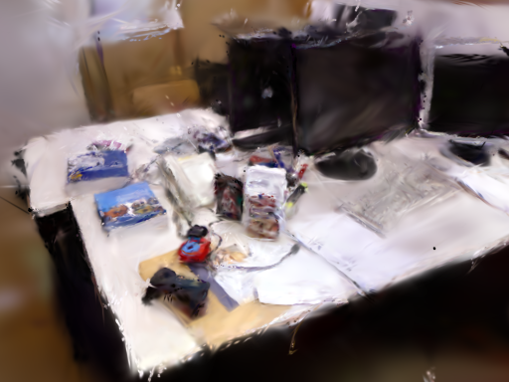

A common renderer makes the comparison meaningful
Same target cameras, resolution, alignment, and metrics
Photo-SLAM
MonoGS
Splatt3R-SLAM
one GT camera
100 frames
Full SH
Same image size
Same metrics
outside the union of keyframes
all exported colour bands
512x288 or 512x384
PSNR + LPIPS-AlexNet
Replica: 8 scenes | TUM desk: 3 renderable systems | TUM: 9-sequence ATE
EXPERIMENTS
14

Slide 15
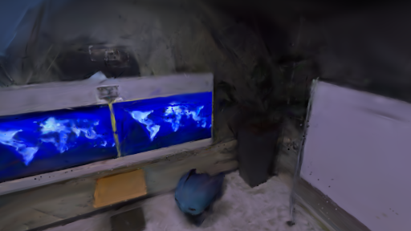
State-of-the-art performance
Replica | all eight scenes | monocular input | common renderer
23.02 dB
+3.54 dB
8 / 8
5 / 8
Splatt3R-SLAM mean
over Photo-SLAM
scene PSNR wins
scene LPIPS wins
MEAN PSNR (dB)
OURS - PHOTO-SLAM, PER SCENE
Photo-SLAM
19.48
o0
+4.11
o1
+4.31
Splatt3R-SLAM
23.02
o2
+0.82
o3
+0.98
o4
+7.21
r0
+7.64
r1
+0.23
Photo-SLAM
Splatt3R-SLAM
r2
+2.98
Smallest margin: room1 +0.23 dB | largest: room0 +7.64 dB
RESULTS
15

Slide 16
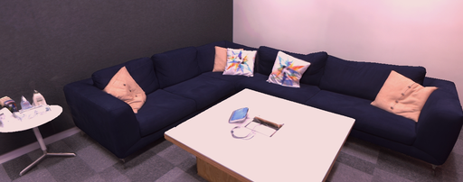
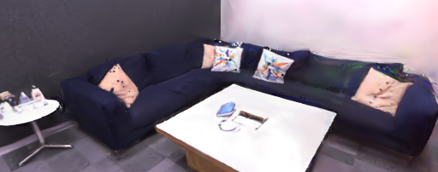
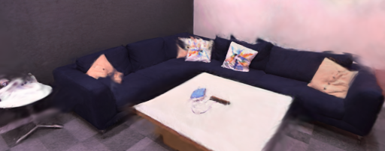
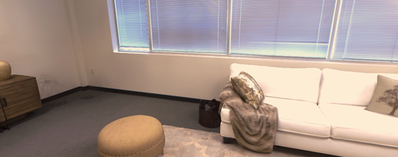
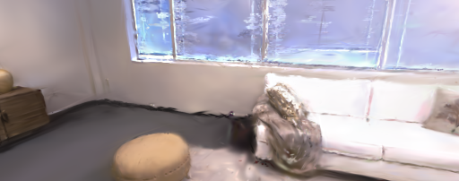
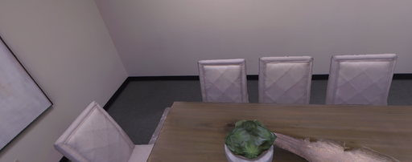
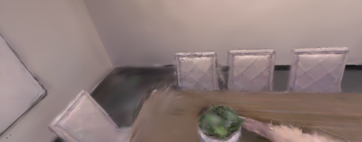
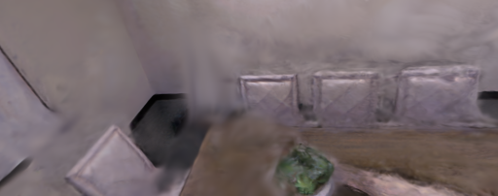
Replica reconstruction across scenes
Four representative scenes | common cameras
Ground truth
Photo-SLAM
Ours
office0
office2
room0
room2
All images use the same selected camera within each scene.
RESULTS
16

Slide 17
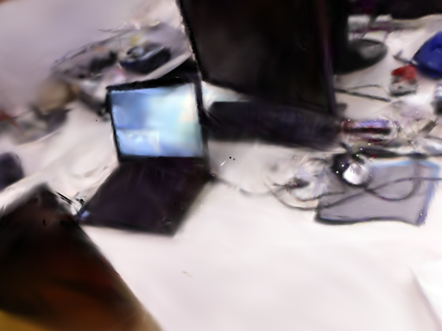

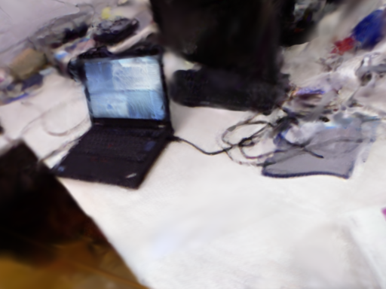
Qualitative reconstruction at common cameras
Measured renders; identical crops and scales
Ground truth
Photo-SLAM
MonoGS
Ours
TUM desk: two middle-ranked Ours-minus-MonoGS PSNR views
Orange panels are identical pixel crops across all methods.
RESULTS
17

Slide 18
Tracking remains the inherited geometric path
Nine TUM freiburg1 sequences | Sim(3)-aligned ATE
MEAN ATE RMSE (m) - LOWER IS BETTER
Ours
0.030
What this result proves
The mapping path does not disturb tracking.
MASt3R-SLAM
0.030
Ours and MASt3R-SLAM have the same rounded mean.
VGGT-SLAM
0.041
Photo-SLAM
0.161
What it does not prove
MonoGS
0.293
Tracking is inherited, not a new contribution.
Single runs can hide system variance.
The map improves appearance downstream of pose estimation.
RESULTS
18

Slide 19
Refinement gives the largest controlled gain
Same head, same insertion, refiner off versus on
PSNR GAIN (dB)
ETH3D sofa_1
+8.69
LPIPS -58.3%
Replica office0
+4.62
LPIPS -56.8%
TUM desk
+3.52
refiner off
refiner on
LPIPS -27.3%
EuRoC V1_01
+1.00
Why the control is causal
LPIPS -14.5%
Only the refiner changes.
The tracker and Gaussian head stay fixed.
Result: sequence observations improve a feed-forward map.
RESULTS
19

Slide 20
Component evidence
All recorded attenuation cells and refinement controls
Opacity attenuation: relative LPIPS change (%)
Refiner on vs. off: PSNR gain (dB)
o3
-13
ETH3D sofa_1
+8.69
o0
-13
o2
-10
Replica office0
+4.62
r0
-8.9
r1
-7.1
o1
-1.6
TUM desk
+3.52
o0-k.9
-5.3
o0-k.6
-1.8
EuRoC V1_01
+1.00
TUM-rel
-6.4
TUM-adapt
-0.6
EuRoC
-5.6
Interpretation
7S
+0.16
Refinement gives the largest controlled gain.
Opacity reduction is robust; confidence allocation is not.
External baseline comparison uses the released head with attenuation off.
RESULTS
20

Slide 21
Online quality is an iteration-budget problem
TUM desk causal replay and GPU placement
14.47
14.5
14.39
14.41
Second GPU
14.35
14.38
14.32
103 ms
+2.15 dB
tracker p50
causal gain
14.0
13.80
13.65
Shared GPU
13.5
206 ms
4.5 fps
tracker p50
sustained
120
500
1000
3000
CAUSAL
POST-HOC
iterations
Most of the desk gain appears by about 500 steps.
RESULTS
21

Slide 22
The quality gain has a clear systems cost
TUM desk, common host measurements
PEAK GPU MEMORY (MiB)
Splatt3R-SLAM
21,035
Quality versus compactness
13.95
2.397M
Photo-SLAM
1,286
PSNR | full map
Gaussians
MonoGS
2,389
Post-hoc truncation collapses quality
below about one million primitives.
EXPORTED PRIMITIVES
Splatt3R-SLAM
2397k
The next engineering target is not more Gaussians.
It is quality per primitive.
Photo-SLAM
36k
MonoGS
23k
The representation is effective, but not yet compact.
RESULTS
22

Slide 23
Several plausible alternatives did not work
Negative results sharpen the central claim
Encoder LoRA
-49% reconstruction quality
What survived
Independent multi-pair averaging
scale spread stops at 3.06%
Shared anchors
Separate appearance refinement
Measured initialization controls
Map-only scale correction
PSNR 12.35 -> 11.50 dB
Post-hoc compacting
quality drops below ~1M primitives
The useful theory is coordinate consistency, not a universal geometry correction.
DISCUSSION
23

Slide 24
Why the result is state of the art
The claim follows directly from the measured common-protocol result
Measured result
Common protocol
23.02
19.48
+3.54
Input
RGB-only monocular
ours | dB
Photo-SLAM | dB
mean gain | dB
Coverage
all 8 Replica scenes
Higher PSNR on every Replica scene.
Views
100 common non-keyframes per scene
Better mean LPIPS: 0.135 versus 0.163.
All values come from saved maps and one evaluator.
Scoring
same cameras, renderer, resolution, metrics
Splatt3R-SLAM achieves state-of-the-art performance
CLAIM
24

Slide 25
The result is reproducible from saved artifacts
One path from system run to paper table
1
2
3
4
5
Run SLAM
Export
Align
Render
Score
RGB stream
config + commit
map + trajectory
frame log
Umeyama Sim(3)
to GT cameras
same cameras
full exported SH
PSNR + LPIPS
JSON + hashes
logs/paper_ral_20261007/<scene>/metrics.json
stores per-frame MSE, LPIPS, camera alignment, selected views, and SHA256 hashes
RA-L PDF
Review PDF
MSc thesis
Source ZIP
7 pages
anonymous
65 pages
clean rebuild
Build: cd docs/Thesis && ./build.sh [ral|review|master]
REPRODUCTION
25

Slide 26
One idea connects the system
Give the local map and its observation cameras the same keyframe anchor.
PREDICT
Dense local Gaussians in one pass
ANCHOR
Pose corrections move map and cameras together
REFINE
Sequence RGB improves appearance downstream
+3.54 dB
8 / 8
23.02
Replica
PSNR wins
mean PSNR
Next: retain this quality with a compact causal map.
CONCLUSION
26

Slide 27
Backup: system implementation
Processes, devices, and shared state
GPU 0: SLAM + visualisation
RGB
Tracker process
Visualiser
sequence
Splatt3R + tracking
frame pose log
bake current anchors
subscribe to snapshots
SharedKeyframes
Backend
images | pointmaps | local Gaussians | poses
retrieval + pose graph
GPU 1: map refinement
CPU shared memory
Refiner process
Supervision
Snapshot
local Gaussian map + Adam state
RGB + relative poses
versioned refined map
Tracking owns poses. Refinement publishes maps. No cross-process partial state.
APPENDIX
27

Slide 28
Backup: SOTA evidence ledger
Existing skill records and saved metrics support the claim
1. Source
2. Align
3. Render
4. Score
5. Result
saved maps
trajectories
SHA256 hashes
GT Sim(3)
common cameras
100 views
same image size
full exported SH
one code path
scene PSNR
LPIPS-AlexNet
macro mean
23.02 dB
+3.54 dB
8 / 8 wins
Claim: Splatt3R-SLAM achieves state-of-the-art performance.
8
800
8 / 8
Replica scenes
scored views
PSNR wins
APPENDIX
28

Slide 29
Backup: settings that define the result
The headline number is one explicit configuration
FIELD
VALUE
WHY IT MATTERS
Input
monocular RGB
all systems in the primary table
Head
released Splatt3R
no family adaptation
Insertion
attenuation off
lambda = 0
Centres
fixed
appearance-only external polish
Polish
300 seconds
post-sequence
Evaluation
100 non-keyframes
common GT cameras
Colour
full exported SH
degree differs by system
Metrics
PSNR + LPIPS-AlexNet
scene macro mean
Changing any row defines a different experiment.
APPENDIX
29

