Slide 1
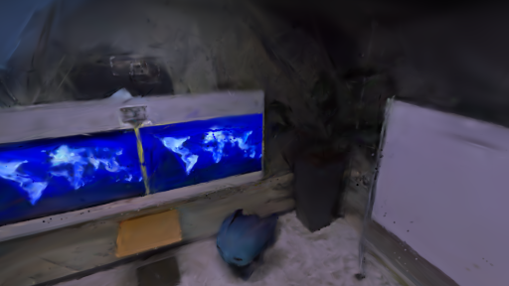
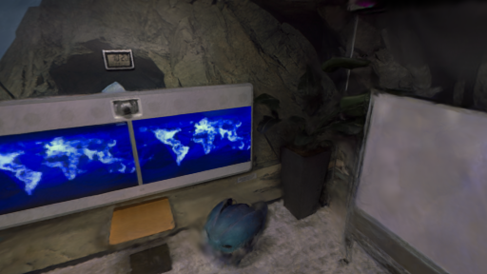
(a) Shared anchor
(b) Same-camera reconstruction
(c) Replica
Pose correction
k′
Photo-SLAM
Splatt3R-SLAM
Mean PSNR (dB) ↑
k
23.02
19.48
20
local map
10
camera
0
Photo
Ours
Map + cameras move together
+3.54 dB
Identical crop · representative office0 view
8/8 scene PSNR wins
含 AI 生成

Slide 2
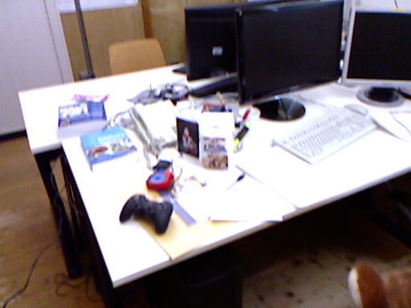
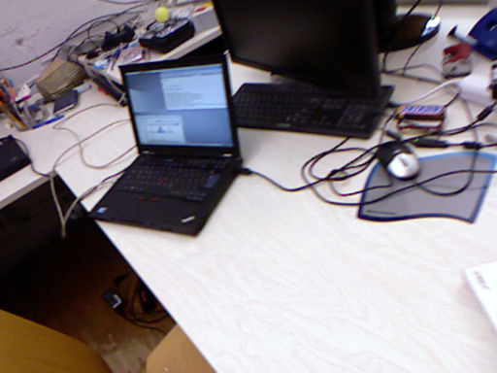
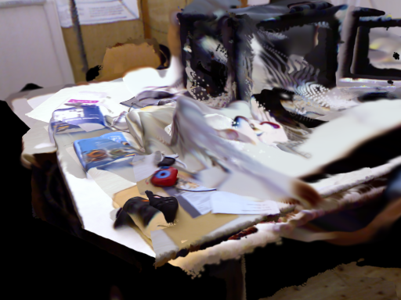
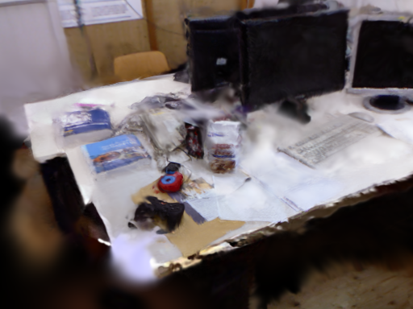
(a) Predict
(b) Anchor
(c) Refine
Sec. III-A · Eq. (1)
Sec. III-B · Eqs. (2–4)
Sec. III-C · Eq. (5)
Image pair
Geometry
Update θ
Tracker + pose graph
Adam
Shared
predictor
Anchor k: T_WCₖ
∇θ L
Splatt3R
Î
Local map Gₖ
Render
Loss
Gaussians
Tracked RGB
RGB + relative
L1 + SSIM
camera pose
I
Sample view
Before refinement
After refinement
Shared-anchor relation
T_{WCf}⁻¹ T_{WCk} = T_{CkCf}⁻¹
Pose corrections move map and cameras together.
Optional initialisation: Sec. III-D · Eqs. (7–8)

Slide 3
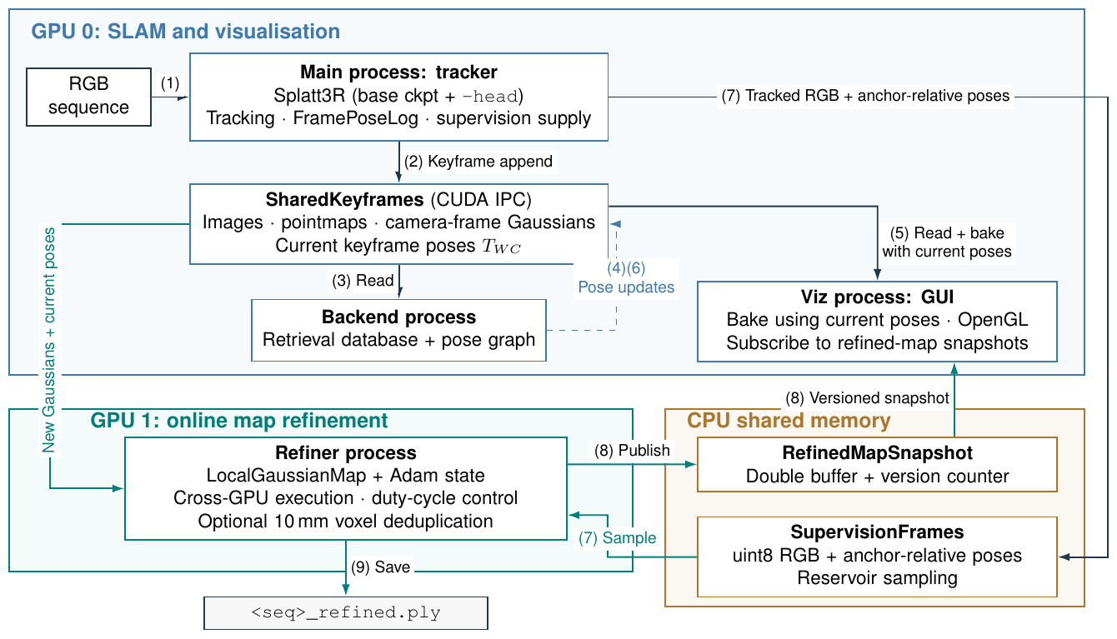

Slide 4
(a) Predict
(b) Anchor
(c) Refine
Ch. 2 · Eq. (2.7)
Ch. 4 · Eqs. (4.1–4.3)
Ch. 7 · Eq. (7.1)
Image pair
Geometry
Update θ
Tracker + pose graph
Adam
Shared
predictor
Anchor k: T_WCₖ
∇θ L
Splatt3R
Î
Local map Gₖ
Render
Loss
Gaussians
Tracked RGB
RGB + relative
L1 + SSIM
camera pose
I
Sample view
Before refinement
After refinement
Shared-anchor relation
T_{WCf}⁻¹ T_{WCk} = T_{CkCf}⁻¹
Pose corrections move map and cameras together.
Optional initialisation: Chs. 5–6 · Eq. (6.1)

