Slide 1
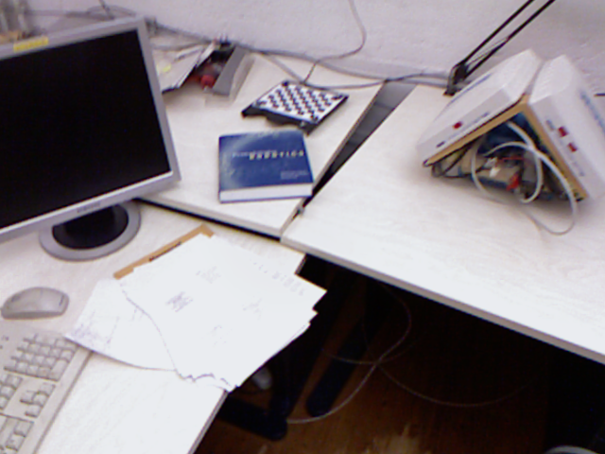
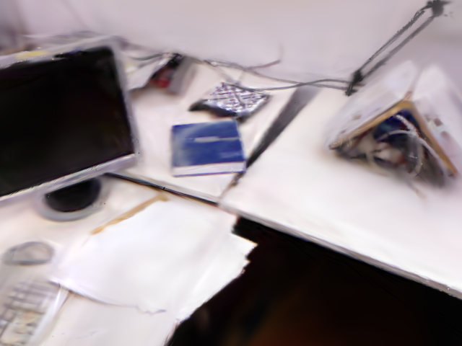
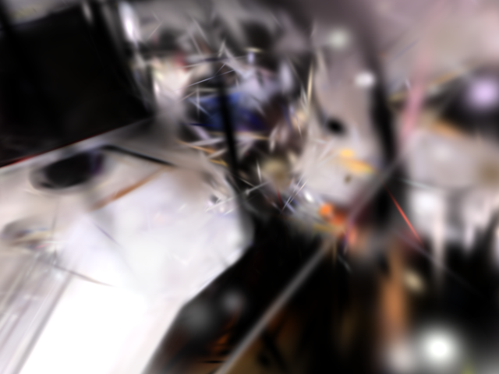

Real-data reconstruction and matched details
Ground truth
Photo-SLAM
MonoGS
Ours
2
2
2
2
1
1
1
1
1
2
1
2
1
2
1
2
Notes:
Region-2 tiles remain exchanged: the tile under the Photo-SLAM display position comes from Ours; the tile under the Ours display position comes from Photo-SLAM. Detail labels are intentionally omitted for manual annotation.

