Slide 1
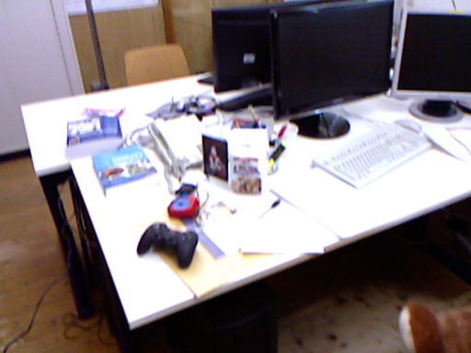
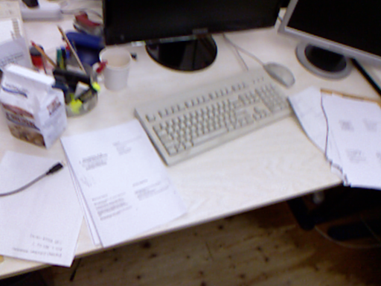
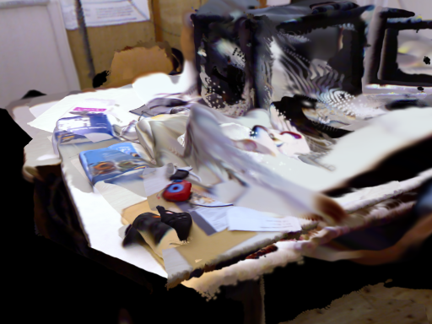
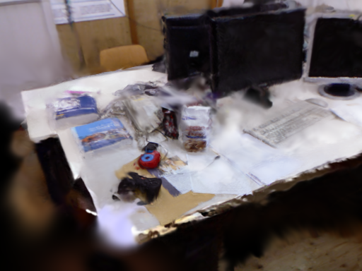
Predict, anchor, refine
RA-L method navigation
1 IMAGE PAIR
Shared predictor
Geometry lane
Shared keyframe anchor
Photometric refinement
Frozen MASt3R features
Pointmap + matching
Gaussian DPT head
tracking -> keyframes -> pose graph
Current pose moves both:
local Gaussian map
supervision cameras
sample tracked RGB
render current map
L1 + SSIM loss
Adam update
Gaussian lane
local means, shape, color, opacity
Sec. III-A / Eq. (1)
current frame + keyframe
Sec. III-B / Eqs. (2-4)
Sec. III-C / Eq. (5)
2 REAL DATA FLOW
Supervision sampler
Optional initialisation
200-frame reservoir
64 recent frames
30% recent sampling
head-only adaptation
opacity attenuation
External comparison:
released head; attenuation off
predicted map
same camera after refinement
Sec. III-D / Eqs. (7-8)
Pose updates change anchors; appearance gradients never update the tracker.

Slide 2
Predict, anchor, refine
MSc method navigation
1 IMAGE PAIR
Shared predictor
Geometry lane
Shared keyframe anchor
Photometric refinement
Frozen MASt3R features
Pointmap + matching
Gaussian DPT head
tracking -> keyframes -> pose graph
Current pose moves both:
local Gaussian map
supervision cameras
sample tracked RGB
render current map
L1 + SSIM loss
Adam update
Gaussian lane
local means, shape, color, opacity
Ch. 2 / Eq. (2.7)
current frame + keyframe
Ch. 4 / Eqs. (4.1-4.3)
Ch. 7 / Eq. (7.1)
2 REAL DATA FLOW
Supervision sampler
Optional initialisation
200-frame reservoir
64 recent frames
30% recent sampling
head-only adaptation
opacity attenuation
External comparison:
released head; attenuation off
predicted map
same camera after refinement
Chs. 5-6 / Eq. (6.1)
Pose updates change anchors; appearance gradients never update the tracker.

Slide 3
Why the supervision camera shares the anchor
Coordinate control and refinement loop
Before a loop closure
Pose correction
Controlled 6% scale test
Local map and camera use keyframe k.
Their relative transform is fixed.
The pose graph changes T_k.
The map and camera move together.
Fixed world camera: refinement reverses the correction.
Shared anchor: correction remains after about 500 steps.
Desk + room controls
T_f^-1 T_k = T_kf^-1
shared anchor: relation preserved
REFINEMENT LOOP
sample RGB
compose pose
render map
L1 + SSIM
Adam update
Only Gaussian scale, rotation, opacity, and DC color receive gradients.

Slide 4
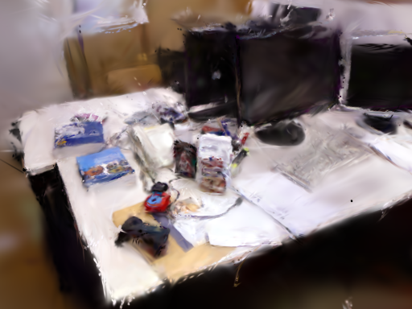
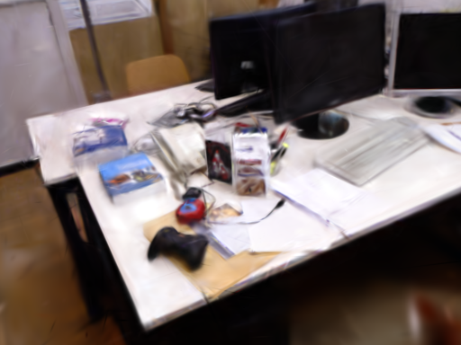
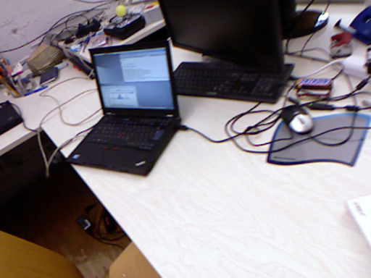
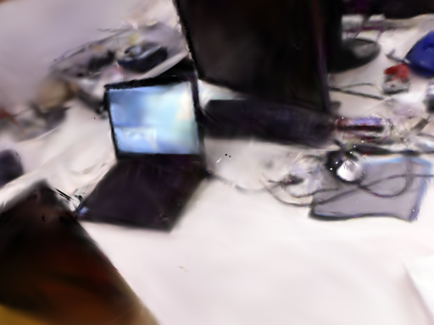
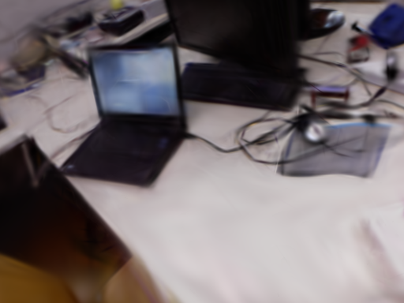
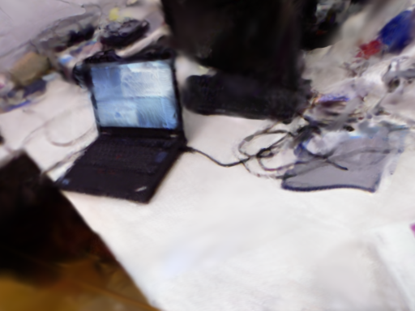
Qualitative reconstruction at common cameras
Measured renders; identical crops and scales
Ground truth
Photo-SLAM
MonoGS
Ours
TUM desk: two middle-ranked Ours-minus-MonoGS PSNR views
Orange panels are identical pixel crops across all methods.

Slide 5
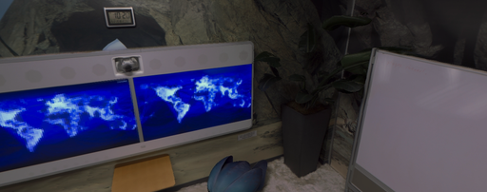
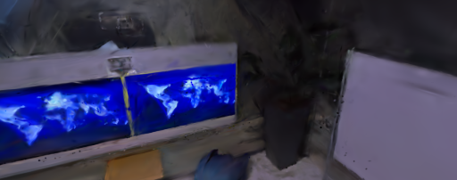
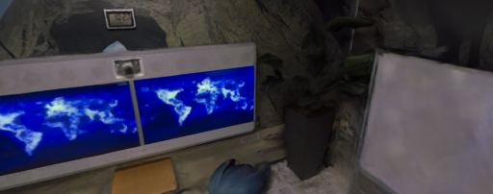
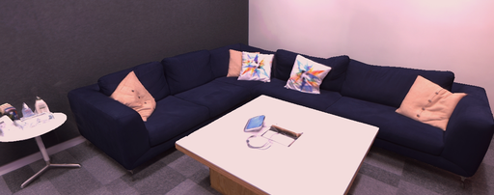
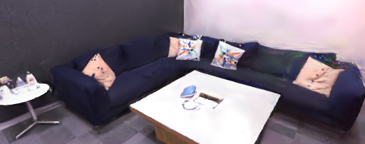
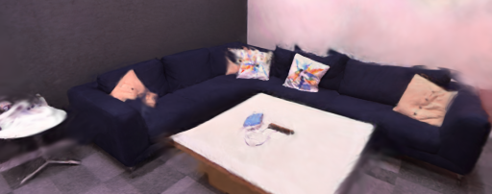
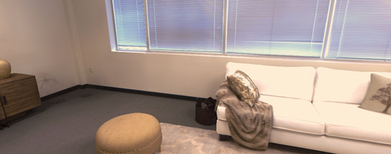
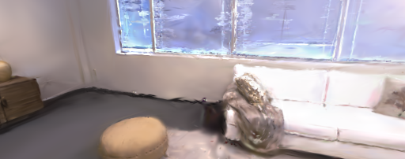
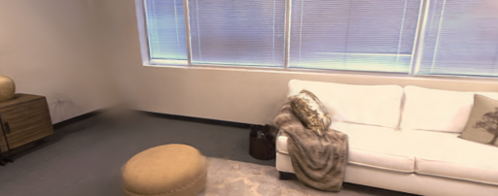
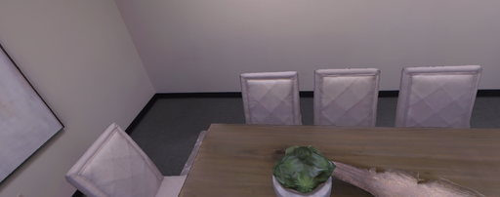
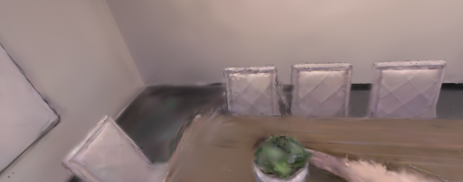
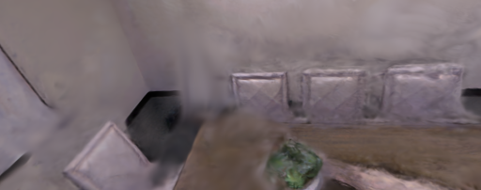
Replica reconstruction across scenes
No monocular MonoGS artifact was available
Ground truth
Photo-SLAM
Ours
office0
office2
room0
room2
All images use the same selected camera within each scene.

Slide 6
Component evidence
All recorded attenuation cells and refinement controls
Opacity attenuation: relative LPIPS change (%)
Refiner on vs. off: PSNR gain (dB)
o3
-13
ETH3D sofa_1
+8.69
o0
-13
o2
-10
Replica office0
+4.62
r0
-8.9
r1
-7.1
o1
-1.6
TUM desk
+3.52
o0-k.9
-5.3
o0-k.6
-1.8
EuRoC V1_01
+1.00
TUM-rel
-6.4
TUM-adapt
-0.6
EuRoC
-5.6
Interpretation
7S
+0.16
Refinement gives the largest controlled gain.
Opacity reduction is robust; confidence allocation is not.
External baseline comparison uses the released head with attenuation off.

