Slide 1
Optical model : Tuesday afternoon
Ex1: ^{nat}Sn total cross section
Task :
Retrieve from EXFOR experimental data for neutron total cross section on Sn
Choose the data from Finlay and Rapaport only
Use sample 16 case a), b), c), d) and compare with data. How well is the fit?

Slide 2
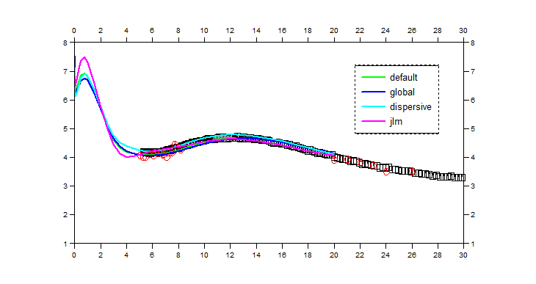

Slide 3
Optical model : Tuesday afternoon
Ex1: ^{nat}Sn total cross section (continued)
Task :
Retrieve from EXFOR experimental data for neutron total cross section on ^{nat}Sn
Choose the data from Finlay and Rapaport only
Use sample 16 case a), b), c), d) and compare with data
How well does it work if you extend the calculations to higher energies?: Extend calculation up to 100 MeV

Slide 4
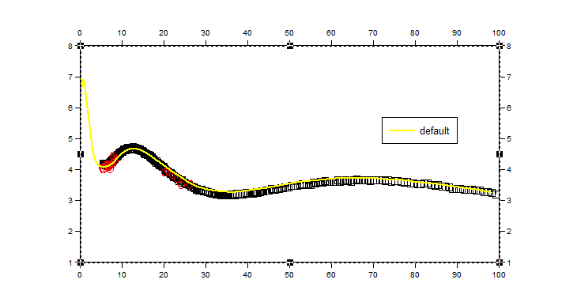

Slide 5
Ex 2

Slide 6
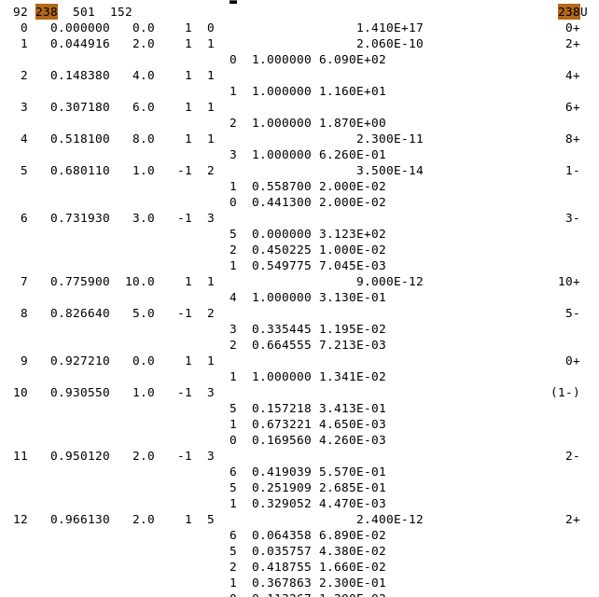
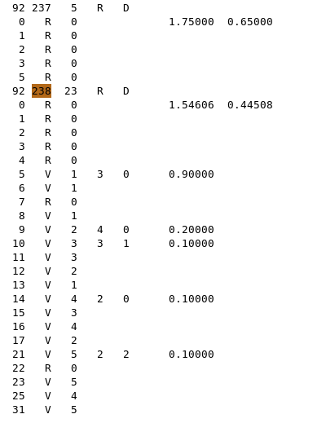
Coupled channels in TALYS
.../talys/structure/deformation/...
Optical model : Tuesday afternoon
../talys/structure/levels/final/..
deformation file z092
level file z092
²⁰⁸Pb inelastic angular distributions
Task :
Perform sample 9
Copy default OMP parameters from structure/deformation directory to local directory
Modify OMP parameters to suppress DWBA informations
Redo plots and compare

Slide 7
Optical model : Tuesday afternoon
²³⁸U Coupled-Channels saturation
Tasks :
Compute and plot total cross section and compound nucleus cross section* with dir 0
Compute and plot total cross section and compound nucleus cross section with dir 4
Let’s see how much time each calculation takes:
Goto directory 0
Talys < input0|grep ‘RES’
Goto directory 9test (not 9!)
Talys < input9 |grep ‘RES’
Plotting:
Keep only data of Abfalterer , Poenitz and Foster. You will find them in the exp directory
Plot total cross sections from directories 1 …. up to 9 on the same plot with exp. data
Optional:
Calculate the χ2 between the exp. data and the talys calculations for each iteration. Plot and discuss the χ2 as a function of the number of coupled levels.
* you will need to comment out omponly to calculate this

Slide 8
