Slide 1
Why Filipino passengers break the world's fastest boarding method
Simulating and Comparing Airplane Boarding Strategies for Philippine Domestic Flights
Agent-based discrete-event simulation · Airbus A320 · 180 passengers · 200 replications per condition
Arnulfo L. Sabayo III · Jessica Danielle D. Dorosan
Notes:
Open with the hook: the method that wins in the lab loses most of its advantage here.

Slide 2
Carriers use the slowest method, and no model accounts for our passengers
Problem definition
Philippine domestic carriers board back to front, which the literature identifies as the worst performer.
Published models assume individual travel, strict compliance with boarding calls, and uniform carry-on.
Philippine operations violate all three: family groups, loose compliance, and heavy pasalubong.
No study measures what those behaviours cost, or which strategy survives them.
The gap this project closes
907 s
Ideal-case saving from dropping back-to-front
525 s
What actually survives Philippine conditions
Notes:
The two numbers on the right are the whole project in miniature: the textbook saving and the real one.

Slide 3
Build it, stress it, then say what an airline should do
Objectives and scope
1
Model
A 30-row A320 cabin as a 1D cell array with six agent states
Out of scope
Dual-door and rear-stair boarding
Priority tiers and pre-boarding
Load factors below 100 percent
Two-dimensional passenger physics
Aircraft other than the A320
2
Compare
Four strategies: Random, Back-to-Front, Outside-In, Steffen
3
Stress
Seven Filipino behaviour features, each independently toggled
4
Prove
16 automated tests plus validation against published rankings
5
Advise
Translate the findings into boarding policy for carriers
Notes:
Be explicit about scope; the rubric rewards a clearly bounded problem.

Slide 4
One passenger per aisle cell, and stowing blocks everyone behind
Conceptual model: agent states and the cabin
QUEUED
WALKING
STOWING
SEATING
SEATED
at the gate
up the aisle
bags overhead
entering seat
cell freed
BLOCKED
loops back when the cell frees
cell ahead taken
Seat blocking is what makes order matter
To reach the window seat A, a passenger must pass C and B. Each neighbour already seated costs a shuffle delay of 4 to 10 seconds.
A
B
C
aisle
D
E
F
Outside-In and Steffen both seat windows first, so both record exactly zero seat interference.
Notes:
Walk the states left to right, then point at the blocked loop. Then drop to the cabin strip and explain blocking.

Slide 5
The four strategies differ in one thing: who is called when
Each strategy orders the same 180 passengers differently
Random
90 shuffles
Back-to-Front
90 shuffles
Uniform shuffle, no structure. The control case.
Five zones of six rows, rear zone first, random within a zone.
Outside-In (WilMA)
0 shuffles
Steffen
0 shuffles
Three waves: all windows, then all middles, then all aisles.
Six waves: windows on even rows, then odd, then middles, then aisles. Back to front within each wave.
Seat interference is fixed by within-row order. Aisle congestion is fixed by spacing. Only Steffen does both.
Notes:
The closing line is the point of the slide.

Slide 6
A modular engine with the configuration fully decoupled
Implementation
cabin.py
passenger.py
strategies.py
behavior.py
Seat map and blocking
Agent dataclass and states
The four orderings
Seven behaviour features
simulation.py
experiments.py
stats.py
charts.py
Time-step engine
Replications and CRN
Tests, intervals, effect size
Figure generation
4,715
16
26 ms
0
lines of Python
tests, all passing
per replication
hard-coded constants
Every parameter lives in one YAML file and is labelled with its provenance, either a citation or the word ASSUMED.
Notes:
Stress the zero hard-coded constants: it is what makes the sensitivity sweeps possible.

Slide 7
Standard scientific Python, with one job each
Tools and techniques
1
numpy
2
pandas
Seeded random streams, vectorised draws
Tidy per-run records, six CSV datasets
3
scipy
4
matplotlib
Paired t-tests, ANOVA, Mann-Whitney U
Seven figures and four GIF animations
5
pytest
6
PyYAML
16 invariant and kinematic tests
Single decoupled configuration file
7
Flask
8
Jupyter
Interactive browser dashboard
Analysis notebook, 16 cells
Techniques: common random numbers for variance reduction, bootstrap confidence intervals, Bonferroni correction, and ablation.
Notes:
Name the techniques, not just the libraries. The rubric asks for use of tools AND techniques.

Slide 8
Every strategy faces the identical 180 passengers
Experiment design and common random numbers
1
Baseline
Ideal conditions, 4 strategies
Common random numbers
Each replication generates one passenger population from seed 12345 plus the replication index, then runs all four strategies against that same population. Differences between strategies cannot be demographic noise.
2
Philippine
All seven behaviours active
3
Compliance sweep
100, 90, 75, 50, 25, 0 percent
4
Group sweep
0, 20, 40, 60 percent in groups
200
800
5
Sensitivity
Stow time x4, walk speed x3
replications per condition
runs in 20.5 seconds
6
Ablation
Each behaviour alone
Notes:
Common random numbers is the one methodological choice worth dwelling on.

Slide 9
Steffen wins in both worlds, but loses the most ground
Mean total boarding time, 200 replications per condition
What the gap costs
+76%
Steffen under Philippine conditions
+9%
Back-to-Front, which has little left to lose
F = 8,853
One-way ANOVA on 3 and 796 df
p < 0.001
All six pairwise tests, Bonferroni
Notes:
The ranking never changes. What changes is the size of Steffen's lead.

Slide 10
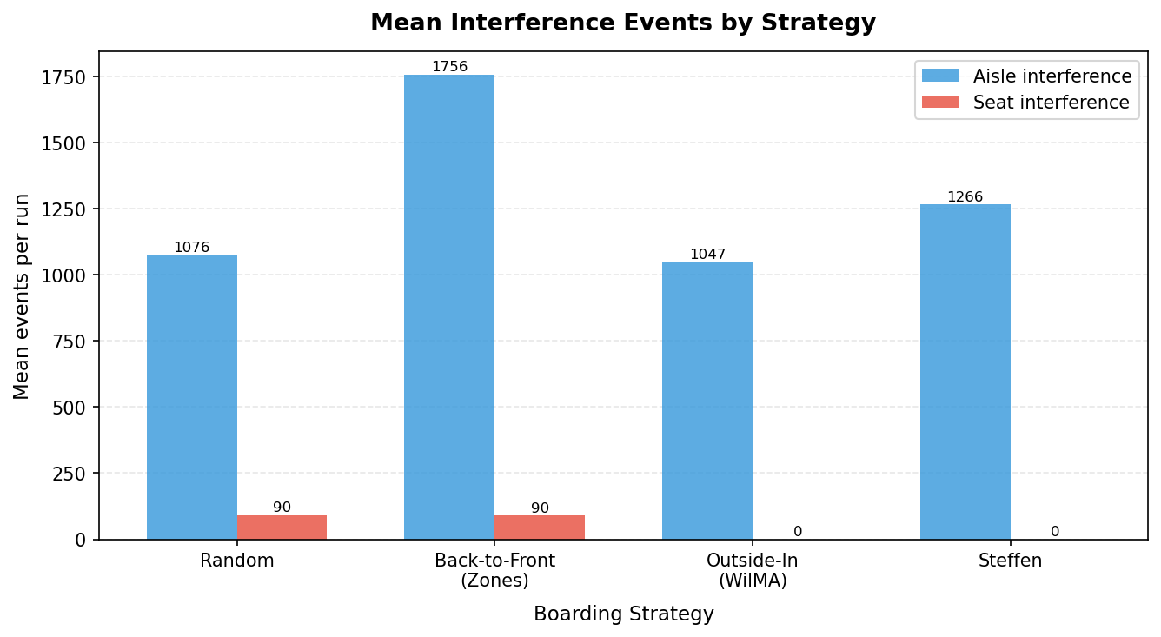
Counting blocking events does not predict the winner
Interference events per run, baseline conditions
Steffen records the second-highest number of aisle blocks, 1,266 per flight, yet finishes fastest.
What differs is how long each block lasts.
1.8 s
8.8 s
per block, Steffen
per block, Back-to-Front
Outside-In and Steffen record exactly zero seat shuffles. Random and Back-to-Front each carry about 90.
Notes:
This is the slide that shows analytical depth. Duration, not count, is what matters.

Slide 11
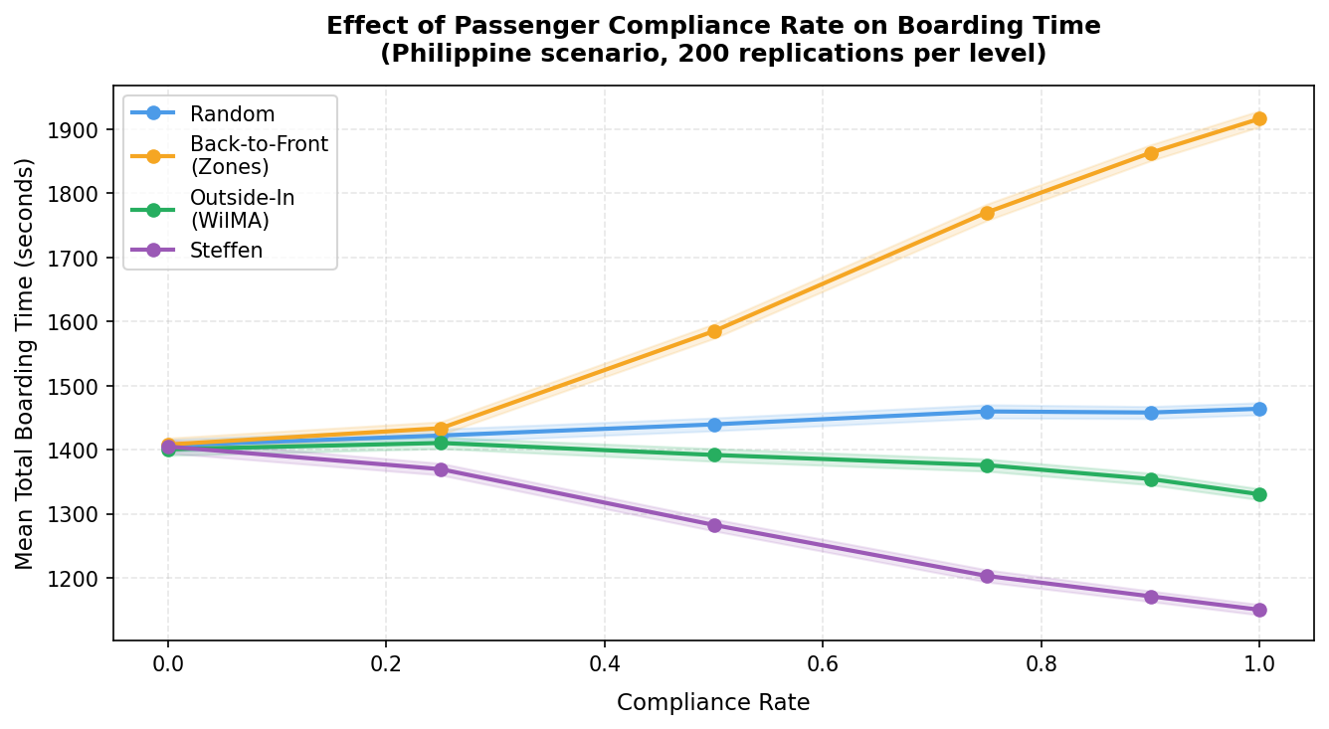
Back-to-front gets slower when passengers obey
The most counter-intuitive result in the study
1,405 s to 1,915 s
Back-to-Front as compliance rises from zero to full
Obeying a back-to-front call perfectly is precisely what creates the jam. Everyone called at once walks to the same six rows.
When nobody complies, all four strategies converge near 1,400 seconds, because the order has become random.
Notes:
Pause after saying the direction of the effect. Audiences expect compliance to help.

Slide 12
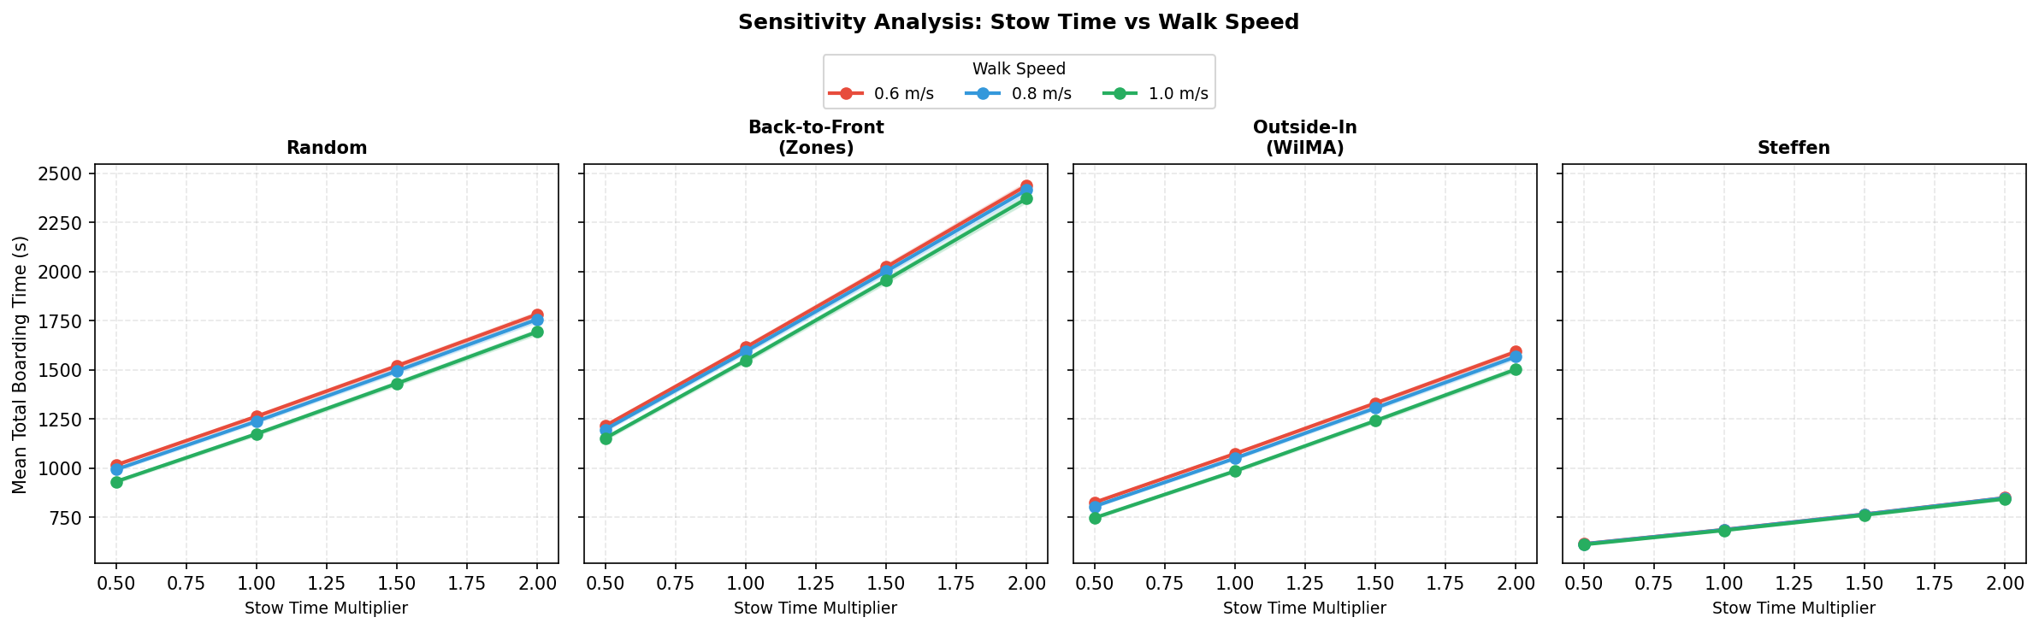
The ranking survives every stress we applied
Sensitivity: stow time halved to doubled, walk speed 0.6 to 1.0 m/s
12 of 12
12 of 12
+38%
+103%
conditions with Steffen first
conditions with Back-to-Front last
Steffen's rise from half to double stow time
Outside-In's rise over the same range
Notes:
Steffen's three walk-speed lines sit on top of each other: stowing is the bottleneck, not walking.

Slide 13
Verified against hand calculations, validated against the literature
Validation and testing
Verification: is the model built correctly?
Validation: does it behave like reality?
3
Single passenger
Hand-computed timings match the engine
Ranking matches Steffen and Hotchkiss (2012)
Pass
2
Two in a row
Seat interference counted in both directions
Outside-In records zero seat interference
Pass
8
Strategies
Valid 180-passenger permutations, correct order
Heavy luggage slows every strategy, 5 to 14 percent
Pass
3
Invariants
50 full runs: no shared cells, no backward motion
Identical seed gives byte-identical output
Pass
Rankings are compared, not absolute times: the 2012 physical trial used a 12-row mock cabin, so durations are not comparable with a 30-row simulation.
Notes:
Separate verification from validation explicitly. Graders look for that distinction.

Slide 14
What a Philippine carrier should actually do
Recommendations, ordered by size of gain
1
Stop boarding back to front
Last in both scenarios and all 12 sensitivity conditions. Switching saves 525 s per turnaround under realistic conditions.
2
Treat call discipline as the main lever
Non-compliance alone costs Steffen 41 percent and group travel a further 53 percent.
3
Enforce window-before-aisle seating
Costs nothing and removes about 90 seat shuffles per flight.
4
Manage carry-on at the gate
Heavy hand-carry adds 14 percent to Back-to-Front and 5 percent to Steffen.
5
Do not promise the published savings
Plan schedules against 525 seconds, not the 907 the ideal case suggests.
Notes:
Recommendation 2 is the headline: discipline beats strategy choice.

Slide 15
What would change the answer next
Recommendations for future work
1
2
3
Measure, do not assume
Add dual-door boarding
Test compliance-robust strategies
A gate observation study at a domestic terminal would convert the behaviour sweeps from plausible ranges into calibrated estimates. This is the model's largest weakness.
Many Philippine domestic flights board through front and rear stairs, which the single-door engine cannot represent. It may compress the gaps between strategies.
Most of Steffen's advantage depends on obedience. A strategy built to degrade gracefully could beat it in practice. No published method targets this.
Four more extensions are listed in the written report: load factor sweeps, other aircraft, recalibrated stow time, and a repeated-measures statistical model.
Notes:
Item 3 is a genuine research opening that the literature does not address. Say so.

Slide 16
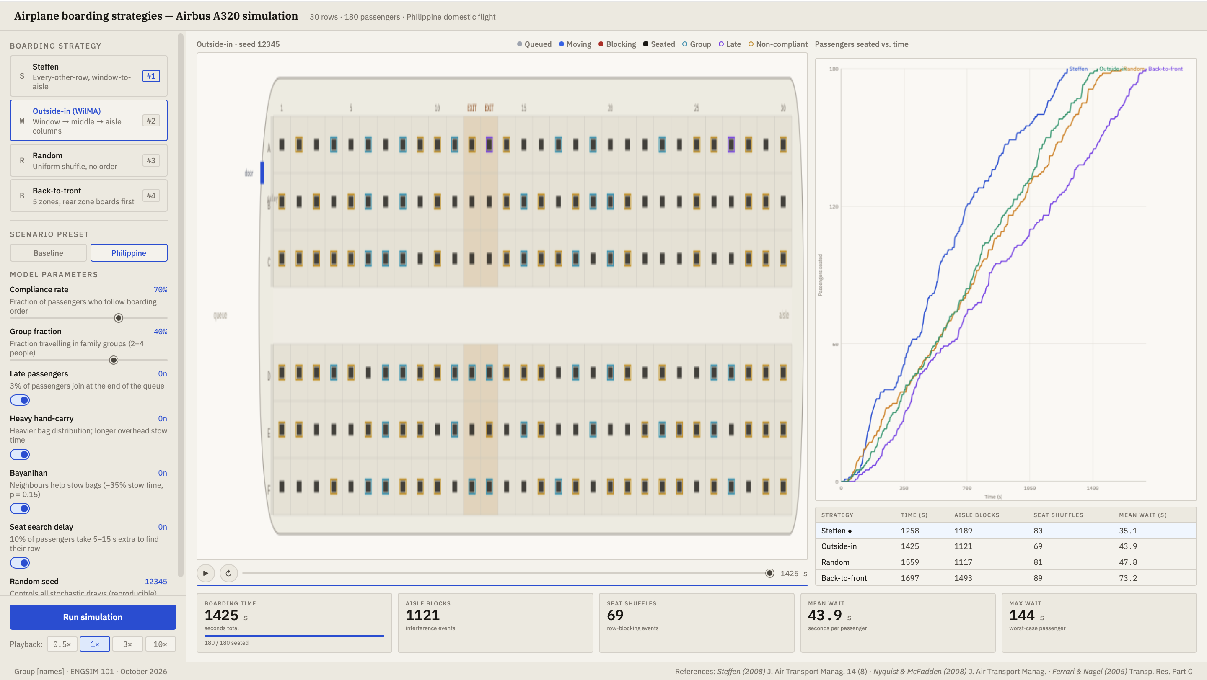
Live demonstration
Twelve minutes of numbers. Now the model that produced them.
What to point at
Pick Steffen, press Run, watch the alternating rows fill.
Switch to Back-to-Front and watch the rear rows jam.
Drop compliance to 30 percent and re-run.
Read the comparison table building up as each run finishes.
Fallback: if the server will not start, play the saved GIF animations in the results folder.
Notes:
Two minutes maximum. Have the dashboard already running on a second tab before the talk starts. Switch back to the deck before speaking again.

Slide 17
Discipline beats strategy choice
Steffen is fastest everywhere we looked, but most of its advantage is contingent on passengers boarding in the order they are called. For a Philippine carrier, improving boarding-call compliance is worth more than adopting a new strategy.
Arnulfo L. Sabayo III · Jessica Danielle D. Dorosan
Model, datasets, figures, dashboard and written report are all in the project repository.
Notes:
Close on the one-line finding, then invite questions.

