Slide 1
My Portfolio
Presented by: Monic Gurung, Samir Gurung, Ashish Gurung
Collage: Prativa Secondary School
Class: 11(Management)
Section: E(Morning)
Roll No: 30, 41, 9

Slide 2
Introduction to the website
This website is a portfolio website of Mr. Monic Gurung which was built by our team which consists of the team leader himself Mr. Monic Gurung, Mr. Samir Gurung and lastly Mr. Ashish Gurung . This was built with the aim of letting the visitors know some information about Mr. Monic Gurung.
Nevertheless this website is only a temporary website. This will be replaced by a new and much more advance website in the future.

Slide 3
Objectives
To know who Monic Gurung is.
To know the information about Monic Gurung.
To know Monic Gurung’s works.
To demonstrate our coding capabilities.

Slide 4
Table of Contents
Home
About Me
My works
Contact me

Slide 5
About My Website(Portfolio)
This portfolio is a collection of Mr. Monic Gurung’s work, showcasing the skills and knowledge that he have acquired over the years. It is an opportunity for us to demonstrate his creativity, innovation, and problem-solving abilities through this website.
From web design to photography, his portfolio is an expression of his journey as an artist and a professional.

Slide 6
Features
This website has a starting animation on the home page. You can reload or refresh the page to review the animation.
This website is responsive to the buttons(Home, About Me, My Works, Contact me).
The submit button as well as Facebook, Instagram and discord button all have a hover effects.
On the contact me section the Facebook, Instagram and discord button will all lead to Mr. Monic Gurung’s respective social media account.

Slide 7
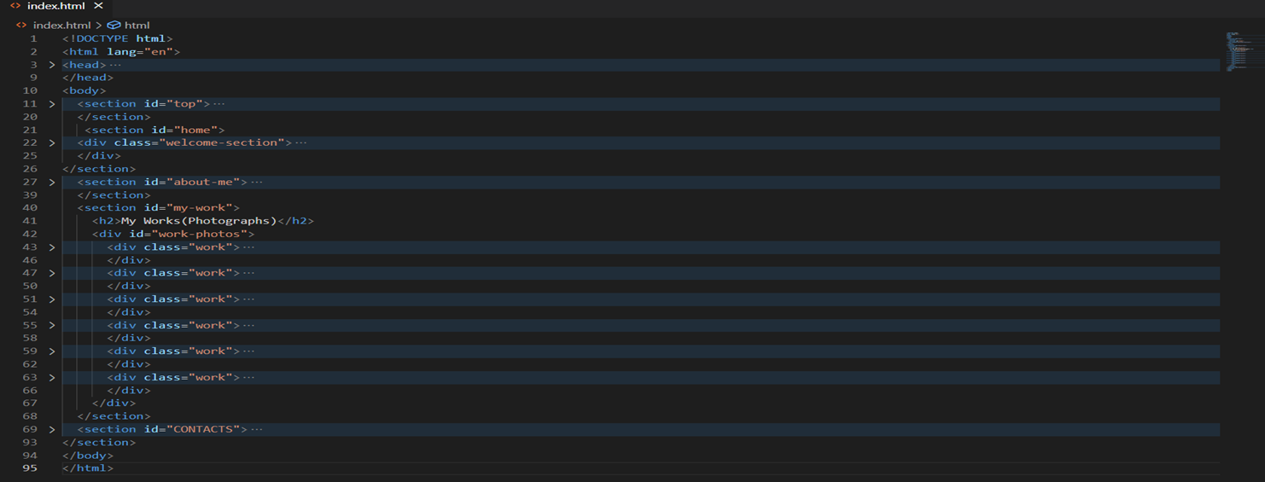
Coding(Html)
This website consists of 95 html lines.

Slide 8
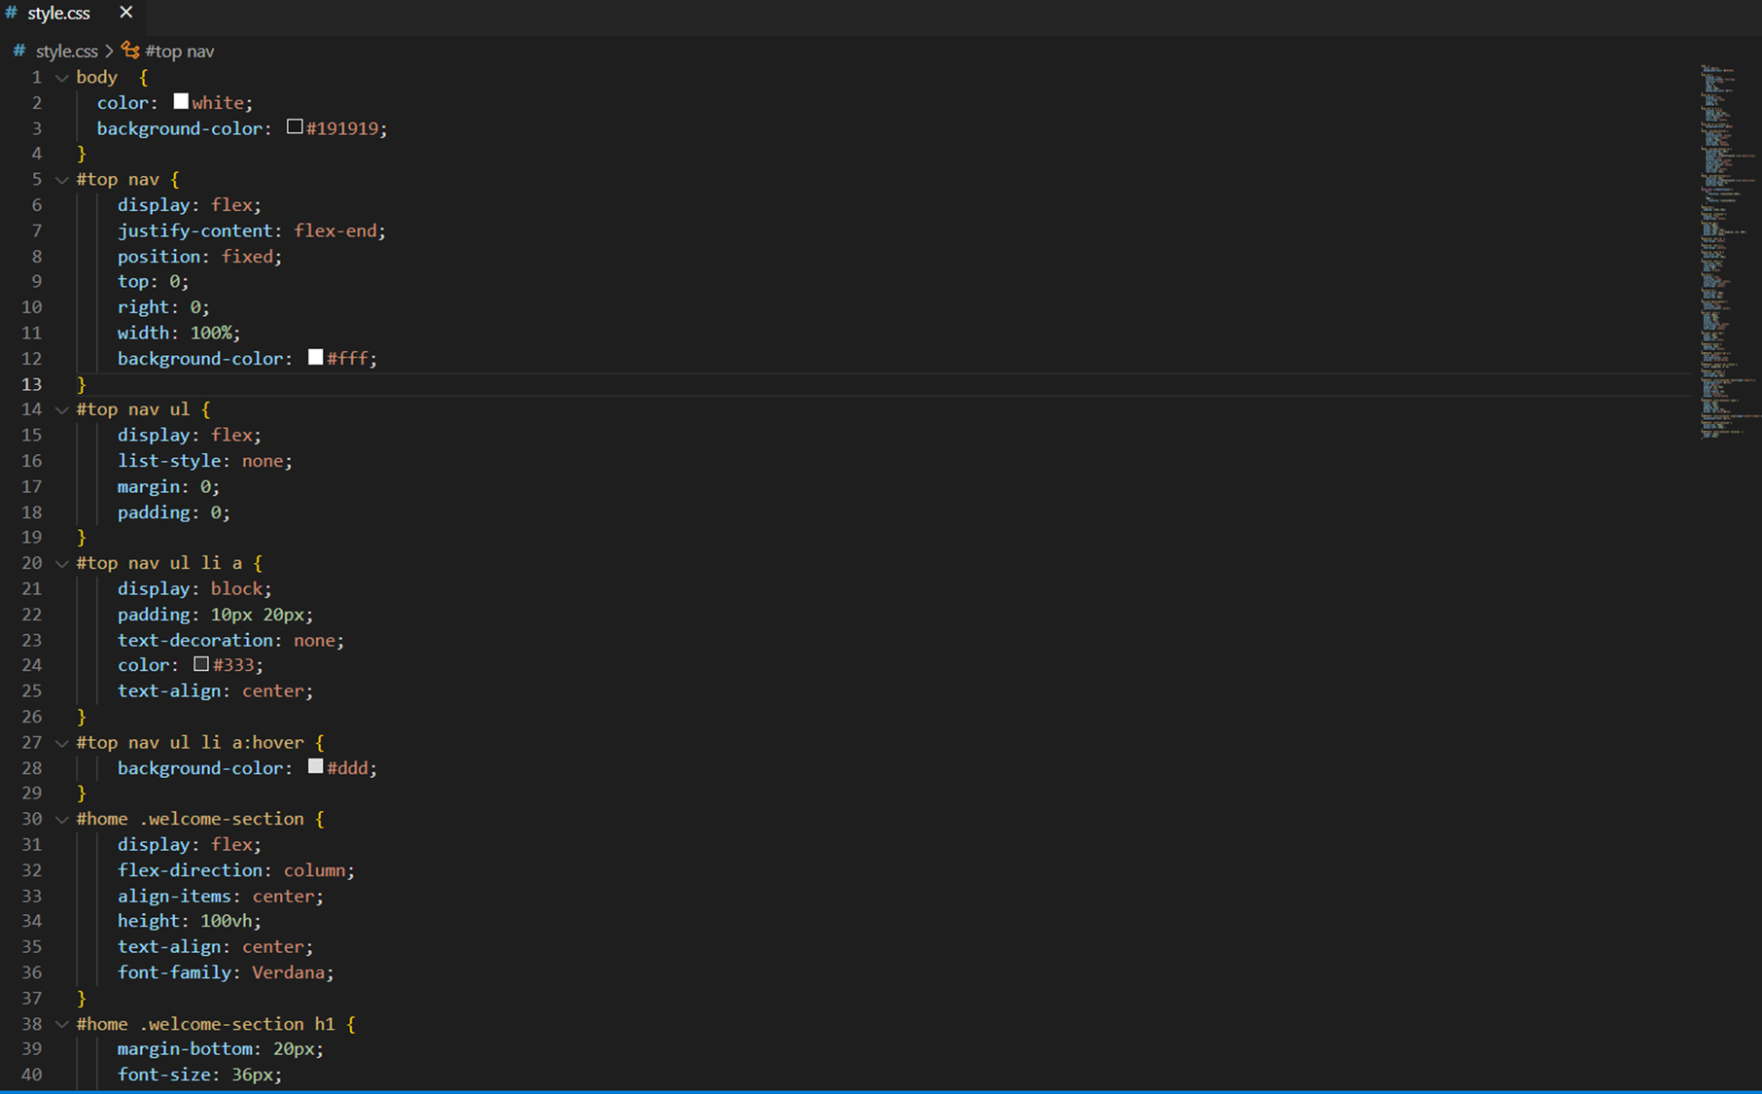
Coding(CSS)
This website consists of 167 css lines.

Slide 9
Limitation
Although out team tried our very best to develop this website, there are some limitations which we could not solve with our capabilities.
Some of them are :
There is no use of java script so certain functions which could be done with java script is not available.
The contact me section is just a front end part and any messages someone sents through it will not actually reach to Mr. Monic Gurung.

Slide 10
Conclusion
This website is a portfolio which consists of collection of Mr. Monic Gurung’s work, showcasing the skills and knowledge he have acquired over the years. It is an opportunity for us to demonstrate his creativity, innovation, and problem-solving abilities through this website.
From web design to photography, this portfolio is an expression of his journey as an artist and a professional.

Slide 11
Reference
Chat gtp
Google
W3schools
A CODER IN A HOODIE(YOUTUBE)
Codehal(YOUTUBE)

Slide 12
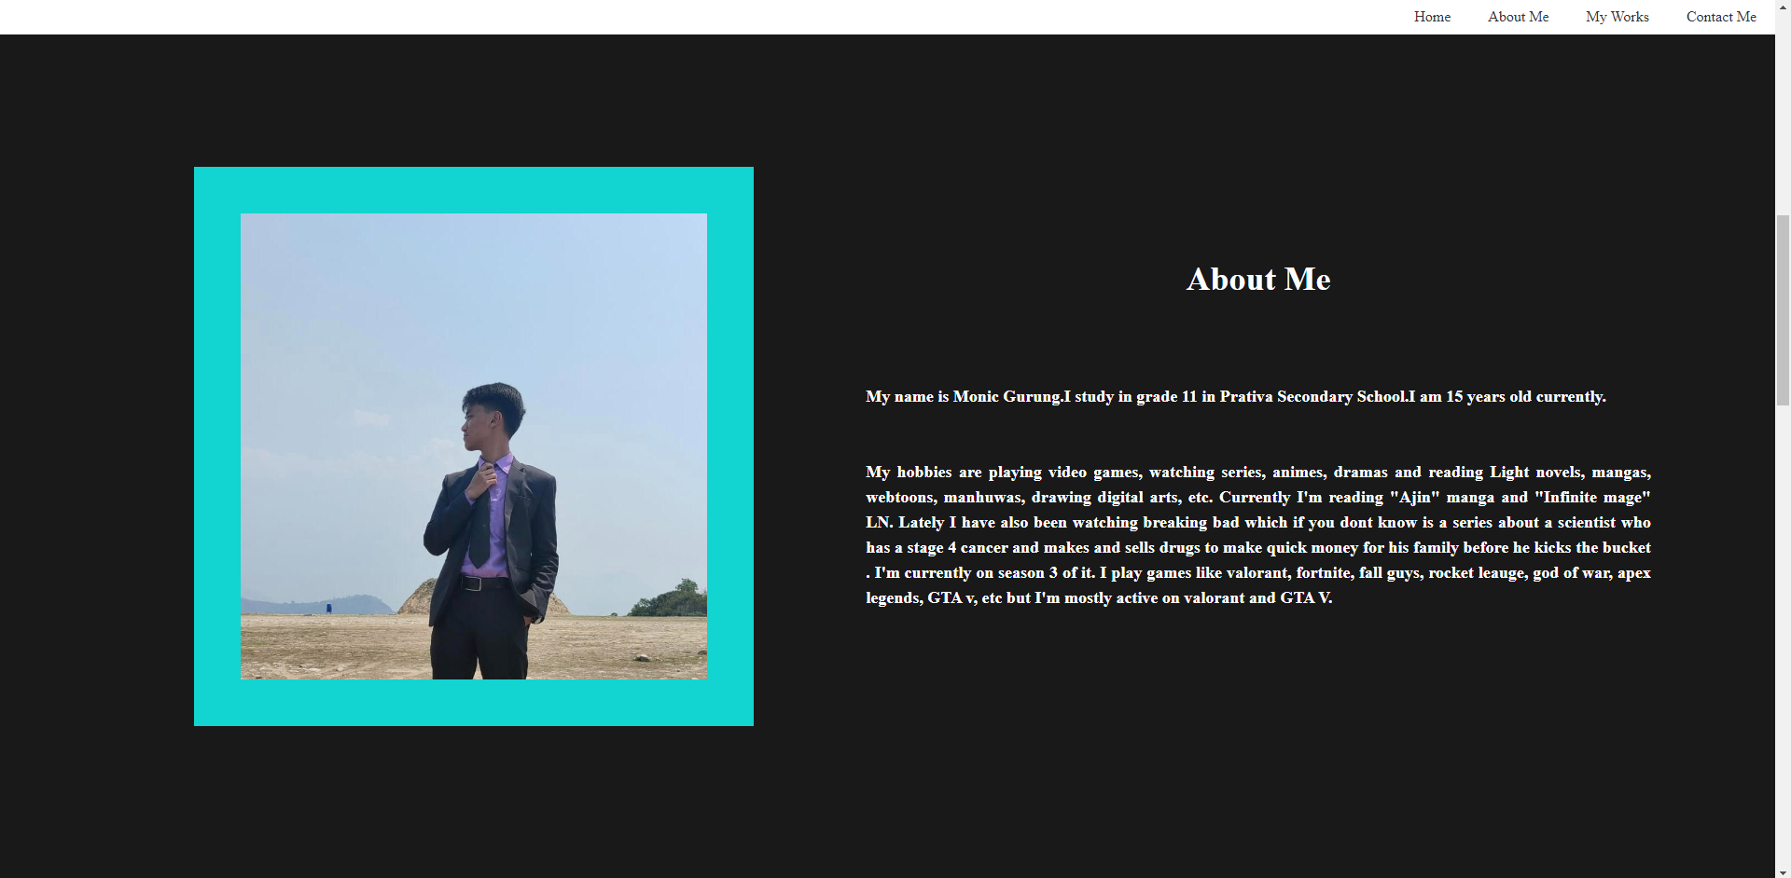
DEMO

Slide 13
THANKYOU

