Slide 1
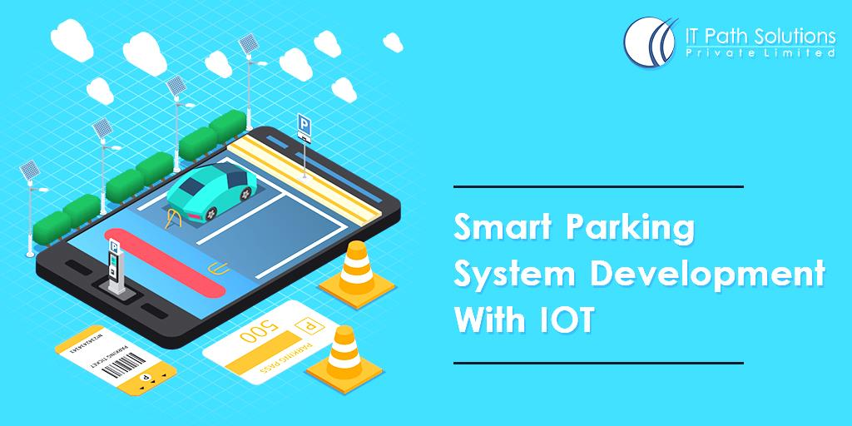
SMART PARKING

Slide 2
INTRODUCTION
The concept of Internet of Things (IoT) started with things with identity communication devices. The devices could be tracked, controlled or monitored using remote computers connected through Internet. IoT extends the use of Internet providing the communication, and thus inter-network of the devices and physical objects, or ‘Things’. The two prominent words in IoT are “internet” and “things”. Internet means a vast global network of connected servers, computers, tablets and mobiles using the internationally used protocols and connecting systems. Internet enables sending, receiving, or communicating of information. Thing in English has number of uses and meanings. Dictionary meaning of ‘Thing’ is a term used to reference to a physical object, an action or idea, situation or activity, in case when we do not wish to be precise. IoT, in general consists of inter-network of the devices and physical objects, number of objects can gather the data at remote locations and communicate to units managing, acquiring, organizing and analyzing the data in the processes and services. It provides a vision where things (wearable, watch, alarm clock, home devices, surrounding objects with) become smart and behave alive through sensing, computing and communicating by embedded small devices which interact with remote objects or persons through connectivity. The scalable and robust nature of Cloud computing is allowing developers to create and host their applications on it. Cloud acts as a partner for IoT as it acts as a platform where all the sensor data can be stored and accessed from remote locations. These factors gave rise to the amalgamation of both technologies thus leading to the formation of a new technology called Cloud of Things(CoT). In CoT the things(nodes) could be accessed, monitored and controlled from any remote location through the cloud. Due to high scalability in cloud any number of node could be added or removed from the IoT system on a real time basis. In simple terms IoT can be explained in form of an equation stating:
Physical Object + Controller, Sensor and Actuators + Internet = Internet of Things

Slide 3
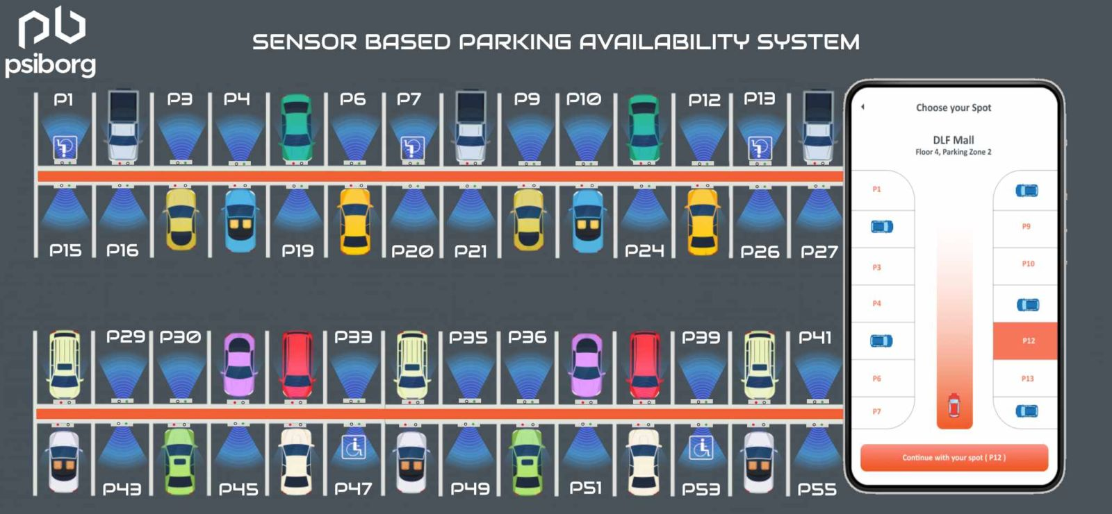

Slide 4

IMPORTANCE OF SMART PARKING
The ideal of creating a Smart City is now becoming possible with the emergence of the Internet of Things. One of the key issues that smart cities relate to are car parking facilities and traffic management systems In present day cities finding an available parking spot is always difficult for drivers, and it tends to become harder with ever increasing number of private car users. This situation can be seen as an opportunity for smart cities to undertake actions in order enhance the efficiency their parking resources thus leading to reduction in searching times, traffic congestion and road accidents. Problems pertaining to parking and traffic congestion can be solved if the drivers can be informed in advance about the availability of parking spaces at and around their intended destination. Recent advances in creating low-cost, low-power embedded systems are helping developers to build new applications for Internet of Things. Followed by the developments in sensor technology, many modern cities have opted for deploying various IoT based systems in and around the cities for the purpose of monitoring. A recent survey performed by the International Parking Institute reflects an increase in number of innovative ideas related to parking systems. At present there are certain parking systems[8] that claim to citizens of delivering real time information about available parking spaces. Such systems require efficient sensors to be deployed in the parking areas for monitoring the occupancy as well as quick data processing units in order to gain practical insights from data collected over various sources.
The smart parking system that we propose is implemented using a mobile application that is connected to the cloud. The system helps a user know the availability of parking spaces on a real time basis.

Slide 5
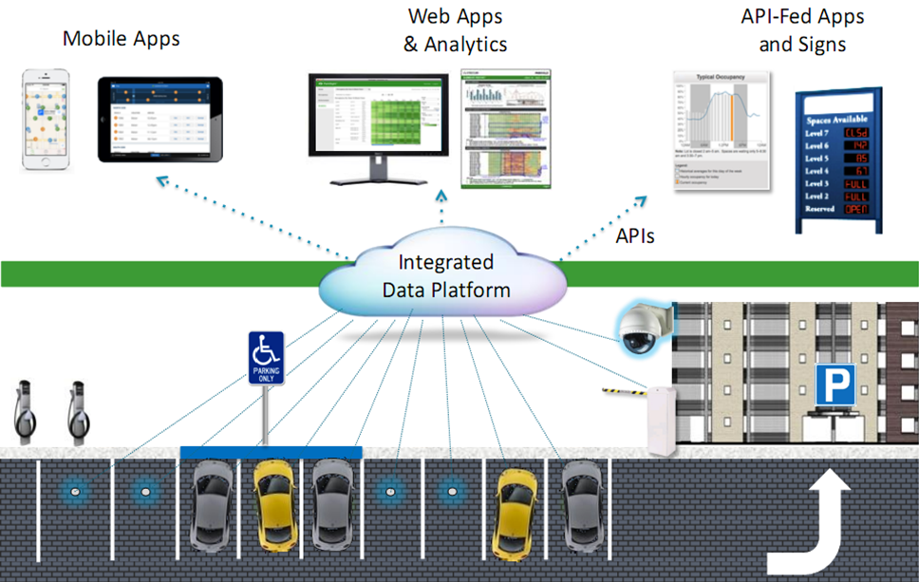

Slide 6
The primary actors that constitute the parking system are:
Parking Sensors:
For our parking system we have made use of sensors like Infrared, Passive Infrared(PIR) and Ultrasonic Sensors. The work of these sensors is the same i.e. to sense the parking area and determine whether a parking slot is vacant or not. In this case we are using ultrasonic sensors to detect the presence of a car. The ultrasonic sensors are wirelessly connected to raspberry pi using the ESP8266 chip. An ESP8266 WiFi chip comprises of a self contained SOC with integrated TCP/IP protocol stack that allows any microcontroller to access a WiFi network. The sensors are connected to a 5V supply either from raspberry pi or an external source. External source being more preferable.

Slide 7
Processing Unit: It comprises of Raspberry pi which is a processor on chip. The processing unit acts like an intermediate between the sensors and cloud. All the sensors are wirelessly connected to the processing unit. A single raspberry pi unit comprises of 26 GPIO i.e. 26 different sensors can be connected to it. However we can increase this number by attaching a multiplexer (MUX) to it. It is essential that the ground of raspberry pi and sensors must be connected in order to transfer data using the GPIO pins. There is a python script running on the chip that checks the status of various GPIO pins and updates this information onto the cloud. Data collected from various sensors is sent to the raspberry pi through the esp8266 chip. The raspberry pi then transmits this data to the IBM MQTT Server through MQTT protocol over a channel. MQTT(Message QueueTelemetry Transport) Protocol is a publish-subscribe based "light weight" messaging protocol that is used on top of the TCP/IP protocol. It is designed to establish connections across remote locations where limited amount of data needs to be transferred or in cases of low bandwidth availability

Slide 8
Mobile application: The mobile application acts like an interface for the end users to interact with the system. The application is developed in Apache Cordova and Angular Js framework using Javascript as a programming language. The purpose of using Apache Cordova is to create applications that can run on both android and iOS platform with the same source code. The application is connected with the IBM MQTT server through a secure channel and a 2 factor authorization. The purpose of this mobile application is to provide information regarding availability of parking spaces and allowing the end user to book a slot accordingly. Transfer of data takes place in JSON format between IBM MQTT server and the mobile application. In order to ensure proper communication both the Raspberry pi and mobile application must be subscribed to a particular channel on IBM MQTT server.

Slide 9
The Cloud:
The IBM MQTT server is hosted on cloud. Cloud acts as a data base to store all the records related to parking areas and end users that have access to the system. It keeps a track of every user connected to the system and maintains information such as time at which the car was parked, time duration for parking a car, amount paid by the user and mode of payment. It is due to the flexible nature of cloud which permits the system to add any number of users at any time of the day. Continuous backup is made of the data stored on cloud in order to ensure easy and quick recovery of data in case of any kind of system failure.

Slide 10
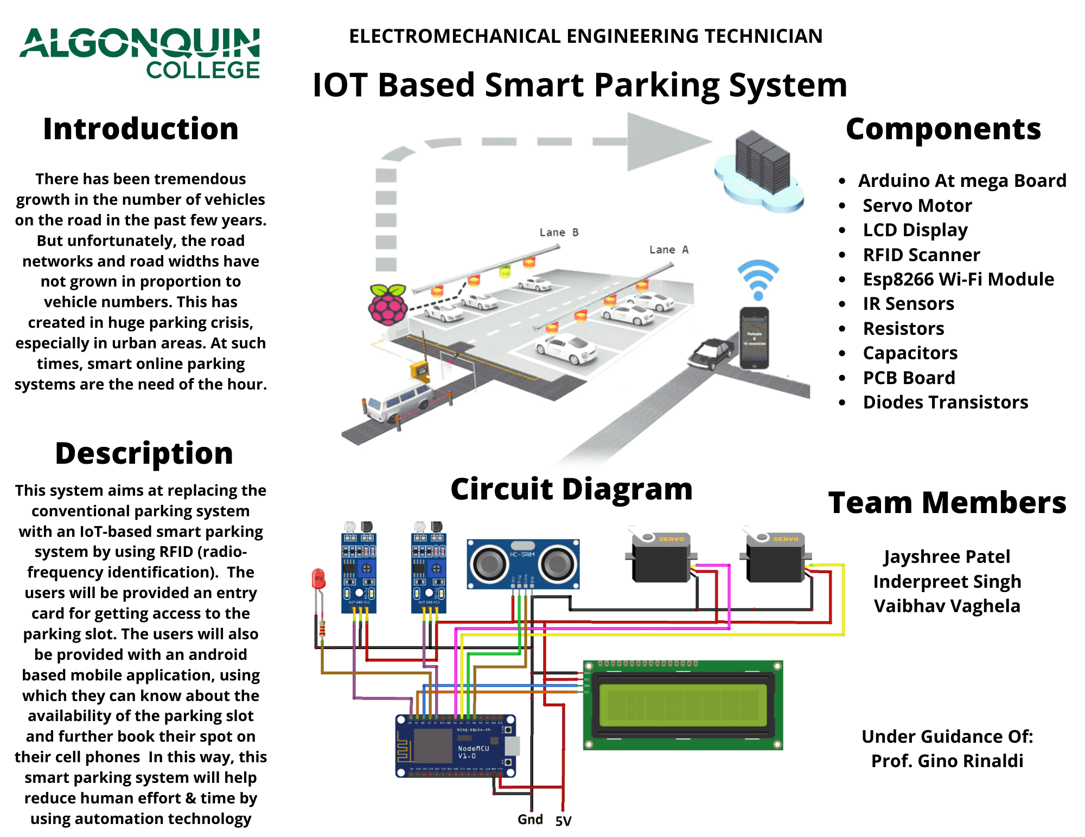
IMPLEMENTATION & WORKING
The complete process of booking a parking slot, parking a car in that slot and leaving the parking area is explained with the help of the following flow chart.

Slide 11
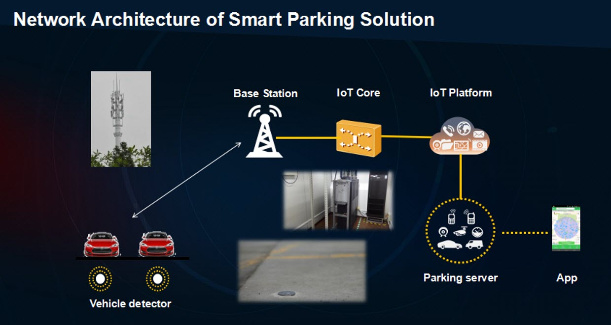

Slide 12
STEPS
Below are the steps that a driver needs to follow in order to park its car using our parking system.
Step 1: Install the smart parking application on your mobile device.
Step 2: With the help of the mobile app search for a parking area on and around your destination.
Step 3: Select a particular parking area.
Step 4: Browse through the various parking slots available in that parking area.
Step 5: Select a particular parking slot.
Step 6: Select the amount of time (in hours) for which you would like to park your car for.
Step 7: Pay the parking charges either with your e-wallet or your credit card.
Step 8: Once you have successfully parked your car in the selected parking slot, confirm your occupancy using the mobile application.

Slide 13
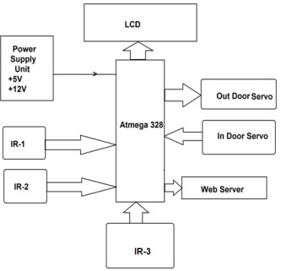

Slide 14

CONCLUSION
The concept of Smart Cities have always been a dream for humanity. Since the past couple of years large advancements have been made in making smart cities a reality. The growth of Internet of Things and Cloud technologies have give rise to new possibilities in terms of smart cities. Smart parking facilities and traffic management systems have always been at the core of constructing smart cities. In this paper, we address the issue of parking and present an IoT based Cloud integrated smart parking system. The system that we propose provides real time information regarding availability of parking slots in a parking area. Users from remote locations could book a parking slot for them by the use of our mobile application. The efforts made in this paper are indented to improve the parking facilities of a city and thereby aiming to enhance the quality of life of its people

Slide 15
THANKYOU

