Slide 1
Welcome to Gan Shmuel
PyDev Week

Slide 2
What is Gan Shmuel
A successful kibbutz near Hadera
Has the biggest juice factory in Israel:
  Citrus (“primor”)
  Tomatoes
  And more

Slide 3
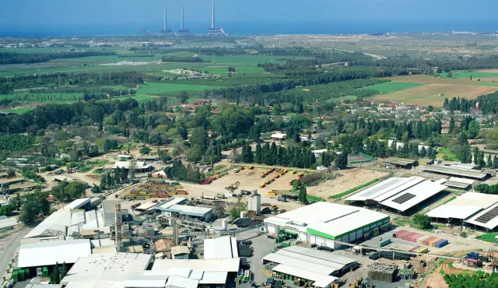

Slide 4
IT Goals for W16-2019
New weight system
  After old one broke
New producer billing system
  Following complaints from everybody
Better automation & dev ops
  For the soul, putting our feet in the water

Slide 5




Architecture
Weight
System
(Micro-service)
Provider
Payment
System
(Micro-service)
POST
weight
GET
sessions
Weight
db
Provider
db
(container tara)
(rate updates)
upload
upload
UI – Admin, Reports, Bills
admin
accounting

Slide 6
Weight System

Slide 7
The Weighing process (Trucks)
Truck enters lot
License & Container IDs registered
Weight taken (Bruto)
Truck unloads containers
Weight taken (Truck Tara)

Slide 8
The weighing process (Container)
Import from manufacturer files:
  CSV
  Json
Ad hoc weigh on site

Slide 9
APIs
REST
  POST /weight (called by new weight)
  POST /batch-weight (called by admin)
  GET /unknown (called by admin)
  GET /weight (report by time)
  GET /item/<id> (truck/container report)
  GET /session/<id> (weighing report)

Slide 10
Provider Payment Module

Slide 11
Paying Providers
Providers are paid on a daily, weekly or monthly basis. Changes by contract.
The rate per product may be global, but often specific providers have special rates for a product
A provider expects a clear report explaining the payments

Slide 12
APIs
REST
  Register provider, trucks
  Update Rates
  Get billing data for period

Slide 13
Automation & DevOPS

Slide 14
Shoot for the moon
We are moving to github
We will use a mono-repo
  3 folders
We will dockerize the services
We will implement master based CI
We will implement E2E automation

Slide 15
DevOPS vs. Team
Teams take full ownership of Docker files
Teams take full ownership of automated testing
DevOPS in charge of
  Infrastructure
  CI
  E2E testing
  Process Quality Assurance

Slide 16
Constraints

Slide 17
Technology Stack
Services: Python, Flask
Deployment: Docker and docker compose
Persistence: Team decision under CIO review
Logging: Python logging
Monitoring: Support /health
CI: Roll your own using python & bash

Slide 18
Additional Rules
Design: Team decisions under CIO review

Slide 19
Timeline
Sunday
  VCS, CI Server, /health for all services
Monday
  Weight: weight APIs
  Payment: domain management
Tuesday: Full E2E + basic Sanity
Wednesday: Full functionality
Thursday: Demo Day

Slide 20
Daily
10 AM – Daily
Every team has 20 minutes:
  (3) Where we are (what works, challenges)
  (3) What we will do today
  (14) Interesting challenge / Achievement / Demo
DO NOT end day without being prepared

Slide 21
Teams
Blue
Weight
  Alla
  Kobi
  Reuven
  Netanel
Providers
  Saar
  Gilad
  Ariel
DevOPS
  Tsachi
  Jonas
  Ofira
Green
Weight
  Jean
  Julio
  Raz
  Sharon
Providers
  Nir
  Dackar
  Imman
DevOPS
  Bruno
  Oren
  Illana

