Slide 1
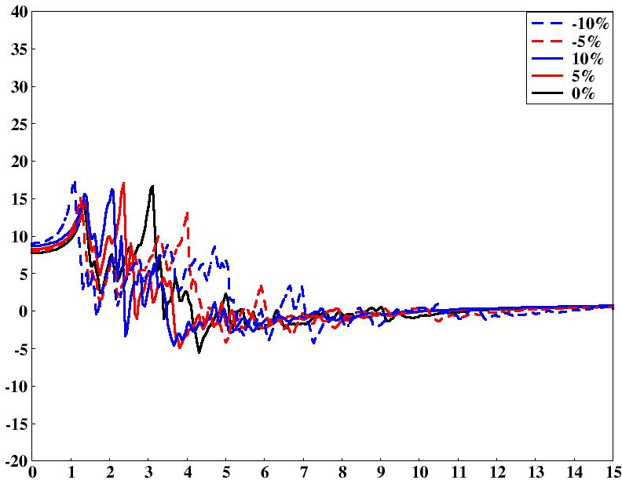
(a)
ε₁
Energy (eV)

Slide 2
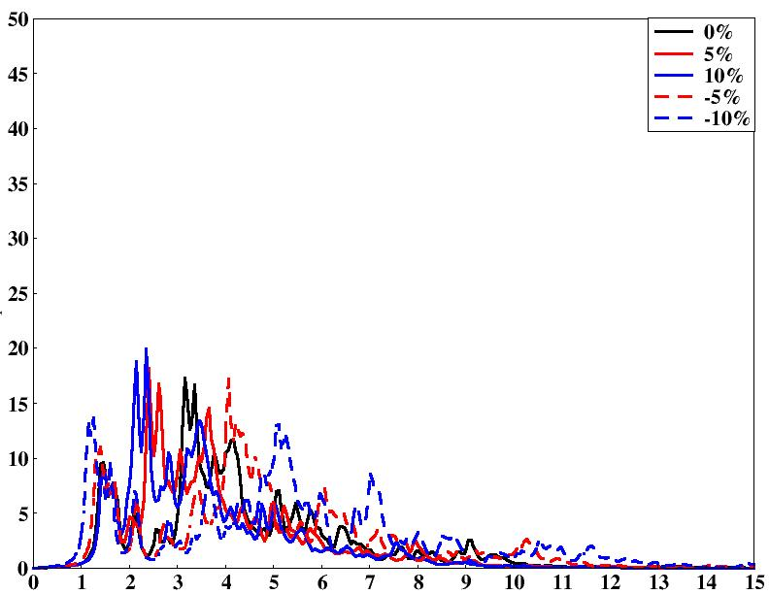
(a)
ε₂
Energy (eV)

Slide 3
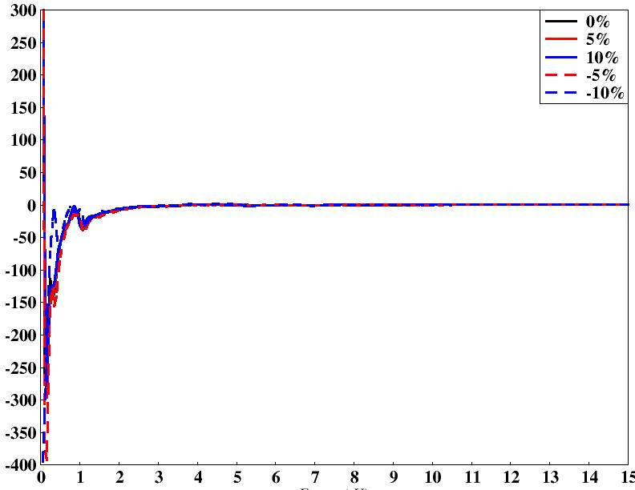
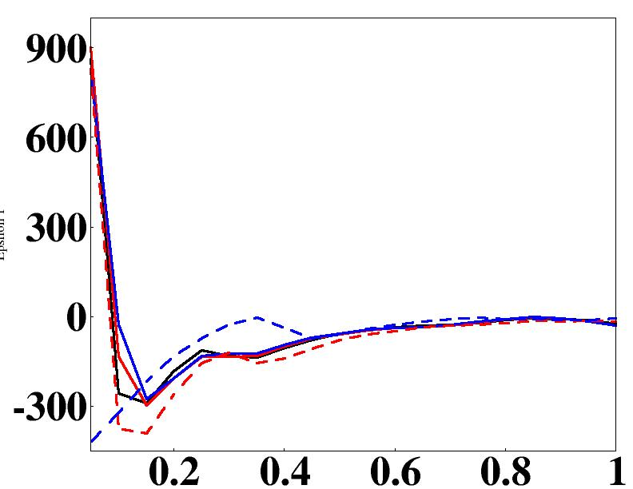
(d)
ε₁
Energy (eV)

Slide 4
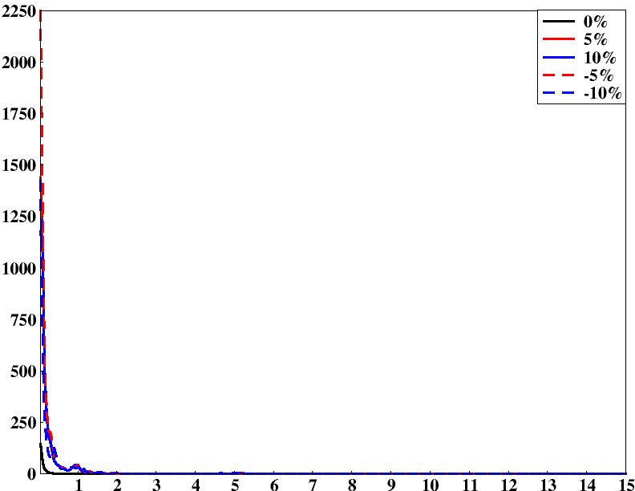
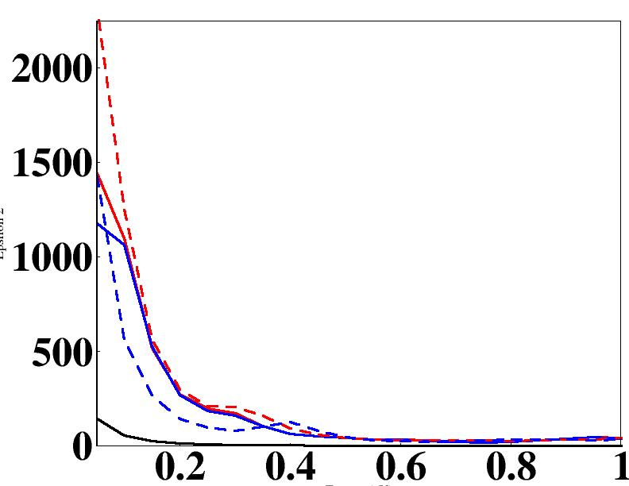
(d)
ε₂
Energy (eV)

Slide 5
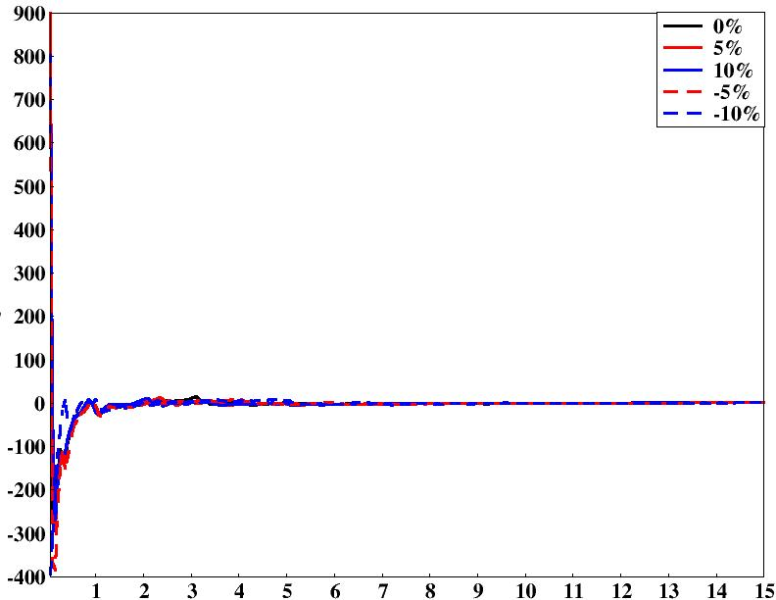
(a)
UP+ DOWN
ε₁
Energy (eV)

Slide 6
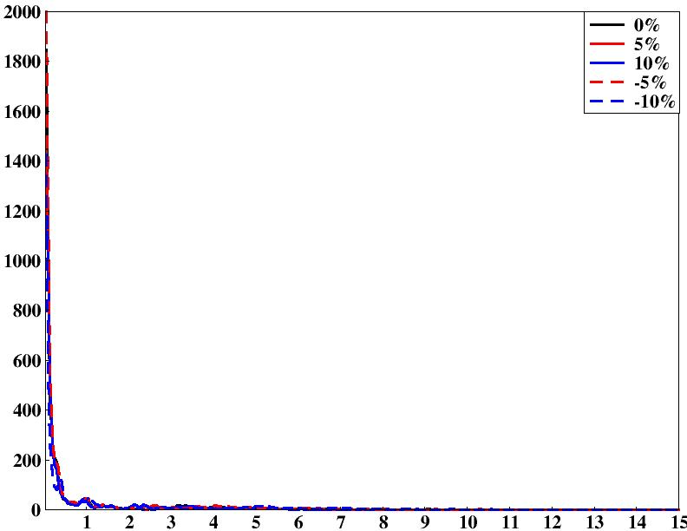
(a)
UP+ DOWN
ε₂
Energy (eV)

Slide 7
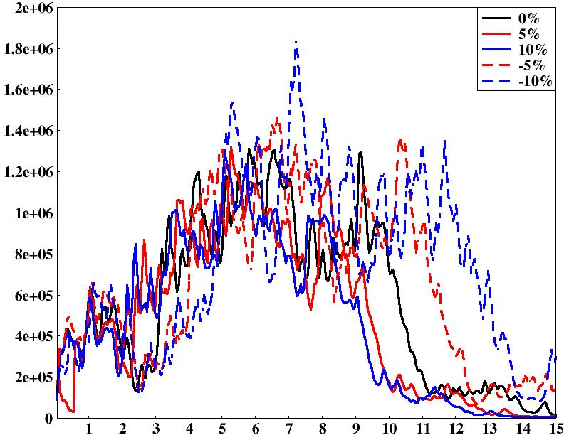
(a)
α
Energy (in eV)

Slide 8
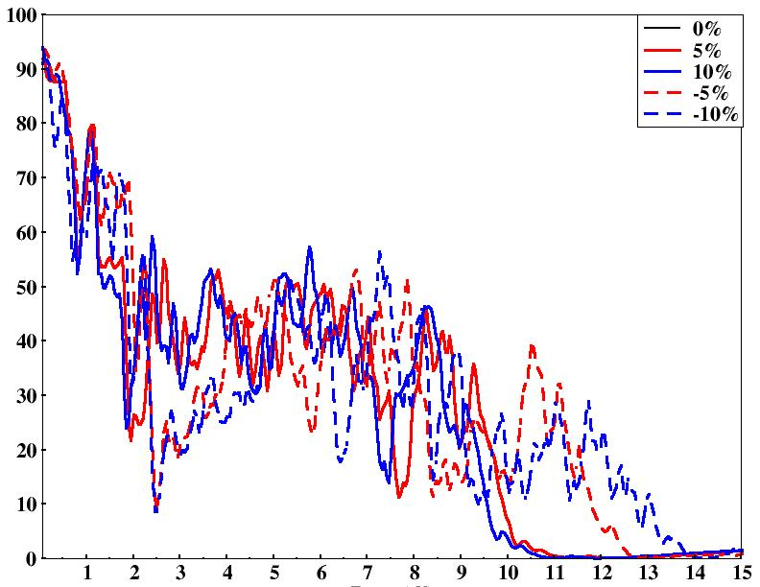
(b)
Reflectivity (in %)
Energy (in eV)

Slide 9
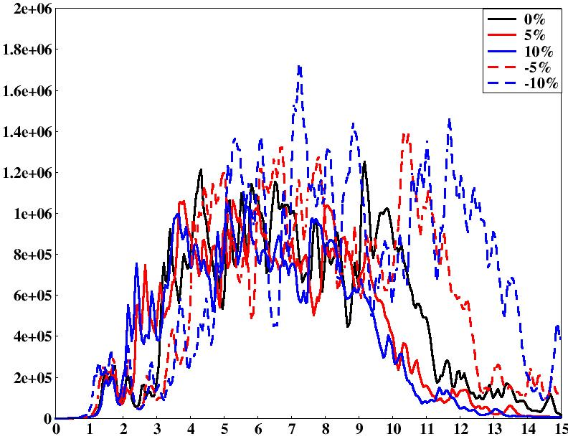
(a)
α
Energy (in eV)

Slide 10
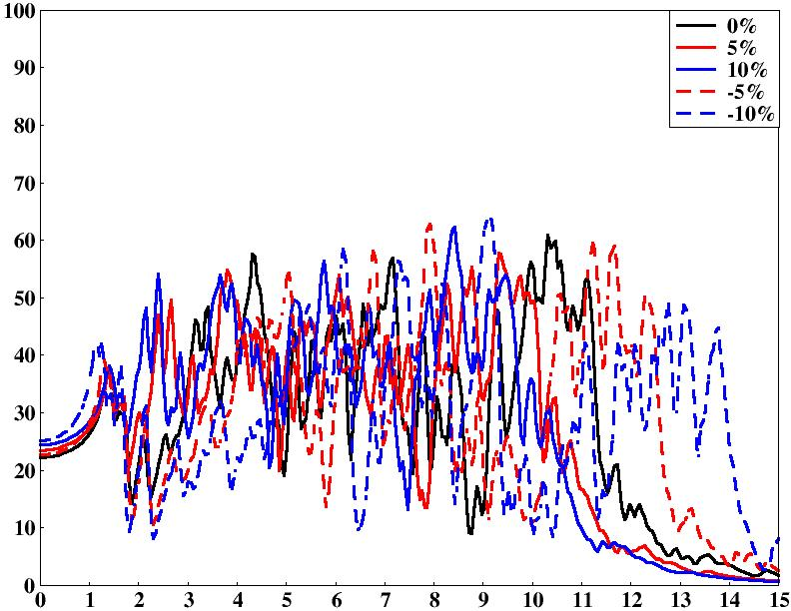
(b)
Reflectivity (in %)
Energy (in eV)

