Slide 1
Introduction to Phyloseq
Daniel Vaulot

Slide 2
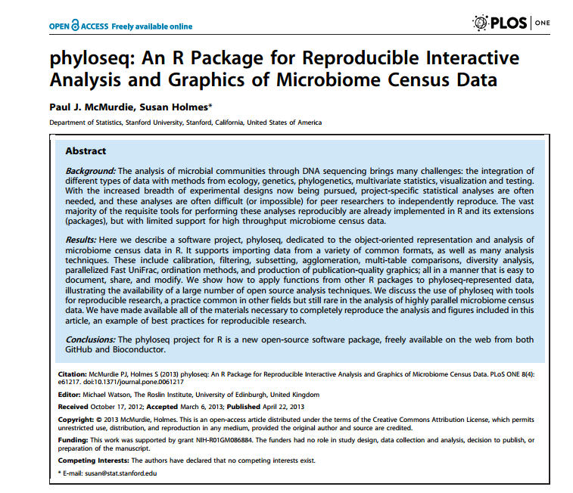

Slide 3
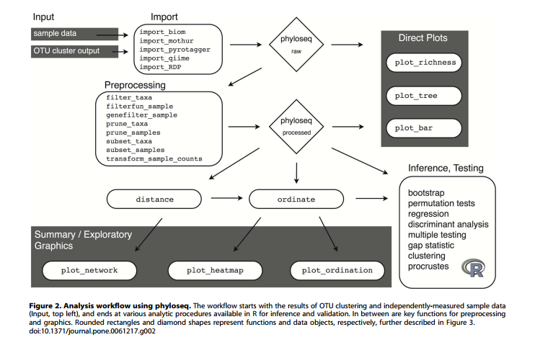

Slide 4
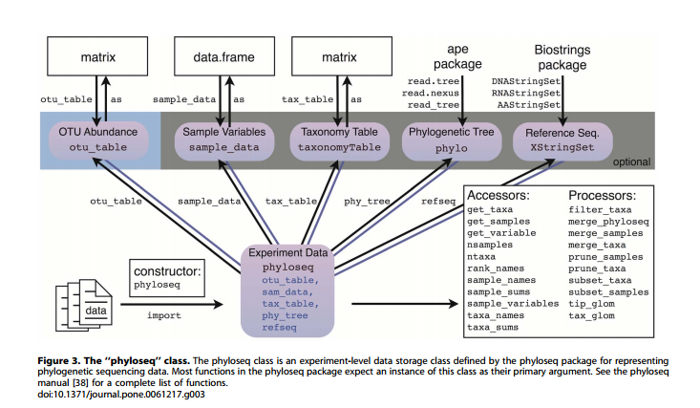

Slide 5
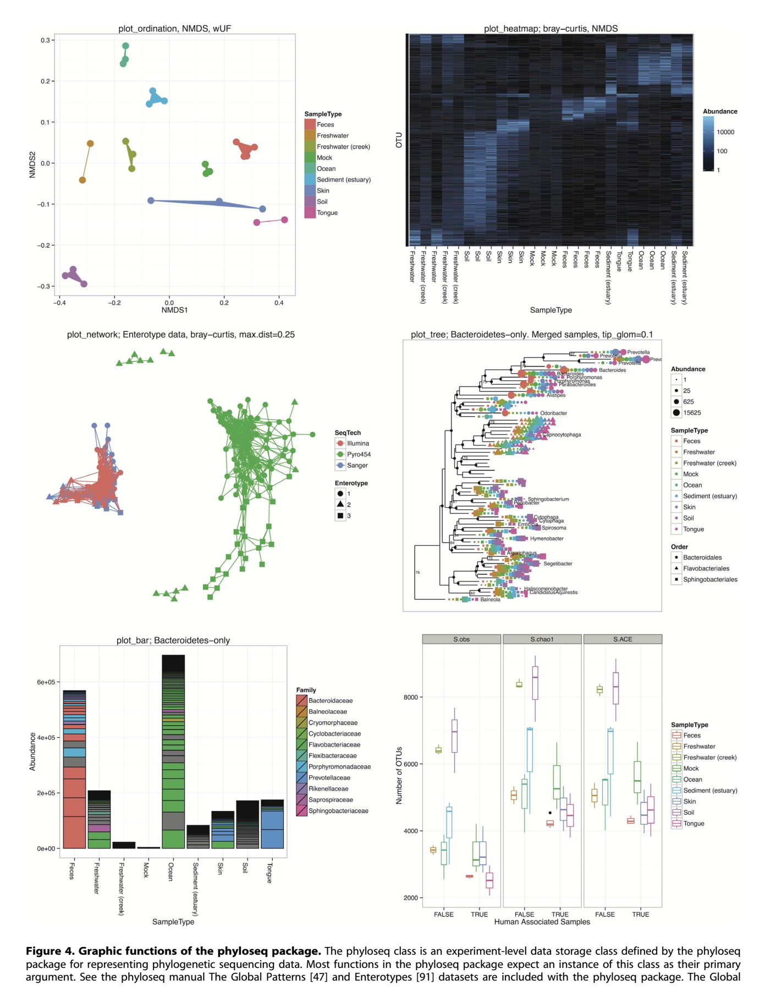

Slide 6
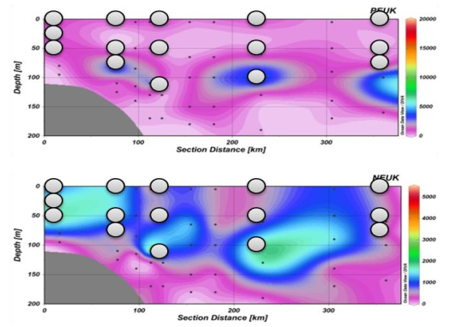
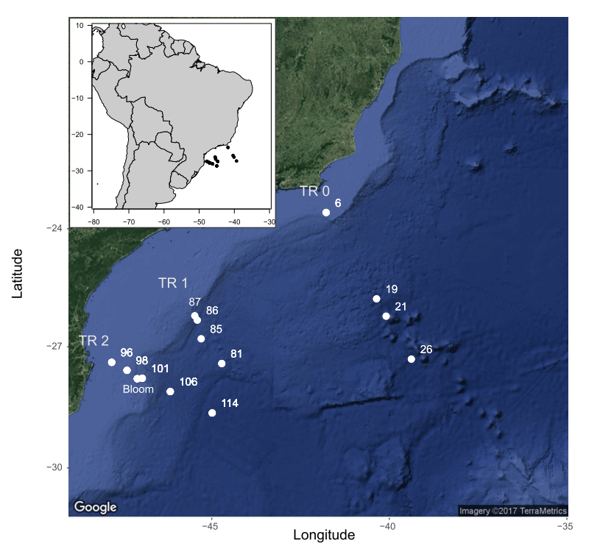
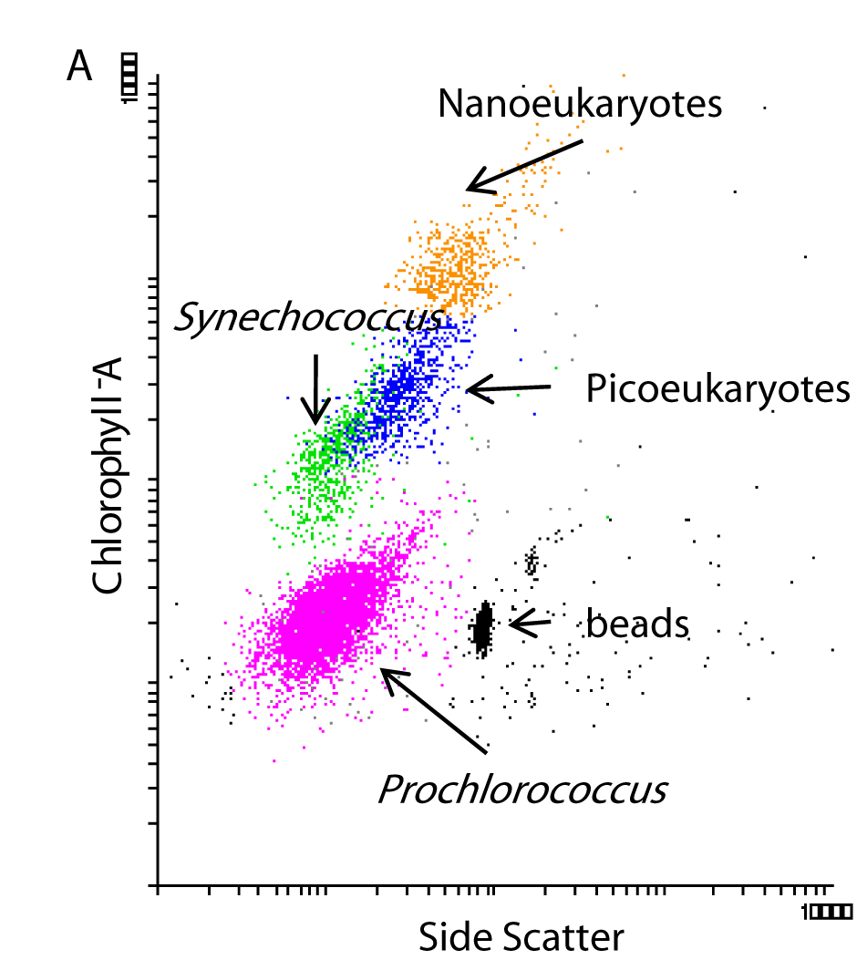
CARBOM cruise
Sorted samples
Pico vs Nano
Surf vs Deep
18S V4
Illumina 2*250 bp
C. Ribeiro and A. Lopes dos Santos, unpublished.

Slide 7
Preparation
Unzip files from phyloseq_tutorial.zip
Open « phyloseq_tutorial_01.R» with R studio

Slide 8
Import data
Necessary
OTU table
Taxonomy table
Sample variables
Optional
Tree
Sequences

Slide 9
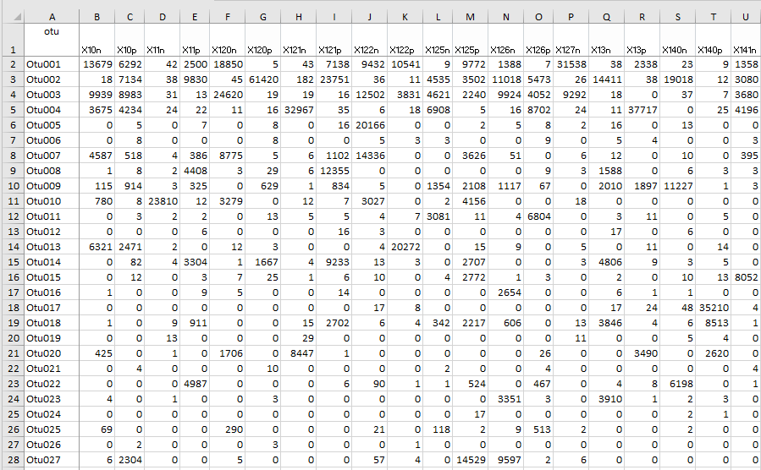
1 - Otu table

Slide 10
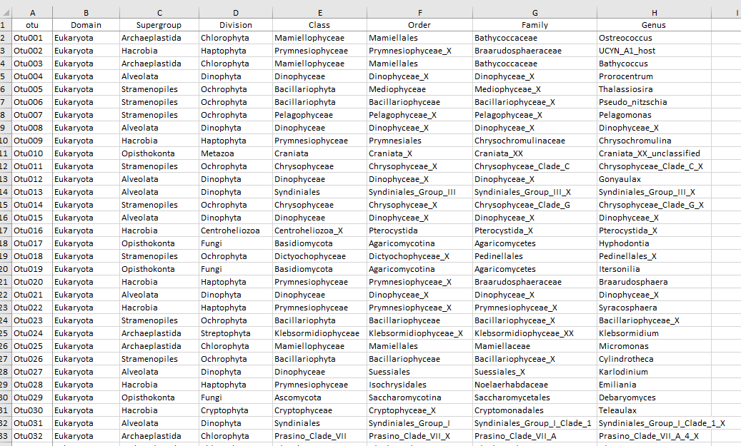
2 - Taxonomy Table

Slide 11
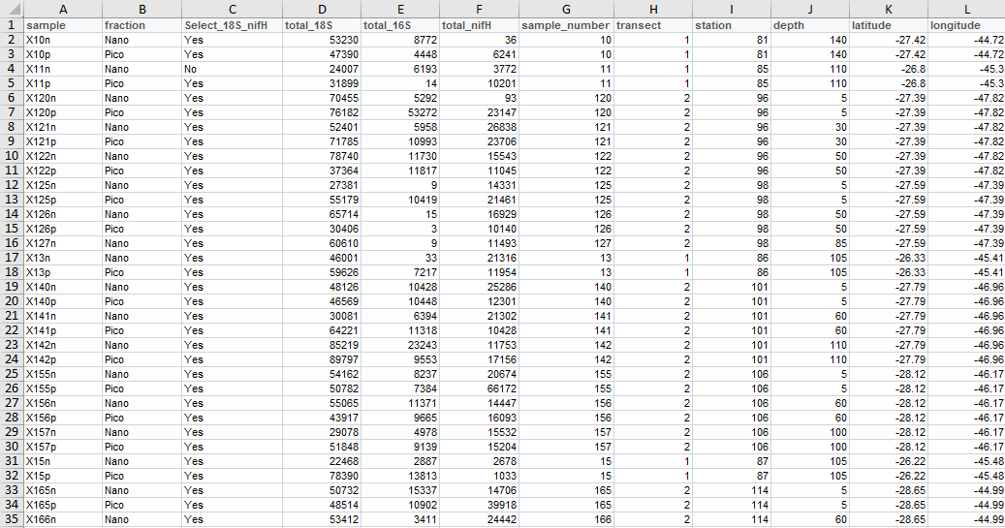
3 - Sample table

Slide 12
Steps
Import data
Combine into "phyloseq" object
Filter the data
taxonomy : e.g. only keep photosynthetic eukaryotes
samples : remove samples with low reads
abundance : remove OTUs with low abundance for some analyses
Barplots
Heatmaps
Alpha diversity
Multivariate analysis
Network analysis

Slide 13
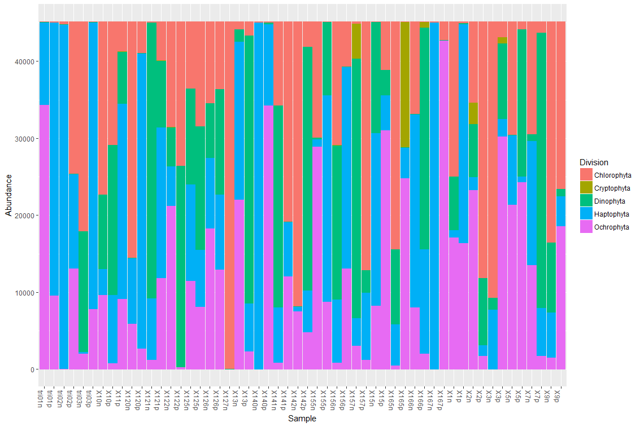
Barplots

Slide 14
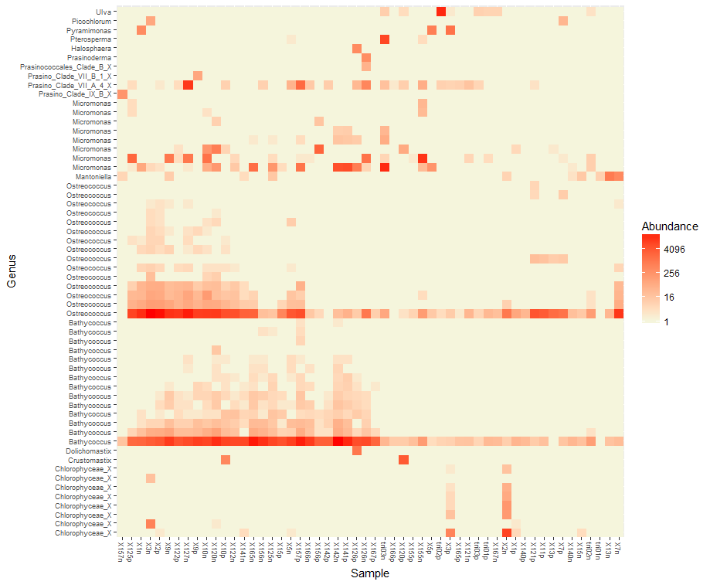
Heatmaps

Slide 15
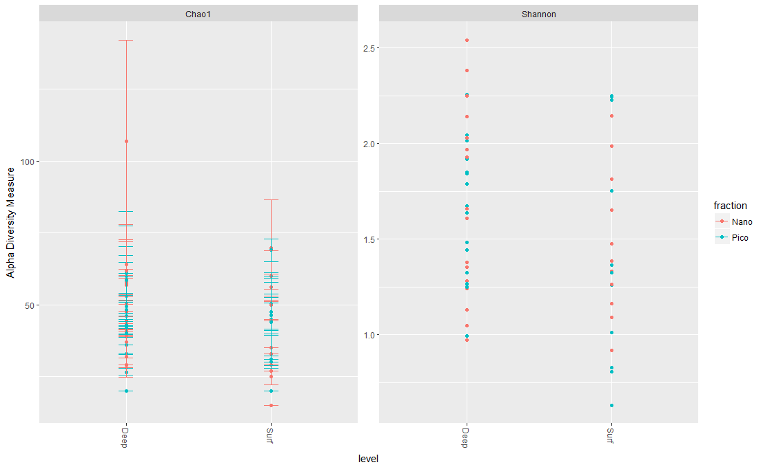
Alpha diversity

Slide 16
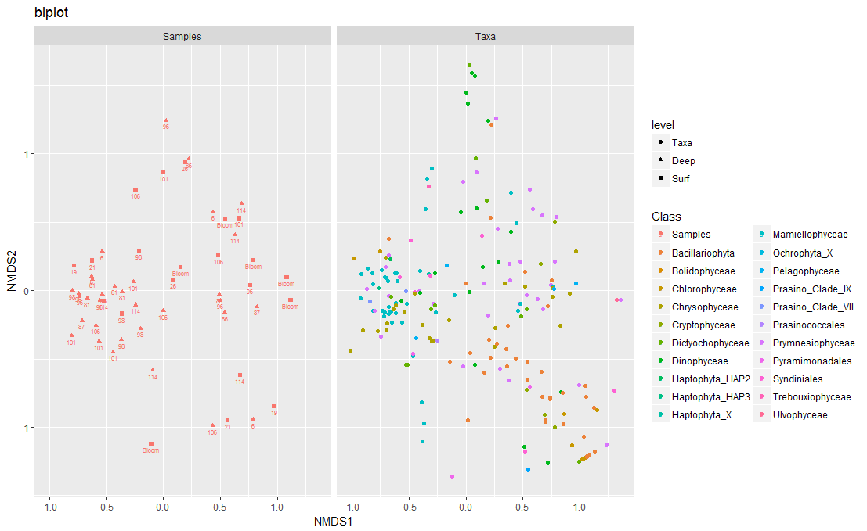
Multivariate analysis

Slide 17
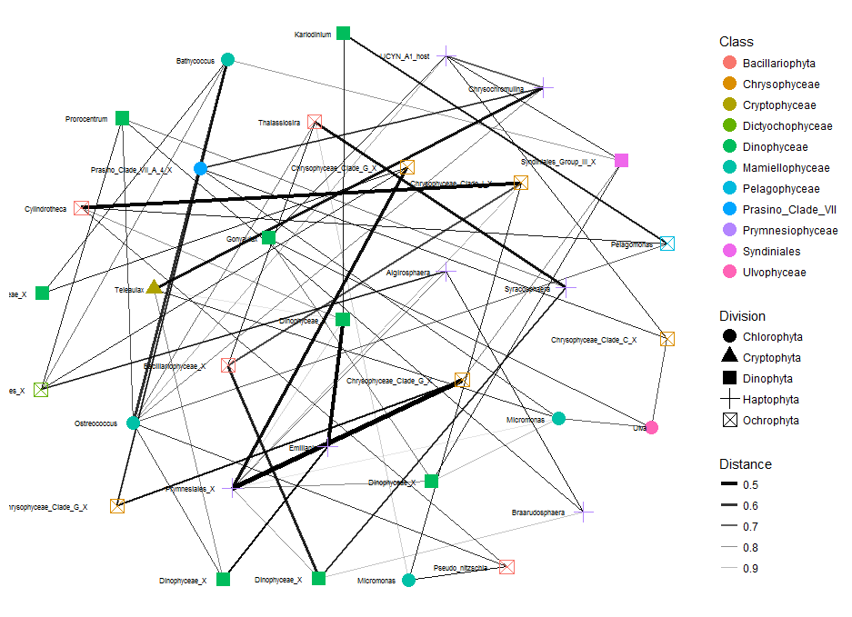
Network analysis

Slide 18
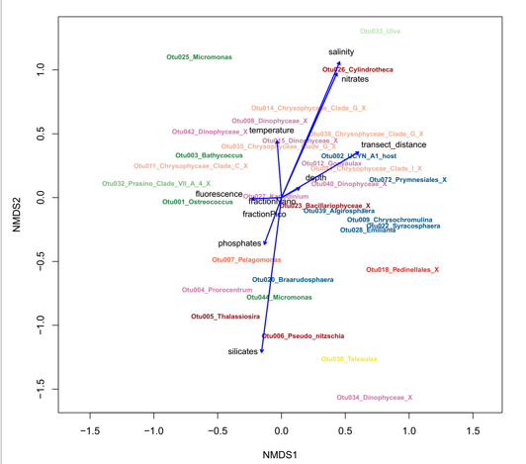
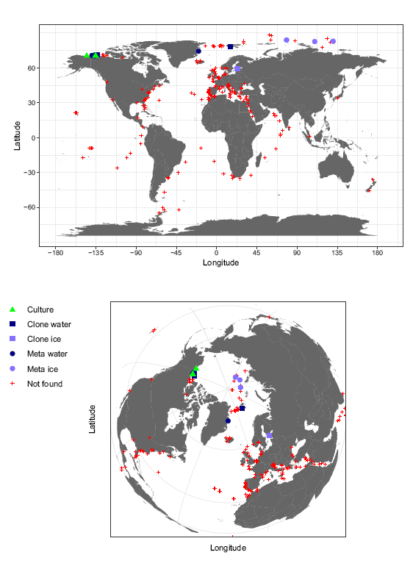
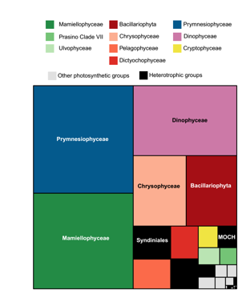
Other useful R packages
ggplot2
Best package for plotting things
vegan
Multivariate analyses
dplyr
Sorting, filtering, reformating data
maps
Plot the distribution of your data
treemaps
Summary plots
Tableau
Very intuitive software for data exploration

