Slide 1

School of Technology Management & Engineering | NMIMS Navi Mumbai
INDUSTRY PROJECT
Revora
DECISION ROWS
ACCURACY
157,519
86.28%
Dynamic Pricing & Demand Intelligence System
Generated decision-quality artifact
Time-based holdout
A MERN-based decision-support platform that turns messy sales data into explainable, guarded price recommendations.
MACRO F1
BUILD
0.7196
Passed
Class-balanced metric
Frontend production build
STUDENT
Pranay Kumar | Roll No. A149 | SAP 70022200357
PROGRAM
B.Tech Computer Engineering | Semester VIII | AY 2025-26
INTERNAL MENTOR
Dr. Preeti Gupta, STME NMIMS
INDUSTRY MENTOR
Mr. Kanwar Pal Singh Rathore, Tech Biz Solution
COMPANY
Tech Biz Solution, Jodhpur
CSV/API
Quality
Models
Guardrails
Decision

Slide 2
School of Technology Management & Engineering | NMIMS Navi Mumbai
Problem Statement
Problem Statement
Pricing data exists, but the decision workflow is usually fragmented.
Core issue
Messy spreadsheet inputs
Manual price changes can ignore demand sensitivity, inventory risk, competitor gaps, and data quality.
duplicate rows, missing cost, inconsistent products
Hidden demand response
The result is not just a bad number. It is an unaudited business decision with unclear assumptions.
price changes are not tied to quantity movement
Unsafe recommendations
no guardrails for below-cost or extreme prices
Why it matters
Retail and service businesses need price decisions that protect margin and inventory.
Managers must understand the reason for each recommendation before trusting it.
A final-year implementation project must show real workflows, not only a model.
02

Slide 3
School of Technology Management & Engineering | NMIMS Navi Mumbai
Objectives
Objectives & Expected Outcomes
Six practical goals guide the Revora implementation.
Authenticated pricing workspace
CSV ingestion and quality gate
01
02
Admin/demo login, JWT sessions, workspace-aware actions.
Mapping, staging, duplicate checks, row issues, data fitness.
Demand intelligence
Scenario simulation
03
04
Price-response models using product, segment, inventory, competitor context.
Demand, revenue, profit, confidence, and warnings for tested prices.
Guarded recommendations
Results export
05
06
Good range, avoid range, competitor distance, business objective.
Dashboards, ML Decision Space, XLSX/CSV reports for review.
Expected outcome: an examiner-ready working product with visible UI, data pipeline, explainable recommendations, measurable ML results, and exportable reports.
03

Slide 4
School of Technology Management & Engineering | NMIMS Navi Mumbai
Industry Relevance
Industry Relevance / Motivation
Revora is positioned as decision support for real business pricing, not blind automation.
1
2
3
4
Foundation
TaskOps
NewsTv19
Revora
Node, Express, MongoDB, auth
RBAC, task boards, real-time workflows
RSS ingestion, search, production codebase
pricing intelligence and decision quality
Angle | How Revora answers it
Business need | Manual pricing needs margin, demand, inventory, and competitor context.
Practical applicability | Retail catalog managers can import CSVs and review safe ranges before acting.
Market fit | Small teams want BI-style guidance without requiring a data-science operator.
Project motivation | Convert internship backend/frontend learning into one analytics product.
Panel answer cue
The system keeps a human in control: it recommends, explains, warns, and exports evidence.
04

Slide 5
School of Technology Management & Engineering | NMIMS Navi Mumbai
Existing System
Literature Survey / Existing System
The gap is not dynamic pricing as a concept; it is trusted execution for messy business data.
Approach | Strength | Limitation | Revora response
Manual Excel pricing | Fast and familiar | No model-readiness or guardrail trail | CSV import + quality labels
Generic BI dashboards | Good visualization | Shows what happened, not what price to test | Simulation + recommendation engine
Black-box price tools | Automated suggestions | Weak explainability for academic/SME review | Calculation steps + warnings
Research models | Strong theory | Often assume cleaner data than real SMEs have | Staged imports + safe ranges
Literature motivation
Design implication
Dynamic pricing learns from historical demand and price experimentation.
Treat the model as decision support.
Limited experimentation increases the need for confidence and safeguards.
Expose assumptions, constraints, and exportable evidence.
05

Slide 6
School of Technology Management & Engineering | NMIMS Navi Mumbai
Proposed System
Proposed System Architecture
A layered MERN workflow from import to auditable pricing decision.
React + Vite UI
Express API
MongoDB
Python ML Space
workspaces, dashboards, upload, simulator
auth, routes, validation, reports
products, sales, batches, models, recommendations
offline decision-quality training and prediction
Users
admin / analyst / examiner demo
CSV/API ingestion
Quality gate
Pricing engine
Reports
mapping, staging, duplicate checks
fitness score, readiness, row issues
demand model, simulation, good/avoid ranges
XLSX/CSV exports and screenshot evidence
Key flow: Import data -> verify fitness -> fit/compare models -> simulate price candidates -> apply trust policy -> store recommendation -> export report.
06

Slide 7
School of Technology Management & Engineering | NMIMS Navi Mumbai
Technology Stack
Technology Stack
Chosen for a full-stack product workflow, not only a model demo.
Frontend
Backend/API
React 19
Node.js
Vite 6
Express
Tailwind CSS 4
Mongoose
Lucide icons
Multer
Custom chart components
csv-parse
ExcelJS
Data & ML
Verification
MongoDB
Unit reliability tests
Python ML pipeline
ML self-test
scikit-learn RandomForestClassifier
Production frontend build
Generated feature dataset
Browser/API evidence
Why this stack? | Reason
MERN | Single JavaScript product layer for UI, API, and data models.
MongoDB | Flexible document storage for variable sales/import records.
Python ML | Keeps offline model training separate from explainable pricing API.
07

Slide 8
School of Technology Management & Engineering | NMIMS Navi Mumbai
Methodology
Methodology: Data-to-Decision Workflow
The implementation follows an auditable path from raw records to final recommendation.
1
2
3
4
5
6
Import
Map
Check
Model
Simulate
Recommend
CSV/API rows
headers + products
quality + readiness
price response
demand/revenue/profit
guardrails + export
Quality controls
duplicate detection, missing-cost checks, stockout exclusion, grouped demand points
Model controls
linear/log-log/context-aware choices, backtest summary, reliability labels
Decision controls
below-cost blocking, extreme-price warnings, good range, avoid range, competitor distance
08

Slide 9
School of Technology Management & Engineering | NMIMS Navi Mumbai
Implementation
Implementation Modules
The product is split into reviewable modules with clear data ownership.
Import Batch
Sales Data
Product
Real functionality implemented
tracks source, status, mapping, row counts
normalized price, quantity, segment, date
SKU, category, cost, inventory, readiness
CSV upload with field mapping and staged commit
Workspace reset and active dataset controls
Pricing insights and model-readiness checks
Scenario planner and objective-based recommendation
ML Decision Space with trained classifier metrics
Demand Model
Recommendation
Assistant Decision
XLSX + CSV report exports
model type, coefficients, backtest metrics
tested prices, expected outcomes, trust label
chat-derived pricing decisions and labels
Most important viva point
The recommendation is not stored as a number only; it stores evidence, assumptions, warnings, and tested alternatives.
09

Slide 10
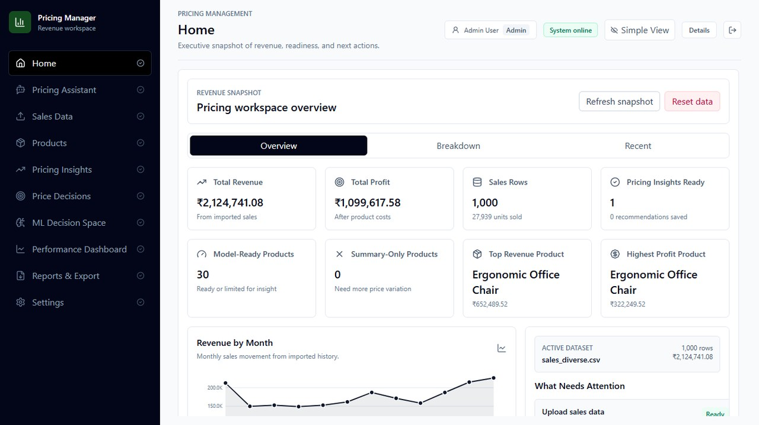
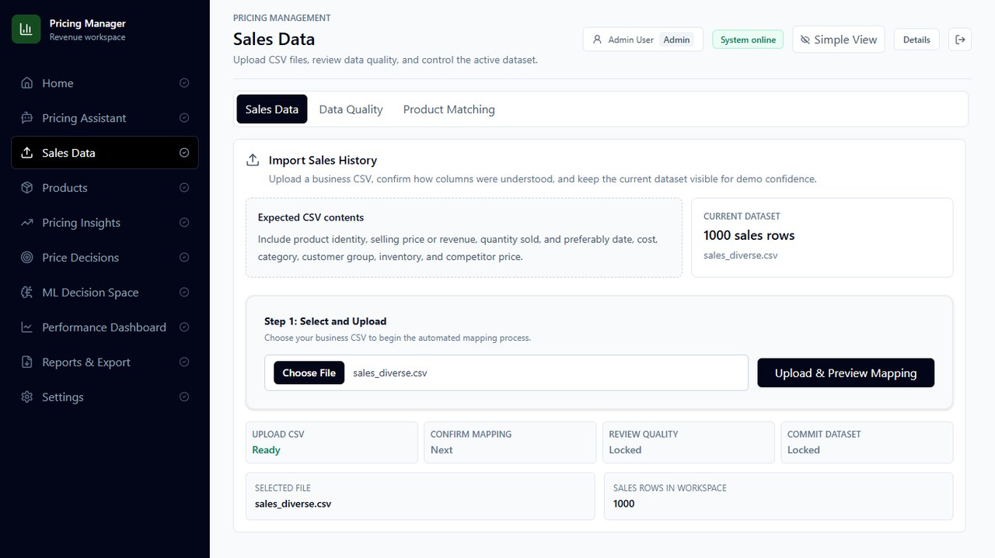
School of Technology Management & Engineering | NMIMS Navi Mumbai
Implementation Evidence
Implementation Screenshots: Workspace & Import
Real UI evidence from the Revora local browser session.
Home workspace
Revenue snapshot, model-ready products, active dataset, and dashboard navigation.
Sales data upload
CSV selection, preview mapping, quality review, and commit pipeline.
Demo talking point: start with dataset reset, upload sales_diverse.csv, then show how Revora converts rows into pricing-ready product groups.
10

Slide 11
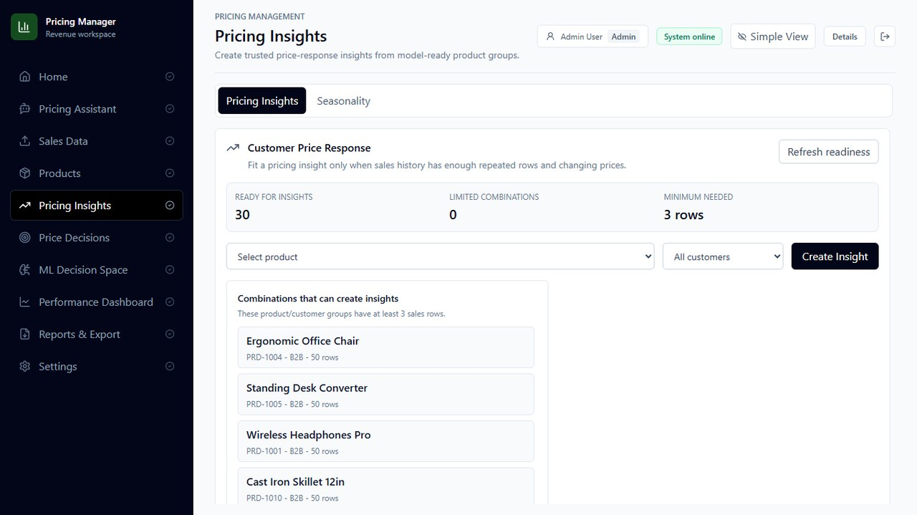
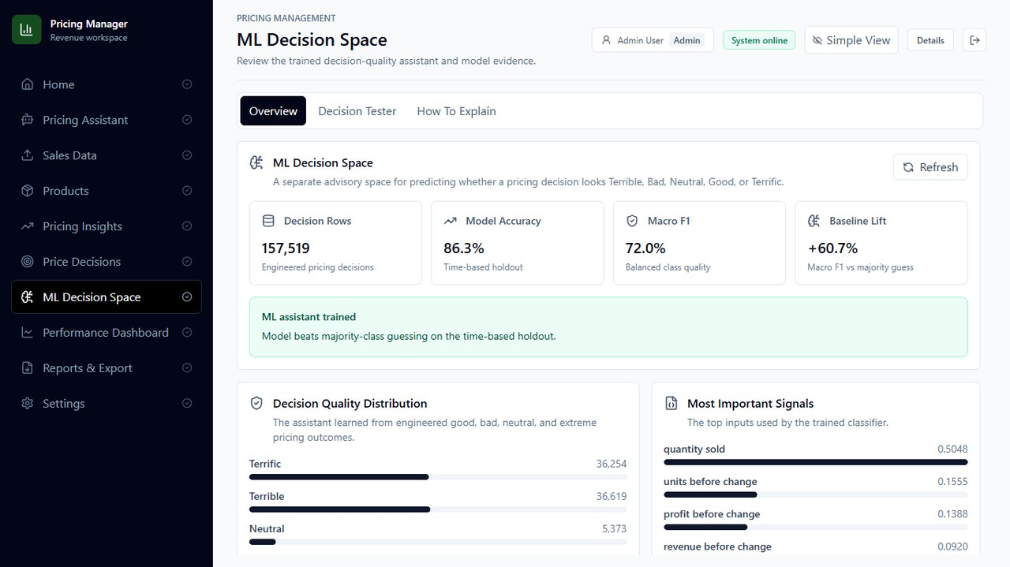
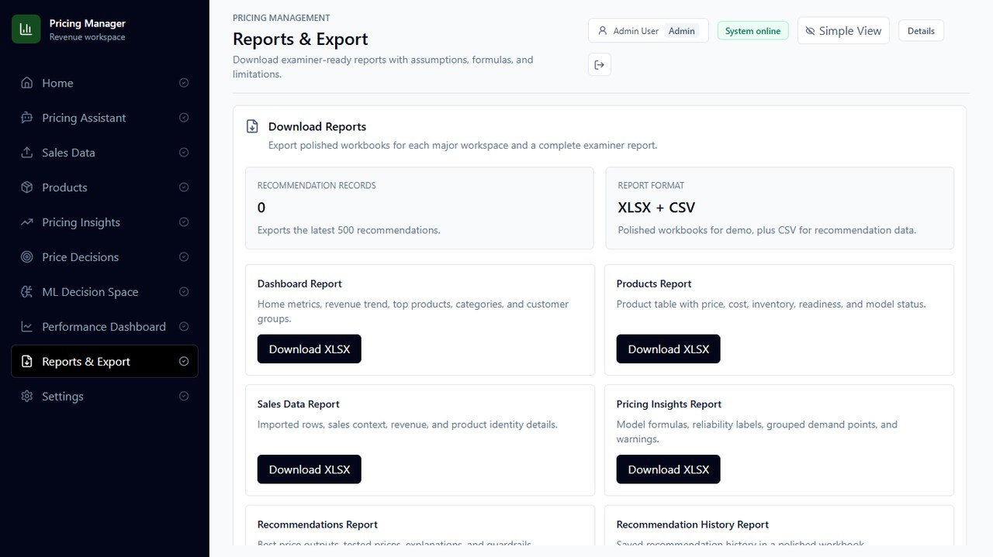
School of Technology Management & Engineering | NMIMS Navi Mumbai
Feature Evidence
Implementation Screenshots: Insights, ML & Reports
Three examiner-visible surfaces prove the pipeline is not just backend code.
Pricing Insights
ML Decision Space
Reports & Export
30 ready combinations, product selection, price-response creation
157,519 decision rows, 86.3% UI accuracy, feature signals
XLSX/CSV reports for dashboard, products, sales, insights
Real functionality over theory
The screenshots align directly with the demo path: create insight -> inspect ML evidence -> export report.
11

Slide 12
School of Technology Management & Engineering | NMIMS Navi Mumbai
Results
Results & Analysis
The final report includes measured ML output and local verification evidence.
TOTAL ROWS
TRAINING ROWS
TESTING ROWS
ACCURACY
MACRO F1
157,519
126,015
31,504
86.28%
0.7196
Generated decision-quality dataset
Used for model fitting
Time-based holdout
Overall classification
Balanced class quality
Decision-quality label distribution
Check | Method | Result
ML pipeline | npm run test:ml-pipeline | Passed
Reliability suite | npm run test:reliability | Passed
Frontend build | npm run build | Passed with large chunk warning
UI evidence | Browser screenshots | Captured
Interpretation
The ML result is prototype evidence: useful for viva demonstration, but real client transaction data is required before autonomous production pricing.
12

Slide 13
School of Technology Management & Engineering | NMIMS Navi Mumbai
Challenges
Challenges Faced, Risk Controls & Failure Testing
The hardest part was making recommendations safe enough to explain.
Challenge | What was done | Panel answer
Varied CSV data | field mapping, staging, duplicate checks | Bad data is stopped before modeling
Sparse price variation | readiness labels and grouped demand thresholds | Some products remain summary-only
Unsafe prices | cost guardrails, range warnings, avoid band | Below-cost and extreme prices are flagged
API/server failure | health route, user-visible errors, local demo backup | Demo can continue with screenshots/recording
Performance growth | build check plus future code splitting | Large chunk warning is known and scoped
Security
Scalability
Trust
JWT auth, protected routes, API-key ingestion path
MongoDB indexes, staged imports, report exports
fitness score, warnings, model limits, human review
13

Slide 14
School of Technology Management & Engineering | NMIMS Navi Mumbai
Future Scope
Scalability & Future Scope
Next work moves Revora from examiner-ready prototype toward production decision support.
Now
Near term
Scale
Production
Local MERN demo, CSV workflow, guarded recommendations
Real client transaction training + A/B testing
ERP/POS imports, marketplace connectors, scheduled reports
cloud deployment, stronger policies, code splitting
Priority | Enhancement | Benefit
High | Train with real client data | Improves reliability and production relevance
High | Controlled price experiments | Separates correlation from elasticity
High | Route-level code splitting | Improves frontend load performance
Medium | ERP/POS imports | Reduces manual CSV dependency
Medium | Fairness and max-change policies | Prevents unsafe automation
Commercial opportunity
Revora can become a lightweight pricing cockpit for SMEs that need evidence-backed decisions before they can invest in enterprise pricing suites.
14

Slide 15
School of Technology Management & Engineering | NMIMS Navi Mumbai
Conclusion
Conclusion, Demo Plan & References
Final outcome: an auditable pricing-intelligence product with real implementation evidence.
Conclusion
Demo backup
Revora demonstrates a complete data-to-price workflow: import, clean, model, simulate, recommend, explain, and export.
Working local build and browser path
Offline screenshots in this deck
Recorded demo backup recommended
Internet backup for deployment/docs
Reference | Source
[1] | Node.js, Express, React, Vite, MongoDB, Mongoose documentation
[2] | Tailwind CSS and scikit-learn documentation
[3] | den Boer, Dynamic pricing and learning, 2015
[4] | Cheung, Simchi-Levi, Wang, Dynamic pricing with limited experimentation
[5] | Revora source code and final project report, May 2026
Viva close
My contribution: MERN implementation, CSV/data quality workflow, pricing logic, ML Decision Space integration, reports, testing, and documentation.
15

