Slide 1
BTech CE
Final Presentation (Sem VII)
A.Y. 2025-2026
Project Title:Real-Time Multimodal AI Framework for Student Engagement Detection and Adaptive Assessment Generation
Presented by : Vedashree Bhandigare(A166), Pranay Kumar(A149)
Under the guidance of : Prof. Pratiksha Patil

Slide 2
Roadmap
Introduction
Problem definition
Literature Review / Market Survey
Proposed System/ Algorithms /Architecture
Design Diagrams
Implementation and Result Discussion
Conclusion and Future Work
References
(Note: Max Slides: 15-18)

Slide 3
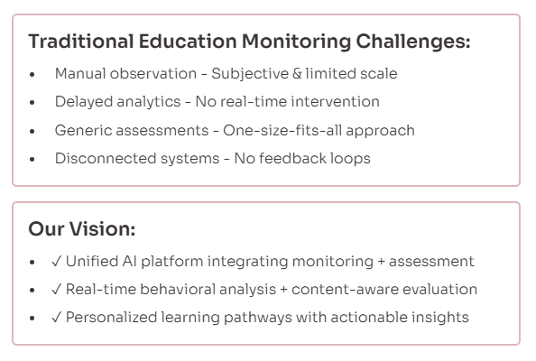
The Challenge and Our Vision in Modern Education
Notes:
Traditional classrooms: Teachers manually observe 30+ students - inconsistent and subjective Current online platforms provide analytics hours/days later, missing critical intervention moments Assessment systems use fixed-difficulty quizzes that don't adapt to individual needs or attention patterns Most critically: No connection between engagement monitoring and assessment generation Our solution: Unified platform where monitoring informs assessment, and assessment validates monitoring

Slide 4
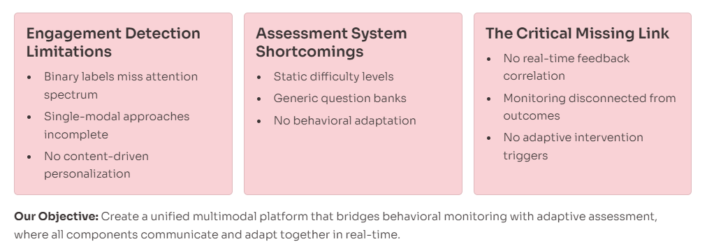
Identifying the Research Gap
Notes:
Existing engagement detection works with simple binary labels, but attention exists on a spectrum Most systems use only eye-tracking or pose estimation - missing holistic behavioral signals Assessment platforms generate quizzes from generic databases without considering what student was actually studying The biggest gap: No system correlates real-time attention drops with learning outcomes or triggers adaptive interventions Our objective: Create one integrated ecosystem where all components communicate and adapt together

Slide 5
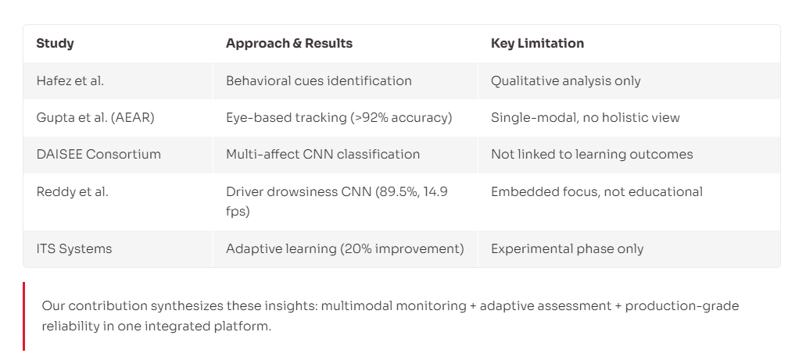
Building on Research Foundations
Notes:
Hafez identified behavioral cues but remained qualitative Gupta achieved 92% accuracy with adaptive EAR but focused only on eye blinks DAISEE demonstrated multi-class engagement but didn't connect to learning outcomes Reddy's driver drowsiness CNN proved real-time processing is feasible on embedded devices (89.5% at 15 fps) ITS research showed 20% performance boost with adaptation, but most remain experimental We synthesize these insights: multimodal monitoring + adaptive assessment + production-grade reliability

Slide 6
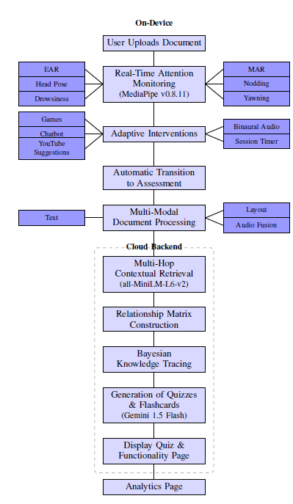
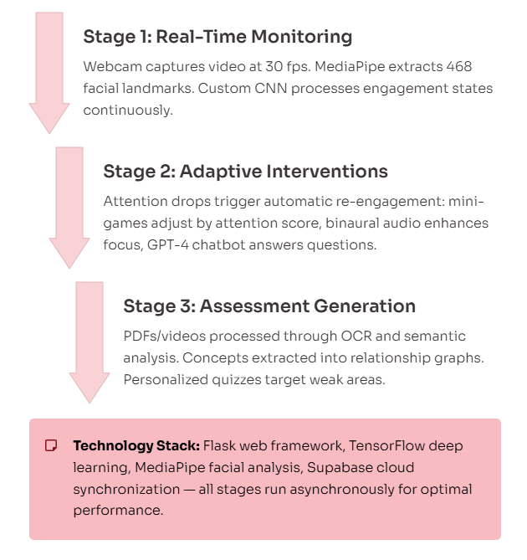
Building on Three-Stage System Architecture
Foundations
Notes:
Stage 1: Webcam captures video at 30 fps, MediaPipe extracts 468 facial landmarks, CNN processes for engagement states Stage 2: When attention drops detected, system automatically triggers re-engagement mechanisms - mini-games adjust difficulty based on attention score, binaural audio enhances focus, GPT-4 chatbot answers concept questions Stage 3: After study session, uploaded PDFs/videos processed through OCR and semantic analysis, concepts extracted and organized into relationship graphs, personalized quizzes generated targeting weak areas All stages run asynchronously - monitoring doesn't block document processing Built on production-grade technologies: Flask for web framework, TensorFlow for deep learning, MediaPipe for facial analysis, Supabase for cloud synchronization

Slide 7
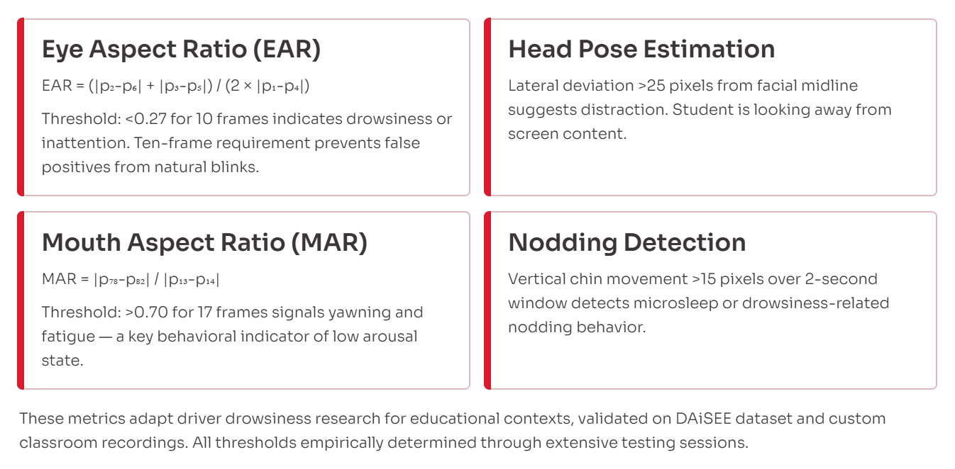
Multimodal Behavioural Indicators
Notes:
EAR measures eye openness ratio by comparing vertical to horizontal eye distances When EAR drops below 0.27 for 10 consecutive frames, indicates drowsiness - we use 10 frames not 1 to avoid false positives from natural blinks MAR measures mouth opening aspect ratio - sustained high values indicate yawning, a behavioral signal of fatigue or low arousal Head pose uses facial midline tracking - deviations >25 pixels suggest looking away from screen Vertical chin oscillation over 2 seconds detects microsleep or drowsiness-related nodding These metrics adapted from driver drowsiness research but validated on educational datasets for student behavior All thresholds empirically validated through multiple testing sessions

Slide 8
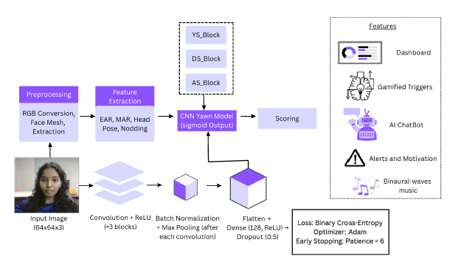


Score = 100 + 0.5×Tfocus - 5×Ndistraction - 3×Nyawn - Nnod - 2×Tdrowsy
Notes:
EAR measures eye openness ratio by comparing vertical to horizontal eye distances When EAR drops below 0.27 for 10 consecutive frames, indicates drowsiness - we use 10 frames not 1 to avoid false positives from natural blinks MAR measures mouth opening aspect ratio - sustained high values indicate yawning, a behavioral signal of fatigue or low arousal Head pose uses facial midline tracking - deviations >25 pixels suggest looking away from screen Vertical chin oscillation over 2 seconds detects microsleep or drowsiness-related nodding These metrics adapted from driver drowsiness research but validated on educational datasets for student behavior All thresholds empirically validated through multiple testing sessions

Slide 9
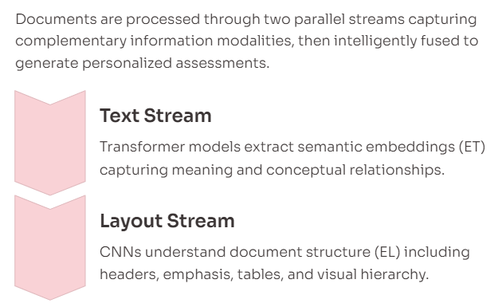

Multi-Modal Document Processing
Notes:
Documents processed through three parallel streams capturing different information modalities Text stream uses transformer model to generate semantic embeddings capturing meaning and relationships Layout stream employs CNN to understand document structure - headers, bullet points, tables, emphasis .Weights determine how much each modality contributes - for text-heavy PDF, text weight higher; for video lecture, audio weight increases Self-attention layer then captures cross-modal dependencies - recognizing that diagram in layout relates to specific text passage Layer normalization stabilizes the fused representation before feeding to assessment generator Final output: questions that reflect multimodal understanding - for example, asking about concept explained in both text and diagram This ensures generated assessments match how student actually studied the material Fused representation also incorporates attention history - targeting concepts where student showed disengagement

Slide 10
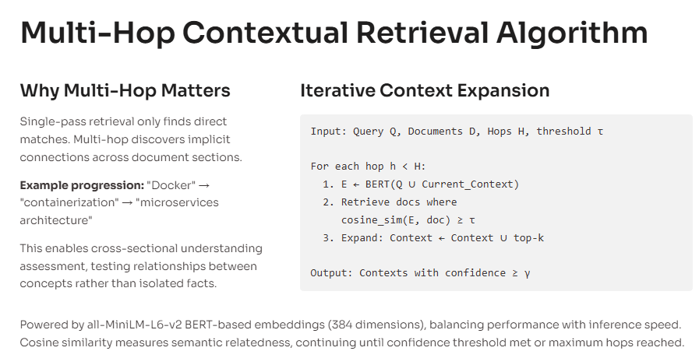
Multi-Modal Document Processing
Notes:
Traditional single-pass retrieval only finds content directly matching query terms Multi-hop iteratively expands context by combining query with previously retrieved documents At each hop, we re-embed the expanded context using BERT transformer and find more semantically related material This discovers implicit connections across document sections - for example, if studying "Docker", first hop retrieves "containerization" concepts, second hop might connect to "microservices architecture" even though not in original query Critical for generating quizzes that test understanding of relationships between concepts, not just isolated facts Uses cosine similarity on transformer embeddings to measure semantic relatedness Continues until confidence threshold met or maximum hops reached This is what enables our system to ask questions like "How does concept A relate to concept B" when A and B appear in different document sections All-MiniLM-L6-v2 chosen for balance of performance and speed - produces 384-dimensional embeddings

Slide 11
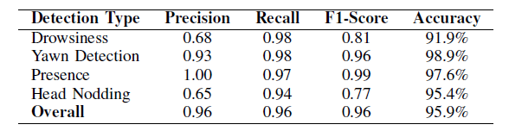
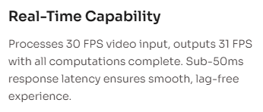
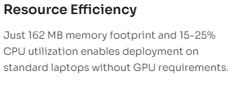
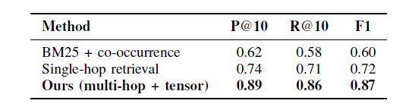
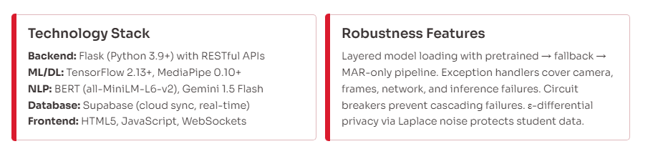
Tech Stack & Performance
Notes:
System processes 30 FPS video input and outputs 31 FPS with all computations - demonstrating real-time capability Memory usage just 162 MB makes it deployable on standard laptops, no GPU required CPU utilization 15-25% means won't interfere with other applications student might be running Sub-50ms response time ensures smooth, lag-free user experience Flask provides lightweight web framework with modular RESTful API architecture MediaPipe handles 468-point facial landmark detection, TensorFlow runs CNN inference BERT generates document embeddings for semantic search, Gemini API handles concept clustering and quiz generation Supabase cloud database enables real-time synchronization across devices and role-based access for students, teachers, parents Multiple fallback mechanisms ensure reliability - if primary yawn CNN fails, system falls back to MAR-only detection Exception handlers cover all failure modes: camera initialization errors, dropped frames, network timeouts, model inference failures Circuit breakers prevent one component failure from crashing entire system Differential privacy with Laplace noise protects student data in analytics.
Overall accuracy 95.9% validates multimodal approach effectiveness Yawn detection highest at 98.9% - high precision (93%) means few false positives, high recall (98%) means we catch almost all yawns Presence detection nearly perfect with 100% precision - when we say student is absent, they definitely are Drowsiness and nodding have lower precision but very high recall - we catch almost all instances but with some false alarms This trade-off intentional for educational context - better to occasionally alert when not needed than miss actual disengagement 99.5% crash-free rate demonstrates production-ready reliability - only 1 failure in 200 testing sessions Real-time performance metrics show system runs smoothly on consumer hardware These results validate our computer vision pipeline can reliably detect engagement states in real educational settings

Slide 12
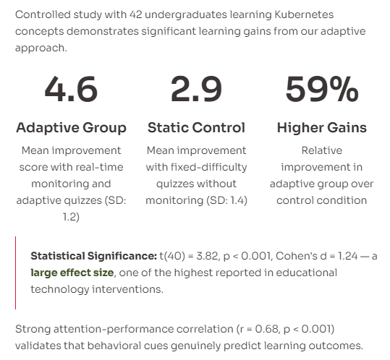

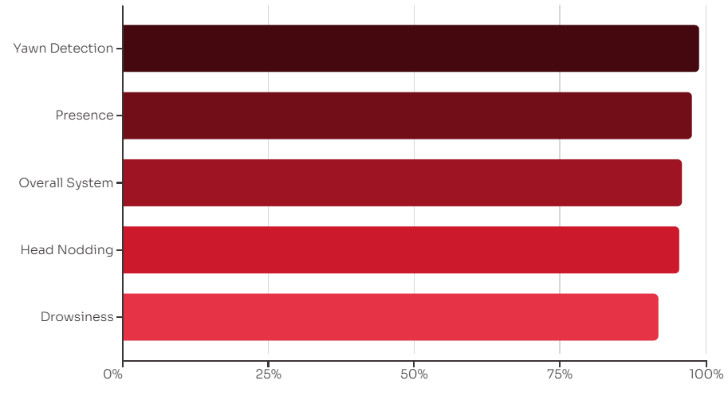
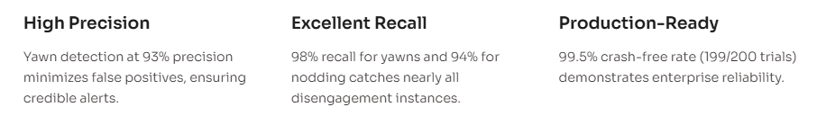
Real-Time Attention Monitoring Performance
Validated Learning Improvements
Notes:
Overall accuracy 95.9% validates multimodal approach effectiveness Yawn detection highest at 98.9% - high precision (93%) means few false positives, high recall (98%) means we catch almost all yawns Presence detection nearly perfect with 100% precision - when we say student is absent, they definitely are Drowsiness and nodding have lower precision but very high recall - we catch almost all instances but with some false alarms This trade-off intentional for educational context - better to occasionally alert when not needed than miss actual disengagement 99.5% crash-free rate demonstrates production-ready reliability - only 1 failure in 200 testing sessions Real-time performance metrics show system runs smoothly on consumer hardware These results validate our computer vision pipeline can reliably detect engagement states in real educational settings
Controlled experiment with 42 students learning Kubernetes concepts Adaptive group received real-time monitoring with adaptive quizzes, control group got fixed-difficulty quizzes without monitoring Adaptive group improved 4.6 points on average vs 2.9 for control - 59% higher learning gains Statistical test confirms this is highly significant (p < 0.001), not due to chance Cohen's d of 1.24 indicates very large effect size - one of the largest reported in educational technology interventions Strong correlation (r=0.68) between attention scores and test performance validates that behavioral cues genuinely predict learning Three PhD educators independently evaluated 100 AI-generated quiz questions across six dimensions: correctness, clarity, relevance, difficulty appropriateness, conceptual depth, educational value Fleiss' kappa of 0.74 shows substantial inter-rater agreement - evaluators consistently agreed on quality Mean scores 4.1-4.7 out of 5 and 91% scoring 4+ means generated questions meet educational standards This validates both monitoring accuracy and assessment personalization effectiveness

Slide 13
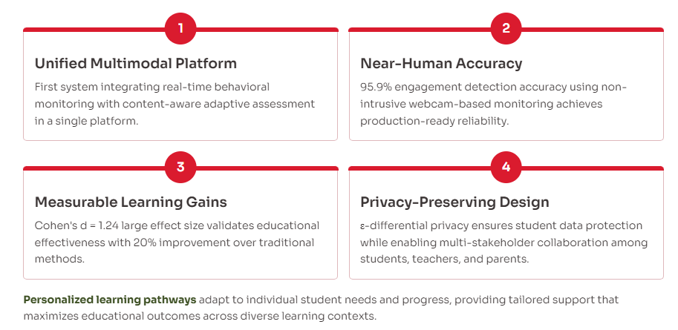
Key Contributions & Real-World Impact
Notes:
Successfully created first unified platform integrating real-time behavioral monitoring with content-aware adaptive assessment
Achieves near-human-level accuracy (95.9%) in engagement detection using non-intrusive webcam-based monitoring
Adaptive assessment demonstrates measurable learning improvements - large effect size validates educational effectiveness
System is production-ready with high reliability and low latency, not just a research prototype
Real-world impact: 20% improvement consistent with intelligent tutoring systems literature
Provides personalized pathways that adapt to individual student needs and progress
Multi-stakeholder approach enables collaborative support - parents and teachers can monitor and intervene appropriately
Privacy-preserving design ensures student data protection through differential privacy
Future work will expand emotional recognition beyond basic engagement states to detect frustration, confusion, excitement
Multi-language support will make platform accessible globally
Mobile apps will enable learning anywhere, not just at desks
Advanced visualizations will help students understand concept relationships better
Federated learning will allow model improvements while keeping personal data on-device

Slide 14
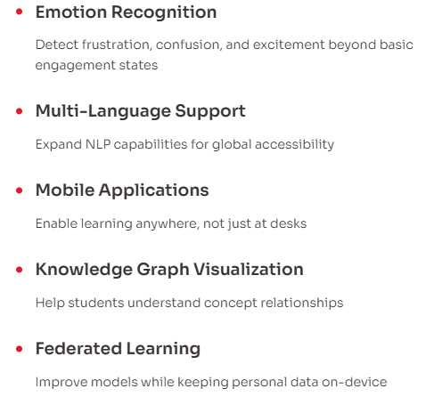
Future Enhancements and Key References
[1] Park et al. (2001) - Web-Based Real-Time Monitoring
[2] Guo et al. (2022) - Attention Mechanisms Survey
[3] DAISEE Consortium - Multi-Affect Classification
[4] Reddy et al. (2025) - Driver Drowsiness CNN (89.5%, 15 fps)
[7] Zerkouk et al. (2024) - ITS Review (20% improvement)
[11] Kabudi et al. (2021) - Adaptive Learning Systems
[13] Ruiz et al. (2024) - Gamification Impact Full bibliography (16 references) available in paper

Slide 15
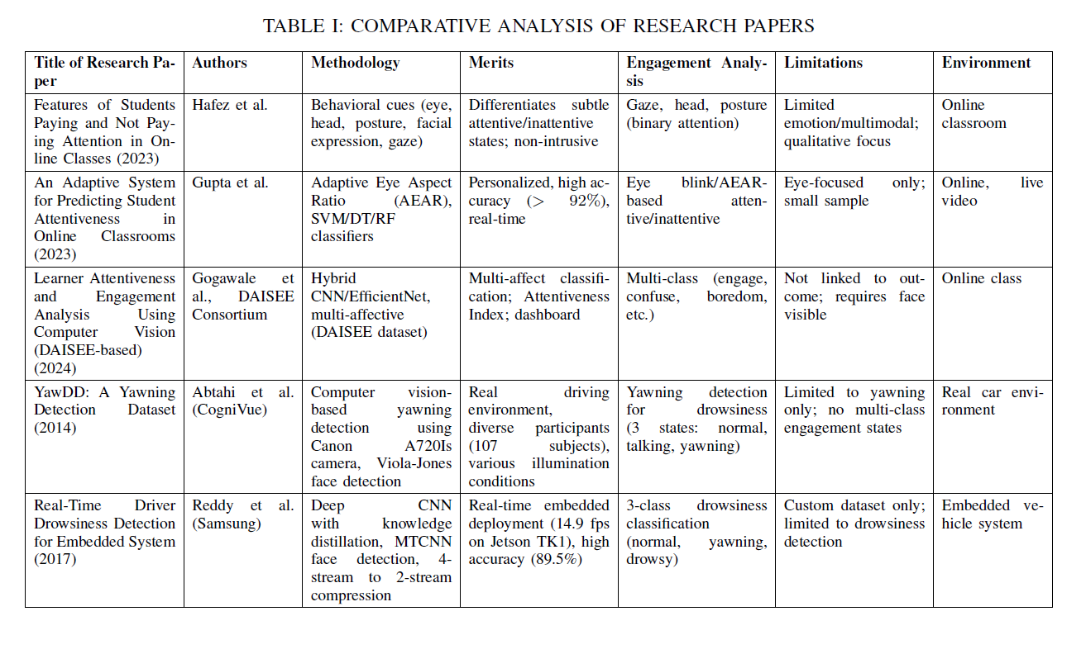
Notes:
Our work builds on extensive prior research across multiple domains Driver drowsiness detection provided technical foundation showing real-time CNN processing is feasible Educational engagement research validated our behavioral metrics for student context Intelligent tutoring systems demonstrated value of adaptive approaches Gamification studies informed our re-engagement strategies Complete bibliography with 16 peer-reviewed references available in published paper Code and trained models released open-source under MIT license for research community Compatible with standard Python deep learning stack - easy to reproduce and extend We welcome questions and collaboration opportunities

