Slide 1



School of Technology Management &
Engineering | Navi Mumbai
Industry Internship Review–3
Name: PranayKumar
Roll No.: A149 SAP ID: 70022200357
Job Description: Full Stack Developer Intern
Internship Duration: 05ᵗʰ January 2026 – 30th April 2026
Internship Company: Tech Biz Solutions
Mentors:
Industry Mentor: Mr. Kanwar Pal(Founder)
Client Project Mentor: Mrs. Renu Chaudhary(Technical Manager)
Faculty Mentor: Dr. Preeti Agarwal
Date: 29th March 2026

Slide 2

School of Technology Management &
Engineering | Navi Mumbai
Internship Overview
• Internship at Delta The Innovators
• Working on TV19 News platform
• Role: MERN Stack Developer Intern
Objective of the Project
• Optimize a real-time news aggregation engine to handle high-volume data from 20+ categories.
• Develop production-level proxy servers using Express.js and TypeScript for multi-source RSS feed parsing.
• Implement automated metadata enrichment and OG image scraping to ensure high-quality content delivery.

Slide 3
School of Technology Management &
Engineering | Navi Mumbai
Projects Overview
Overview: Developed scalable, in-house full-stack platforms for Tech Biz Solution to replace third-party limitations with custom high-performance solutions.
1. TaskOps: Enterprise Management Hub
Purpose: Centralized organizational workflow tool replacing generic tracking apps.
Core Tech: MongoDB, Express, React, Node.js, Socket.io, AWS S3.
Key Deliverables:
3-Tier RBAC (Admin/Sub-Admin/Employee) for data security.
Real-time notifications and interactive Kanban Task Boards.
Live analytics dashboards for team performance tracking.
2. TV19 News: Live Aggregation Engine
Purpose: High-speed real-time news delivery system across 20+ categories.
Core Tech: TypeScript, React, Express RSS Proxy, Metadata Scraping.
Key Deliverables:
Unified data pipeline to normalize and deduplicate multi-source feeds.
Automated OG-image scraping for enriched content delivery.
Localized state-specific news and sub-second search performance.

Slide 4
School of Technology Management &
Engineering | Navi Mumbai
Project Overview – “Revora”
3. Revora- Dynamic Pricing & Demand Intelligence System
Purpose
Data-Driven Optimization: Transform historical sales data into actionable price recommendations.
Explainable AI: Use transparent statistical modeling (Linear, Log-Log, Ridge) to predict demand.
Business Growth: Maximize profit and revenue while minimizing risk through automated data fitness gates.
Core Tech
Stack: Node.js, Express, MongoDB, React 19, Vite.
Logic: Regression-based elasticity models (Price Sensitivity).
Reporting: Automated Excel workbook generation via ExcelJS.
Key Deliveries
Interactive Simulator: Real-time "what-if" testing for price changes.
Recommendation Engine: Automated search for optimal price points based on profit/revenue goals.
Intelligence Dashboard: Portfolio-wide insights into sales trends and data quality.
Smart Ingestion: CSV pipeline with automated feature engineering and stockout detection.

Slide 5
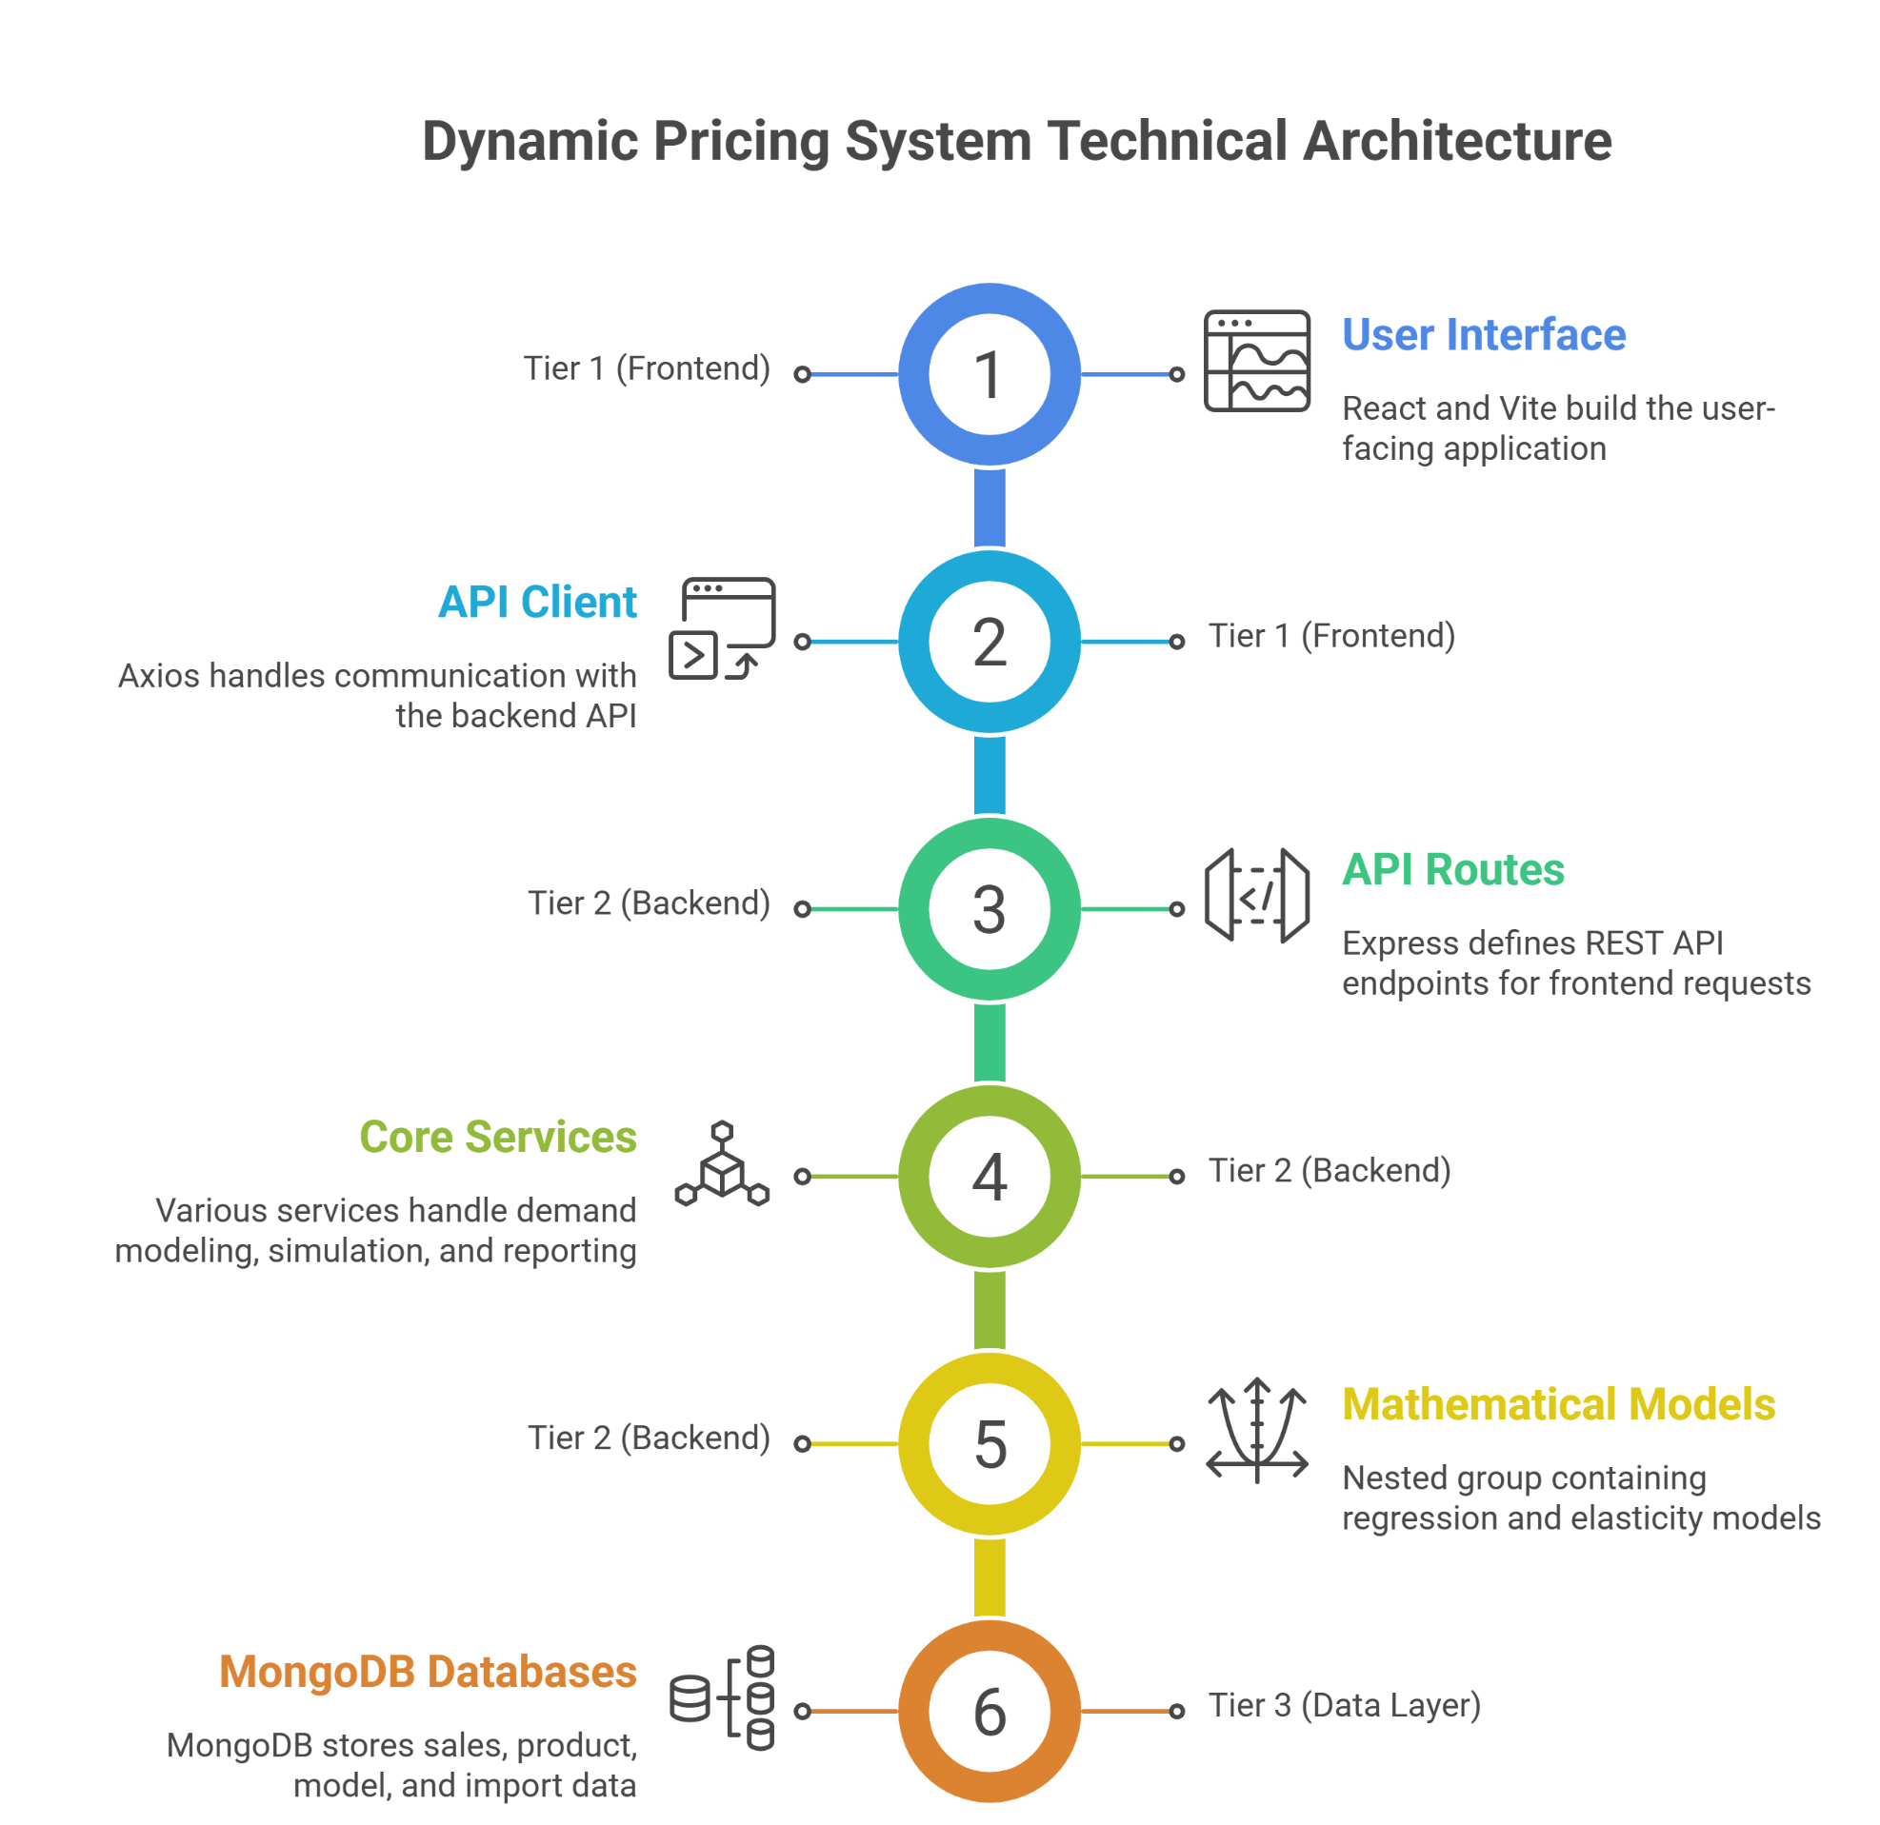
School of Technology Management &
Engineering | Navi Mumbai
Revora Project Architecture
1. Presentation Layer (Frontend)
React 19 & Vite: Modular dashboard for simulations, recommendations, and analytics.
Fixed-Frame UI: Premium, responsive layout built with Tailwind CSS 4.
2. Application Layer (Backend Services)
Modeling Engine: Fits Linear, Log-Log, and Ridge regressions to find the best demand curve.
Trust Policy Layer: Enforces data quality gates (R-Squared, Backtest error) before providing insights.
Intelligence Pipeline: Automated seasonality detection, weekend indexing, and holiday adjustment.
3. Data Ingestion & Transformation
CSV Middleware: High-speed ingestion with automated data cleaning.
Stockout Detection: Intelligently identifies and excludes inventory-driven low sales to prevent model bias.
4. Persistence Layer (Database)
MongoDB (Mongoose): Document storage for sales history, fitted models, and recommendations.
Performance Optimization: Models are fitted on "Grouped Demand Points" to handle large datasets efficiently.

Slide 6
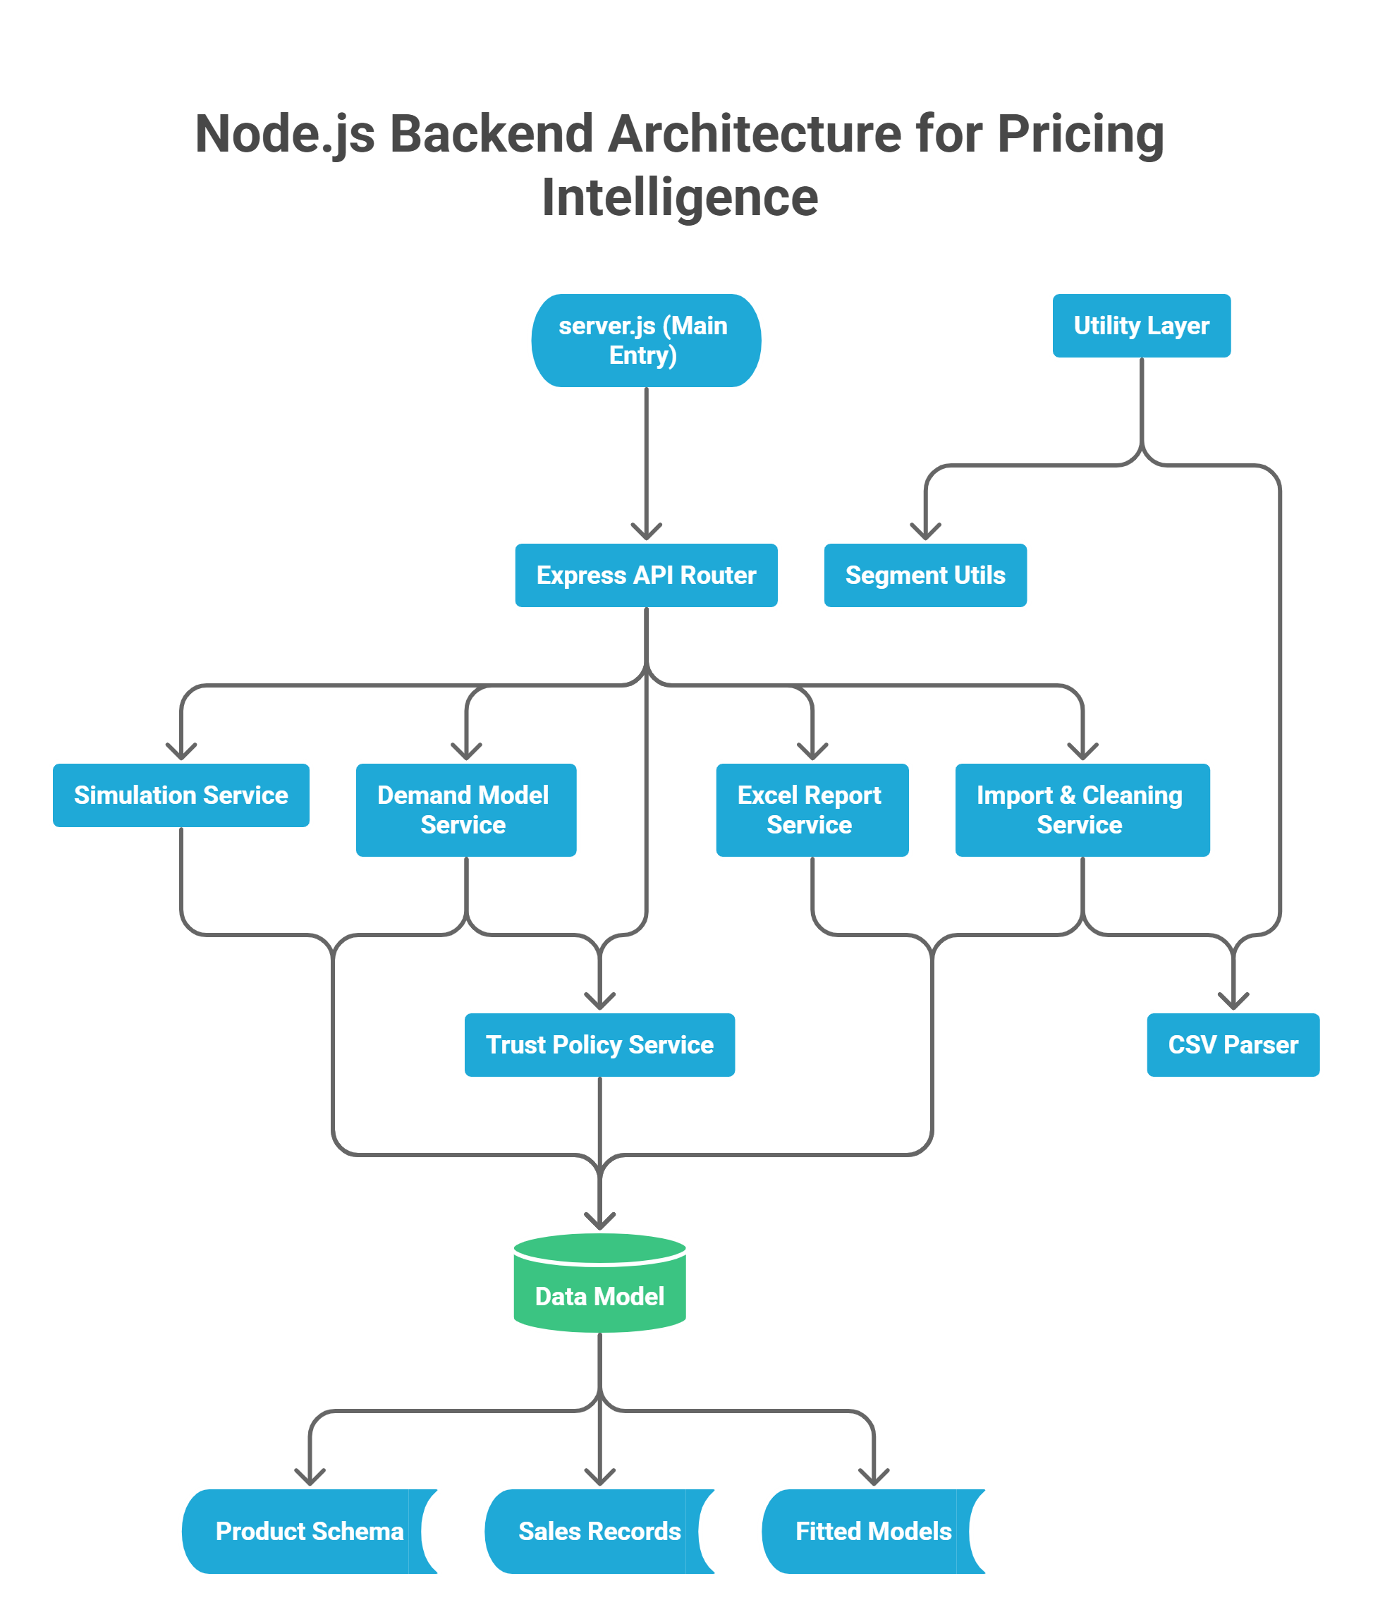
School of Technology Management &
Engineering | Navi Mumbai
System Modules
Modeling Engine: Fits statistical regressions to identify price response patterns.
Price Simulator: Real-time sandbox for "what-if" testing of price changes.
Recommendation Engine: Goal-oriented optimizer for finding the "Best Price."
Data Ingestion: CSV pipeline with automated cleaning and stockout detection.
Intelligence Dashboard: Visual center for portfolio health and model readiness.
Trust Policy: Validation layer that blocks unreliable models to minimize risk.
Reporting Module: Generates multi-sheet Excel workbooks for stakeholders.

Slide 7
School of Technology Management &
Engineering | Navi Mumbai
Work Done (Timeline Feb – Present)
Mar 12 – Mar 20
Elasticity research & modeling requirements.
MongoDB schema for multi-batch data.
Initial Smart CSV Ingestion pipeline.
Mar 21 – Mar 29
Linear & Log-Log regression engines.
Automated Stockout Detection logic.
Backend API for real-time model fitting.
Mar 30 – Apr 7
Context-Adjusted Ridge Regression.
"Trust Policy" reliability framework.
Seasonality & holiday feature engineering.
Apr 8 – Apr 18
Interactive Simulator with real-time UI.
Multi-Objective optimization engine.
UI overhaul with Tailwind CSS 4.
Apr 19 – Present
Automated Excel reporting (ExcelJS).
Portfolio-wide Intelligence Dashboard.
Performance auditing & DB optimization.
Contributions
Multi-Model Engine: Advanced regressions (Linear, Log-Log, Ridge) for forecasting.
Smart Ingestion: CSV pipeline with automated cleaning and stockout detection.
Trust Policy: Risk-mitigation layer for data and model validation.
Price Simulator: Real-time "what-if" sandbox for elasticity visualization.
BI Reporting: Automated stakeholder-ready Excel workbooks via ExcelJS.
Modern UI: Premium dashboard built with React 19 and Tailwind 4.
DB Optimization: Optimized MongoDB pipelines for high-speed processing.

Slide 8
School of Technology Management & Engineering | Navi Mumbai
Technology Stack: TV19 News Hub
Backend Infrastructure
Runtime: Node.js
Framework: Express.js (v5)
Language: JavaScript (ESM)
Data Processing: RSS-Parser (Normalization & Deduplication)
Communication: Axios (Parallel external API fetching)
Security: CORS (Middleware for restricted origin access) Database: MongoDB
Data Processing: csv-parse (For streaming and cleaning large sales datasets)
Business Intelligence: ExcelJS (For generating the stakeholder workbooks)
Frontend Environment
Library: React.js (v19)
Language: TypeScript (for type-safe development)
Build Tool: Vite (high-performance modular bundling)
Routing: React Router DOM (v7)
Animations: Framer Motion (smooth UI/UX transitions)
Icons/UI: FontAwesome & Iconscout Unicons
Styling: Tailwind CSS 4, Lucide
External Services & Tools
Data Sources: Multi-source XML/RSS endpoints (BBC, TOI, Google News)
Metadata: Custom Open Graph (OG) tag scraping logic
Testing: Postman (API verification & performance monitoring)
Version Control: Git & GitHub

Slide 9
School of Technology Management &
Teamwork & Professional Learning
Engineering | Navi Mumbai
Learning & Skill Development
Skills Developed
Full-Stack Architecture: Engineering high-performance applications using React 19, Node.js, and MongoDB.
Statistical Modeling: Implementing Linear, Log-Log, and Ridge regression for predictive demand forecasting.
Advanced Data Engineering: Designing robust pipelines for CSV ingestion, stockout detection, and automated feature extraction.
Business Intelligence: Developing automated reporting frameworks and optimization algorithms for data-driven decision making.
• Contribution to ongoing company NewsTV19 and the ongoing Revora project.
• Regular technical syncs with mentors and developers
• Participation in planning and feature-mapping meetings
• Collaborative debugging and cross-team code reviews
• Adaptation and contribution to an active codebase
• Exposure to professional industry git-workflow

Slide 10
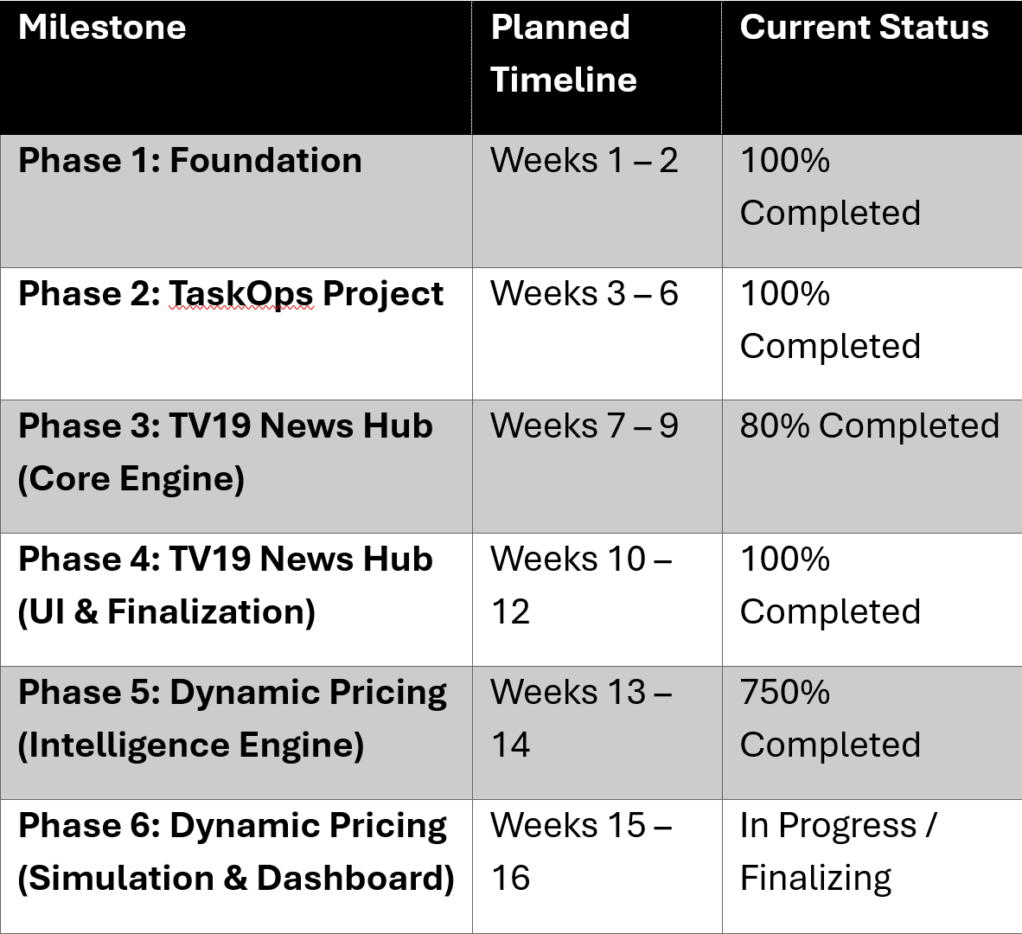
School of Technology Management &
Engineering | Navi Mumbai
Current Progress vs Plan
Progress Snapshot
Target: Complete core Demand Intelligence & Pricing Architecture by mid-April.
Actual: Successfully implemented Multi-Model Regression Engine, Smart Data Ingestion, and Trust Policy validation ahead of schedule.
Next Milestone: Finalization of the Interactive Price Simulator and Automated Business Reporting (Expected by end of week).

Slide 11
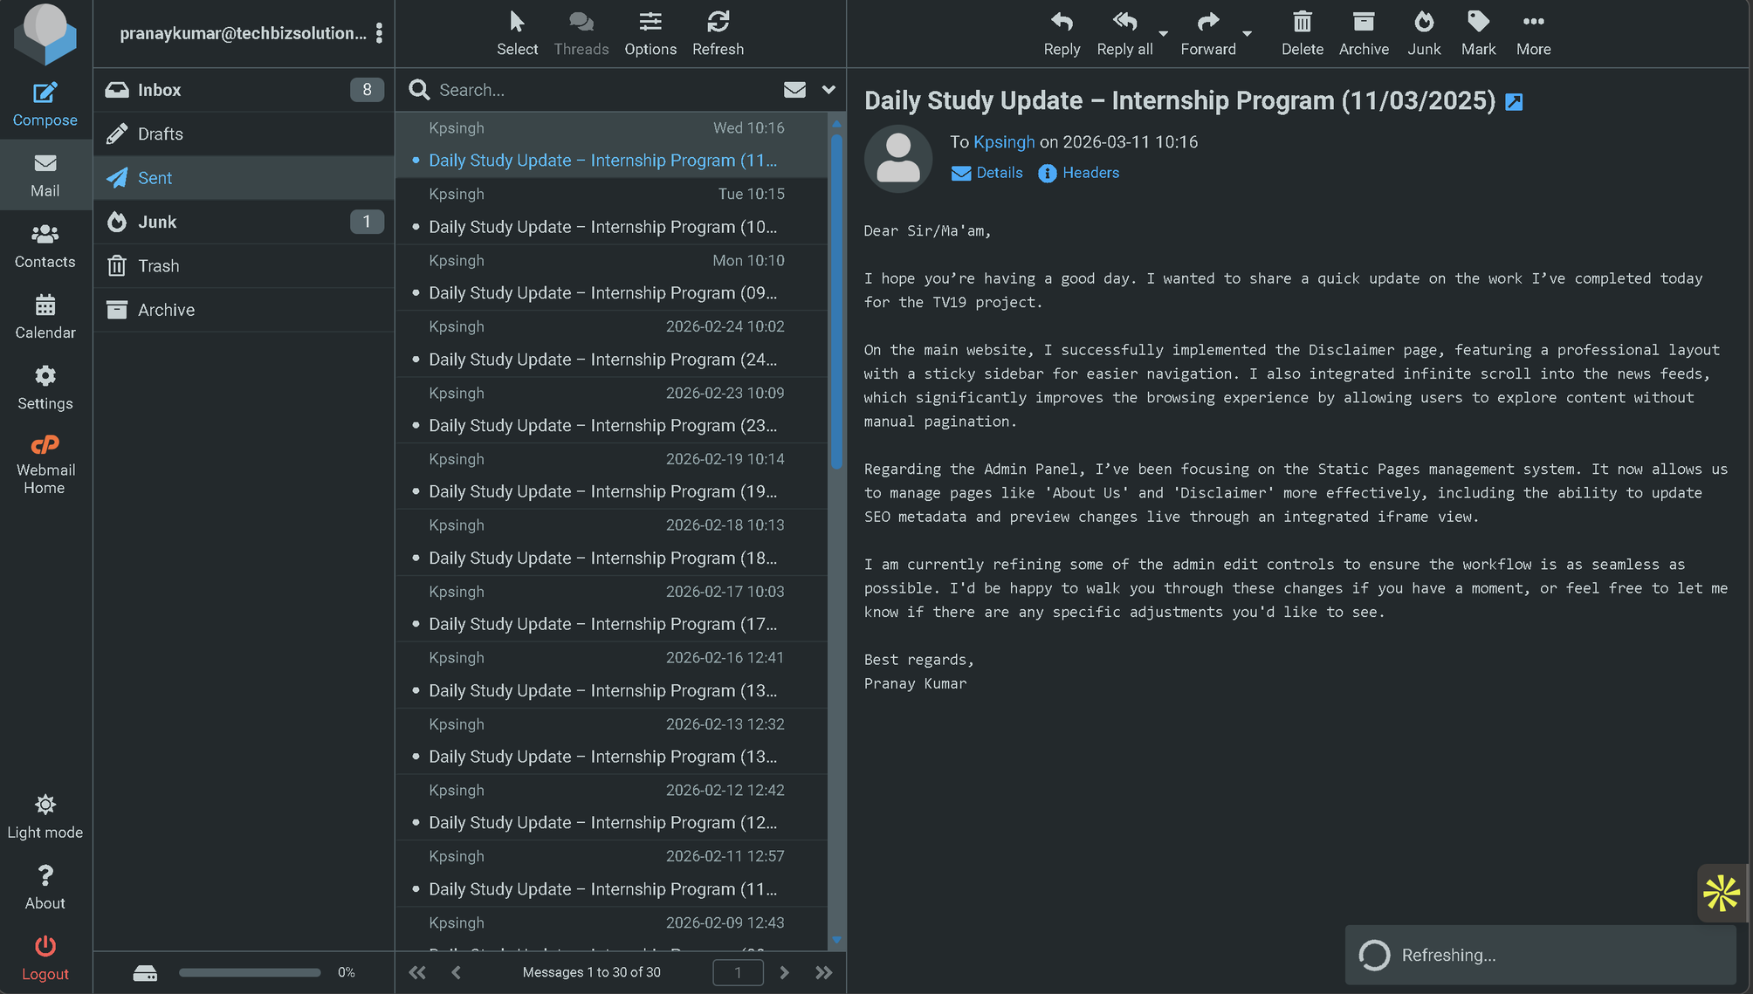
School of Technology Management &

Slide 12

School of Technology Management &
Engineering | Navi Mumbai
Conclusion
• Gained exposure to real-world software architecture
• Contributed to production-level backend APIs
• Improved backend development and debugging skills
• Working towards full system integration

