Slide 1
PROJECT 4

Slide 2
Brainstorming
Current used car market - forecasting future prices using Linear Regression
How to find the most dominant colors in an image using k-means clustering - an unsupervised learning technique
Location of fishing vessels (world wide) from voyage patterns using Logistic Regression
Sudoku Puzzle Solver using convolutional neural networks to read puzzle images and solve the puzzle using Python code

Slide 3
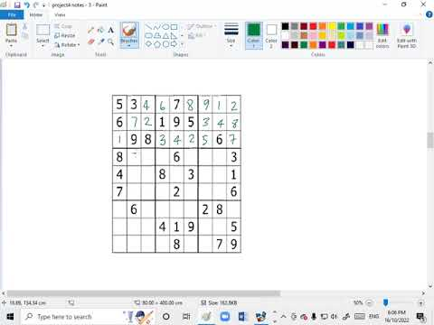
What is Sudoku???

Slide 4
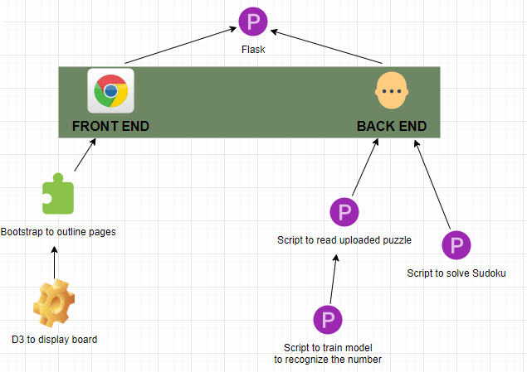
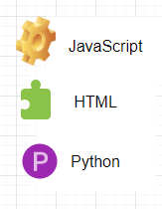
Overview of Project Tools

Slide 5
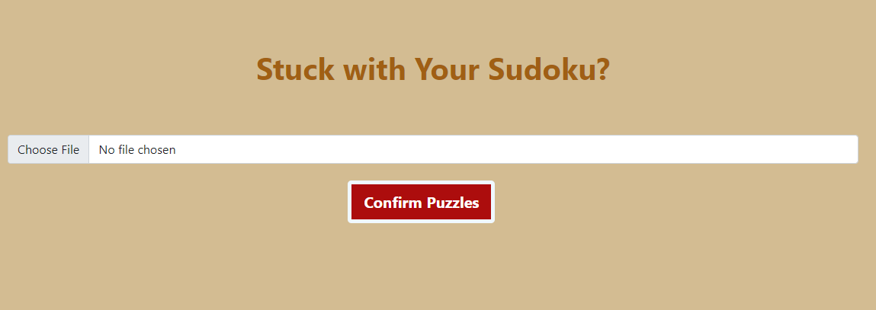
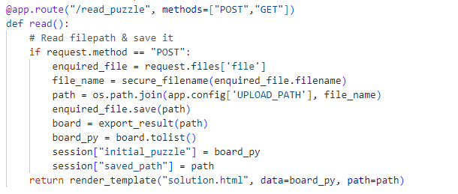
User Interface - Home Page
Function:
For user to upload their puzzles
Trigger the function to read & return the puzzle for user to further check

Slide 6
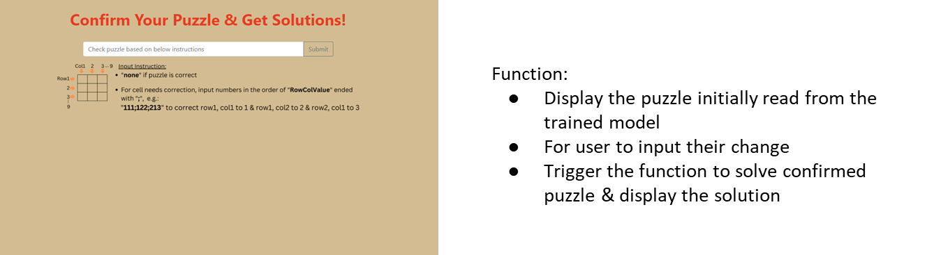
Use Interface - Solution Page

Slide 7
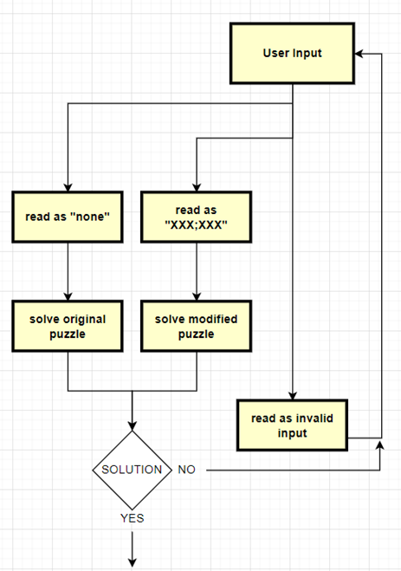
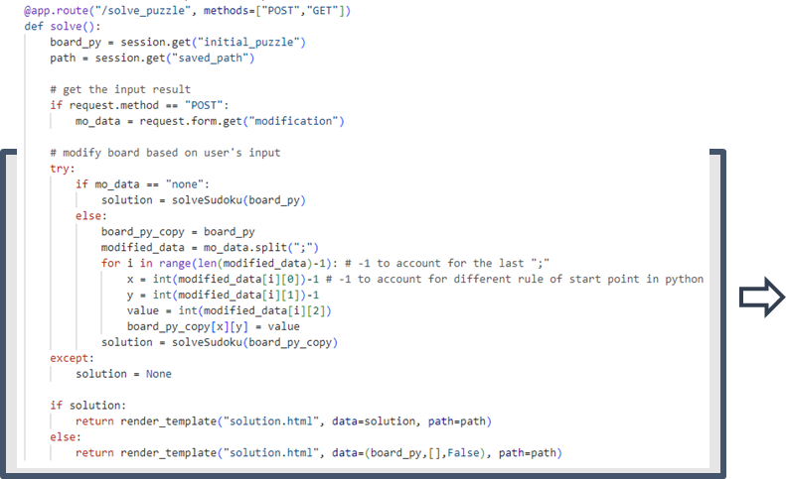
Use Interface - Solution Page

Slide 8
Machine Learning
Use range of image processing techniques to find the puzzle
Convert image to grayscale
Apply Gaussian blur
Threshold the image
Find contours
Extract digit cell and return it so that the ML model can recognise it
Loop through each cell of the 9x9 puzzle and on each cell read and predict the number and place into board array
Display recognised numbers on puzzle
User option to amend wrong predictions
Solve!
Note: Originally used a handwriting recognition model created earlier, just finished training new model which is trained on both handwritten and text data, and trained longer/with more Conv2D layers

Slide 9
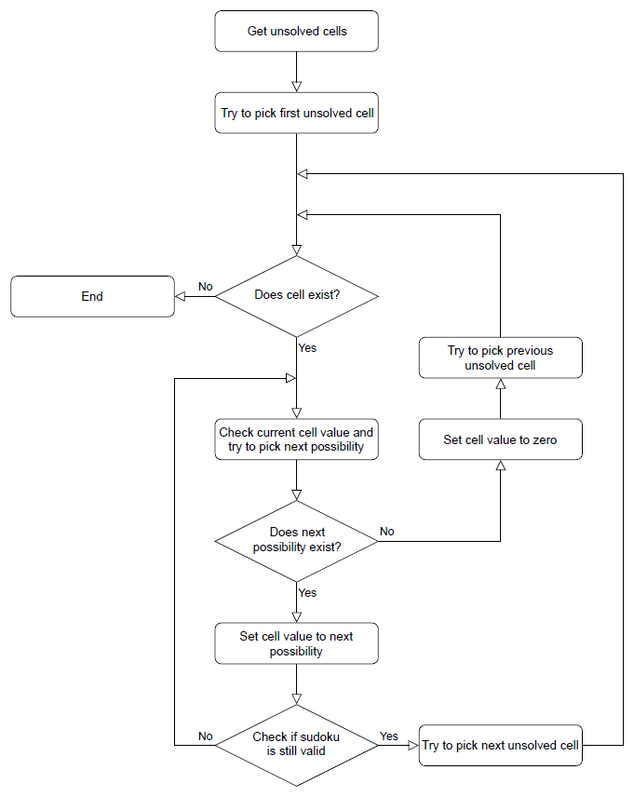
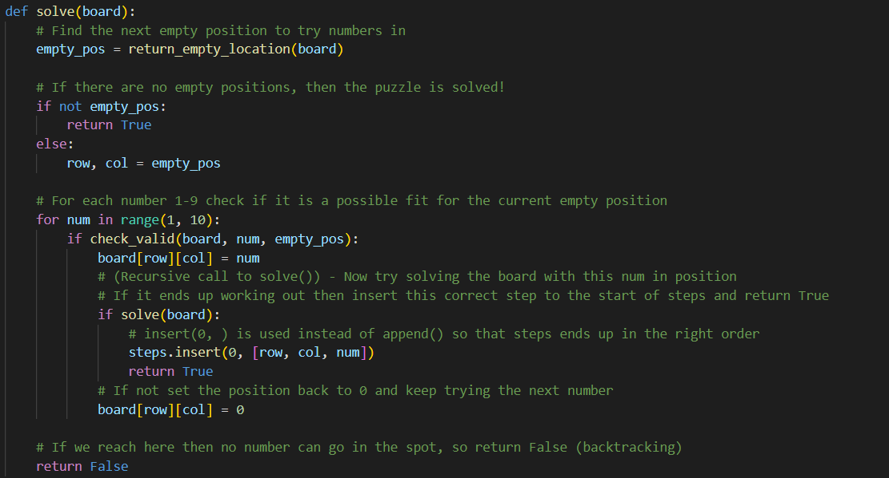
Sudoku Solver
We wrote our own Sudoku solver module in Python
Follows a ‘backtracking’ algorithm:
Outputs the solved grid as a list of lists, and the order each number was added

Slide 10
Output Display
We used D3 to create a grid to output our data from our python processor. This was done in three steps;
1. Import necessary packages, define the application in flask and create a datastore.
2. Create the code to generate data to send to the front end for the home page.
3. Convert data into json format for d3 and send the same to the front end
We created two divisions, one to host the users puzzle on the left and one to host the solved sudoku data on the right.

Slide 11
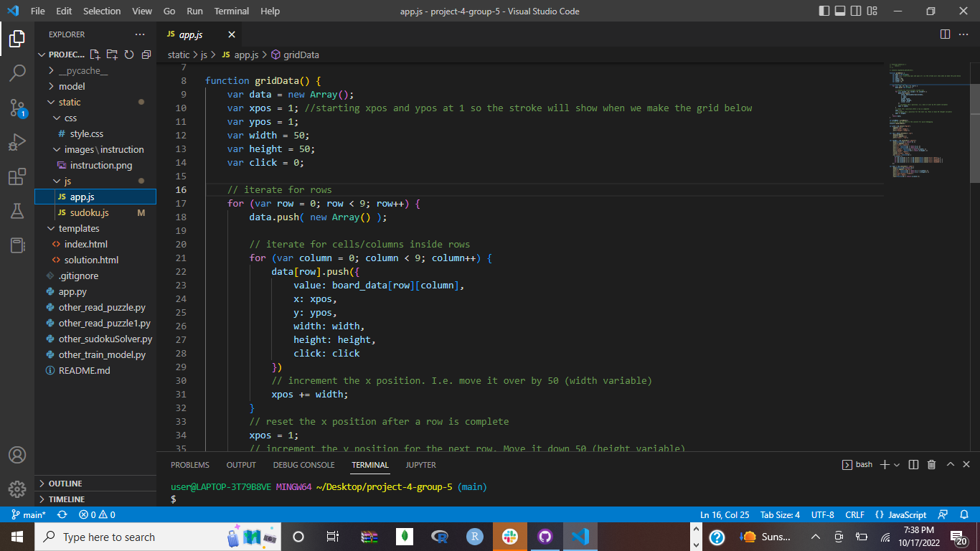
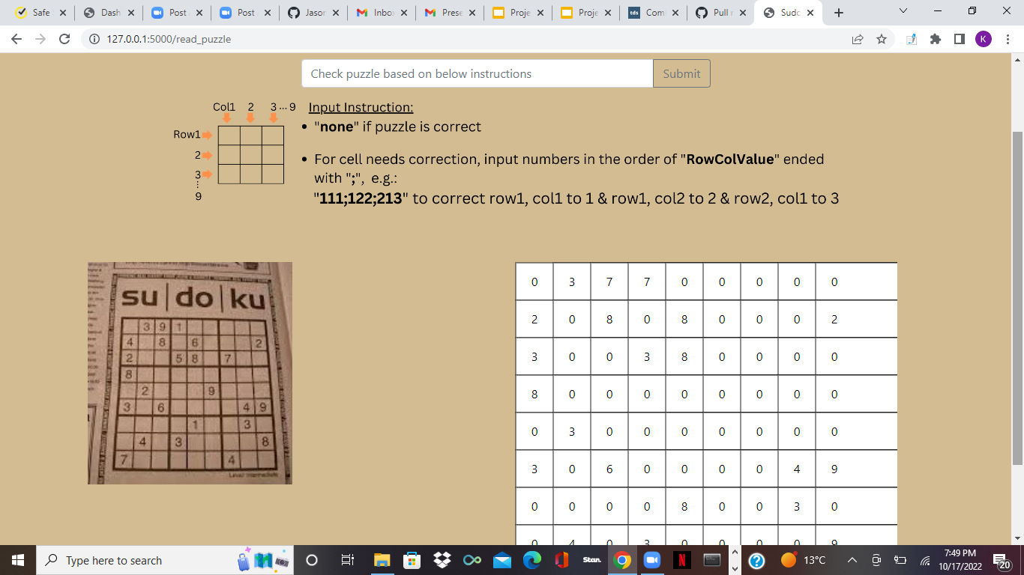
Output data

Slide 12
Demonstration!

