Slide 1
Ascendancy
Bernd Schmidt
Thomas Volkmann
Chris Arnold
Norman Simanowski
Erfurt University of Applied Sciences
Sommersemester 2015

Slide 2
Gliederung
Wireframes
Architektur
Komponenten
Klassendiagramm
Datenbank Schema
Aktueller Stand, Probleme
Zusammenarbeit im Team

Slide 3
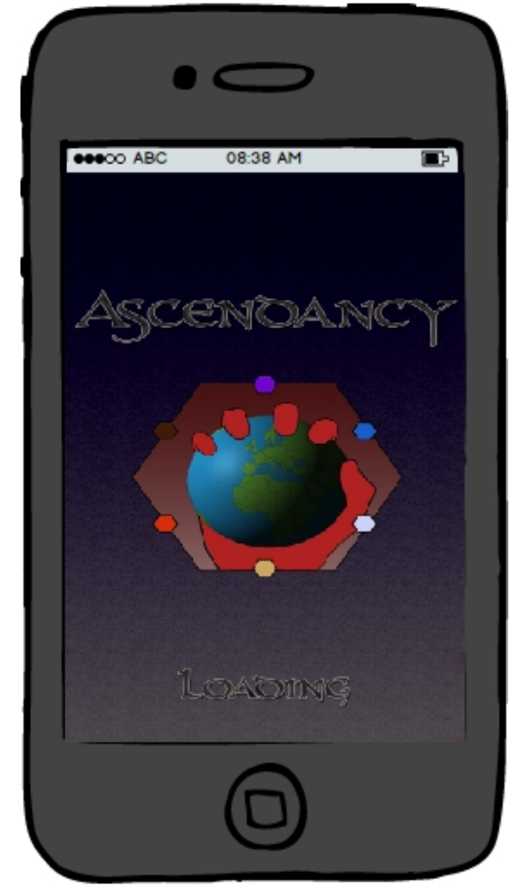
Wireframes

Slide 4
Architektur
Warteschlange
Controller
Zauberwort: Asynchron
API
Model
Datenbank
Server-Request
Controller
Model
View

Slide 5


Komponenten - Base
ZellTypen
Request (LoadRegion)
{
"RegionPositions": [Region0, Region1, ...],
"Position":PlayerPosition,
"SessionID": GUID
}
Region
Position (X, Y)
Region
Welt-Position
(Latitude, Longitude)
Region
Zell
Zell
Zell
Zell
Aktion (Bewegen)
Einheit

Slide 6
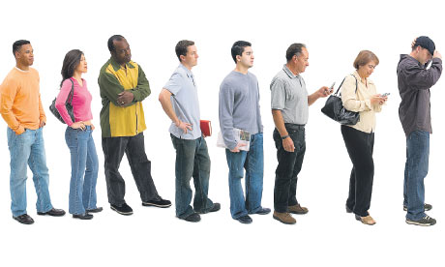

Komponenten - Server
Datenbank
API
Warteschlange
Controller
(viele, viele Daten
hin und her
schaufeln)

Slide 7
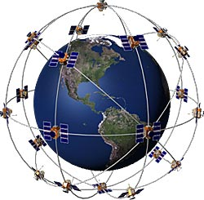
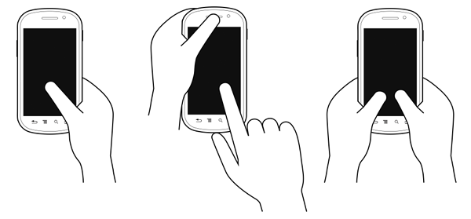





Komponenten - Client
GPS
Touch → Aktionen
CocosSharp
Scene
Sprites
Layer
Layer
Layer
TileMap

Slide 8
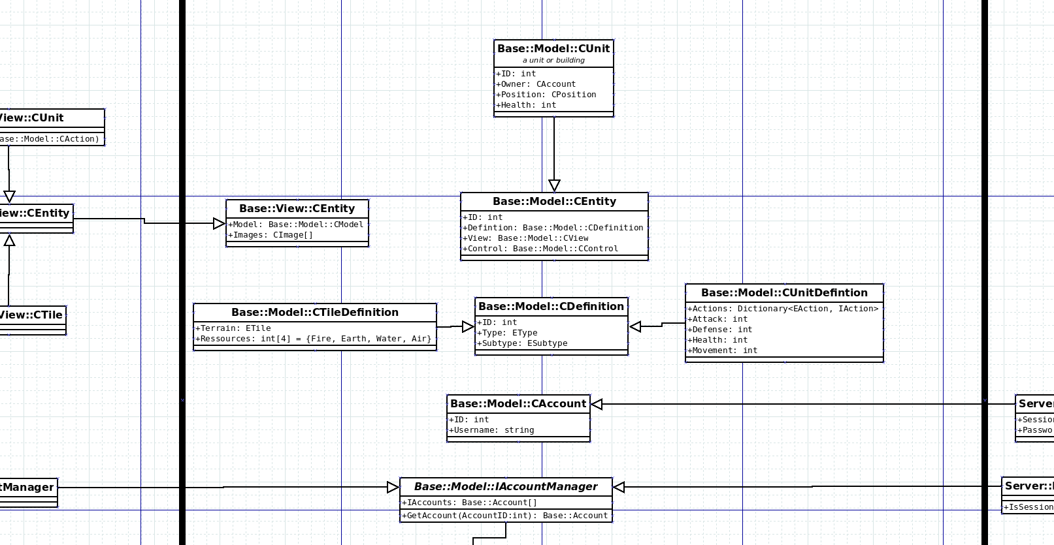
Klassendiagramm

Slide 9
Datenbank
Datenbank fast unnötig (die meisten Daten sind persistent)

Slide 10
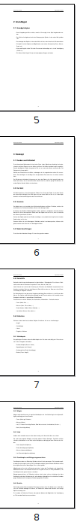
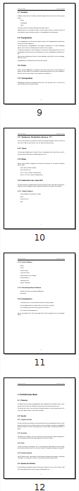
Aktueller Stand
Rudimentäre Anzeige (von Chris und Norman)
Game Design (alle, 14 Seiten)
Weltdaten als JSON (Bernd)
[[11, 11, 11, 5, 5, 11, 11, 11, 11, 11, 11, 5, 11, 11, 11, 11, 11, 5, 5, 5, 5, 5, 4, 4, 4, 4, 4, 4, 4, 4, 4, 5], [11, 11, 11, 5, 5, 11, 11, 11, 11, 11, 5, 5, 11, 11, 11, 11, 5, 5, 5, 5, 5, 4, 4, 4, 4, 4, 4, 4, 4, 4, 4, 5], [11, 11, 11, 5, 5, 11, 11, 11, 11, 11, 5, 5, 11, 11, 11, 11, 5, 5, 5, 5, 5, 4, 4, 4, 4, 4, 4, 4, 4, 4, 4, 4], [11, 11, 11, 5, 5, 11, 11, 11, 11, 11, 11, 5, 11, 11, 11, 11, 5, 5, 5, 5, 5, 4, 4, 4, 4, 4, 4, 4, 4, 4, 4, 4], [11, 11, 11, 5, 5, 11, 11, 11, 11, 11, 11, 5, 5, 11, 11, 11, 5, 5, 5, 5, 5, 4, 4, 4, 4, 4, 4, 4, 4, 4, 4, 4], [11, 11, 11, 11, 5, 11, 11, 11, 11, 11, 11, 5, 5, 11, 11, 11, 5, 5, 5, 5, 5, 4, 4, 4, 4, 4, 4, 4, 4, 4, 4, 4], [11, 11, 11, 11, 5, 5, 11, 11, 11, 11, 11, 5, 5, 11, 11, 11, 5, 5, 5, 5, 5, 4, 4, 4, 4, 4, 4, 4, 4, 4, 4, 4], [11, 11, 11, 11, 5, 5, 11, 11, 11, 11, 11, 5, 5, 11, 11, 11, 5, 5, 5, 5, 5, 5, 4, 4, 4, 4, 4, 4, 4, 4, 4, 4], [11, 11, 11, 11, 5, 5, 11, 11, 11, 11, 11, 11, 5, 5, 11, 11, 11, 5, 5, 5, 5, 5, 5, 4, 4, 4, 4, 4, 4, 4, 4, 4], [11, 11, 11, 11, 5, 5, 11, 11, 11, 11, 11, 11, 5, 11, 11, 11, 11, 5, 5, 5, 5, 5, 5, 4, 4, 4, 4, 4, 4, 4, 4, 4], [11, 11, 11, 11, 5, 5, 11, 11, 11, 11, 11, 11, 5, 5, 11, 11, 11, 11, 5, 5, 5, 5, 5, 5, 4, 4, 4, 4, 4, 4, 4, 4], [11, 11, 11, 11, 5, 5, 11, 11, 11, 11, 11, 11, 5, 5, 11, 11, 11, 11, 5, 5, 5, 5, 5, 5, 5, 4, 4, 4, 4, 4, 4, 4], [11, 11, 11, 11, 11, 5, 11, 11, 11, 11, 11, 11, 5, 5, 11, 11, 11, 11, 11, 5, 5, 5, 5, 5, 5, 5, 4, 4, 4, 4, 4, 4], [11, 11, 11, 11, 11, 5, 5, 11, 11, 11, 11, 11, 5, 5, 11, 11, 11, 11, 11, 5, 5, 5, 5, 5, 5, 5, 5, 4, 4, 4, 4, 4], [11, 11, 11, 11, 11, 5, 5, 11, 11, 11, 11, 11, 5, 5, 11, 11, 11, 11, 11, 11, 5, 5, 5, 5, 5, 5, 5, 5, 5, 4, 4, 4], [11, 11, 11, 11, 11, 5, 5, 11, 11, 11, 11, 11, 11, 5, 11, 11, 11, 11, 11, 11, 11, 5, 5, 5, 5, 5, 5, 5, 5, 5, 4, 4], [11, 11, 11, 11, 11, 11, 5, 11, 11, 11, 11, 11, 11, 5, 5, 5, 5, 5, 11, 11, 11, 11, 11, 5, 5, 5, 5, 5, 5, 5, 5, 5], [11, 11, 11, 11, 11, 5, 5, 11, 11, 11, 11, 11, 11, 5, 5, 5, 5, 5, 5, 11, 11, 11, 11, 5, 5, 5, 5, 5, 5, 5, 5, 5], [11, 11, 11, 11, 11, 5, 5, 11, 11, 11, 11, 11, 11, 5, 5, 11, 5, 5, 5, 5, 11, 11, 11, 11, 11, 5, 5, 5, 5, 5, 5, 5], [11, 11, 11, 11, 11, 11, 5, 11, 11, 11, 11, 11, 11, 5, 5, 11, 11, 11, 5, 5, 5, 11, 11, 11, 11, 11, 5, 5, 5, 5, 5, 5], [11, 11, 11, 11, 11, 11, 5, 5, 11, 11, 11, 11, 11, 5, 5, 11, 11, 11, 11, 5, 5, 5, 11, 11, 11, 11, 11, 5, 5, 5, 5, 5], [11, 11, 11, 11, 11, 11, 5, 5, 11, 11, 11, 11, 11, 11, 5, 11, 11, 11, 11, 11, 5, 5, 5, 11, 11, 11, 11, 11, 5, 5, 5, 5], [11, 11, 11, 11, 11, 11, 5, 5, 11, 11, 11, 11, 11, 11, 5, 5, 11, 11, 11, 11, 11, 5, 5, 5, 5, 11, 11, 11, 11, 11, 5, 5], [11, 11, 11, 11, 11, 11, 5, 5, 11, 11, 11, 11, 11, 11, 5, 5, 11, 11, 11, 11, 11, 11, 5, 5, 5, 5, 11, 11, 11, 11, 11, 5], [5, 11, 11, 11, 11, 11, 11, 5, 5, 11, 11, 11, 11, 11, 11, 5, 11, 11, 11, 11, 11, 11, 11, 11, 5, 5, 5, 5, 11, 11, 11, 11], [11, 11, 11, 11, 11, 11, 5, 5, 11, 11, 11, 11, 11, 11, 5, 5, 11, 11, 11, 11, 11, 11, 11, 11, 11, 5, 5, 5, 11, 11, 11, 11], [11, 11, 11, 11, 11, 11, 11, 5, 11, 11, 11, 11, 11, 11, 5, 5, 11, 11, 11, 11, 11, 11, 11, 11, 11, 11, 5, 5, 5, 11, 11, 11], [5, 11, 11, 11, 11, 11, 11, 5, 5, 11, 11, 11, 11, 11, 11, 5, 11, 11, 11, 11, 11, 11, 11, 11, 11, 11, 11, 5, 5, 5, 5, 11], [5, 11, 11, 11, 11, 11, 11, 5, 5, 11, 11, 11, 11, 11, 11, 5, 11, 11, 11, 11, 11, 11, 11, 11, 11, 11, 11, 11, 5, 5, 5, 5], [5, 11, 11, 11, 11, 11, 11, 5, 5, 11, 11, 11, 11, 11, 11, 5, 5, 11, 11, 11, 11, 11, 11, 11, 11, 11, 11, 11, 11, 11, 5, 5], [5, 11, 11, 11, 11, 11, 11, 5, 5, 11, 11, 11, 11, 11, 11, 5, 5, 11, 11, 11, 11, 11, 11, 11, 11, 11, 11, 11, 11, 11, 11, 5], [5, 11, 11, 11, 11, 11, 11, 5, 5, 11, 11, 11, 11, 11, 11, 5, 5, 11, 11, 11, 11, 11, 11, 11, 11, 11, 11, 11, 11, 11, 11, 11], [5, 5, 11, 11, 11, 11, 11, 11, 5, 5, 11, 11, 11, 11, 11, 11, 5, 5, 5, 5, 5, 5, 11, 11, 11, 11, 11, 11, 11, 11, 11, 11], [5, 5, 11, 11, 11, 11, 11, 11, 5, 11, 11, 11, 11, 11, 11, 5, 5, 5, 5, 5, 5, 5, 11, 11, 11, 11, 11, 11, 11, 11, 11, 11], [5, 5, 11, 11, 11, 11, 11, 11, 5, 5, 11, 11, 11, 11, 5, 5, 5, 11, 11, 11, 5, 5, 5, 5, 11, 11, 11, 11, 11, 11, 11, 11], [5, 5, 11, 11, 11, 11, 11, 11, 5, 5, 11, 5, 11, 5, 5, 5, 11, 11, 11, 11, 11, 5, 5, 5, 5, 11, 11, 11, 11, 11, 11, 11], [5, 5, 11, 11, 11, 11, 11, 11, 5, 5, 5, 5, 5, 5, 5, 11, 11, 11, 11, 11, 11, 11, 11, 5, 5, 5, 11, 11, 11, 11, 11, 11], [5, 5, 11, 11, 11, 11, 11, 5, 5, 5, 5, 5, 5, 5, 11, 11, 3, 3, 3, 11, 11, 11, 11, 11, 5, 5, 5, 11, 11, 11, 11, 11], [5, 5, 5, 5, 5, 5, 5, 5, 5, 5, 5, 5, 5, 5, 5, 5, 3, 3, 3, 3, 11, 11, 11, 11, 11, 5, 5, 5, 11, 11, 11, 11], [11, 5, 5, 5, 5, 5, 5, 5, 11, 11, 11, 5, 5, 5, 5, 5, 5, 3, 3, 3, 3, 11, 11, 11, 11, 11, 5, 5, 5, 5, 11, 11], [3, 11, 11, 11, 11, 11, 11, 11, 11, 3, 3, 5, 3, 5, 5, 5, 5, 5, 3, 3, 3, 3, 3, 11, 11, 11, 11, 11, 5, 5, 5, 11], [3, 3, 3, 3, 11, 3, 3, 3, 3, 3, 5, 5, 3, 3, 5, 5, 5, 5, 5, 3, 3, 3, 3, 11, 11, 11, 11, 11, 11, 5, 5, 5], [5, 3, 3, 3, 3, 3, 3, 3, 3, 5, 5, 3, 3, 3, 3, 5, 5, 5, 5, 5, 3, 3, 3, 3, 3, 11, 11, 11, 11, 11, 5, 5]]

Slide 11
Probleme
Threading auf dem Server
Viele Leser
Paralleles Schreiben
Performance
Datenkonsistenz
Lösung theoretisch vorhanden → praktisch noch nicht umgesetzt
Konvertierung der Geodaten zu JSON
Große Welt → Viele Daten → Lange Konvertierungszeiten

Slide 12
TMB Transformation
Es werden .xnb Dateien erwartet
Monogame Content Pipeline
Keine native Unterstützung für Tiled Format (.tmx)
daher eigene Kompilierung des Benötigten Tools
Rattenschwanz an Abhängigkeiten und Fehlern
GitHub liefert beim Clonen nicht alle Abhängigkeiten
CocosSharp -> MonoGame
MonoGame -> Dependencies
MonoGame -> Kickstart
3 Schritte
Monogame Erstellen
CocosSharp Content Pipeline Erstellen
Monogame mit CCS Pipeline neu Erstellen

Slide 13
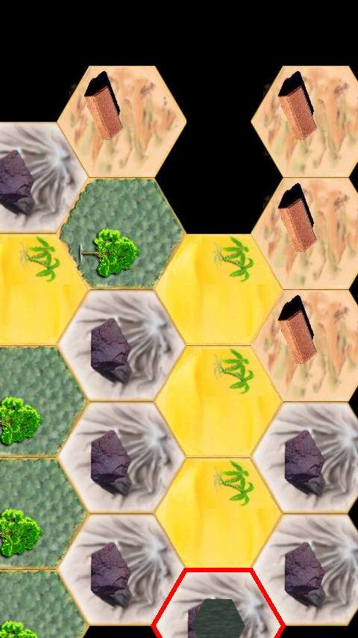
Hexagonale Felder
Ursprünglich Hexagonale Felder gedacht
→ Probleme bei Anzeige jeder zweiten Zeile
„Lösung“: Isometrische Ansicht
mit Hexagonalen Feldern

Slide 14

Zusammenarbeit im Team
Git, Skype, regelmäßige Treffen (wöchentlich)
Thomas: „Der Zusammenhang im Team ist super, wenn es darum geht, jemanden zu verbessern oder anzuscheißen“

