Slide 1
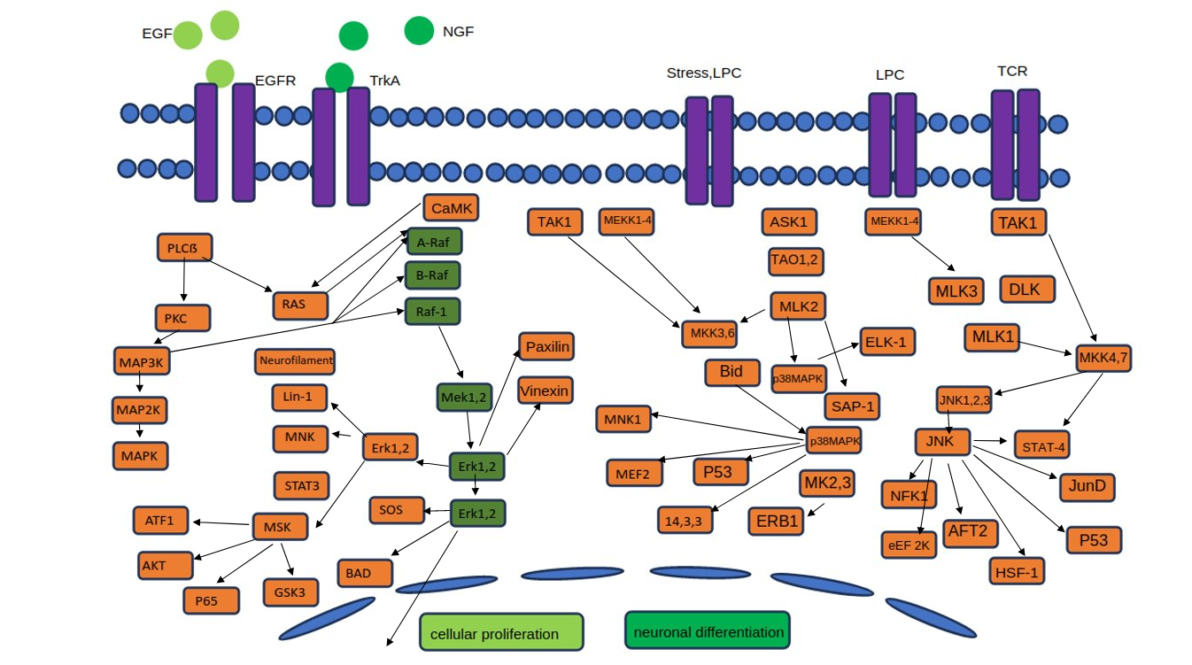

Slide 2
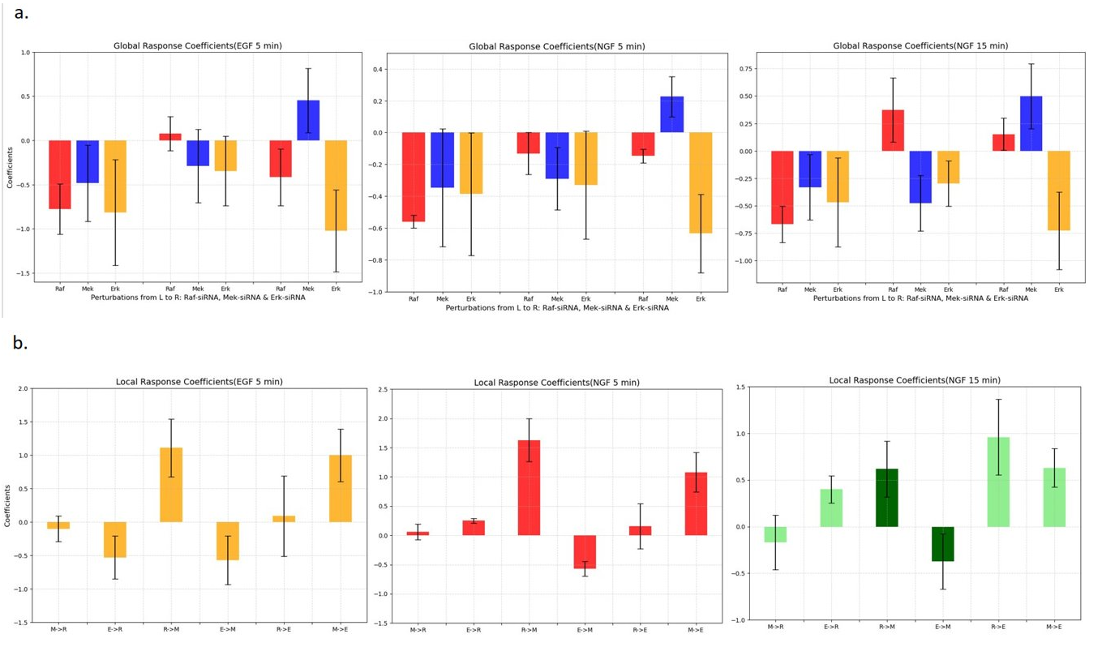

Slide 3
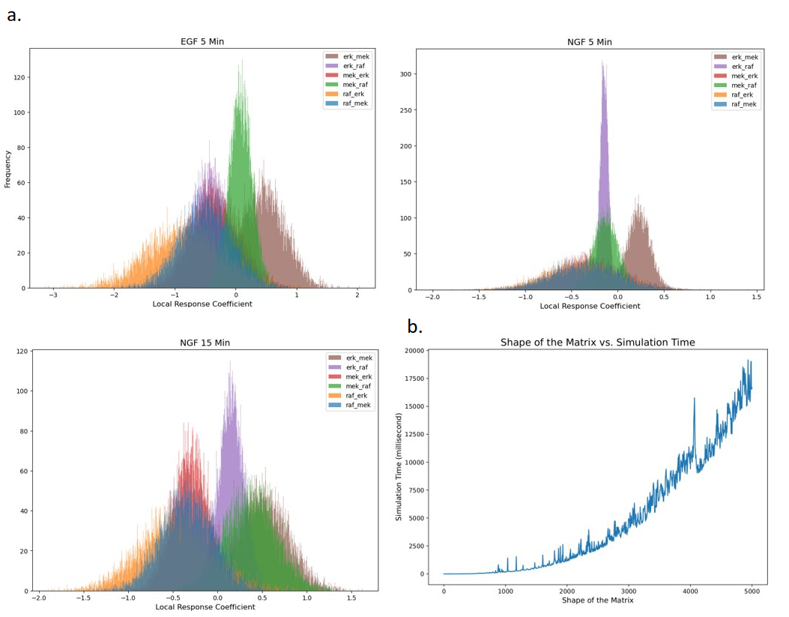

Slide 4
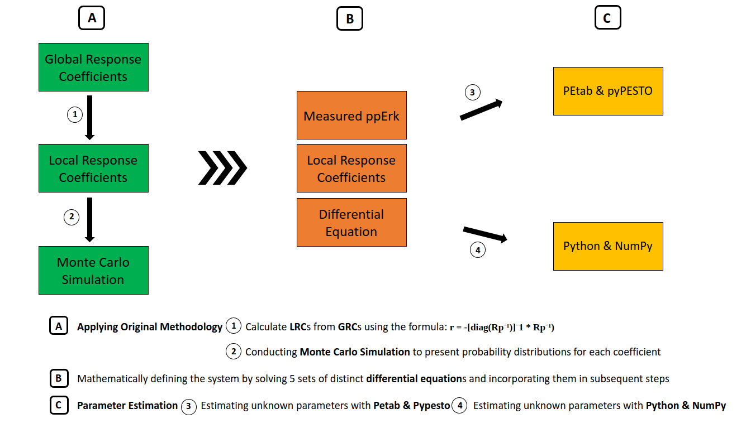

Slide 5

A
B
C
Global Response Coefficients
PEtab & pyPESTO
Measured ppErk
3
1
Local Response Coefficients
Local Response Coefficients
Differential Equation
2
Python & NumPy
Monte Carlo Simulation
4
A
Applying Original Methodology Calculate LRCs from GRCs using the formula: r = -[diag(Rp⁻¹)]⁻1 * Rp⁻¹)
Conducting Monte Carlo Simulation to present probability distributions for each coefficient
Mathematically defining the system by solving 5 sets of distinct differential equations and incorporating them in subsequent steps
Parameter Estimation Estimating unknown parameters with Petab & Pypesto Estimating unknown parameters with Python & NumPy
1
2
B
C
3
4

Slide 6
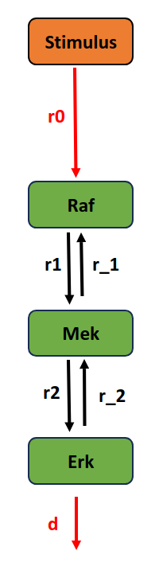

r3
r_3

Slide 8
Stimulus
r0
r_0
Raf
pRaf
r1
r_1
r_3
Mek
pMek
r3
r2
r_2
Erk
pErk
d

Slide 9
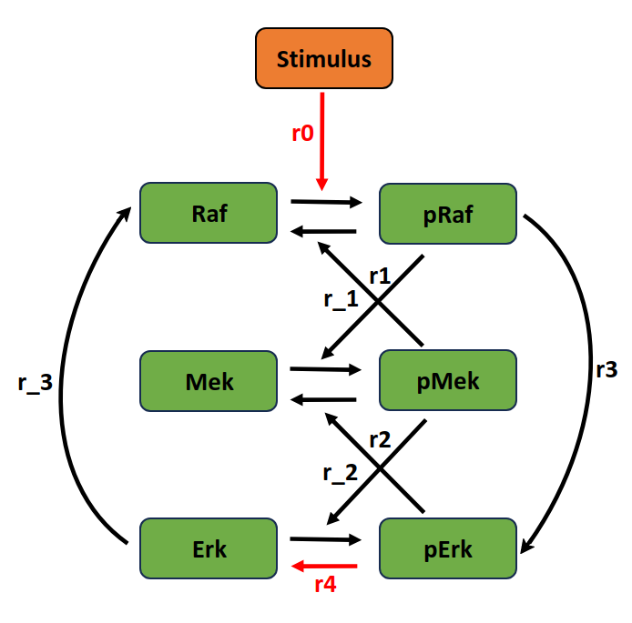
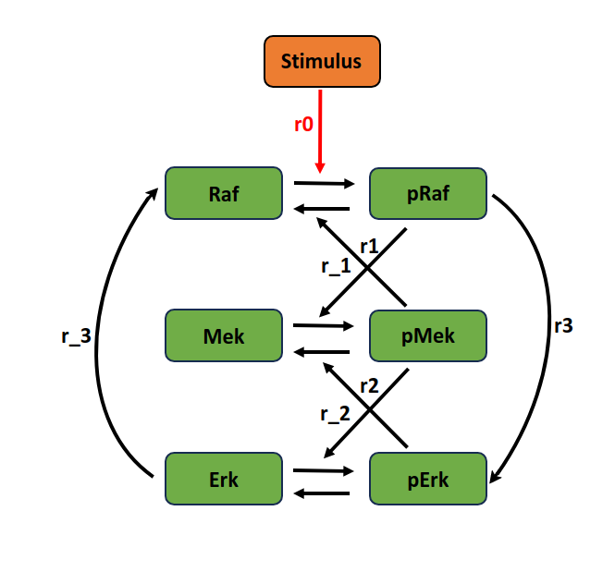
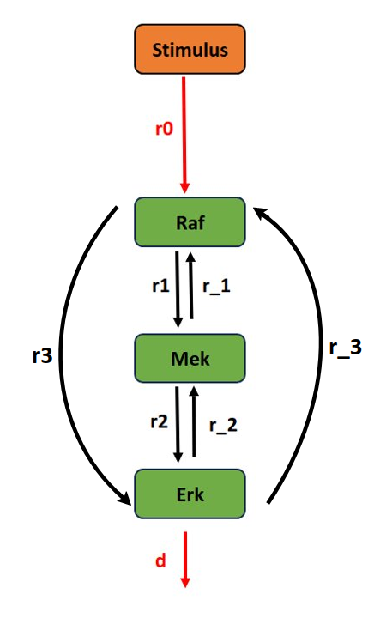
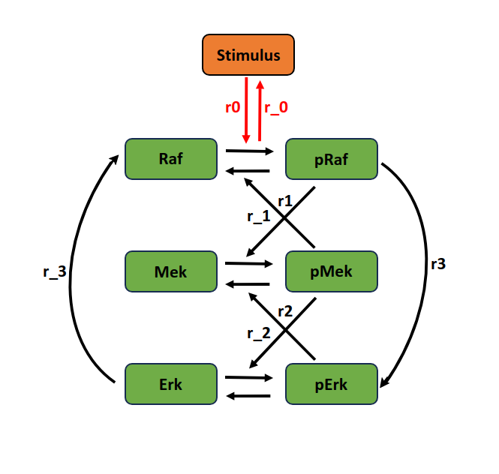
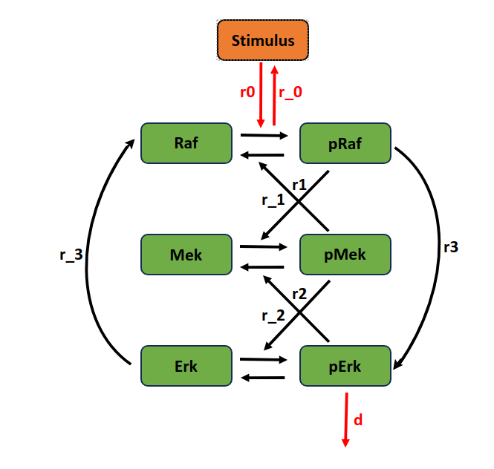
A
B
2
3
1
4
5

Slide 10
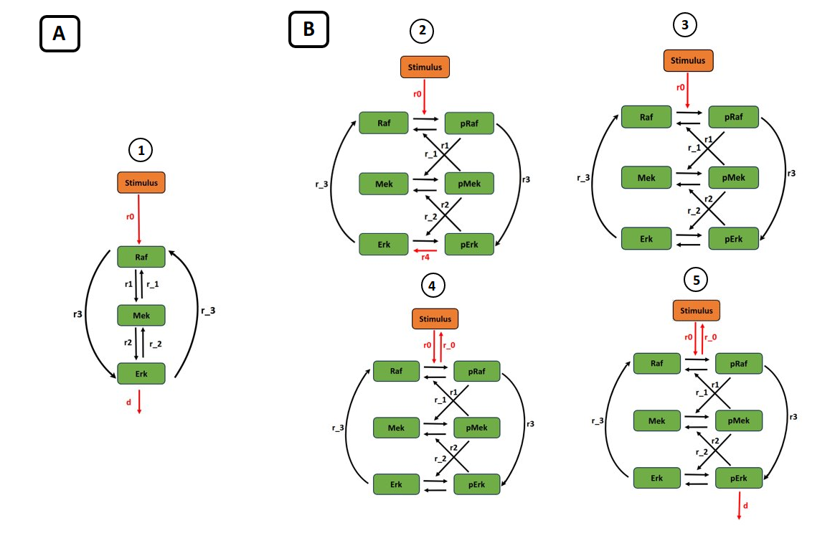

Slide 11


a.
b.
c.
EGF (5 min)
NGF (5 min)
NGF (15 min)
RAF
RAF
RAF
-0.10
1.11
0.06
1.63
-0.17
6.18
-0.53
MEK1,2
0.09
0.25
MEK1,2
0.16
0.40
MEK1,2
0.96
-0.35
1.00
-0.57
1.08
-3.73
0.63
ERK1,2
ERK1,2
ERK1,2

Slide 12
