Slide 1
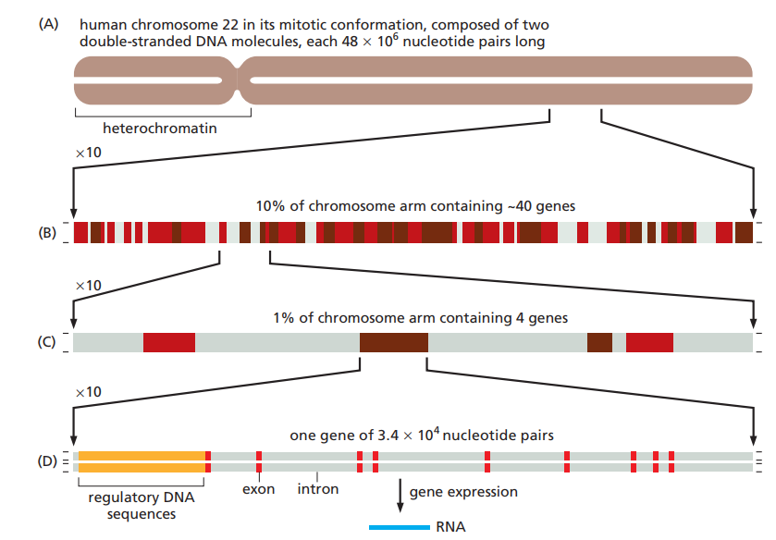

Slide 2
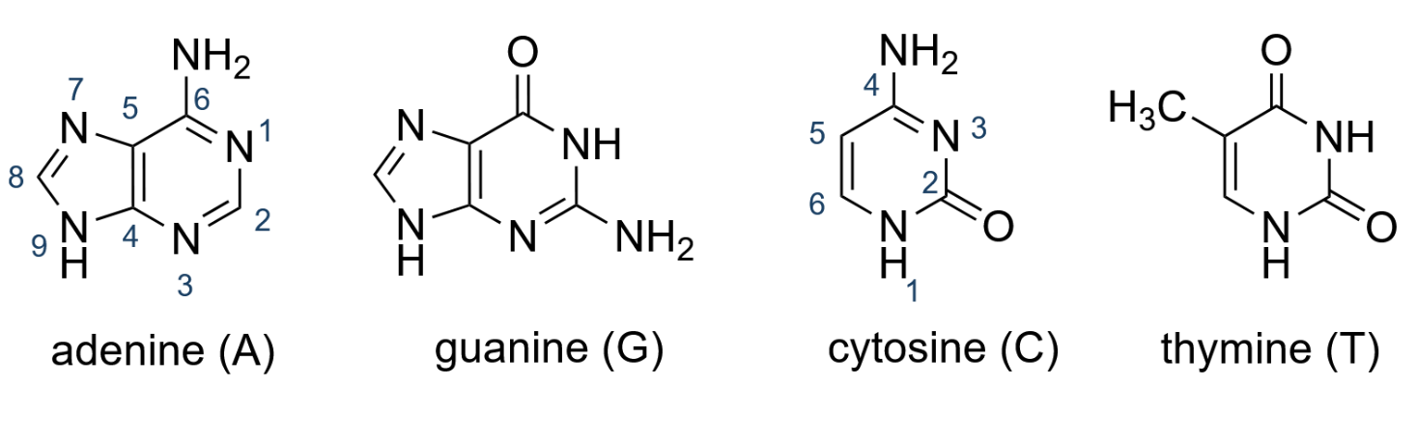
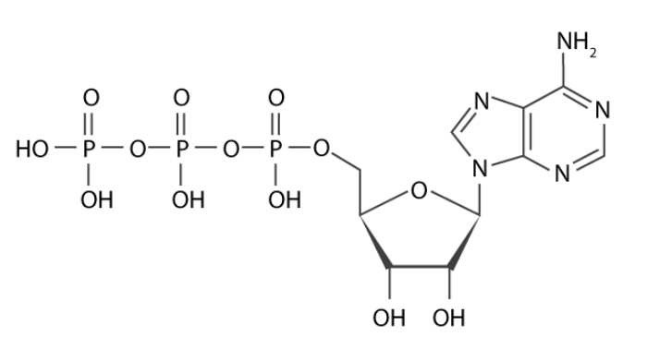
A.
B.
Adenosine triphosphate (ATP)

Slide 3
Population | Weighted Fitness
X_1 | 0.12
X_2 | 0.32
X_3 | 0.23
X_4 | 0.20
X_5 | 0.13

Slide 4
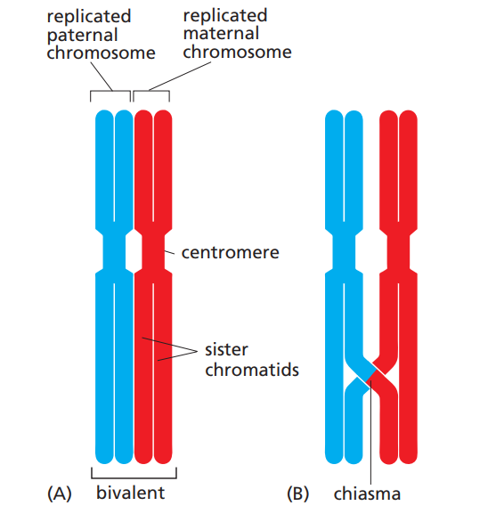
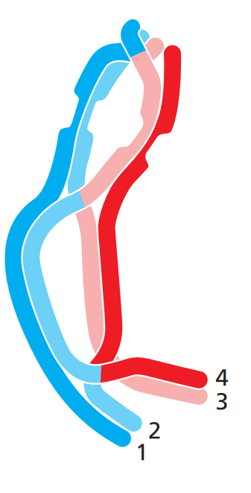
A)
B)

Slide 5

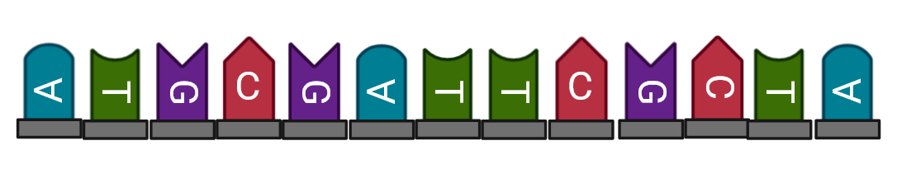



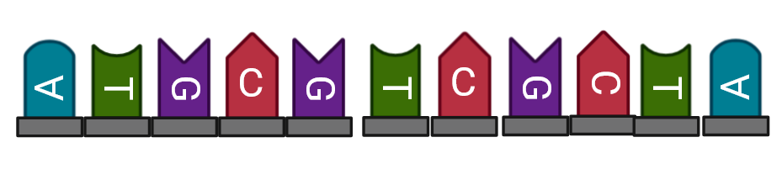

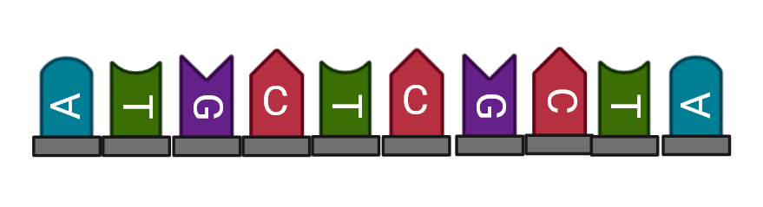

Deletion Substitution
Insertion Inversion

Slide 6
Population Initialization
Fitness Computation
Selection of Survivors
Recombination
(Crossover)
Loop until the termination criteria are met
Mutation
Population Updated for
Next Generation
Return the Best Results

Slide 7


X1 = random.sample(1, len(paren1), 1)
p1 = „1011100001010101010101101101001011110000“ o1 = „1011100001010101010101101111000000000001“
p2 = „1110000001111000001010101011000000000001“ o2 = „1110000001111000001010101001001011110000“
p3 = „1011100001010101010101101101000000000000“ o3 = „1011100001111000001010111111111111111110“
p4 = „1110000001111000001010111111111111111110“ o4 = „1110000001010101010101101101000000000000“
p5 = „1011100001010111100100101101001001010000“ o5 = „1110000001010111101010101011000011111111“
p6 = „1110000001111000001010101011000011111111“ o6 = „1011100001111000000100101101001001010000“
X2 = random.sample(1, len(paren3), 1)
X3 = random.sample(1, len(paren5), 2)

Slide 8
A.
mutation_rate = 0.02
new_chromosome = ''.join(
'1' if bit == '0' and random.random() <= mutation_rate else
'0' if bit == '1' and random.random() <= mutation_rate else
bit
for bit in chromosome
)
B.
o1 = „1011100001010101010101101111000000000001“ o1 = „1011000001010101011101101111000001000000“
o2 = „1110000001111000001010101001001011110000“ o2 = „0110000001111000001010101001001011110101“
o3 = „1011100001111000001010111111111111111110“ o3 = „1001100001111000001010111111111111111110“
o4 = „1110000001010101010101101101000000000000“ o4 = „1110000001010101001101101101000000000000“
o5 = „1110000001010111101010101011000011111111“ o5 = „1110001001010111101010001011000011111111“
o6 = „1011100001111000000100101101001001010000“ o6 = „1011100001111000000100101101000001010000“

