Slide 1
Simulation
For i = 1, …, tmax/dt:
for l in range(compartment_length):
for d in tange(compartment_depth):
update:
free_morphogen
inhibitor_morphogen
bound_morphogen
inhibitor_bound_morphogen
# cell growth Verhulst ?
# diffusion:
free_morphogen
inhibitor_morphogen
inhibitor_bound_morphogen
intermediate save based on saveStepInterval
Output:
Three dimensonal matrices contain intermediate-saves
Exp:
Free_morpgogen_all.shape = (l, d, (tmax/dt) / saveStepInterval)
# cells_GFP
# cells_mCherry
# cells_iM

Slide 2
1) 2) 3)
Diffusion Pattern
upper_left_corner_diff()
upper_side_diff()
upper_right_corner_diff()
left_side_diff()
diffusion2d()
right_side_diff()
lower_left_corner_diff()
lower_side_diff()
lower_right_corner_diff()
5)
4)
7)
6)
9)
8)

Slide 3




Sim_python4-Sim1
Each cell is able to trap GFP (A_cells 0.5)
The first 10 cells from left produce GFP (GFP_cells 5)
The 10 cells from right produce anti GFP(I_cells 5)
Simulation duration: 1-50
GFP(10 cells) GFP-Inhibitor GFP_Inhibitor(10 cells)
Anchor

Slide 4
Sim_python4-Sim2
There is no Anchor
The first 10 cells from left produce GFP (GFP_cells 5)
The 10 cells from right produce anti GFP(I_cells 5)
Simulation duration: 1-50
GFP(10 cells) GFP-Inhibitor GFP_Inhibitor(10 cells)

Slide 5





Sim_pythpn5-sim1
The first 10 cells from left produce GFP (GFP_cells 2)
The third 10 cells from the left produce mCherry as soon as they are activated with GFP (MC_cells 0.4)
The 10 cells from right produce anti mCherry(I_cells 2)
Simulation duration: 1-50
GFP(10 cells) mCherry (10cells) mCherry-Inhibitor inhibitor(anti-mCherry)(10 cells)

Slide 6
Sim_pythpn5-sim2
The first 10 cells from left produce GFP (GFP_cells 2)
The third 10 cells from the left produce mCherry as soon as they are activated with GFP (MC_cells 0.4)
Each cell is able to trap mCherry (A_cells 0.5)
The 10 cells from right produce anti mCherry(I_cells 2)
Simulation duration: 1-50
GFP(10 cells) mCherry (10cells) mCherry-Inhibitor inhibitor(anti-mCherry)(10 cells)
Anchor (traps mCherry)

Slide 7
Protein cascades, that lead to gene expression
Different initializations
Different cell production potential
Feedback loops (positive and negative)
Competitive and non-competitive inhibitor and anchor binding patterns
More than one morphogen
Genetic Algorithms
- Gene regulatory mechanisms (GRMs )
- reverse engineering Gene regulatory mechanisms (GRMs )
- Reza Mousavi1 & Daniel Lobo

Slide 8
Diffusion pattern
fm = np.array(data["fM"])
fm_last = fm[:, :, -1]
print(fm_last[:, 10])
"""
[28.45005 28.45173 28.44928 28.445587 28.441536 28.437447 28.433462
28.42965 28.426043 28.422657 28.419497 28.416565 28.413849 28.411348
28.409046 28.406933 28.404999 28.40323 28.401615 28.400143 28.398806
28.39759 28.396488 28.395489 28.394585 28.39377 28.393034 28.392372
28.391775 28.39124 28.39076 28.390335 28.389954 28.389614 28.389317
28.389053 28.388823 28.388624 28.388456 28.388317 28.3882 28.388107
28.388039 28.387995 28.38797 28.387968 28.387989 28.388035 28.388103
28.388199 28.388317 28.388466 28.388641 28.388851 28.389095 28.389378
28.389698 28.390064 28.390476 28.390942 28.391466 28.39205 28.392702
28.39343 28.394238 28.39513 28.396116 28.397205 28.398405 28.399725
28.401173 28.402763 28.404503 28.406403 28.408476 28.410732 28.413189
28.415857 28.418755 28.421894 28.42529 28.428959 28.432919 28.437183
28.441776 28.446705 28.451992 28.457653 28.4637 28.47015 28.47701
28.48429 28.49198 28.500076 28.508545 28.517317 28.526255 28.535038
28.542791 28.546618]
"""

Slide 9
heatmap_plots.py
def __init__(self,
data_path,
video_directory,
video_name,
title, # redundant
x_label,
y_label,
z_labels, # title
subplots, # (3, 3)
cmaps,
title_size=14,
label_size=12,
fps=20,
interval=50,
writer='ffmpeg’,
fig_size=(28, 16),
colorbar=True,
pad=0.1,
grid=None,
subplot_size=None, plot_margins=None, hide_axis=False, background_color='white',
title_color='black', xlabel_color='black', ylabel_color='black', colorbar_axis=True
):

Slide 10
Population Initialization
Genetic Algorithm
Simulation
Fitness Computation
Selection of Survivors
Recombination
(Crossover)
Loop until the termination criteria are met
Mutation
Population Updated for
Next Generation
Return the Best Results

Slide 11
Population Initialization
Population Initialization
Species:
sp1 (matrix (10, 10))
Sp2 (matrix(10, 10))
sp1_cells (matrix(10, 10))
sp2_cells (matrix(10, 10))
Params (matrix(1, 6))
(sp1_sec, sp2_sec, sp1_diff,
sp2_diff, sp1_deg, sp2_deg)
Simulation output (Y^):
sp2_predicted (10, 10)
Target (Y):
sp2 (matrix(10, 10))
[„1011101010110111 …10101110“]
Euch chromosome (individuale)
precision_bits (min_val, max_val, bits)
[„1011101010110111 … 10101110“,
„1011101010110111 … 10101110“,
„1011101010110111 … 10101110“,
„1011101010110111 … 10101110“,
„1011101010110111 … 10101110“ ]
Population
[[„1011101010110111 … 10101110“,
„1011101010110111 … 10101110“,
„1011101010110111 … 10101110“,
„1011101010110111 … 10101110“,
„1011101010110111 … 10101110“ ],
…
…
[„1011101010110111 … 10101110“,
„1011101010110111 … 10101110“,
„1011101010110111 … 10101110“,
„1011101010110111 … 10101110“,
„1011101010110111 … 10101110“ ]]
Simulation
Fitness Computation
Selection of Survivors
Recombination
(Crossover)
Loop until the termination criteria are met
Mutation
Population Updated for
Next Generation
Return the Best
Results

Slide 12
Population Initialization
Simulate the system with each chromosome
convert binary population into decimal population
[„1011101010110111 … 10101110“,
„1011101010110111 … 10101110“,
„1011101010110111 … 10101110“,
„1011101010110111 … 10101110“,
„1011101010110111 … 10101110“ ]
Simulation
binary_chromosome decimal_chromosome
sp1 (ndarray) of shape (10, 10)
sp2 (ndarray) of shape (10, 10)
sp1_cells (ndarray) of shape (10, 10)
sp2_cells (ndarray) of shape (10, 10)
params (ndarray) of shape (1, 6)
Fitness Computation
Selection of Survivors
Recombination
(Crossover)
Loop until the termination criteria are met
A list of decimal_predictied (y^)
sp2(ndarray) of shape(10, 10)
Simulations
Mutation
Population Updated for
Next Generation
Return the Best
Results

Slide 13

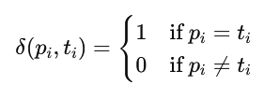
Population Initialization
Compute fitness of each simulation result (y^)
Simulation
a list of decimal_predicted (Y^)
sp2(ndarray) of shape(10, 10)
Fitness Computation
Compare with
Selection of Survivors
a list of binary predicted (Y^)
sp2(binary)
binary target (y)
sp2 (binary)
Recombination
(Crossover)
Loop until the termination criteria are met
Mutation
Population Updated for
Next Generation
Minimum fitness = 0
Maximum fitness = len(binary target)
Return the Best
Results

Slide 14


Population Initialization
Selection based on fitness
Population = [chr_1, chr_2, …, chr_n]
Fitness_scores = [f_1,f_2,…,f_n]
Population Size = n
Tournament Size: k
Simulation
Fitness Computation
Fitness Proportionate Selection (Roulette Wheel Selection)
Tournament
Selection of Survivors
Recombination
(Crossover)
Loop until the termination criteria are met
Mutation
Population Updated for
Next Generation
Return the Best
Results

Slide 15
Population Initialization
Recombination (Crossover) and Mutation
parent1 = random.choice(parents)
parent2 = random.choice(parents)
parents.remove(parent1)
parents.remove(parent2)
Simulation
Parent1: [„10110111 … 10101110“, „0110111 … 10101110“, „10110111 … 10101110“, „010110111 … 10101110“, „010110111 … 10101110“ ]
Parent2: [„10110111 … 10101110“, „0110111 … 10101110“, „10110111 … 10101110“, „010110111 … 10101110“, „010110111 … 10101110“ ]
Fitness Computation
If random.random() < crossover_rate:
crossover_points = sorted(random.sample(range(1, n)), 2)) # [10, 40]
Selection of Survivors
Each sub-chromosome:
Crossover rate (0.8)
Number of crossover points (2)
Recombination
(Crossover)
Loop until the termination criteria are met
sp1(paren1): „1011101010110000001110111 000000000000111111110101010000111111111111111110101110“
sp1(parent2)„1011101010110000001110111 000000000000000011110000000000000011111111111110101110“
sub-offspring1: „1011101010110000001110111 000000000000111111110101010000111111111111111110101110“
sub-offspring2: „1011101010110000001110111 000000000000111111110101010000111111111111111110101110“
mutation rate: 0.01
sub-offspring1: „1011101010110000001110111 000000000000111111110101010000111111111111111110101110“
sub-offspring1: „1011101010110000001111111 000000000000111111110101010000110111111111111110101110“
Mutation
Population Updated for
Next Generation
Return the Best
Results

Slide 16









Parameters Specie 1 Specie 2 Specie 3 Specie 4 Specie 5 Specie 6
[„1010100001010“, „11000011“, „100100“, „010011“, „101011“, „00101“, „10110101“]

Slide 17
Diffusion:
print(sp1[:10, :10, 50])
[ [0.00031737 0.00029505 0.00027393 0.000254 0.00023519 0.00021748 ...] [0.00031737 0.00029505 0.00027393 0.000254 0.00023519 0.00021748 ...] [0.00031737 0.00029505 0.00027393 0.000254 0.00023519 0.00021748 ...] [0.00031737 0.00029505 0.00027393 0.000254 0.00023519 0.00021748 ...] [0.00031737 0.00029505 0.00027393 0.000254 0.00023519 0.00021748 ...] [0.00031737 0.00029505 0.00027393 0.000254 0.00023519 0.00021748 ...] [0.00031737 0.00029505 0.00027393 0.000254 0.00023519 0.00021748 ...] [0.00031737 0.00029505 0.00027393 0.000254 0.00023519 0.00021748 ...] [0.00031737 0.00029505 0.00027393 0.000254 0.00023519 0.00021748 ...] [0.00031737 0.00029505 0.00027393 0.000254 0.00023519 0.00021748 ...]
….
]
print(sp1[:, 10, 50])
[0.00014389 0.00014389 0.00014389 0.00014389 0.00014389 0.00014389 0.00014389 0.00014389 0.00014389 0.00014389 0.00014389 0.00014389 0.00014389 0.00014389 0.00014389 0.00014389 0.00014389 0.00014389 0.00014389 0.00014389 0.00014389 0.00014389 0.00014389 0.00014389 0.00014389 0.00014389 0.00014389 0.00014389 0.00014389 0.00014389 0.00014389 0.00014389 0.00014389 0.00014389 0.00014389 0.00014389 0.00014389 0.00014389 0.00014389 0.00014389 0.00014389 0.00014389 0.00014389 0.00014389 0.00014389 0.00014389 0.00014389 0.00014389 0.00014389 0.00014389 0.00014389 0.00014389 0.00014389 0.00014389 0.00014389 0.00014389 0.00014389 0.00014389 0.00014389 0.00014389 0.00014389 0.00014389 0.00014389 0.00014389 0.00014389 0.00014389 0.00014389 0.00014389 0.00014389 0.00014389 0.00014389 0.00014389 0.00014389 0.00014389 0.00014389 0.00014389 0.00014389 0.00014389 0.00014389 0.00014389 0.00014389 0.00014389 0.00014389 0.00014389 0.00014389 0.00014389 0.00014389 0.00014389 0.00014389 0.00014389 0.00014389 0.00014389 0.00014389 0.00014389 0.00014389 0.00014389 0.00014389 0.00014389 0.00014389 0.00014389]

Slide 18
4
3b
3a
2b
2a
1b
1a
Individual Matrix
1a: species 1 (target) compartment
1b: species 1 secretion pattern compartment
2a: species 2 compartment
2b: species 2 secretion pattern compartment
3a: complex1 (species1-species2) compartment
3b: complex1 infos matrix
4: species and simulation infos matrix

Slide 19
ind 1 ind 2 ind m
Population =
(m, z, y, x)
, , … ,
…
updated
(m, y)
In every iteration of each epoch:
.T
rates
.T
=
…
…
(m, y)
(m, )

Slide 20

.T
updated
…
…
=
…
broadcasting
(y, m) (y, m)
(m, y)
: Elementwise multiplication

Slide 21
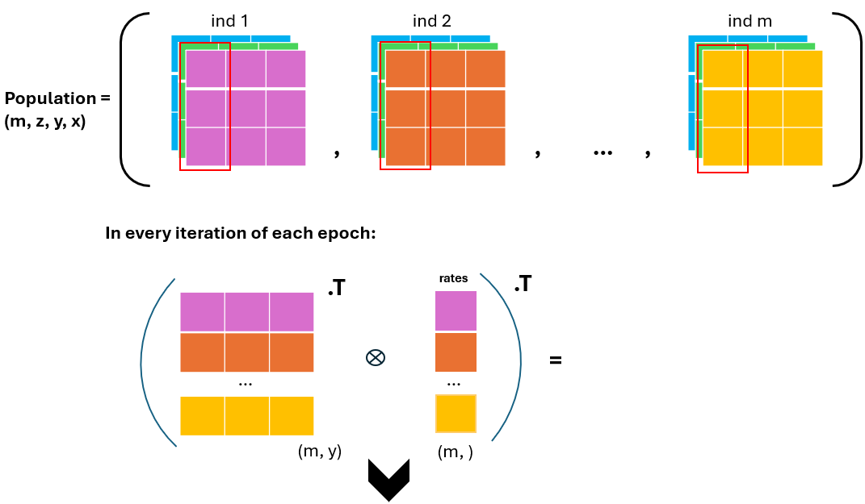
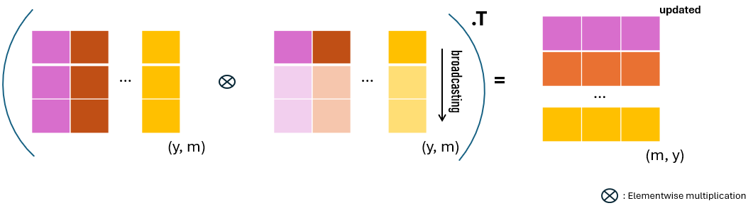

Slide 22
Species 1:
1) production rate
2) degradation rate
3) diffusion rate
Species2:
1) production rate
2) degradation rate
3) diffusion rate
Simulation Information:
1) number of species in the system
2) number of complexes in the system
3) maximum number of simulation epochs
4) stop time of simulation
5) time step
Species and Simulation Infos Matrix
Species 1
Species 2
…
Simulation
Information
2 3
2 3
… … …
1 2 3 4 5

Slide 23
Complex Infos Matrix
2
3 4 5 6
1: species 1 index
2: species 2 index
3: collision rate
4: dissociation rate
5: degradation rate
6: diffusion rate

Slide 24
Signaling molecule
This complex can not be created (collision rate = 0)
An Individual (Biological System)
Production rate: 0.2
Degradation rate: 0.1
Diffusion rate: 0.6
Collision rate: 0.0
Dissociation rate: …
Degradation rate: ..
Diffusion rate: ..
Signaling molecule
A complex
Collision rate: 0.7
Dissociation rate: 0.4
Degradation rate: 0.1
Diffusion rate: 0.3
Production rate: 0.6
Degradation rate: 0.3
Diffusion rate: 0.9
anchor molecule (diffusion rate = 0)
Trapped signal molecule (anchor-signal, diffusion rate = 0)
Production rate: 0.4
Degradation rate: 0.39
Diffusion rate: 0.0
Collision rate: 0.1
Dissociation rate: 0.06
Degradation rate: 0.01
Diffusion rate: 0.0

Slide 25
Epoch i
iter 1 iter 2 iter 3 iter 4 iter 5 iter 6 iter 7 iter 8 iter 9 iter 10
Compartment size: (10, 10)
Epoch: i
Iteration: 4
Iteration Direction: left to right
Iteration Direction:

Slide 26
A
B
A
B
C
Species Insertion Mutation
A
B
C
A
B
A
C
C
B
Species Deletion Mutation
B
A
C
A
C

Slide 27
p
d
f
Production
Degradation
Diffusion
s
X
c
d
Y_hat Y
f
Collision
Degradation
Dissociation
Diffusion
≈
c
s
X: individual matrix
Y_hat: prediction
Y: Target
P: Prodiction rate
C: Collision rate
D: Degradation rate
S: Dessociation rate
F: Diffusion rate
: Forward pass direction
: Backward pass direction
Production
Degradation
Diffusion
p
d
f

Slide 28


Forward Pass:
Backward Pass:
Linear Transformation Reaction Activation Diffusion Diffusion Activation Cost Computation
Z1 = W.X A = g(Z1) Z2 = W2.A Ý = g(Z2)
X
Z1
A
Z2
Ý
loss
W1
W2
ӘX
ӘZ1
ӘA
ӘZ2
ӘÝ
Әloss
ӘW1
ӘW2
X: Concentration of a species or complex in the system W1: Production/degradation/collision/dissociation rate Z1: Updated concentration A: Applied ReLU activation to ensure non-zero concentration
Z2: Updated concentration after diffusion W2: Diffusion rate
Ý: Applied ReLU activation to ensure non-zero concentration Loss: Computed difference between actual and predicted values (Ý - Y) Әloss: Derivative of the cost function ӘÝ: Partial derivative of Ý with respect to loss (Әloss/ӘÝ)
ӘZ2: Partial derivative of Z2 with respect to ӘÝ ӘW2: Partial derivative of W2 with respect to ӘZ2
ӘA: Partial derivative of A with respect to ӘZ2 (ӘA/ӘZ2) ӘZ1: Partial derivative of Z with respect to ӘA (ӘZ/ӘA) ӘW1: Partial derivative of W1 with respect to Z (ӘW1/ӘZ)
Gradient of Loss with Respect to W1 and W2:

Slide 29
0 | 0 | 0 | 0 | 0 | 0
0 |  |  |  |  | 0
0 |  |  |  |  | 0
0 |  |  |  |  | 0
0 |  |  |  |  | 0
0 | 0 | 0 | 0 | 0 | 0
2 | 1 | 3 | 5
5 | 3 | 7 | 7
8 | 1 | 4 | 1
6 | 1 | 5 | 2
2 | 1 | 3 | 5
5 | 3 | 7 | 7
8 | 1 | 4 | 1
6 | 1 | 5 | 2
5/1.22 7/2.44
8/1.77 5/1.33
Zero Padding Max Pooling
Average Pooling
Max(0, 0, 0, 0, 2, 1, 0, 5, 3) = 5
Average(0, 0, 0, 0, 2, 1, 0, 5, 3) = 1.22
Max(0, 8, 1, 0, 6, 1, 0, 0, 0) = 8
Average(0, 8, 1, 0, 6, 1, 0, 0, 0) = 1.77
Max(0, 0, 0, 3, 5, 0, 7, 7, 0) = 7
Average(0, 0, 0, 3, 5, 0, 7, 7, 0) = 2.44
Max(4, 1, 0, 5, 2, 0, 0, 0, 0) = 5
Average(4, 1, 0, 5, 2, 0, 0, 0, 0) = 1.33

Slide 30
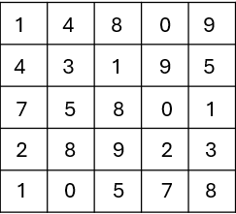
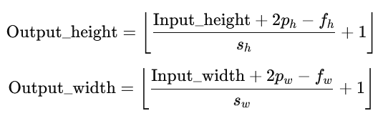


Filter height = 3
Input 2D matrix (5, 5)
0 0 0 0 0 0 0
Strides = 2
Max(0,0,0,0,1,4,0,4,3) = 4
Avg(0,0,0,0,1,4,0,4,3) = 1.3
Max(0,0,0,4,8,0,3,1,9) = 9
Avg(0,0,0,4,8,0,3,1,9) = 2.8
Max(0,0,0,0,9,0,9,5,0) = 9
Avg(0,0,0,0,9,0,9,5,0) = 2.6
Max(0,4,3,0,7,5,0,2,8) = 8
Avg(0,4,3,0,7,5,0,2,8) = 3.2
1 4 8 0 9
0 0
Output 2D matrix (3, 3)
4 3 1 9 5
0 0
4/1.3 9/2.8 9/3.2
Zero Padding Max/Avg Pooling
7 5 8 0 1
0 0
8/3.2 … …
Padding = (1, 1)
2 8 9 2 3
0 0
… … …
1 0 5 7 8
0 0
0 0 0 0 0 0 0
calculating the output dimensions after applying pooling operation
Output 2D matrix (5, 5)
Input 2D matrix (3, 3)
Kernel(3, 3), glorot initialized
0.4 1.6 … … …
4 9 …
0.1 0.4 0.3
… … … … …
… … …
Transpose Convolution
filters=1,
padding=valid,
stirdes=(1, 1)
… … … … …
p = padding
p=0 for "valid" padding (no padding)
p>0 for "same" or custom padding
s = strides (here s = 2)
f = filter size (here f = 3)
0.5 0.2 0.1
… … …
0.1 0.6 0.3
… … … … …
… … … … …
"Valid" Padding with Transpose Convolution
​​
= Symbol of convolution operation

Slide 31
Padding & Pooling
Down-sampling (optional, reduce computational cost)
Population Initialization
Simulation
Cost Computation
Evolutionary Optimization I
Crossover
Pooling up-sampling
(If Down-sampling Was Used)
Mutation
Simulation
Cost Computation
Evolutionary Optimization II
Crossover
Mutation
Gradient-based Optimization with Adam (optional)

