Slide 1
================================================================================ *** Genetic Algorithm *** ================================================================================ Generation 1; Best/Max Fitness: 95/200; Generation Duration: 3.3435909748077393 Generation 2; Best/Max Fitness: 114/200; Generation Duration: 1.6619575023651123 Generation 3; Best/Max Fitness: 119/200; Generation Duration: 2.164839029312134 Generation 4; Best/Max Fitness: 116/200; Generation Duration: 1.6536173820495605 Generation 5; Best/Max Fitness: 118/200; Generation Duration: 1.6604735851287842
…
Generation 95; Best/Max Fitness: 163/200; Generation Duration: 2.179832935333252
Generation 96; Best/Max Fitness: 163/200; Generation Duration: 1.7125046253204346
Generation 97; Best/Max Fitness: 161/200; Generation Duration: 1.7150671482086182
Generation 98; Best/Max Fitness: 166/200; Generation Duration: 2.189692974090576
Generation 99; Best/Max Fitness: 165/200; Generation Duration: 1.7210311889648438
Generation 100; Best/Max Fitness: 161/200; Generation Duration: 1.9727318286895752
-----------------------------------------------
Simulation Complete!
The best found fitness: 166
Total Generations: 100
Average Fitness: 149.10
Total Simulation Duration: 186 seconds
-----------------------------------------------

Slide 2
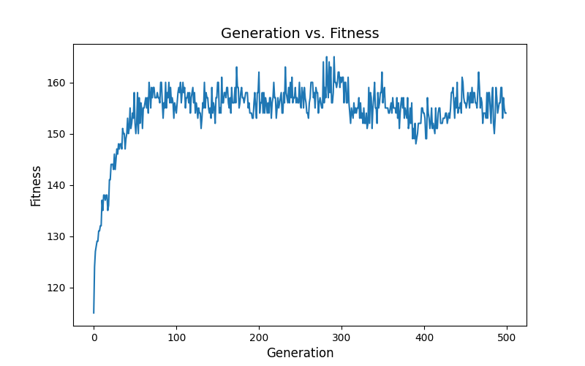

Slide 3
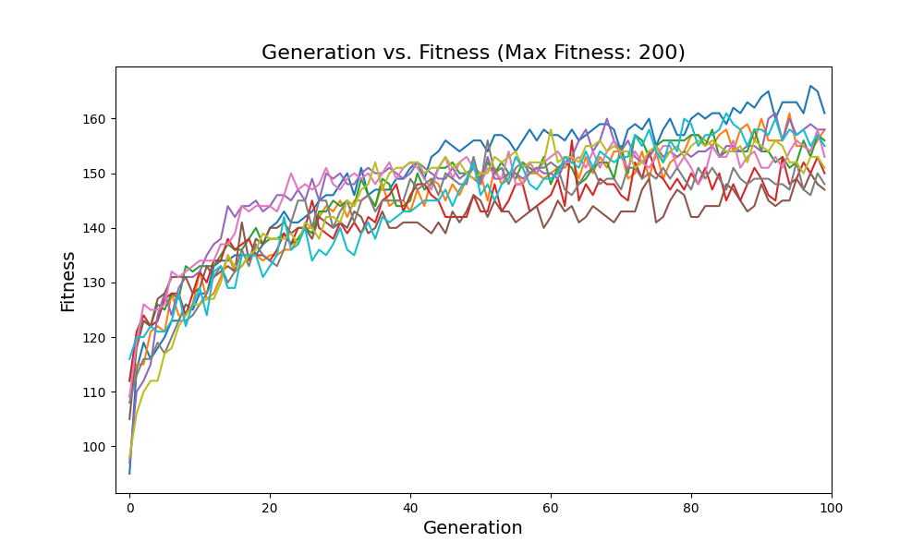

Slide 4
Max Fitness: 200
Best Fitness: 165
Target:
[[129.08548467 139.4739894 160.67062751 193.99802891 180.4960492]
[129.21644978 139.58958083 160.71755831 193.77797854 180.52591354]
[129.28557002 139.65169458 160.75683413 193.77208116 180.55663708]
[129.30294135 139.67869755 160.81186232 193.88001524 180.62530641]
[129.25838938 139.65215348 160.85920086 194.20219023 180.6948121 ]]
Randomly Initialized:
[[ 12.54901961 57.25490196 89.41176471 54.90196078 180.39215686]
[ 92.54901961 127.84313725 140.39215686 175.68627451 88.62745098]
[105.88235294 62.74509804 88.62745098 186.66666667 83.1372549 ]
[ 23.52941176 18.03921569 97.25490196 38.43137255 152.94117647]
[170.98039216 64.31372549 134.11764706 18.03921569 7.84313725]]
Best Result:
[[128.8724352 144.36290359 158.94568972 175.17227271 181.75961926] [129.45646491 142.97626138 161.11917527 172.59943632 180.41509976] [131.0108769 140.05192516 161.70561132 174.81293616 180.02641528] [129.20854791 142.09493839 161.51019647 169.23852482 180.35813287] [128.90336386 144.0897526 160.55283452 169.12834169 179.46000974]]

