Slide 3
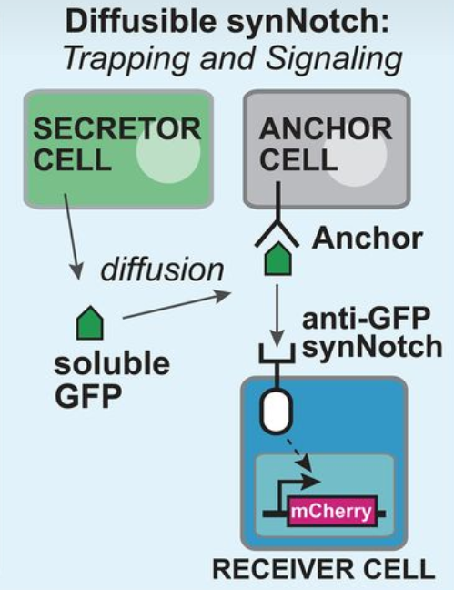
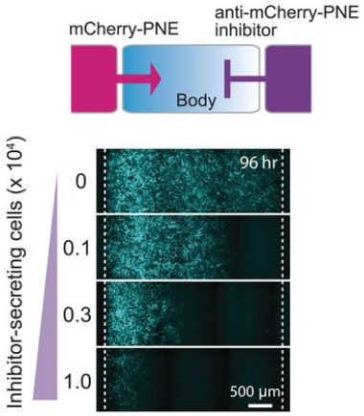
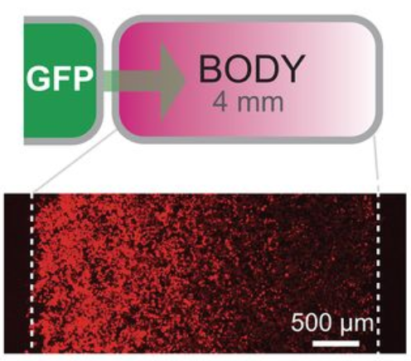
Synthetic morphogen systems
Synthetic Notch system
S. Toda et al., 2020
Arbitrary proteins engineered into synthetic morphogens.
Formation of gradients and directing cell patterning.
Applications in advanced tissue engineering.
“Engineering synthetic morphogen systems that can program multicellular patterning”
Diffusible synNotch system. (S. Toda et al., 2020)

Slide 4
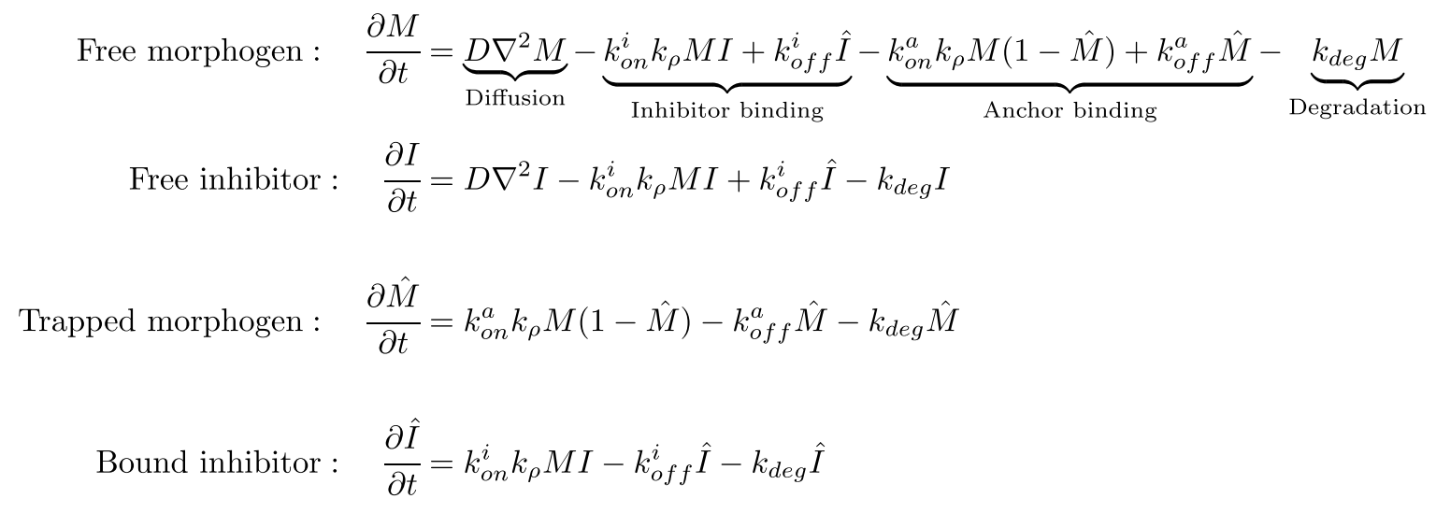
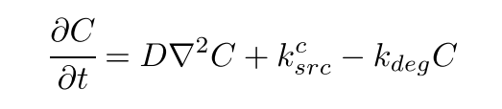
Computational model
Present proteins in the system
Morphogen
Inhibitor
Anchor
Diffusion:
Mathematical Equations (S. Toda et al., 2020)

Slide 5
Protein Secretion Patterns
Morphogen Secretion
Inhibitor Secretion
Cells capable of producing morphogen
Indicated by green cells
Cells capable of producing inhibitor
Indicated by red cells

Slide 6
Diffusion Patterns
Analysis of protein diffusion in a 2D tissue compartment.
Examining three distinct diffusion patterns based on cell location.
Corner Cells
Edge Cells
Central Cells
Cells located at the four corners of the compartment.
Cells situated along the edges of the compartment.
Cells positioned in the middle, away from edges and corners.

Slide 7
Simulation Results
Compartment Size: 100 x 100
GFP Production: First 10 columns on the left
GFP Inhibitor Production: First 10 columns on the right
Anchor Production: None
Free GFP Inhibitor-GFP Free Inhibitor

Slide 8
Genetic Algorithms for Pattern Formation
R. Mousavi and D. Lobo, 2024
Using genetic algorithms to optimize initial protein concentrations for desired spatial patterns.
Develop a genetic algorithm to design and optimize protein concentrations for spatial pattern formation in our system.
“Automatic design of gene regulatory mechanisms for spatial pattern formation”

Slide 9
Genetic Algorithms (GAs)
Introduction
Population Initialization
mimic the natural selection process to find optimal solutions
Pioneered by John Holland’s work(1960s)
represent potential solutions as chromosomes
evolve populations towards better solutions by applying genetic operators like recombination and mutation
Simulation
Fitness Computation
Selection of Survivors
Recombination (Crossover)
Mutation
Update Population
Return the Best Results

Slide 10
Genetic Algorithms
Population Initialization

Slide 11
Genetic Algorithms
Simulation

Slide 12
Genetic Algorithms
Fitness Computation

Slide 13
Genetic Algorithms
Selection of Survivors

Slide 14
Genetic Algorithms
Recombination (Crossover)

Slide 15
Genetic Algorithms
Mutation

Slide 16
Genetic Algorithms
Update Population

Slide 17
Genetic Algorithms
Return the Best Results

Slide 19
E-Mail
Telefon +49 (0) 711 685-
www.
Universität Stuttgart

Slide 20
E-Mail
Telefon +49 (0) 711 685-
www.
Universität Stuttgart

