Slide 1
Highly accurate protein structure prediction with AlphaFold2
Loghman Samani
March 2024

Slide 2
Table of Contents
Introduction to AlphaFold
Introduction to Machine Learning
AlphaFold Structure
Database Search
Evoformer
Structure Module
Achievements
References

Slide 3
Introducing AlphaFold
What is AlphaFold?
AlphaFold is a cutting-edge computational
algorithm developed by DeepMind
AlphaFold1 (2018)
AlphaFold2 (2020)
Critical Assessment of Structure Prediction (CASP)
Purpose
It's designed to predict the 3D structure of proteins

Slide 4
Introducing AlphaFold
Methodology
Employes a deep learning architecture
Attention mechanisms
Gradient-based optimization
Key Features
High accuracy
Scalability
Accessibility
Applications
Drug discovery
Biotechnology
Basic research

Slide 5
Machine Learning Model Overview
Model Representation
Model = W⋅XT + b
W: Weight matrix
X : Input features
B : Bias term
Cost Function
J(W, b) = 1/2m ∑ (predicted−actual)²
m: number of training examples
Training Process
Initialization : randomly initialize W and b
Repeat until Convergence:
Calculate Gradient:
dJ/dW and dJ/db
Update Parameters:
W = W − α ⋅ dJ/dW
B = b − α ⋅ dJ/db
Objective: minimize the cost function J(W,b) by updating parameters W and b iteratively
α (alpha) : learning rate

Slide 6
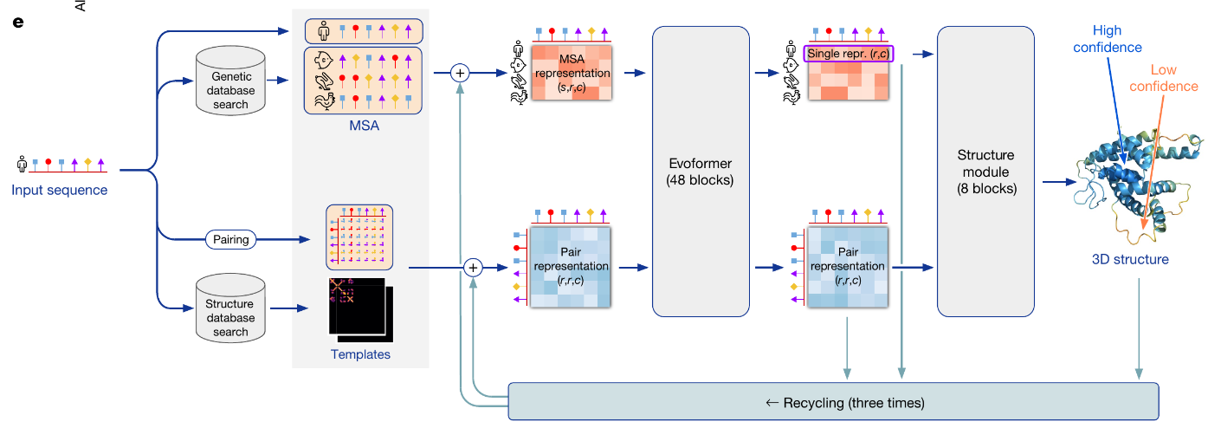
AlphaFold Structure
John Jumper et al. 15 July 2021. https://www.nature.com/articles/s41586-021-03819-2

Slide 7
AlphaFold Structure
Database Search Evoformer Module Structure Module

Slide 8
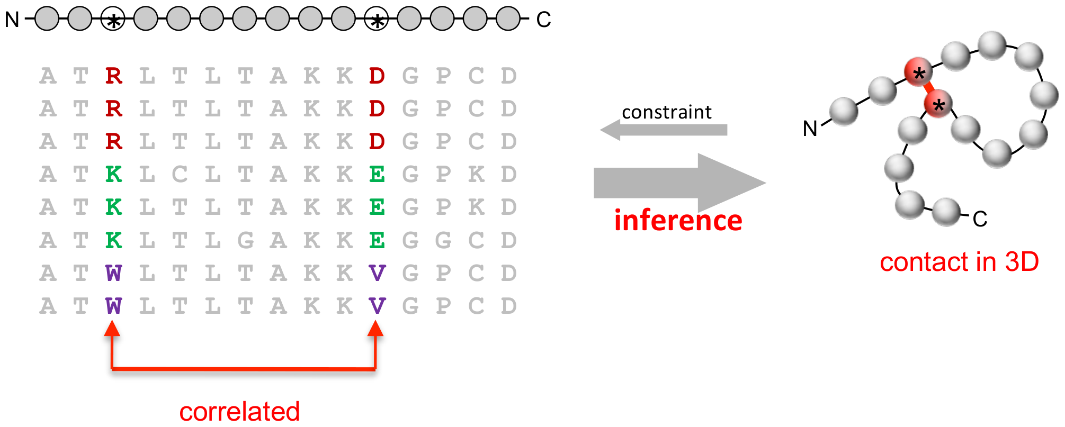
Database Search
Genetic Database Search Structure Database Search
Big Fantastic Database (BFD)
Multiple Sequence Alignment (MSA)
Protein Data Bank (PDB)
The 3D Structure of Proteins
X-ray crystallography
Debora S. Marks et al. December 7, 2011. https://doi.org/10.1371/journal.pone.0028766

Slide 9
AlphaFold Structure
Database Search Evoformer Module Structure Module

Slide 10
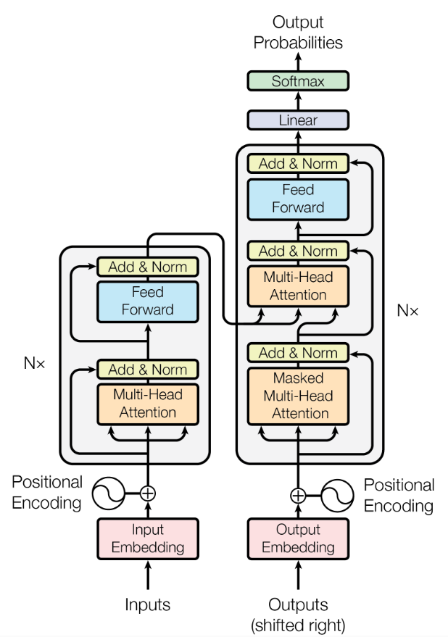
Evoformer (Evolutionary Transformer ?)
Introduction to Transformers
Attention is all you need, Google Brain (2017)
Application Area
Natural Language Processing
Notable Models
GPT-2, GPT-3, Gemini, Google BERT, AlphaFold2
Transformer Components
Embedding Input
Multi-Head Attention
Feed Forward Neural Network
Ashish Vaswani et al. 12 Jun 2017. https://arxiv.org/abs/1706.03762

Slide 11
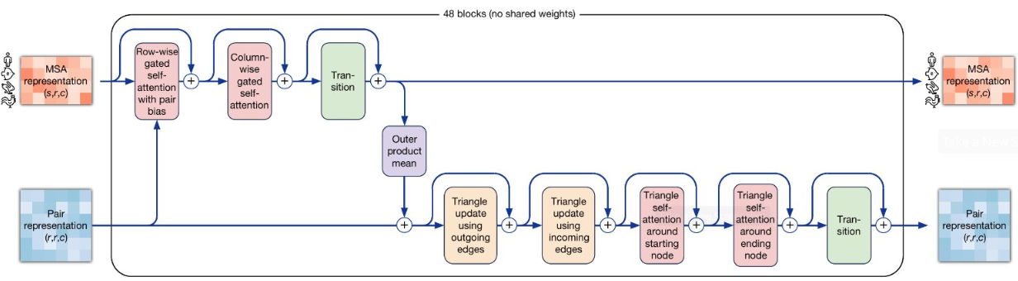
Evoformer (Evolutionary Transformer ?)
MSA Representation Transformer
Pair Representation Transformer
John Jumper et al. 15 July 2021. https://www.nature.com/articles/s41586-021-03819-2

Slide 12
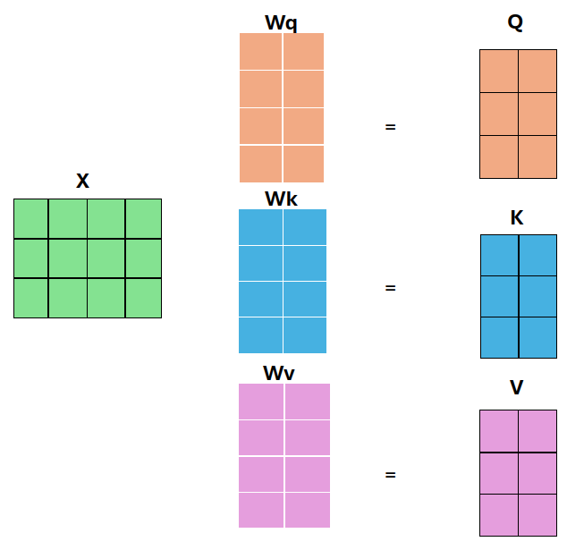
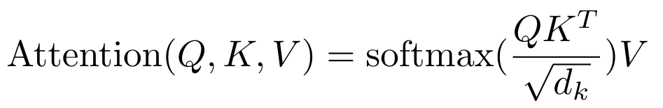
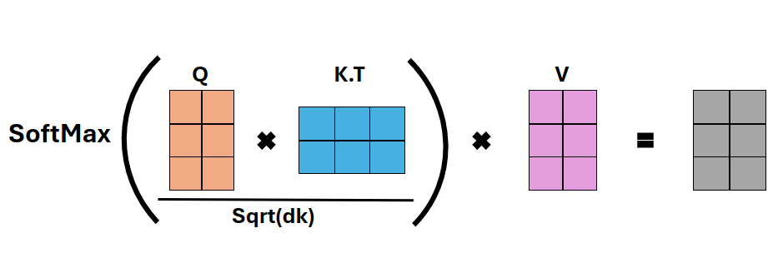
Evoformer (Evolutionary Transformer ?)
Attention Mechanism
Capture Dependencies and Relationships within Input Sequence

Slide 13

Evoformer (Evolutionary Transformer ?)
MSA Representation Transformer
Row-wise and Column-wise Attention ( )
Feed Forward Neural Network ( )

Slide 14
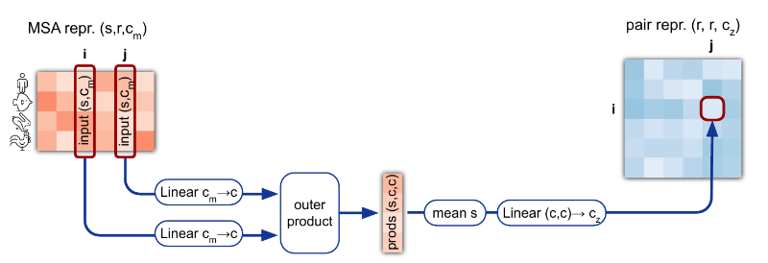
Evoformer (Evolutionary Transformer ?)
MSA Representation Transformer
Row-wise and Column-wise Attention ( )
Feed Forward Neural Network ( )

Slide 15
Evoformer (Evolutionary Transformer ?)
MSA Representation Transformer
Row-wise and Column-wise Attention ( )
Feed Forward Neural Network ( )

Slide 16
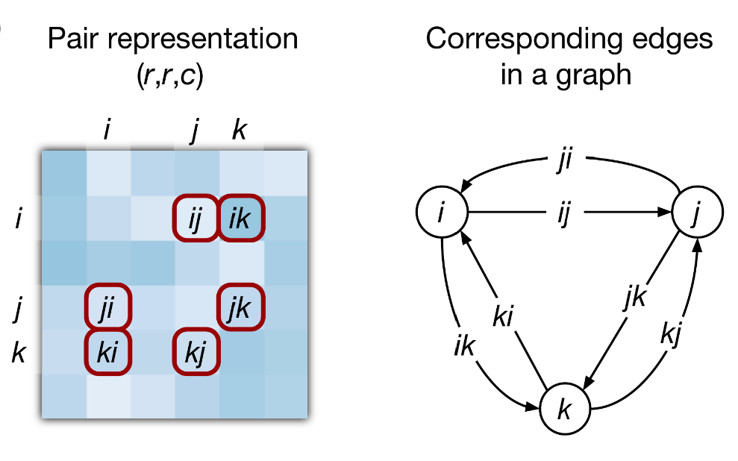
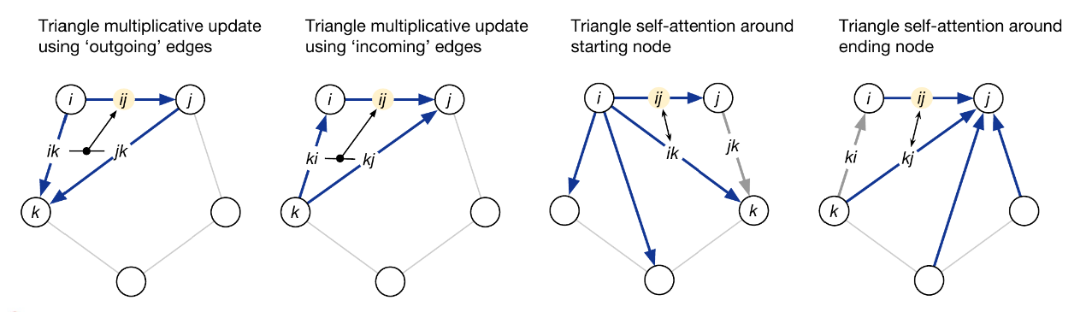
Evoformer (Evolutionary Transformer ?)
Pair Representation Transformer
Triangle Updates
Self-Attention
Feed Forward Neural Network
John Jumper et al. 15 July 2021. https://www.nature.com/articles/s41586-021-03819-2

Slide 17
Evoformer (Evolutionary Transformer ?)
MSA Representation Transformer
Row-wise and Column-wise Attention ( )
Feed Forward Neural Network ( )

Slide 18
AlphaFold Structure
Database Search Evoformer Module Structure Module

Slide 19
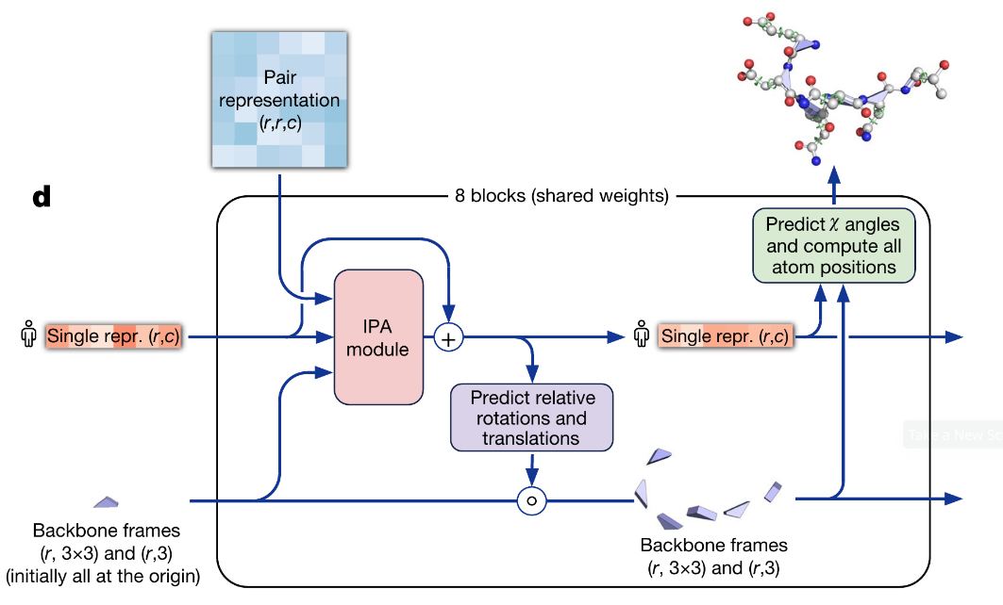
Structure Module
Input
Single Representation
Pair Representation
Backbone Frames
Output
3D Model of the Protein
Cartesian Coordinates in Protein Data Bank (PDB) Format
John Jumper et al. 15 July 2021. https://www.nature.com/articles/s41586-021-03819-2

Slide 20
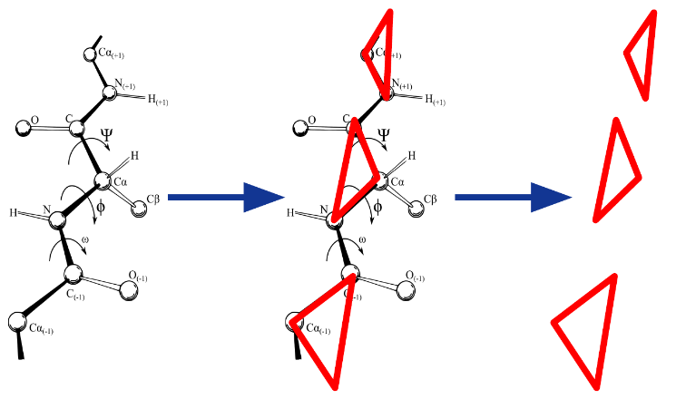
Structure Module
Input
Single Representation
Pair Representation
Backbone Frames
Output
3D Model of the Protein
Cartesian Coordinates in Protein Data Bank (PDB) Format

Slide 21
Structure Module
Input
Single Representation
Pair Representation
Backbone Frames
Output
3D Model of the Protein
Cartesian Coordinates in Protein Data Bank (PDB) Format

Slide 22
AlphaFold Structure
John Jumper et al. 15 July 2021. https://www.nature.com/articles/s41586-021-03819-2

Slide 23
Machine Learning Model Overview
Model Representation
Model = W⋅XT + b
W: Weight matrix
X : Input features
B : Bias term
Cost Function
J(W, b) = 1/2m ∑ (predicted−actual)²
m: number of training examples
Training Process
Initialization : randomly initialize W and b
Repeat until Convergence:
Calculate Gradient:
dJ/dW and dJ/db
Update Parameters:
W = W − α ⋅ dJ/dW
B = b − α ⋅ dJ/db
Objective: minimize the cost function J(W,b) by updating parameters W and b iteratively
α (alpha) : learning rate

Slide 24
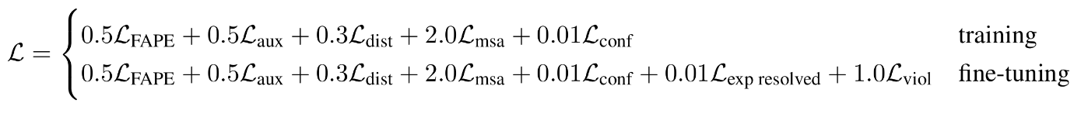
AlphaFold Cost Function
John Jumper et al. 15 July 2021. https://www.nature.com/articles/s41586-021-03819-2
L (FAPE) : Frame Alined Point Error (FAPE) loss
L (aux) : auxiliary loss from the Structure Module
L (dist) : averaged cross-entropy loss for distogram prediction
L (msa) : averaged cross-entropy loss for masked MSA prediction
L (conf) : model confidence loss
L (exp) : experimentally resolved loss
L (viol) : violation loss

Slide 25
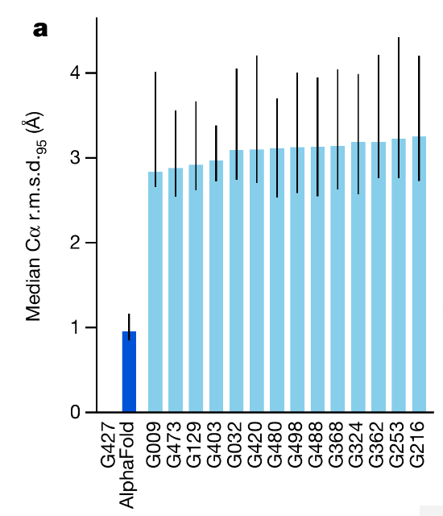
Achievements
First Place in the 14th Critical Assessment of Protein Structure Prediction (CASP14)
Median Backbone Accuracy: 0.96 Å
All-Atom Accuracy of AlphaFold: 1.5 Å
Predicted 98.5% of the Human Proteome
Database with 214 Million Protein Structure Predictions
John Jumper et al. 15 July 2021. https://www.nature.com/articles/s41586-021-03819-2

Slide 26
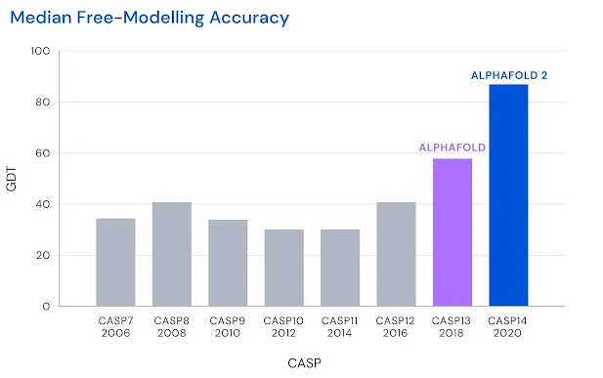
Achievements
First Place in the 14th Critical Assessment of Protein Structure Prediction (CASP14)
Median Backbone Accuracy: 0.96 Å
All-Atom Accuracy of AlphaFold: 1.5 Å
Predicted 98.5% of the Human Proteome
Database with 214 Million Protein Structure Predictions

Slide 27
References
[1] Jumper, J., Evans, R., Pritzel, A. et al. Highly accurate protein structure prediction with
AlphaFold. Nature 596, 583–589 (2021)
[2] Tunyasuvunakool, K., Adler, J., Wu, Z. et al. Highly accurate protein structure prediction for
the human proteome. Nature 596, 590–596 (2021).
[3] Senior, A.W., Evans, R., Jumper, J. et al. Improved protein structure prediction using potentials
from deep learning. Nature 577, 706–710 (2020).
[4] Big Fantastic Database. Accessed 14 January 2024.
[5] Wang, S., Zhou, W. & Jiang, C. A survey of word embeddings based on deep learning.
Computing 102, 717–740 (2020). https://doi.org/10.1007/s00607-019-00768-7.
[6] Chunyan Xu, Zhen Cui, Xiaobin Hong, Tong Zhang, Jian Yang, Wei Liu. Graph Inference
Learning for Semi-supervised Classification.
[7] Protein Data Bank: the single global archive for 3D macromolecular structure data. Nucleic
acids research 47, no. D1 (2019): D520-D528.
[8] Ashish Vaswani, Noam Shazeer, Niki Parmar, Jakob Uszkoreit, Llion Jones, Aidan N. Gomez,
Lukasz Kaiser, Illia Polosukhin. Attention Is All You Need.
[9] Richard E. Turner. An Introduction to Transformers.
[10] G. Bebis and M. Georgiopoulos, Feed-forward neural networks, in IEEE Potentials, vol. 13,
no. 4, pp. 27-31, Oct.-Nov. 1994, doi: 10.1109/45.329294.

Slide 28
Thank you for your attention

Slide 29
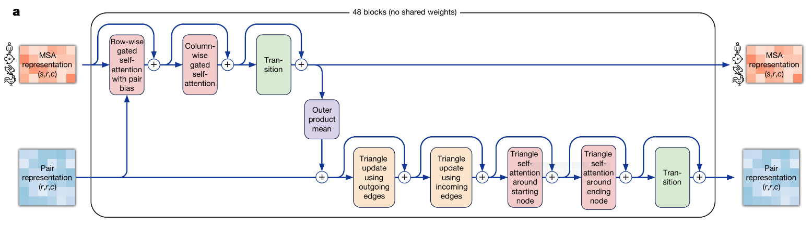

Slide 30
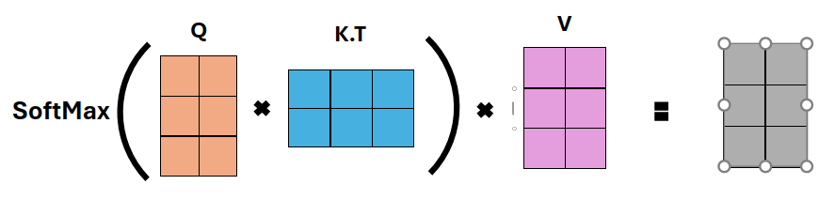
Q K.T V
SoftMax
Sqrt(dk)

