Slide 1


Database Search Evoformer Module Structure Module
2
4
7
11
1
6
9
3
5
8
10

Slide 2
Evoformer Block (48 Blocks)
1
3
4
5
12
6
2
7
8
9
10
11
13

Slide 3
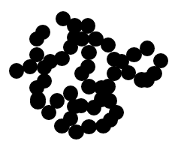
Structure Module (8 layers)
1
6
4
2
5
3

Slide 4

a.
Pair Representation Corresponding edges in a graph
i
j
k
i
i
ij
ik
ji
ki
ij
ik
j
ji
jk
k
ki
kj
j
jk
k
kj
b.
i
i
ij
j
i
ik
ij
ki
ij
jk
ki
ij
k
j
k
kj
j
i
k
k
kj
j
jk
ik
Triangle multiplicative update Triangle multiplicative update Triangle self-attention around Triangle self-attention around
using ‘outgoing’ edges using ‘incoming’ edges starting node ending node

