Slide 1
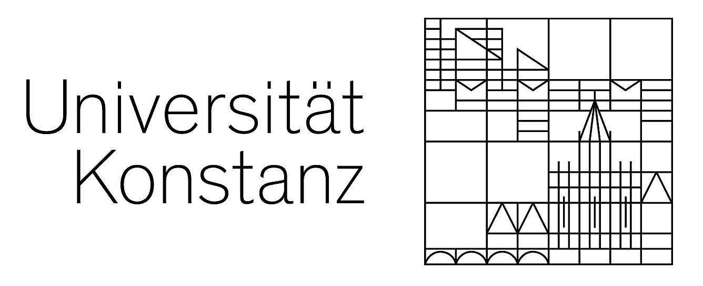
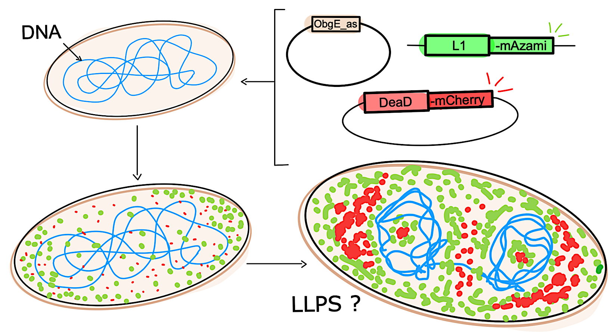
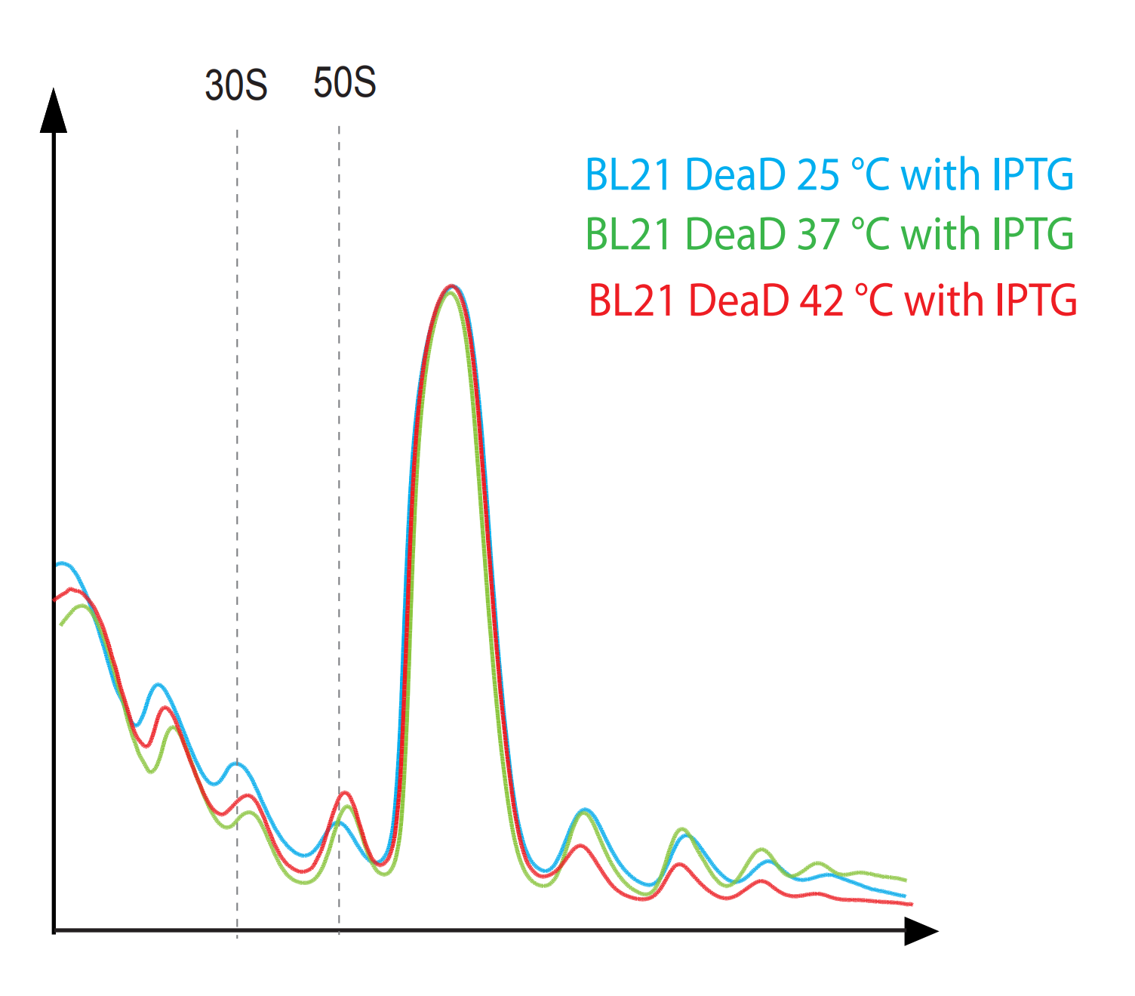
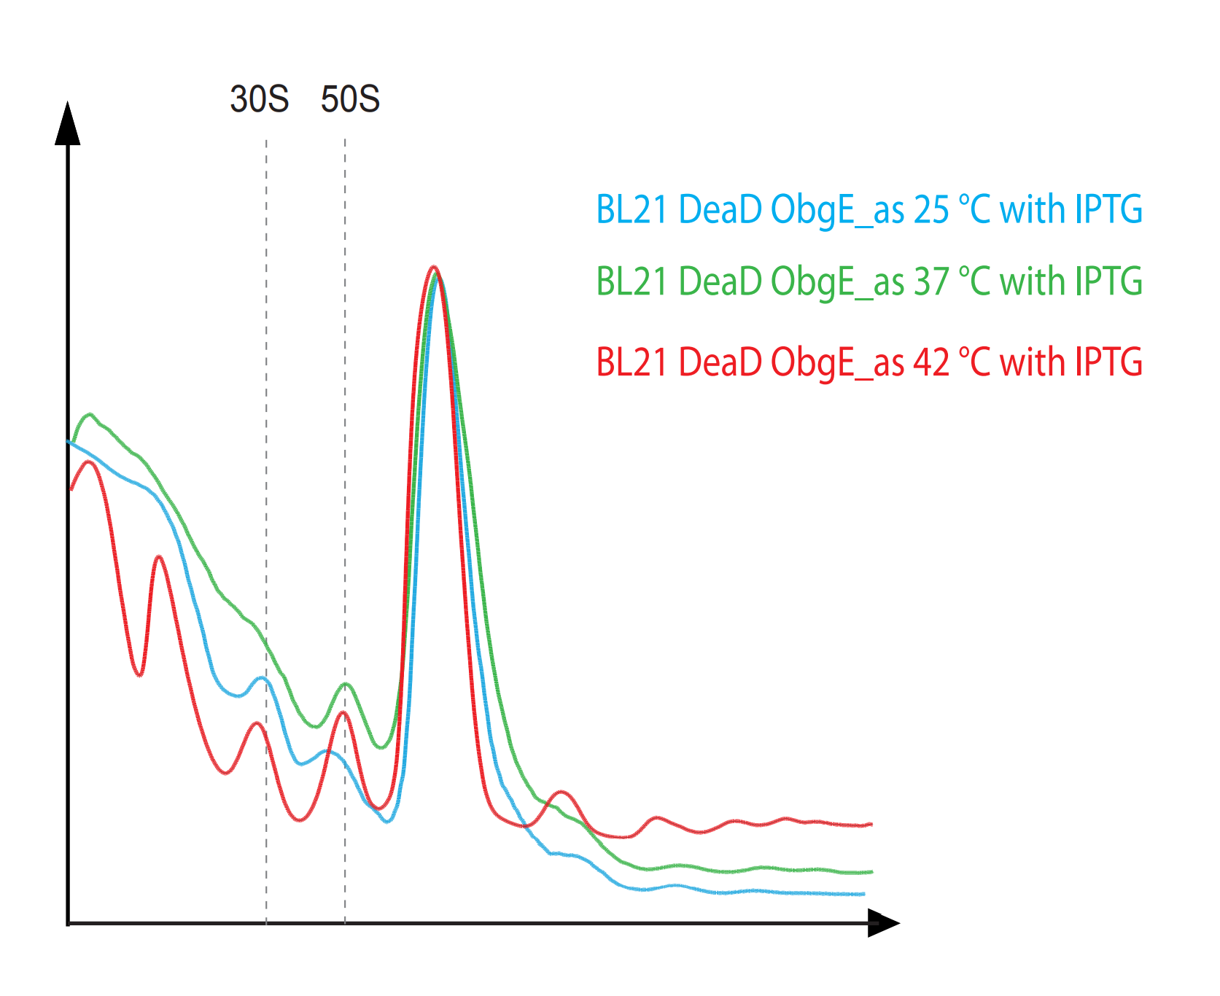

Spatio-temporal localization of proteins during ribosome biogenesis in E. coli
Dilan Torcuk-Cakir, Loghman Samani, Johannes Wenger
Background
1
3
Procaryotes are so far distinguished from eucaryotes mainly by their lack of organelles. Organelles allow for spatio-temporal separation of biochemical reaction centers (BRC). However, Hondele et al. discovered that the rRNA binding protein DEAD forms BRC in procaryotes through a process called liquid-liquid phase separation (LLPS).
E. coli BL21 was used to generate fluorescently labelled strains tagging DEAD-mCherry and ribosomal protein L1-mAzami. Furthermore, knock-down of the GTPase ObgE (ObgE_as) allowed for better observation of possible ongoing effects.
ObgE_ as causes growth deficits in liquid medium
Hypothesis
2
Is LLPS a process associated with ribosome biogenesis in E. coli ?
Phenotypic characterization took place by growth analysis in liquid medium of BL21 DeaD-mCherry (left) and BL21 DeaD-mCherry ObgE_as (right) at different temperatures. Cells were cultivated with no IPTG (grey) or with IPTG (red) to induce DeaD-mCherry overexpression, and ObgE_as respectively. Growth rates were calculated during exponential growth phase at each temperature and normalized to the growth rates of uninduced cells.
IPTG induction caused growth deficits at all temperatures, whereby the ObgE_as strains were affected more severely.
ObgE_as perturbs ribosome assembly in sucrose gradient fractionation
4
Overlays of IPTG induced polysome profiles at different temperatures. The x-axis refers to the sucrose gradient from 10 % - 40 % (left to right), and the y- axis depicts the absorption at 254 nm .
The peaks on the far left depict a soluble fraction and free RNA in the cells, followed by the peaks marked 30S and 50S, which illustrate the according ribosomal subunits. The highest peak depicts the monosomes, and the peaks on the far right depict polysomes.
Plasmid induction disrupts ribosome assembly more at higher temperatures (37°C and 42°C). A variance in the levels of the soluble fraction and free RNA peaks is visible in presence of ObgE_as. The ObgE_as further aggravates the profiles at 25 °C and 42 °C and depict a higher deviation from the profile at 37 °C in their curve progressions.
A₂₅₄
10%
40%
10%
40%
ObgE_as visualizes phase separation in 3D-SIM
5
Super resolution fluorescence microscopy (3D-SIM) images of BL21 L1-mAzami DeaD-mCherry (A-C) and BL21 L1-mAzami DeaD-mCherry ObgE_as (D-F). Cells were grown at different temperatures (25 °C – 42 °C). DNA staining was performed with DAPI DNA stain and is depicted in blue. Ribosomal protein L1-mAzami is visualized in green. Helicase DeaD-mCherry is represented in red.
It appears that DeaD-mCherry forms strong droplets within the ribosomal foci, enclosing a donut-like shaped condensed chromosome, especially in cells grown with perturbed ribosome biogenesis. Furthermore, the three fluorescence signals (green, red and blue) are completely separated from each other depending on the temperature (D – F).
Conclusion
6
The data implied a reduction of growth rate in liquid medium, depending on cultivation temperature and plasmid induction. At low temperatures, the DeaD-mCherry overexpression depicted the highest growth rates, while ObgE knock-down lead to the highest growth deficit. Polysome-profile analysis reproduced the effects of a perturbed ribosome assembly indebted to the knock-down of ObgE.
The microscopy images of the cells with an ObgE knock-down depicted a higher amount of DeaD-mCherry droplet formation in the perturbed ribosome biogenesis irrespective of temperature (D – F). This cannot be stated for cells without the ObgE knock-down (A – C).
In summary, the data suggests an association between LLPS and ribosome biogenesis. However, experiments must be repeated and more research on the mechanism of phase separation is needed. Live cell imaging would be a future step.
Acknowledgements
Prof. Dr. Elke Deuerling, Carla Dahlem (M.Sc), Dr. Rainer Nikolay, and the whole group at the Deuerling Lab.

