Slide 1
MPM Base
MLS-MPM
CKMPM
Linear Momentum
Unit Test
Comparing MPM Base · MLS-MPM · CKMPM
on Elastic Colliding Cubes (3-D)

Slide 2
Shared Simulation Parameters
All three solvers use identical initial conditions — only the MPM algorithm differs.
Parameter | MPM Base | MLS-MPM | CKMPM
Young's Modulus E | 1 × 10⁶ Pa | 1 × 10⁶ Pa | 1 × 10³ Pa *
Poisson's Ratio ν | 0.4 | 0.4 | 0.4
Density ρ | 1000 kg/m³ | 1000 kg/m³ | 1000 kg/m³
Initial velocity v₀ | ±0.1 m/s (x) | ±0.1 m/s (x) | ±0.1 m/s (x)
Particles / cell | 8 (2³) | 8 (2³) | 8 (2³)
Grid size | 64³ → dx=1/64 | 64³ → dx=1/64 | 64³ → dx=1/64
CFL | 0.5 | 0.5 | 0.5
Kernel | Quadratic B-spline | MLS (APIC) | Quadratic B-spline
Contact model | Implicit grid | Implicit grid | Explicit kinematic
* CKMPM required E reduced to 1×10³ Pa for stable collision — see slides 5–6.

Slide 3
MPM Base & MLS-MPM — Elastic Collision
MPM Base (Quadratic B-spline)
MLS-MPM (APIC)
Observation: Both methods conserve total momentum, but the cubes do not achieve perfect surface-to-surface contact. The implicit grid-based contact means momentum exchange begins before physical contact and the interface is smeared over ~2 dx.

Slide 4
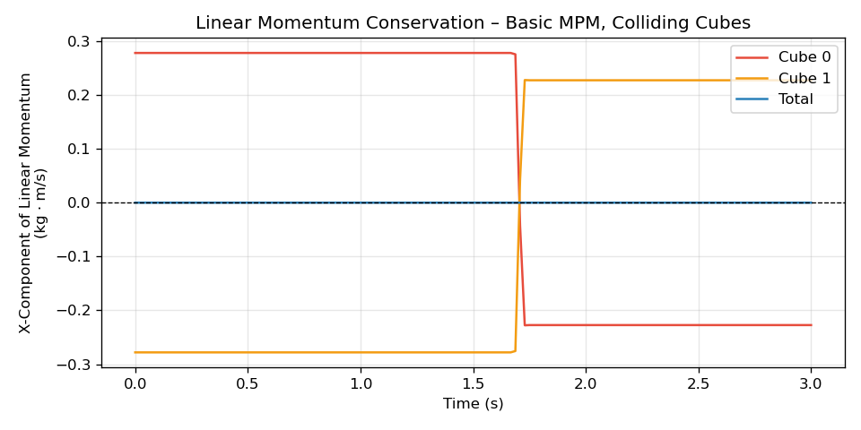
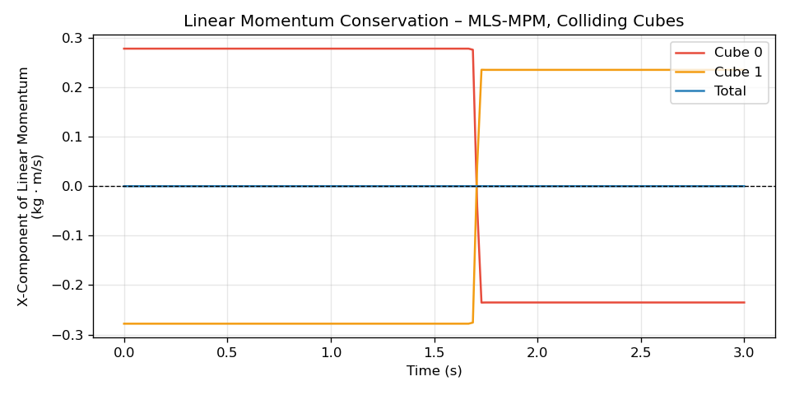
Momentum Conservation — MPM Base & MLS-MPM
Why can't the cubes achieve zero-gap contact?
1 Grid resolution limit: dx = 1/64 m defines the finest scale at which pressure can be resolved. Two bodies begin exchanging momentum once their surfaces are within ~1.5 dx of a shared grid node — actual particle-level contact is never enforced. 2 No contact separation: Standard MPM has no explicit contact detection. Both bodies share the same background grid; the interaction is purely momentum-based. After bounce-back, the final speeds are slightly lower than initial (|Δp_total| ~10⁻⁵), indicating mild numerical dissipation through the shared grid.

Slide 5
CKMPM — Problem with Stiff Material (E = 1×10⁶ Pa)
What happens at E = 1×10⁶ Pa
Why does CKMPM freeze?
①
Cubes approach each other at ±0.1 m/s — stiff material barely deforms.
CKMPM uses explicit kinematic contact constraints (impulse-based projection) to separate bodies at each time step. With E = 1×10⁶ Pa: • Very stiff material → negligible deformation • The contact constraint imposes zero relative normal velocity at the interface • The solver repeatedly projects out velocities → cubes lock and stop moving Root cause: the kinematic contact projection is incompatible with near-rigid elastic rebound when the material cannot store or release sufficient strain energy.
②
Contact detected → kinematic constraint removes all relative normal velocity.
③
No elastic strain energy is stored or released (rigid body behaviour).
④
Every subsequent step re-applies the constraint → cubes remain locked in place.
⚠
Result: cubes freeze at collision point, simulation stalls.
Solution: Reduce Young's modulus progressively until the contact-deformation cycle can close properly.

Slide 6
CKMPM — Softening Material to Achieve Stable Collision
E = 1×10⁶ Pa
E = 1×10⁵ Pa
E = 1×10⁴ Pa
E = 1×10³ Pa
✗ Freezes
✗ Freezes
✗ Freezes
✓ Stable!
CKMPM E = 1×10³ Pa ✓
What changed?
With E = 1×10³ Pa (softer material): • Cubes deform noticeably on impact → contact region stores elastic strain energy • The stored energy drives the bodies apart after contact, allowing the kinematic constraints to release cleanly • Total simulation time extended to 5 s to capture the full bounce cycle

Slide 7
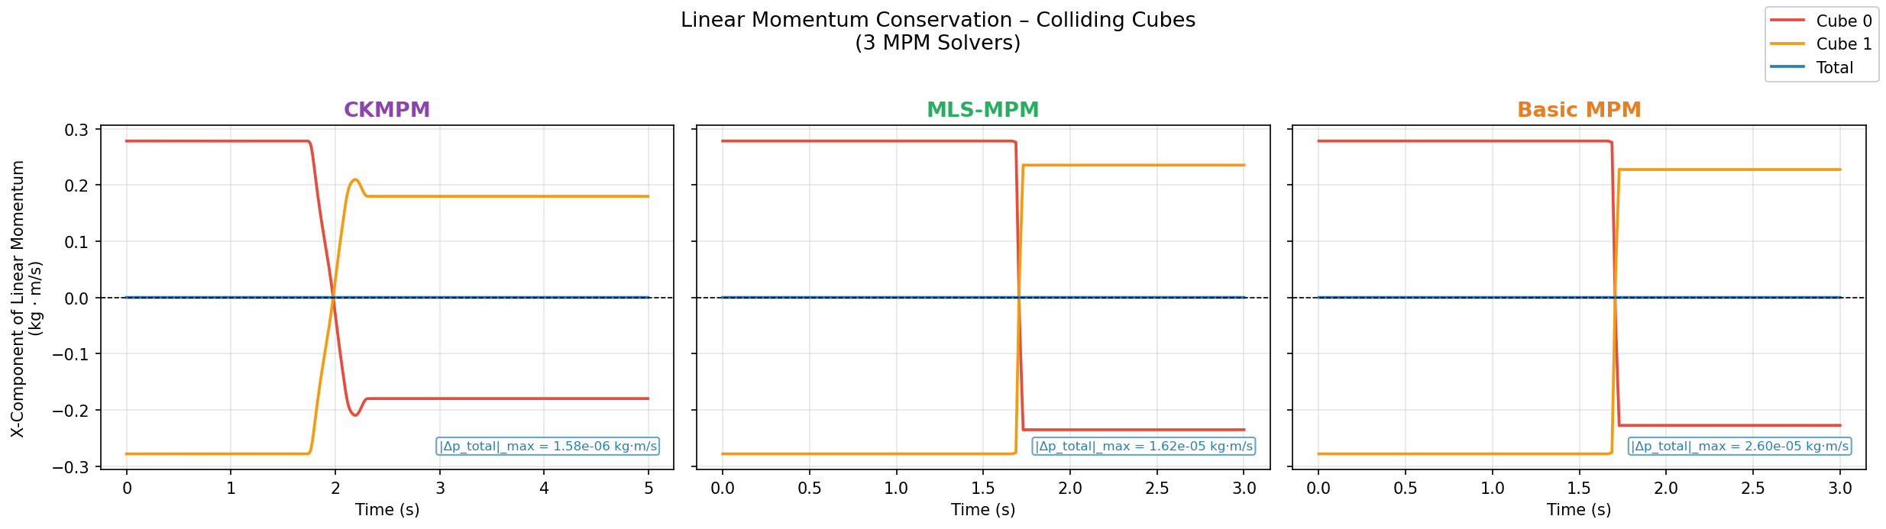
All Three Methods Conserve Linear Momentum
MPM Base
MLS-MPM
CKMPM
|Δp|_max ≈ 2.6×10⁻⁵ kg·m/s
|Δp|_max ≈ 1.6×10⁻⁵ kg·m/s
|Δp|_max ≈ 1.6×10⁻⁶ kg·m/s
✓ All solvers achieve total momentum conservation to within numerical precision.

Slide 8
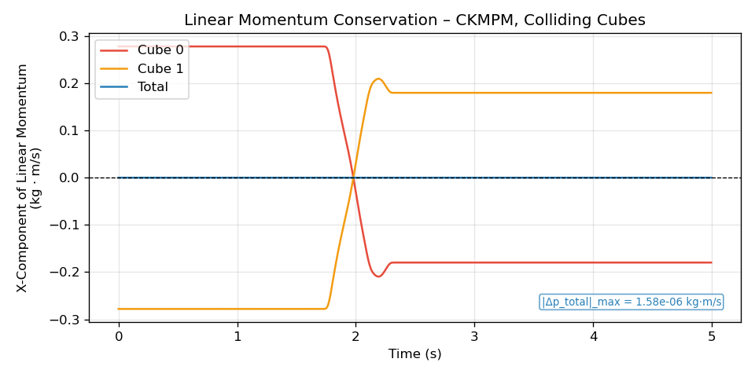
CKMPM — Why More Energy Dissipation During Collision?
Post-collision |p| ≈ 0.19 kg·m/s
vs initial |p| ≈ 0.28 kg·m/s
→ Δ ≈ 32 % energy absorbed
1 Impulse-based contact projection
At each contact time step, CKMPM applies a velocity projection that removes the relative normal velocity at the contact surface. This operation is inherently inelastic — it eliminates the colliding component without recovering it as elastic strain.
2 Dissipative constraint at softer E
With E = 10³ Pa, the bodies deform significantly before separating. The kinematic constraint "clamps" momentum at peak compression, leading to a longer energy-absorbing contact phase compared to the near-instantaneous bounce in the stiffer MPM Base/MLS runs.
3 Momentum IS conserved; energy is not
The velocity projection redistributes momentum symmetrically (total Δp ≈ 1.6×10⁻⁶), but the kinetic energy is partially transferred into heat/numerical dissipation. This is physically analogous to a partially inelastic collision.
Takeaway: CKMPM's explicit contact algorithm gives exact momentum conservation but at the cost of a larger (and more physically controllable) energy dissipation per collision event.

