Slide 1
From sql to nosql
Stefano Felli – 1896877
Lorenzo Cirillo – 1895955
Hw 3 – Data Management for Data Science
Sapienza University of Rome

Slide 2
Table of contents
Why Neo4j?
Constraints
Import DB: Approach #1
Import DB: Approach #2
Import DB: Approach #3
Go to the queries…

Slide 3
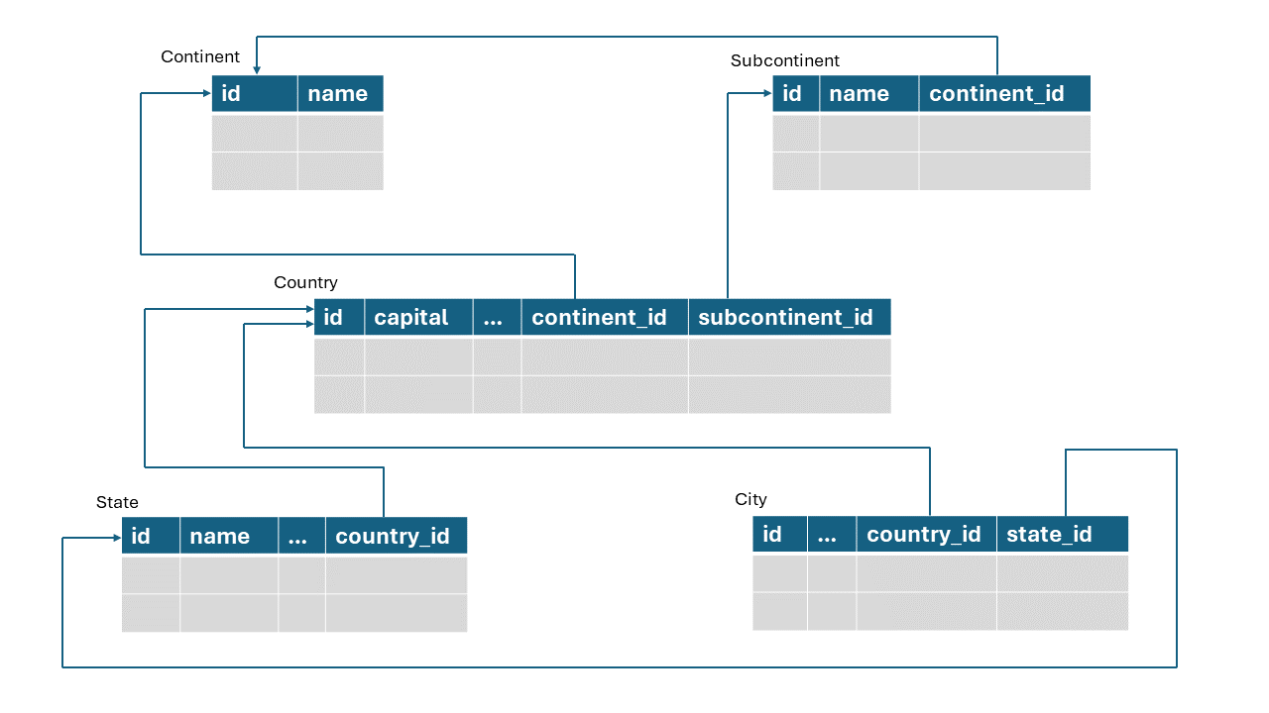
Why Neo4j?
Many binary relationships
Hierarchical structure
Faster query execution

Slide 4
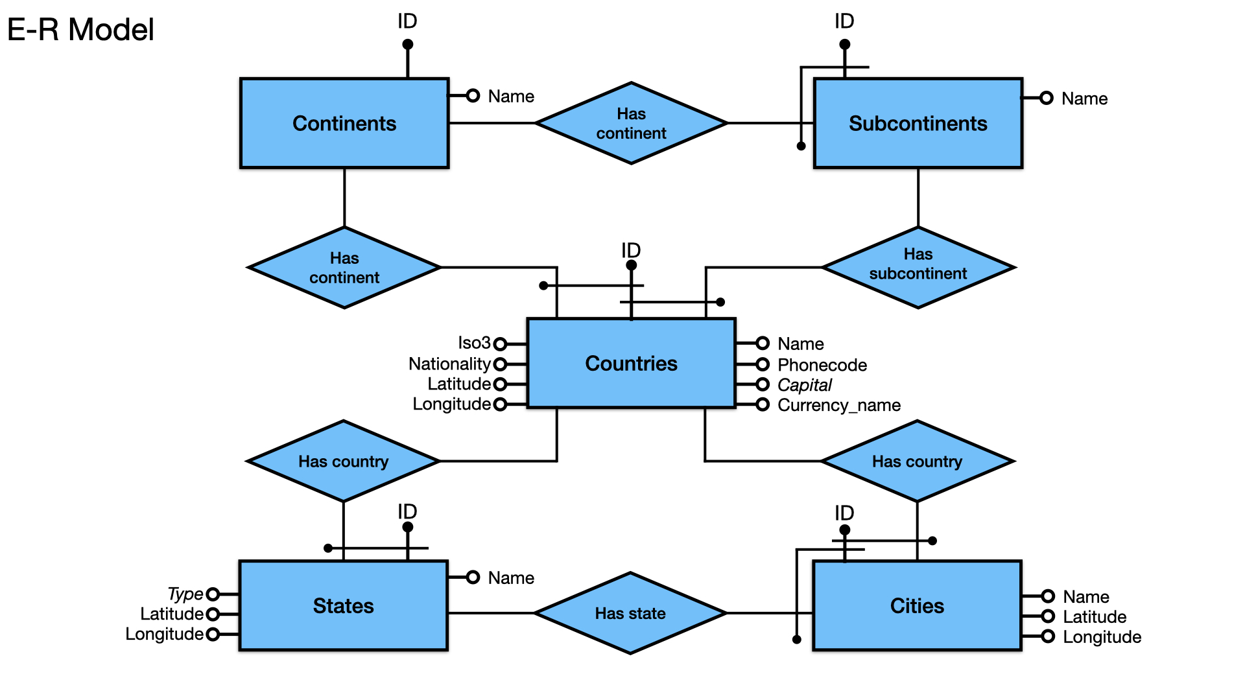
Constraints
All the constraints reported in the E-R Model have been implemented (i.e., keys and not null)

Slide 5
Import DB: Approach #1
:Continent
BELONGS_TO_CONTINENT
:Subcontinent
Same «schema» as relational db
rows → nodes
columns → properties
primary keys → relationships
capital property inside Country nodes
BELONGS_TO_
SUBCONTINENT
BELONGS_TO
_CONTINENT
:Country
Capital: …
BELONGS_TO
_COUNTRY
BELONGS_TO
_COUNTRY
:State
BELONGS_TO_STATE
:City

Slide 6
Import DB: Approach #2
:Continent
BELONGS_TO_CONTINENT
:Subcontinent
capital modeled as City
edge HAS_CAPITAL between City and Country
problems:
not all capital appear as tuples in City table
there are cities with the same name
BELONGS_TO_
SUBCONTINENT
BELONGS_TO
_CONTINENT
:Country
BELONGS_TO
_COUNTRY
BELONGS_TO
_COUNTRY
HAS_CAPITAL
:State
BELONGS_TO_STATE
:City

Slide 7
Import DB: Approach #3
BELONGS_TO_CONTINENT
:Continent
BELONGS_TO_CONTINENT
:Subcontinent
BELONGS_TO_
SUBCONTINENT
edges HAS_CONTINENT and HAS_SUBCONTINENT from State and City, without passing through Country
BELONGS_TO
_CONTINENT
BELONGS_TO_SUBCONTINENT
BELONGS_TO_SUBCONTINENT
BELONGS_TO_CONTINENT
:Country
BELONGS_TO
_COUNTRY
BELONGS_TO
_COUNTRY
HAS_CAPITAL
:State
BELONGS_TO_STATE
:City

Slide 8
LET’S GO THE QUERIES…

