Slide 1

Geometric Algebra Transformer
Master in Artificial Intelligence and Robotics
How deal with geometric data
Course: Deep Learning
Professor: Fabrizio Silvestri
Students: Claudio Schiavella 1884561, Lorenzo Cirillo 1895955, Jacopo Tedeschi 1882789

Slide 2

Summary
Geometric Algebra Tansformer
Pagina <number>

Slide 3
Introduction
Dealing with geometric data is an ongoing task with deep learning
Gatr (equivariance) to deal with them
Four models: Transformer, Metaformer, GATr, MetaGATr
Evaluation metrics: accuracy, f1-score, inference time
Task: binary calssification on a geometric dataset
Geometric Algebra Transformer
Pagina <number>

Slide 4
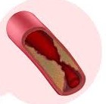
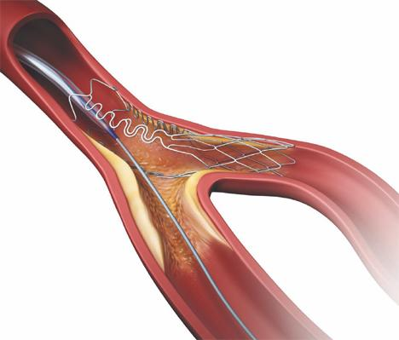
Dataset
Bifurcating artery
Single stenosis artery
Bifurcating and single stenosis arteries
5 properties: position, wss, face, pressure and inlet index
Colab restrictions: dataset divided into partitions and then shuffled
Labels: 0 for single, 1 for bifurcating
Geometric Algebra Transformer
Pagina <number>

Slide 5
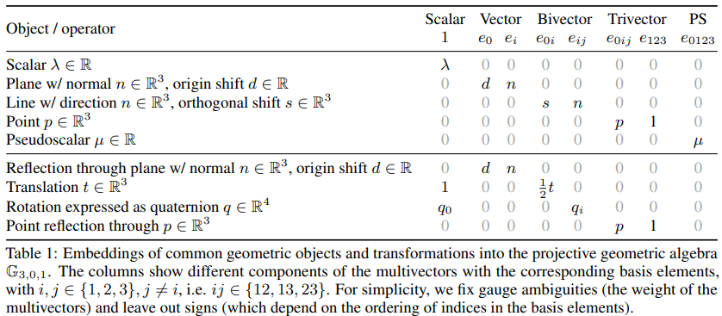
Data Preprocessing
Geometric data as multivectors
Multivectors: arrays with 16 elements
Inlet index multivector discarded
Geometric Algebra Transformer
Pagina <number>

Slide 6
Geometric Algebra Transformer
Pagina <number>

Slide 7
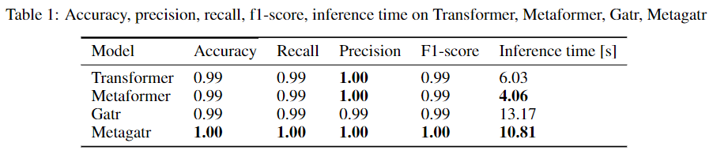
Results
Smaller inference times for meta versions
No performance aggravation
Geometric Algebra Transformer
Pagina <number>

