Slide 1

Data-driven identification of a one-link robot with flexible joint
Master in Artificial Intelligence and Robotics
Lagrangian Neural Networks applied to elastic robots
Course: Robotics 2
Professor: Alessandro De Luca
Tutor: Pietro Pustina
Students: Lorenzo Cirillo 1895955, Claudio Schiavella 1884561

Slide 2


INTRODUCTION
Robot dynamic model
Relationship between applied forces and motion
D’Alembert, Hamilton
Euler-Lagrange equations
Modeling and control
Symbolic form equations of motions
Modeling systems Neural networks Lagrangian NN
Notes:
Espandere parte teorica + aggiungere il controllore PD per il caso rigido + focus su una traiettoria (grafici + rmse) + se controllore, rimuovi 2 simuòlazioni del caso rigido

Slide 3
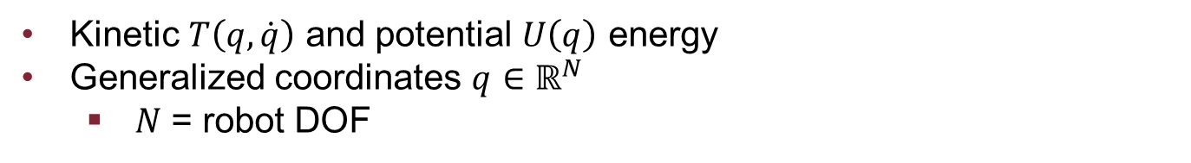
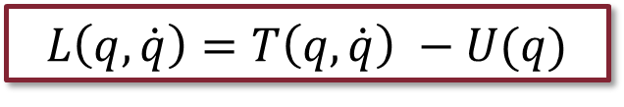


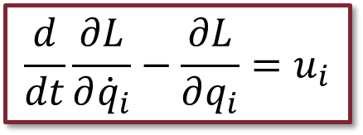
PARAMETRIC LAGRANGIAN
Lagrangian
$$L\left(q,\dot{q}\right)=T\left(q,\dot{q}\right) −U(q)$$
Kinetic $T\left(q,\dot{q}\right)$ and potential $U\left(q\right)$ energy
Generalized coordinates $q∈ℝ^{N}$
$N$ = robot DOF
Euler-Lagrange equations
$$\frac{d}{dt}\frac{∂L}{∂{\dot{q}}_{i}}−\frac{∂L}{∂q_{i}}=u_{i}$$
$$i=1,…, N$$
Non-conservative forces $u_{i}$
Considered null in our application

Slide 4
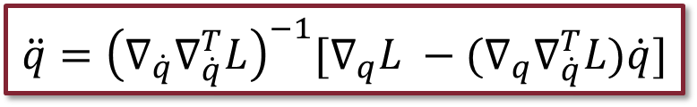
PARAMETRIC LAGRANGIAN
Parametric Lagrangian
$$\ddot{q}={\left(∇_{\dot{q}}∇_{\dot{q}}^{T}L\right)}^{−1}[∇_{q}L −(∇_{q}∇_{\dot{q}}^{T}L)\dot{q}]$$
Lagrangian analytical expression not always known
Alternative approach
Learning L + Automatic differentiation
Notes:
Espandere, alternative approach è apprendere la lagrangiana e la imparo -> non nota L, la imparo (cosi so stutto sul Sistema), come la imparo? Non la posso misurare, allora sfrutto il fatto che posso misurare l’accelerazione oppire posizione evelocità e quindi sfruttando l’automatic differentiation data una L qualsisasi get the q dot dot, che poi integro

Slide 5
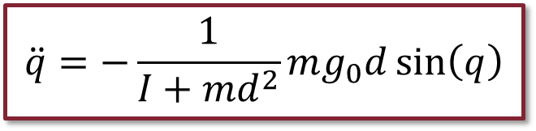
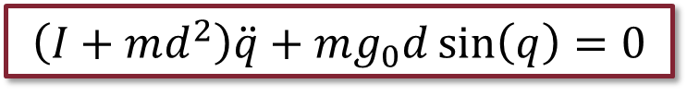
RIGID ROBOT
1R robot with y-axis agreeing with gravity
Dynamic Model:
$$\left(I+md^{2}\right)\ddot{q}+mg_{0}d\sin\left(q\right)=0$$
Acceleration:
$$\ddot{q}=−\frac{1}{I+md^{2}}mg_{0}d\sin\left(q\right)$$
Coriolis and Centrifugal term not present
One single link
Contribute to the joint when it is moving is null

Slide 6
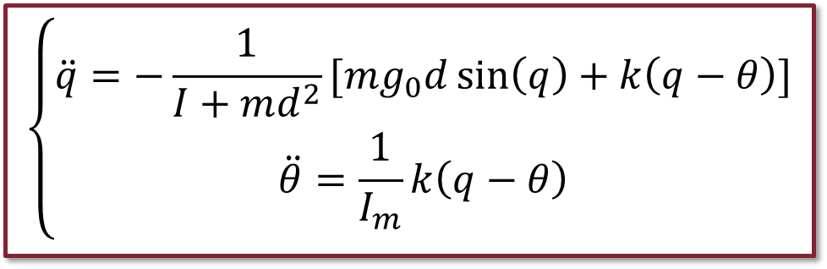
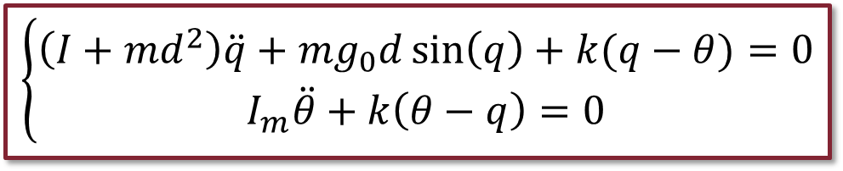
ELASTIC ROBOT
1R robot with y-axis agreeing with gravity
Dynamic model:
$$\left\{\begin{aligned}\left(I+md^{2}\right)\ddot{q}+mg_{0}d\sin\left(q\right)+k(q−θ)=0 \\ I_{m}\ddot{θ}+k\left(θ−q\right)=0\end{aligned}\right.$$
Accelerations:
$$\left\{\begin{aligned}\ddot{q}=−\frac{1}{I+md^{2}}[mg_{0}d\sin\left(q\right)+k\left(q−θ\right)] \\ \ddot{θ}=\frac{1}{I_{m}}k\left(q−θ\right)\end{aligned}\right.$$
Again Coriolis and Centrifugal term not present
Constant inertia matrix

Slide 7
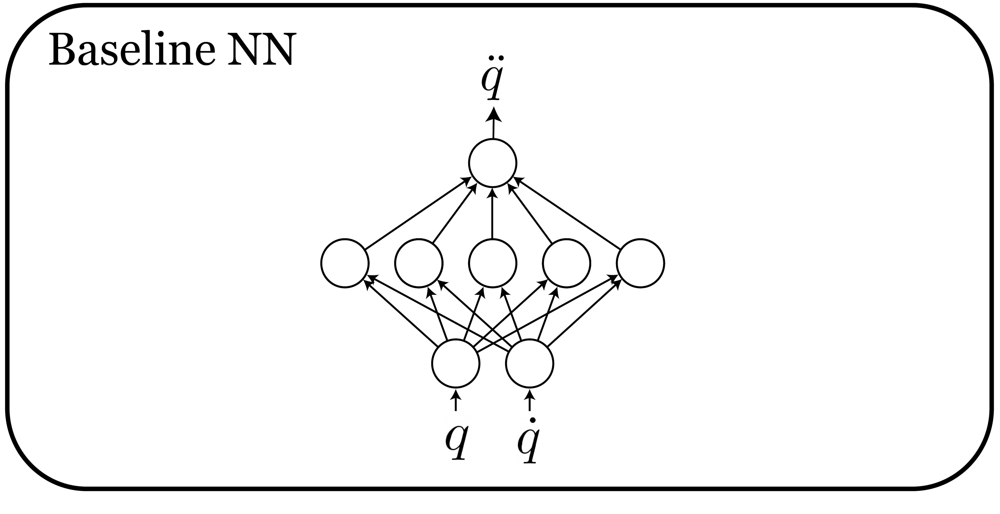
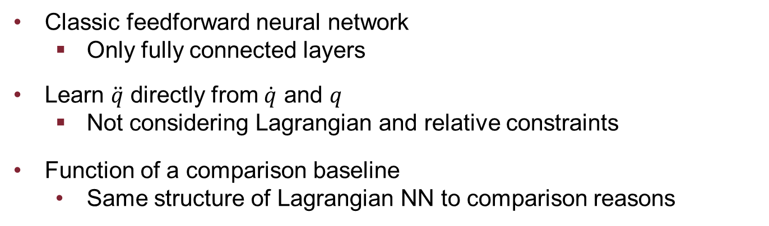
BASELINE NN
Classic feedforward neural network
Only fully connected layers
Learn $\ddot{q}$ directly from $\dot{q}$ and $q$
Not considering Lagrangian and relative constraints
Function of a comparison baseline
Same structure of Lagrangian NN to comparison reasons

Slide 8
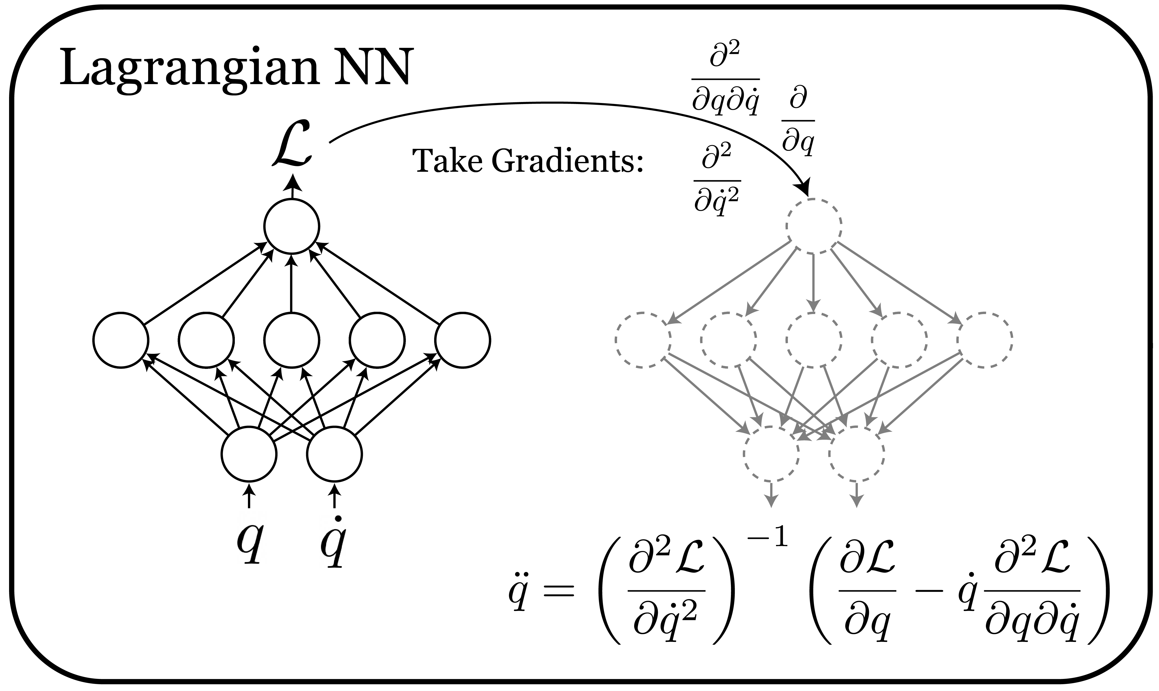
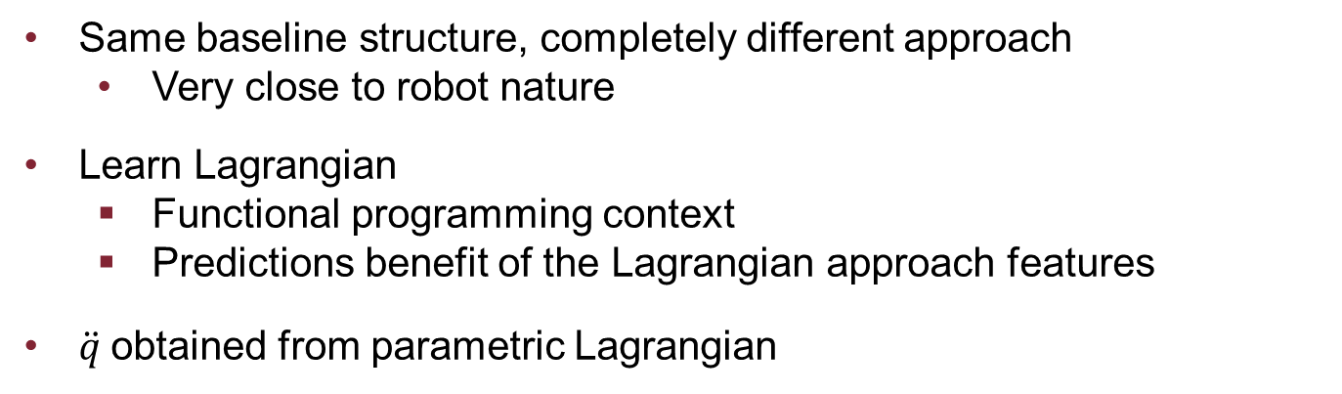
LAGRANGIAN NN
Same baseline structure, completely different approach
Very close to robot nature
Learn Lagrangian
Functional programming context
Predictions benefit of the Lagrangian approach features
$\ddot{q}$obtained from parametric Lagrangian

Slide 9
SIMULATIONS
Type 1: Observe behavior of the two networks
Trajectory tracking
Trajectory error
Energy conservation
Type 2: Introduce measurament noise
Same tests as in type 1
Highlight network robustness in not ideal context

Slide 10
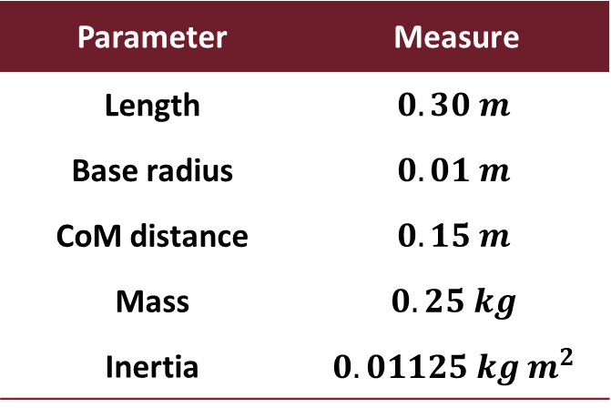
RIGID CASE
Robot parameters
Network setup
Parameter | Measure
Length | $$0.30 m$$
Base radius | $$0.01 m$$
CoM distance | $$0.15 m$$
Mass | $$0.25 kg$$
Inertia | $$0.01125 kg m^{2}$$
Characteristic | Value
Layers | 4
Neurons | 500
Activation | Softplus
Loss | MSE
Regularization | L2 penalty
Train epochs | 10 000

Slide 11
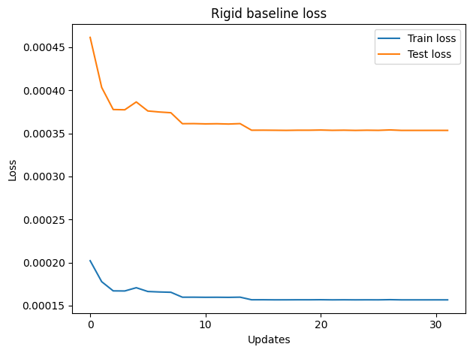
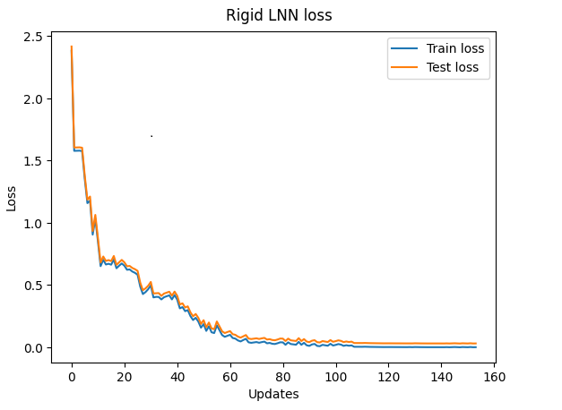
RIGID CASE – NETWORK TRAINING
Train and test losses

Slide 12
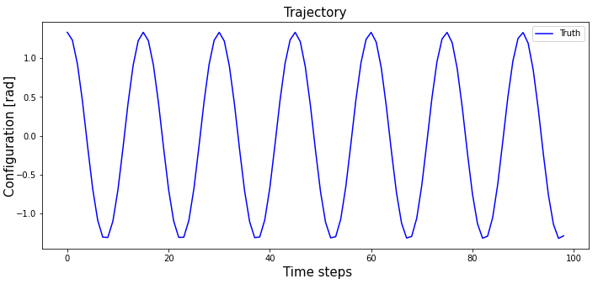
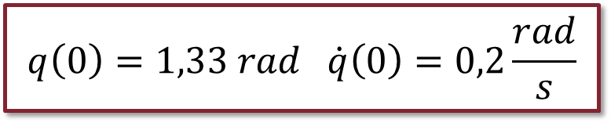
RIGID CASE – SIMULATION 1
$$q\left(0\right)=1,33 rad \dot{q}\left(0\right)=0,2\frac{rad}{s}$$
Initial conditions:

Slide 13
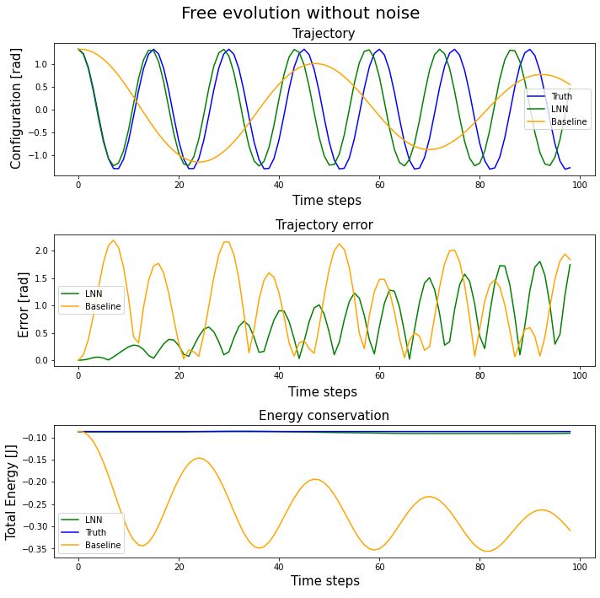
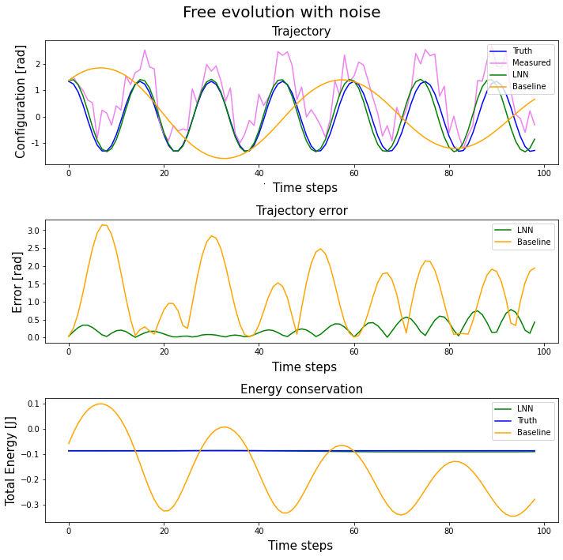
RIGID CASE – SIMULATION 1
Notes:
Perchè arriva il delay della traiettoria? Le algrangiane non sono identiche, se c’è un errore che si accumula amen (tuttvaia energia simile, tuttavia simu okay, div integrazione accumula errore per def, tuttavia energia è conservata e molto vicina, applicando controllore model based dovrenne funz bene) + simulazione Sistema meccanico a tanti secondi (10 min), quasi sempre diverge la simulazione

Slide 14
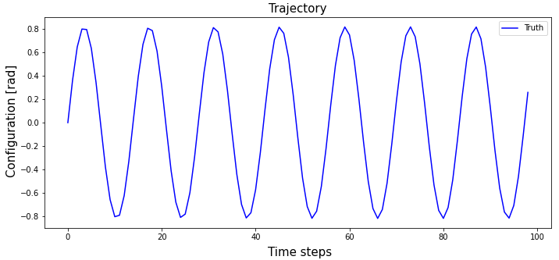
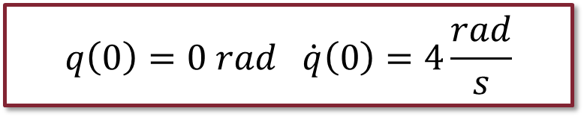
RIGID CASE – SIMULATION 2
$$q\left(0\right)=0 rad \dot{q}\left(0\right)=4\frac{rad}{s}$$
Initial conditions:

Slide 15
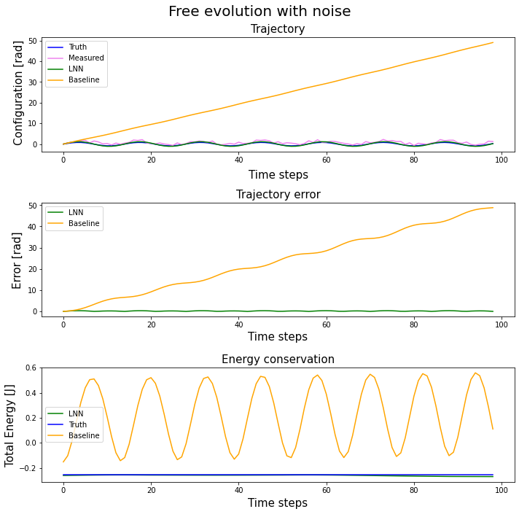
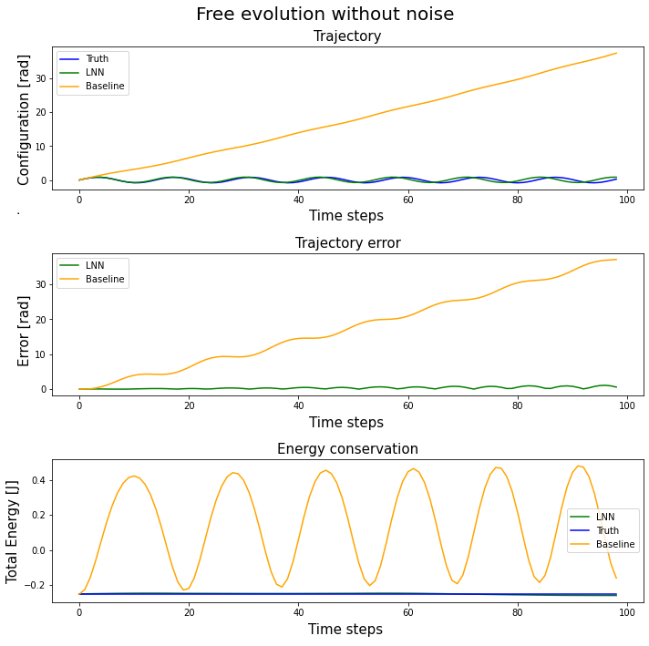
RIGID CASE – SIMULATION 2

Slide 16
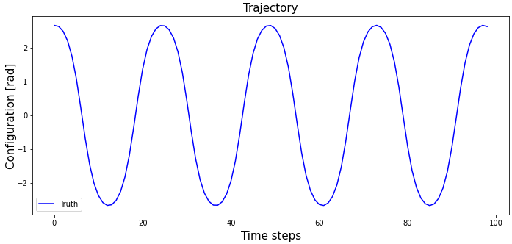
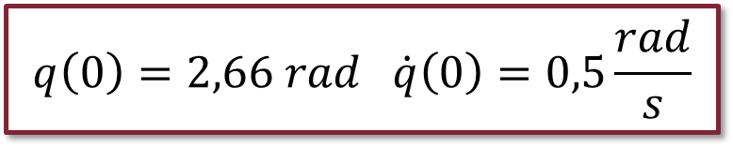
RIGID CASE – SIMULATION 3
$$q\left(0\right)=2,66 rad \dot{q}\left(0\right)=0,5\frac{rad}{s}$$
Initial conditions:

Slide 17
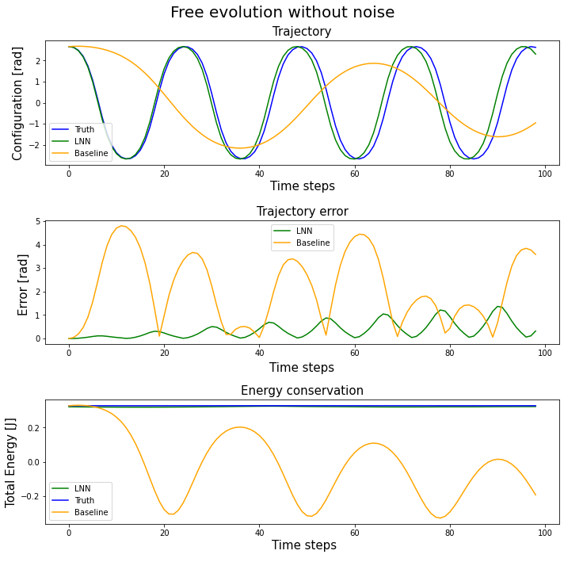
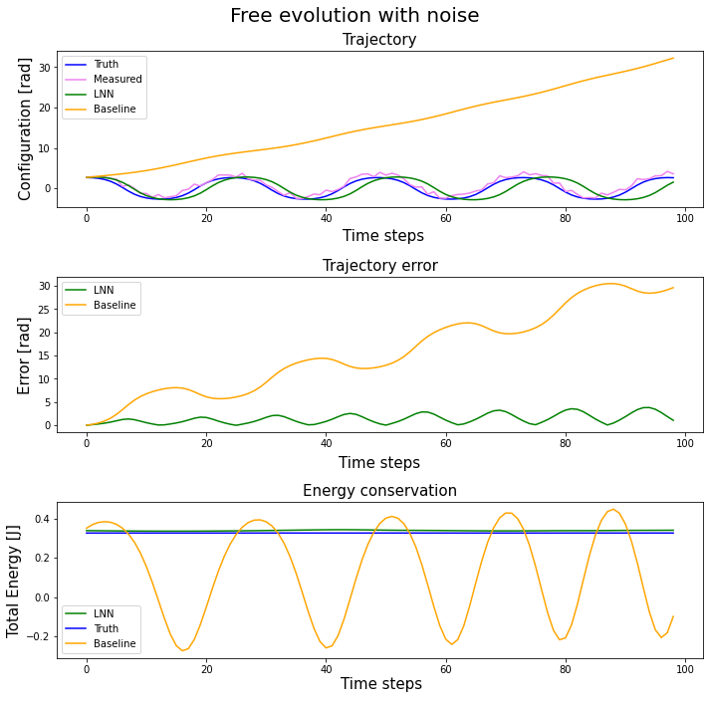
RIGID CASE – SIMULATION 3

Slide 18
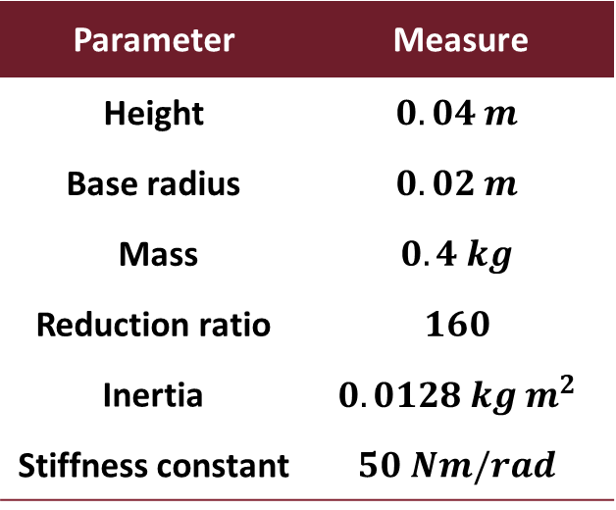
ELASTIC CASE
Motor parameters
Network setup
Parameter | Measure
Height | $$0.04 m$$
Base radius | $$0.02 m$$
Mass | $$0.4 kg$$
Reduction ratio | $$160$$
Inertia | $$0.0128 kg m^{2}$$
Stiffness constant | $$50 Nm/rad$$
Configuration | Units | Layers
A | 300 | 2
B | 500 | 4
C | 700 | 5

Slide 19
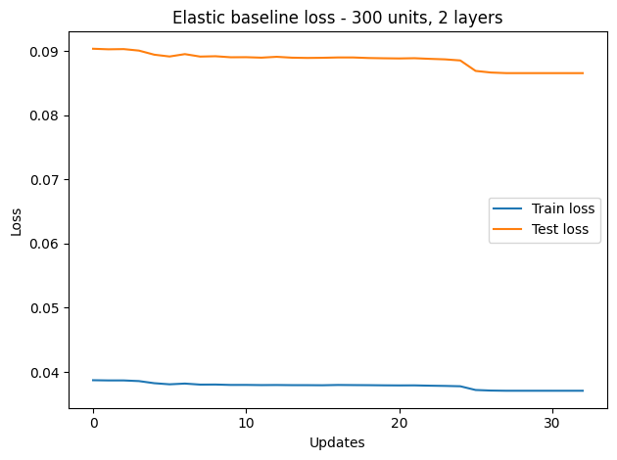
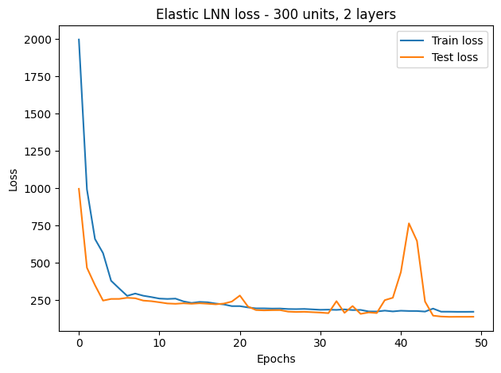
ELASTIC CASE – CONFIGURATION A
Train and test losses
Notes:
SPECIFICARE PERCHE DIVERSE SCALE DI UPDATES

Slide 20
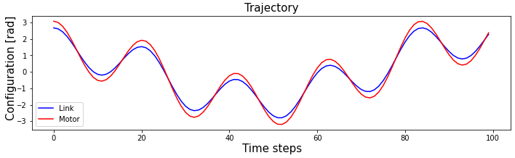
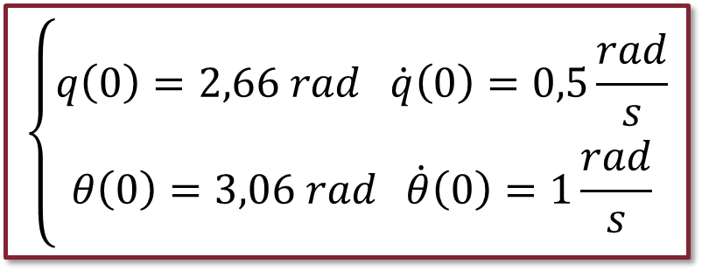
ELASTIC CASE – SIMULATION 1
$$\left\{\begin{aligned}q\left(0\right)=2,66 rad \dot{q}\left(0\right)=0,5\frac{rad}{s} \\ θ\left(0\right)=3,06 rad \dot{θ}\left(0\right)=1\frac{rad}{s}\end{aligned}\right.$$
Initial conditions:

Slide 21
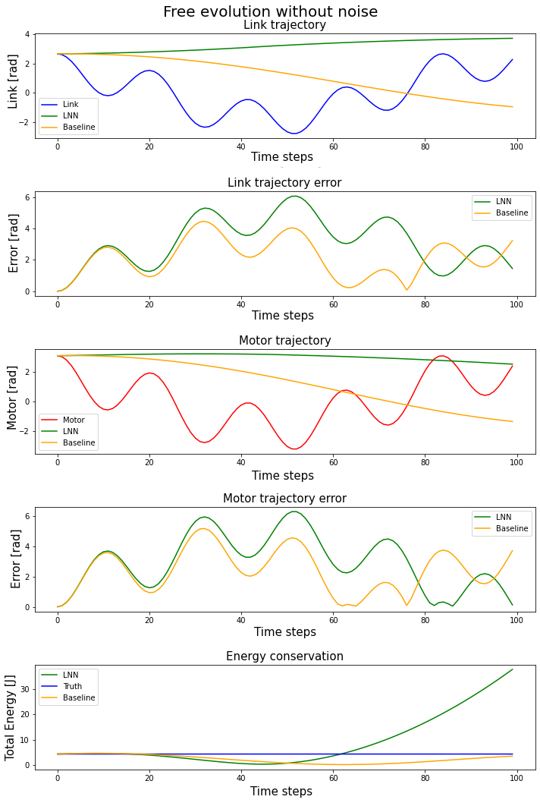
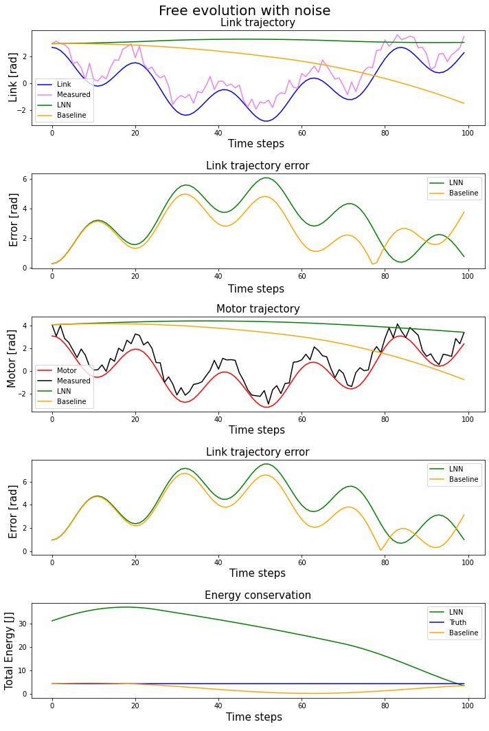
ELASTIC CASE – SIMULATION 1

Slide 22
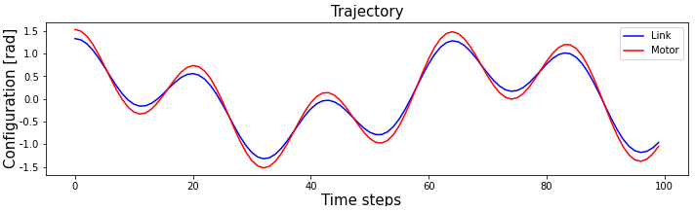
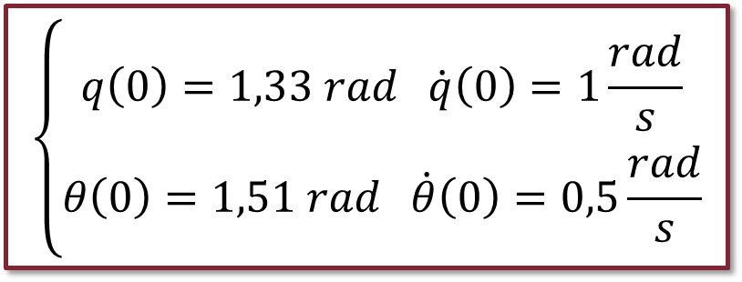
ELASTIC CASE – SIMULATION 2
$$\left\{\begin{aligned}q\left(0\right)=1,33 rad \dot{q}\left(0\right)=1\frac{rad}{s} \\ θ\left(0\right)=1,51 rad \dot{θ}\left(0\right)=0,5\frac{rad}{s}\end{aligned}\right.$$
Initial conditions:

Slide 23
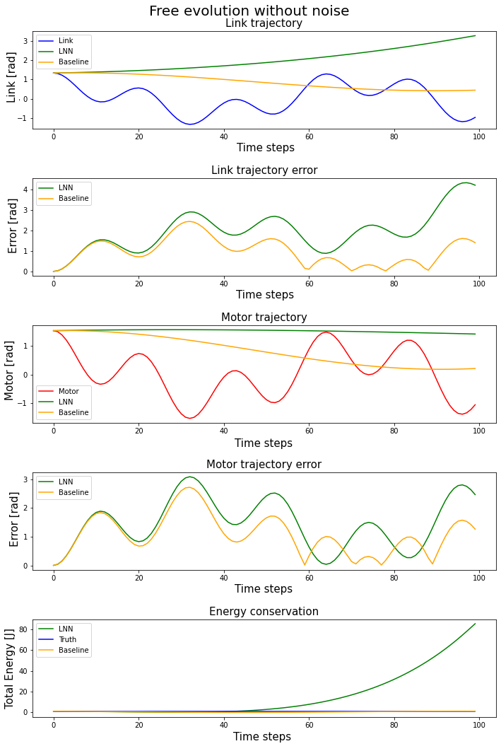
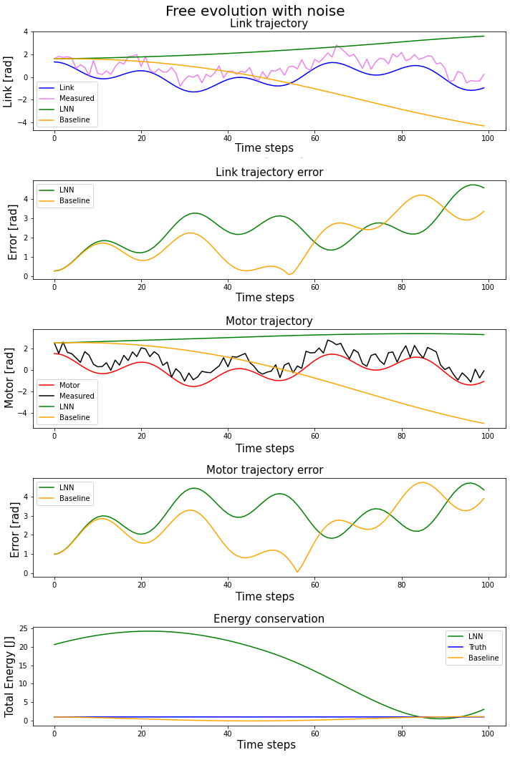
ELASTIC CASE – SIMULATION 2

Slide 24
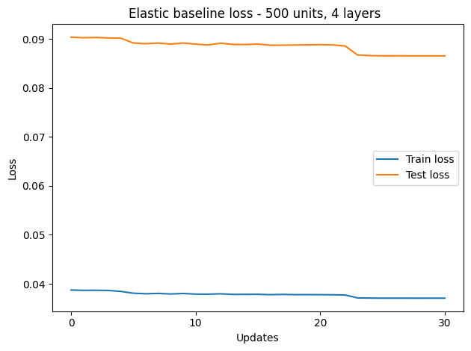
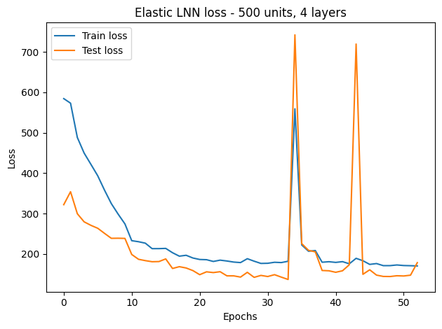
ELASTIC CASE – CONFIGURATION B
Train and test losses
Notes:
Lìinfo interessante non è il valore basso di loss, ma che non cala + INSERISCI STRUTTURA CONFIGURAZIONE

Slide 25
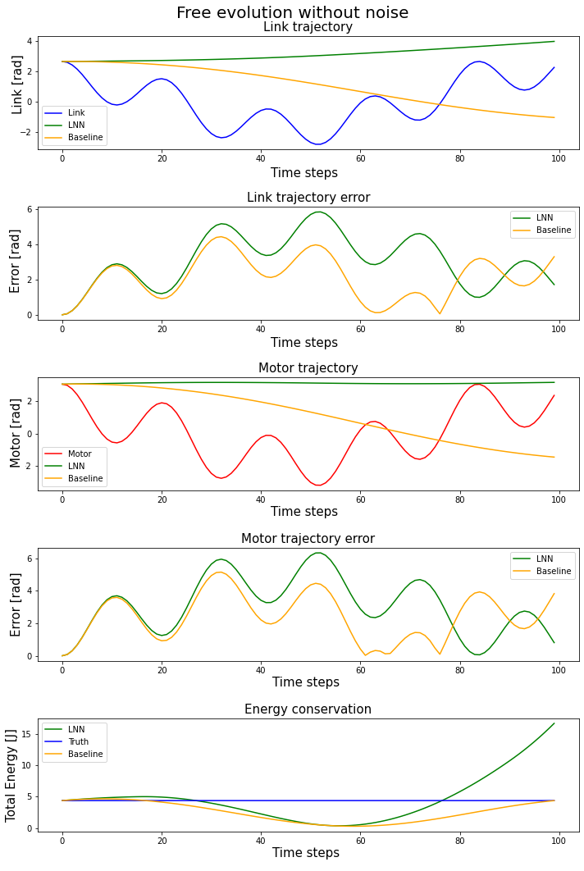
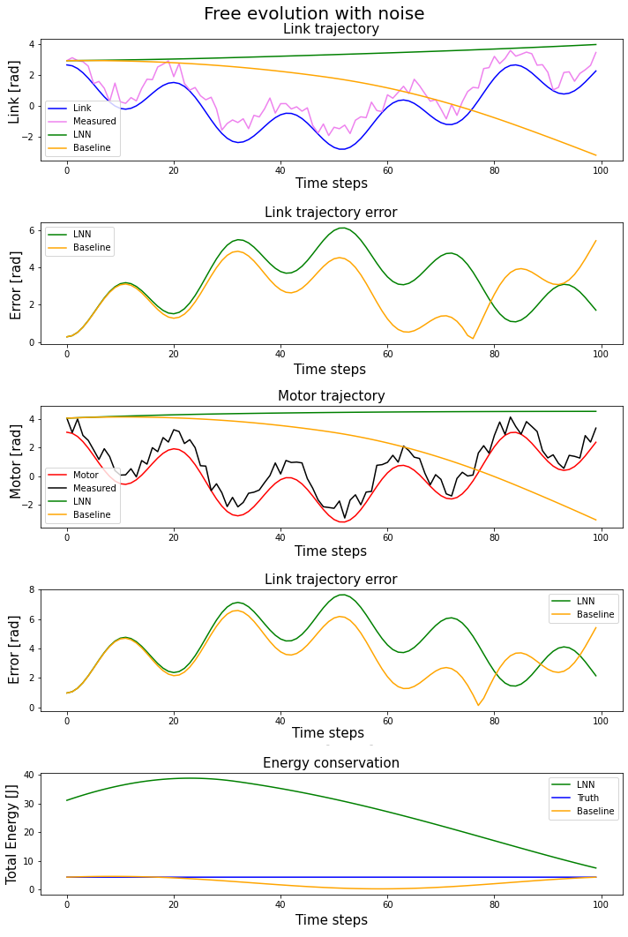
ELASTIC CASE – SIMULATION 3

Slide 26
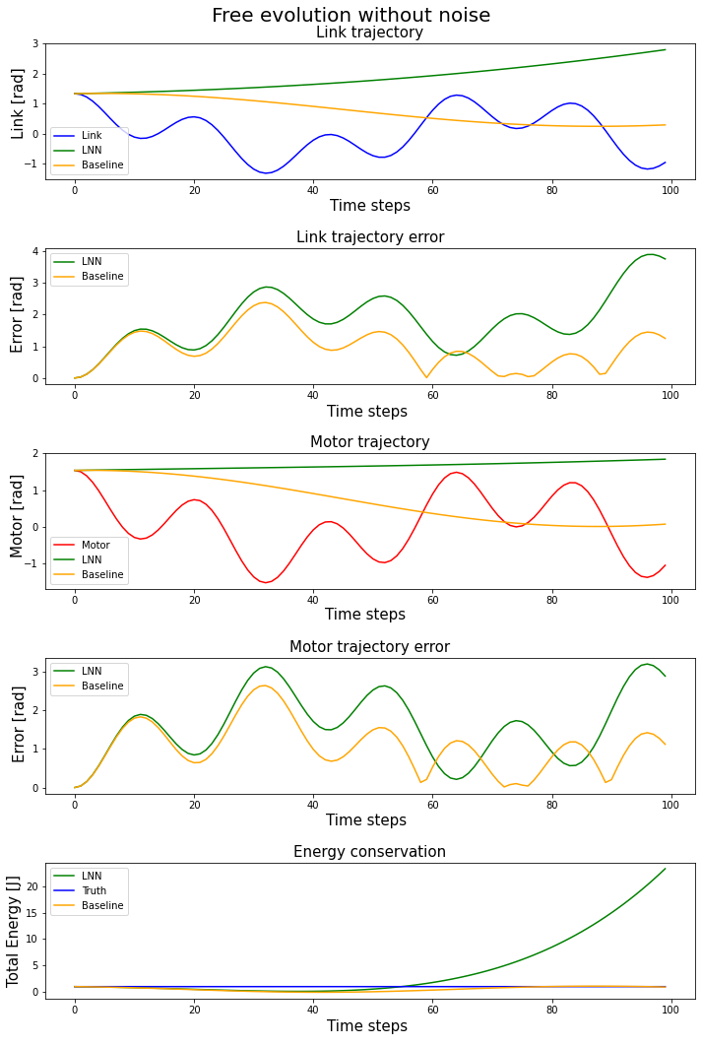
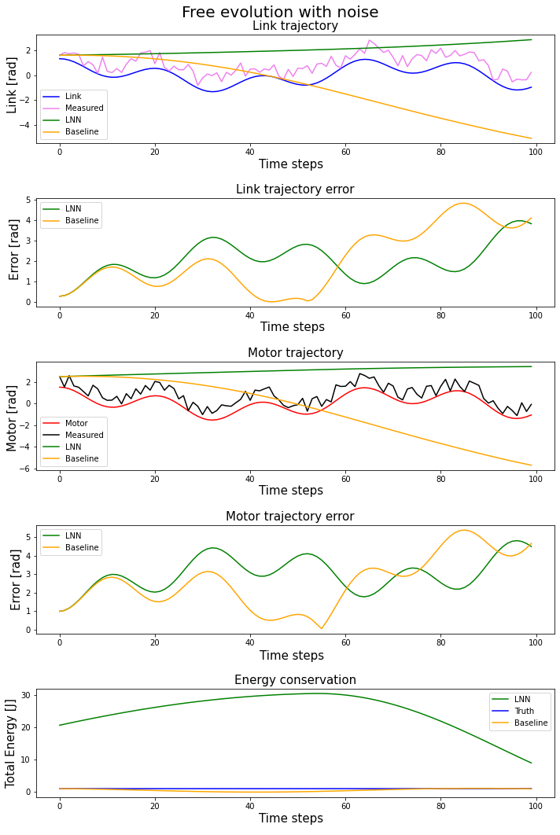
ELASTIC CASE – SIMULATION 4

Slide 27
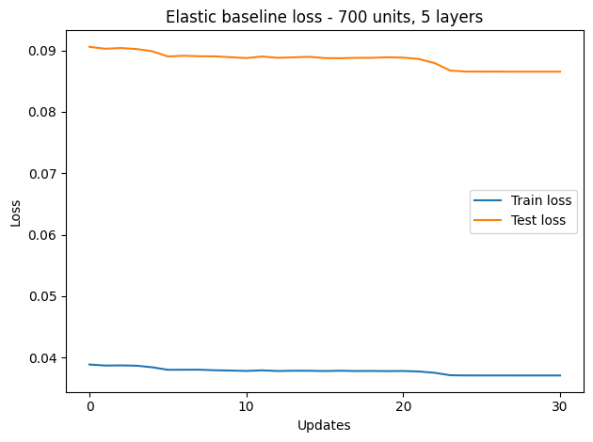
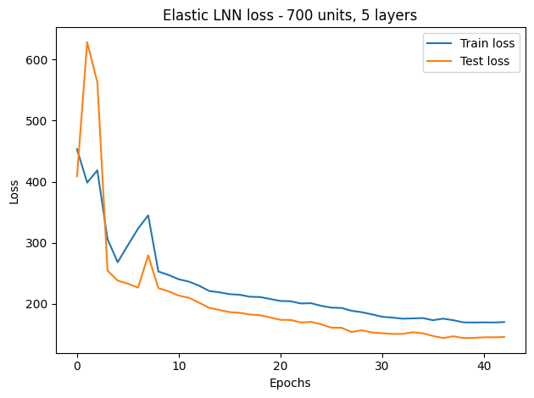
ELASTIC CASE – CONFIGURATION C
Train and test losses

Slide 28
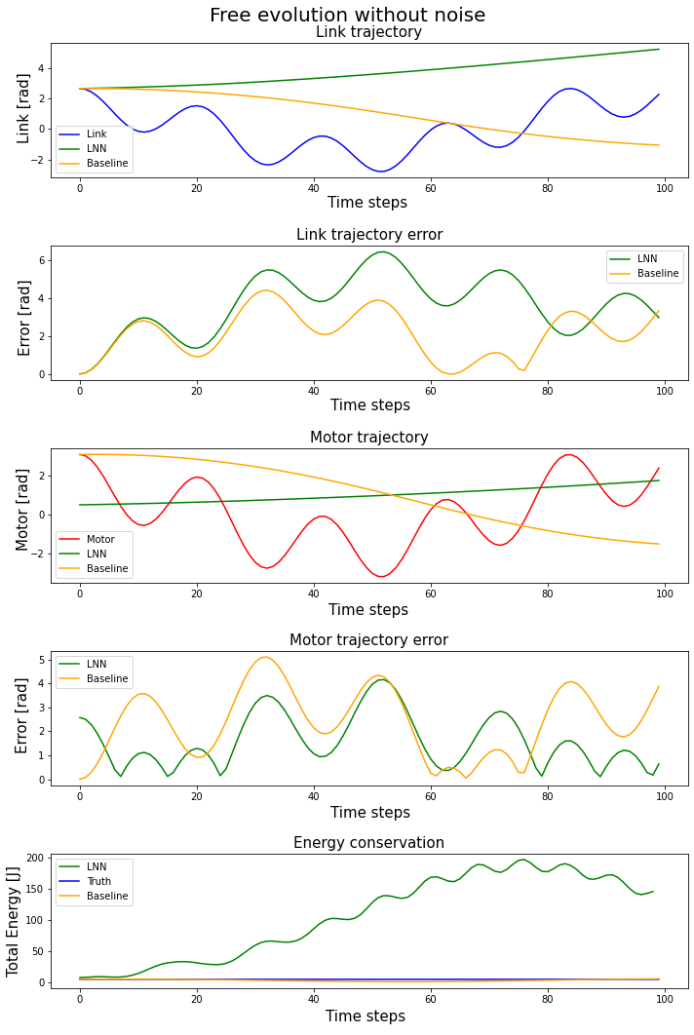
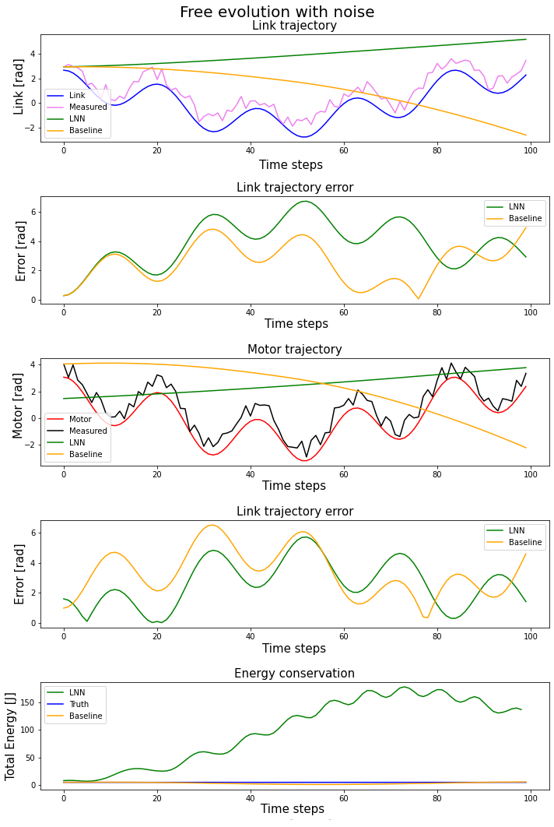
ELASTIC CASE – SIMULATION 5

Slide 29
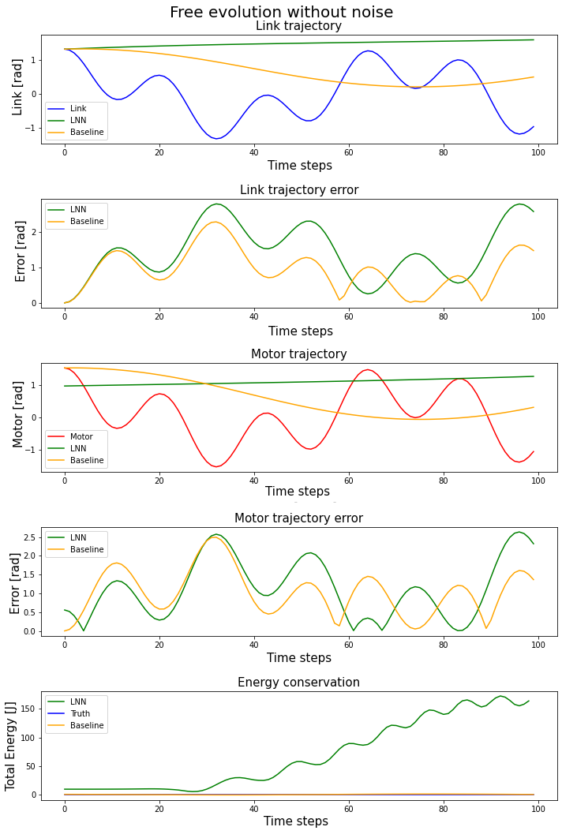
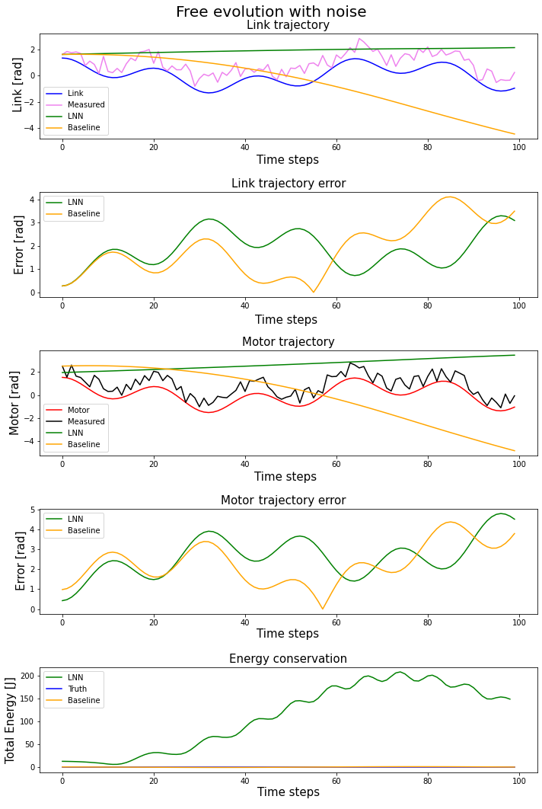
ELASTIC CASE – SIMULATION 6

Slide 30
CONCLUSIONS
At least in the rigid case, LNN performances are very good
Both in trajectory error and energy conservation
Unfortunately, bad results in elastic case
Elastic LNN seems to improve as network complexity increase
More wide/deep network and more initial conditions
High computational resources needed
Paper LNN approach works on unitary configurations
We reject this in preference to real robot parameters

Slide 31
THANK YOU FOR THE ATTENTION

