Slide 1
Exercise 3 – Data Deduplication
By Lorenzo Toso, Roxana Tapia, Vincent Deuschle

Slide 2
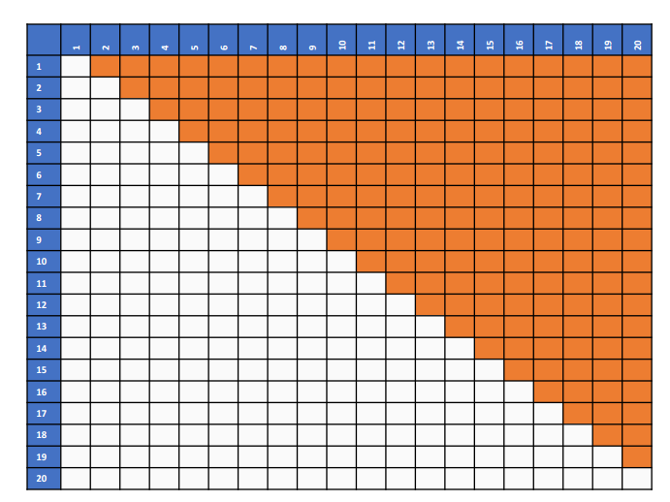
Idea
Brute Force
Try all pairs
With Symmetry
➔ ≈ 4.5 billion comparisons necessary

Slide 3
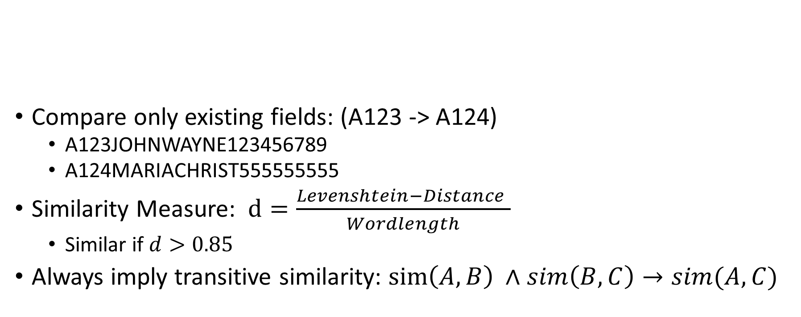
Idea
ID | First Name | Middle Name | Last Name | ZIP | SSN
A123 | John | K. | Wayne | 12345 | 123456789
A124 | Maria |  | Christ |  | 555555555
A125 | M. | J. | Cist | 23456 | 555555555
Compare only existing fields: (A123 -> A124)
A123JOHNWAYNE123456789
A124MARIACHRIST555555555
Similarity Measure: $d=\frac{Levenshtein−Distance }{Wordlength}$
Similar if $d>0.85$
Always imply transitive similarity: $sim\left(A,B\right) ∧sim\left(B,C\right)→sim(A,C)$

Slide 4
Problem
Laptop performs ≈ 1 Million comparisons per Minute
Calculation requires around 75 hours
(In our implementation) Each comparison results in 3 values (id1, id2, distance) ➔ 12 byte
➔ 4.5 billion comparisons need around 50 Gb of main memory

Slide 5
Optimization
Hardware:
Using 3 Laptops instead of 1
25 hours required
Parallelization:
Using multiple worker-processes
Ca 15 hours required
Algorithm improvement (generally applicable):
If two records have a similarity of > 0.9 they are almost equal
Remove one record from further consideration
Algorithm improvement (requires domain knowledge):
If two records have the exact same SSN, they are the same person
➔ Same cluster ➔ more transitive similarities

Slide 6
Approach
Implementation in Python 3
Distance calculation using ratio method from Levenshtein library
Levenstain ratio indicates how many times the first record contains the second
>>> ratio('Hello world!', 'Holly grail!') -> 0.583333
>>> ratio('Brian', 'Jesus') -> 0.0
Filter by distance > 0.85
Parallelization using multiprossesing library
(result for 1000 records)
Elapsed time normal → ~ 11 seconds
Elapsed time multiprocessing → ~3.4 seconds
Results need to be stored in an async dictionary
Results:
TP: 38196 → True positives
FP: 211 → False positives
Precision: 0.994 → TP/(TP+FP)
FN: 209029 → Duplicate pairs that were not discovered
Recall: 0.1544 → TP/(FN+TP)

