Slide 1

Basic Web
MVC Architecture, Symfony Framework for PHP Web Apps
Software University
http://softuni.bg
SoftUni Team
Technical Trainers

Slide 2
Table of Contents
Model-View Controller (MVC)
Symfony MVC
Installing and Running
Entities and Forms
Annotations
Controllers
Twig View Engine

Slide 3
Have a Question?
sli.do
#tech-fund

Slide 4
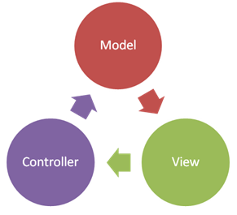
MVC
Model-View Controller

Slide 5
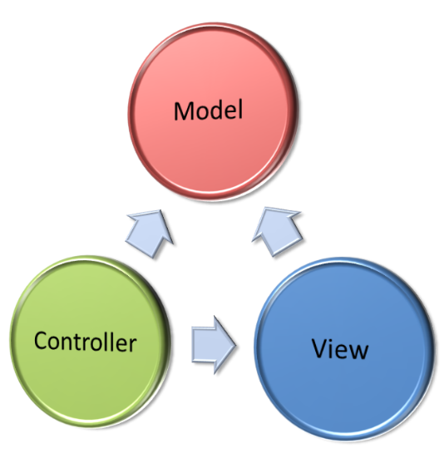
Model-View-Controller (MVC)
Model-View-Controller (MVC) is a software architecture pattern
Originally formulated in the late 1970s by Trygve Reenskaug
Code reusability and separation of concerns
Originally developed for desktop
Then adapted for internet applications

Slide 6
What is Model-View Controller
MVC == Model-View-Controller
Views (presentation / UI)
Render UI (produce HTML)
Controllers (logic)
Prepare UI (presentation logic)
Update database (business logic)
Models (data)
Data access classes or ORM

Slide 7
Model (Data)
Set of classes that describes the data we are working with
Rules for how the data can be changed and manipulated
May contain data validation rules
Often encapsulates data stored in a database

Slide 8

View
Defines how the application's user interface (UI) will be displayed
May support master views (layouts)
May support sub-views (partial views or controls)
May use templates to dynamically generate HTML

Slide 9
Controller
The core MVC component – holds the logic
Process the requests
A set of classes that handles
Communication from the user
Overall application flow
Application-specific logic (business logic)
Every controller has one or more "actions"

Slide 10
The MVC Pattern
HTTP Request
Front controller (dispatcher)
/Some/Page/
Delegate request
User
Controller
HTTP Response
Select view & pass data
CRUD operations
View
(render UI)
Model (data)
Use data from
the model

Slide 11

Symfony Framework
Web MVC Framework for PHP

Slide 12
What is Symfony?
Symfony == popular Web MVC framework for PHP
Created by Sensio Labs
Open-source
Large community

Slide 13
Installing and Running Symfony
Download symfony.phar from https://symfony.com/installer
Run the Symfony installer
Create a new Symfony project named "hello"
Run the Symfony Web server
Browse to the "hello" Web app at http://127.0.0.1:8000
php symfony.phar
php symfony.phar new hello 3.4
php .\hello\bin\console server:run

Slide 14
Composer: Dependency Manager for PHP
Composer – https://getcomposer.org
Package (dependency) management tool for PHP
Like the npm in the Node.js world
Installing and running Composer:
Run the installer from https://getcomposer.org/Composer-Setup.exe
Run composer:
Packagist – https://packagist.org
Composer's official open-source package repository
Composer

Slide 15
Symfony App Structure
Bundles
Bundles are application components (modules), e.g. AppBundle
Controllers
src/AppBundle/Controller/
Views
app/Resources/views/
Models
src/AppBundle/Entity/, src/AppBundle/Repository/

Slide 16
Symfony Entities: Fields
Entities have fields and properties
Use annotations for additional functionality
/** * @var string */ private $name;
Data type
Field name

Slide 17
Symfony Entities: Properties
Getters and setters
Return type
Parameter type
/**
* @return string
*/
public function getName()
{
return $this->name;
}
/**
* @param string $name
*/
public function setName($name)
{
$this->name = $name;
}
Accessing the field

Slide 18
Entity Example (1)
class Person
{
/**
* @var string
*/
private $name;
// Continues on the next slide

Slide 19
Entity Example (2)
/**
* @return string
*/
public function getName() { return $this->name; }
/**
* @param string $name
*/
public function setName($name) { $this->name = $name; }
}

Slide 20
Symfony Form Component
Allows to easily create, process and reuse forms
class PersonType extends AbstractType
{
public function buildForm(FormBuilderInterface $builder,
array $options)
{
$builder
->add('name', TextType::class);
}
}

Slide 21
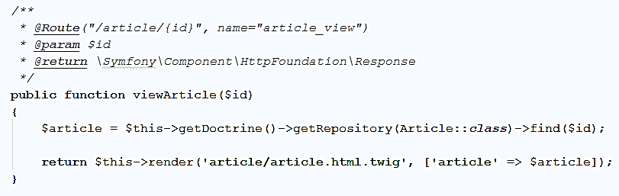
Annotations in Symfony
Annotations == comments used by Symfony to modify the method behavior
URL that calls the controller action
Action Parameters
Action name
Return type
Describes this action

Slide 22
Symfony Controllers (1)
MVC controllers hold actions, mapped to URL by annotations
Extends Controller
use Symfony\Bundle\FrameworkBundle\Controller\Controller;
class HomeController extends Controller
{
…
}

Slide 23
Symfony Controllers (2)
Controllers can hold multiple actions on different routes
/**
* @param Request $request
* @Route("/home")
* @return \Symfony\Component\HttpFoundation\Response
*/
public function indexAction(Request $request)
{
return $this->render('view', array('name' => $name));
}
Mapped to http://localhost:8000/home

Slide 24
Controller Actions
public function indexAction(Request $request)
{
$person = new Person();
$form = $this->createForm(PersonType::class, $person);
if ($form->isSubmitted()) {
//POST Request
}
//GET Request
}

Slide 25

Twig
Template Engine

Slide 26
Twig
Twig is a view engine used in Symfony
Natural templates – HTML with additional attributes to add view logic
Twig allows us to:
Use variables / collections in our views
Execute operations on our variables
Iterate over collections

Slide 27
Twig Variable Expressions
Variable expressions are executed on the context variables
Examples:
{{ ... }}
{{ title }}
{{ article.title }}
{{ foo['bar'] }}

Slide 28
Passing Parameters to View
Passing a string to the view
<body>
<p>Hello, {{ name }}!</p>
</body>
public function indexAction()
{
return $this->render('default/home.html.twig',
array("name" => "Peter"));
}

Slide 29
Forms in Twig
In Twig you can create HTML forms:
<form action="{{ path("home_index") }}" method="post">
<label for="person_create" name="id">Name</label>
<input type="text" name="person[name]" id="person_create"/>
<input type="submit">
</form>

Slide 30
Handling Form
Can parse the input as an object by the form component
/**
* @Route("/home", name="home_index")
* @return \Symfony\Component\HttpFoundation\Response
*/
public function indexAction(Request $request) {
$person = new Person();
$form = $this->createForm(PersonType::class, $person);
$form->handleRequest($request);
if ($form->isSubmitted()) var_dump($person);
return $this->render('default/home.html.twig');
}

Slide 31
Conditional Statements in Twig
You can use if / else if / else statements in twig using
{% if %} … {% endif %}
{% if %}
<div>
<p>The statement is true"</p>
</div>
{% endif %}

Slide 32
Loops in Twig (1)
Iterating over a sequence of numbers
Iterating over keys
{% for i in range(0, 5) %}
{{ i }}
{% endfor %}
// 0 1 2 3 4 5
{% for name in phonebook|keys %}
<li>{{ name }}</li>
{% endfor %}

Slide 33
Loops in Twig (2)
Iterating over values
Iterating over keys and values
{% for age in phonebook %}
<li>{{ age }}</li>
{% endfor %}
{% for name, age in phonebook %}
<li>{{ name }}: {{ age }}</li>
{% endfor %}

Slide 34
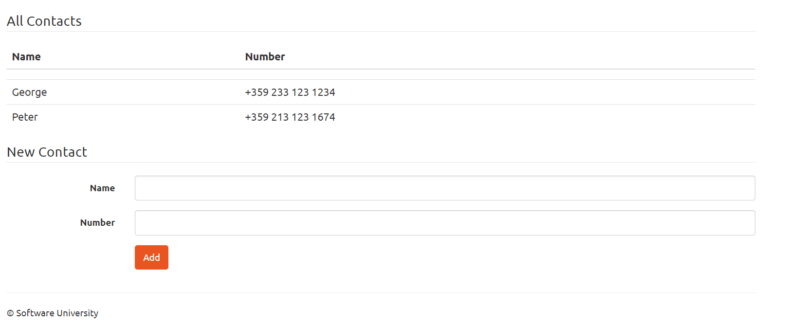
Problem: Simple Phonebook Application
Write a web application, which displays and creates contacts in a phonebook
Implement listing and adding contacts

Slide 35

Live Exercises

Slide 36

Summary
…
…
…
Implementing MVC Pattern
Symfony MVC
Open Source Framework for PHP
Twig
Powerful view engine
Expressions, Conditions and Iterations

Slide 37
https://softuni.bg/courses/technology-fundamentals

Slide 38













SoftUni Diamond Partners

Slide 39





SoftUni Organizational Partners

Slide 40




Trainings @ Software University (SoftUni)
Software University – High-Quality Education and Employment Opportunities
softuni.bg
Software University Foundation
http://softuni.foundation/
Software University @ Facebook
facebook.com/SoftwareUniversity
Software University Forums
forum.softuni.bg

Slide 41

License
This course (slides, examples, demos, videos, homework, etc.) is licensed under the "Creative Commons Attribution-NonCommercial-ShareAlike 4.0 International" license

