Slide 1
Microarchitecture and performance estimate
Group 12
Susanne Gripsgård, Ole Jakob Schubert & Lorang Strand

Slide 2
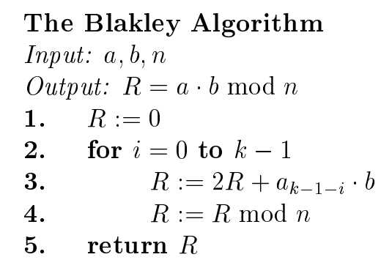
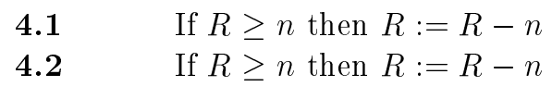
RSA algorithm
Blaykley’s method
Why?
Notes:
We knew from the start that we didn’t want to use too much time on choosing an algorithm, but rather use more of our time on the implementation of it.
When looking at our two options for the RSA algorithm we chose to go for the method that we found more intuitive. At first glance we thought Blaylkley’s method looked more intuitive and that’s why we went for it.

Slide 3
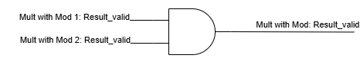
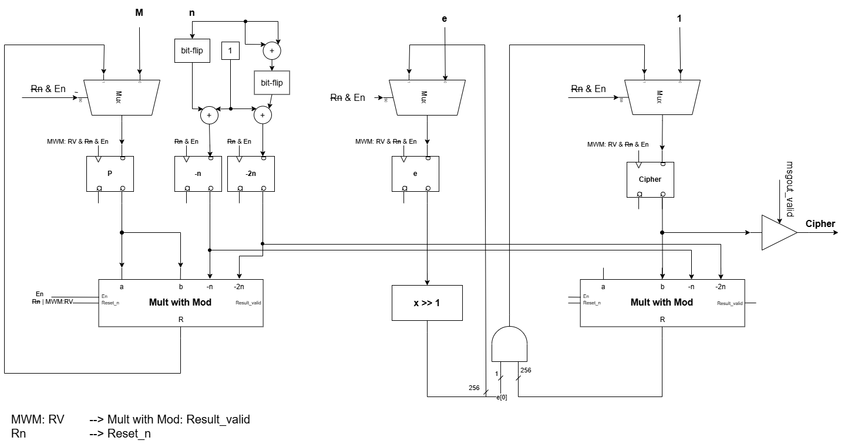
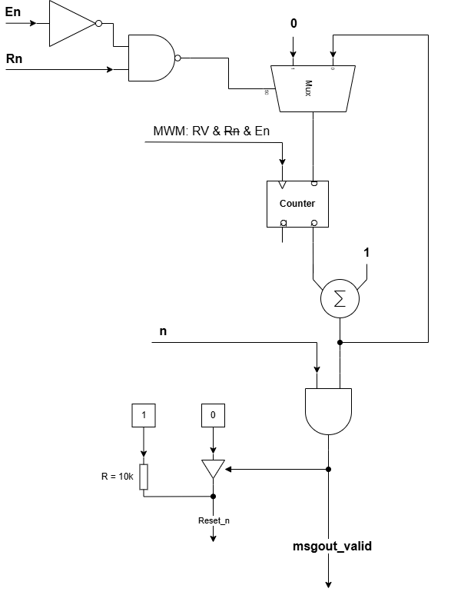
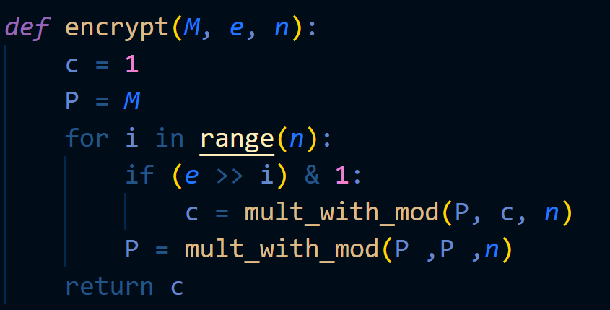
Microarchitecture – RSA core

Slide 4
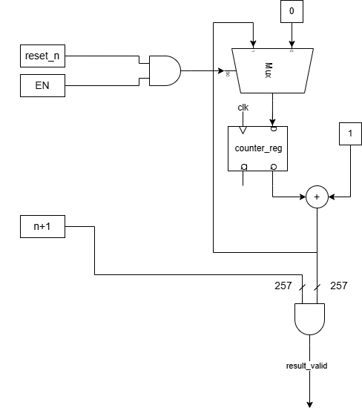
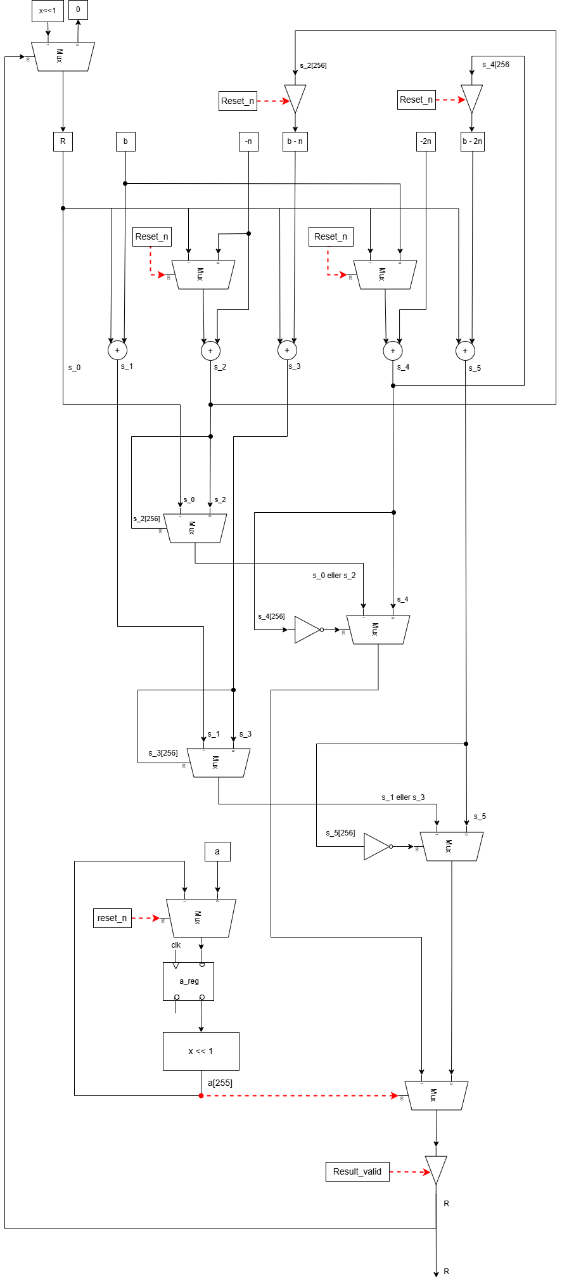
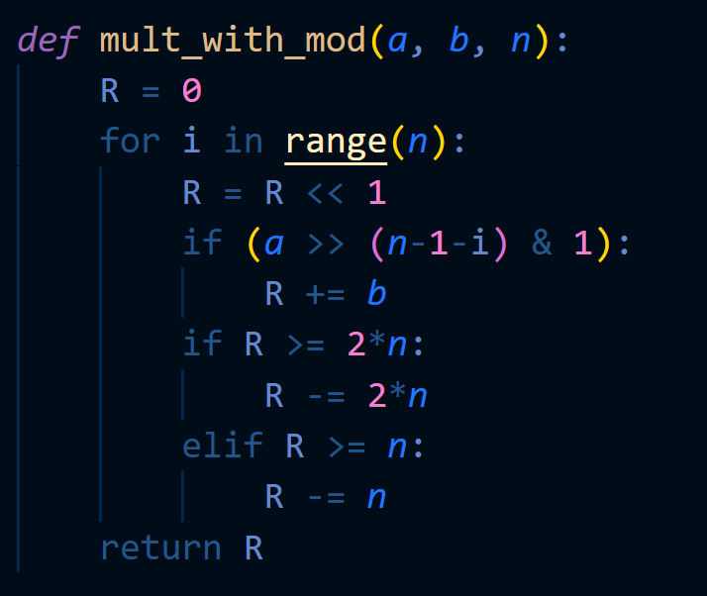
Microarchitecture - mult with mod

Slide 5

Estimated number of clock cycles for executing the encoding/decoding
$E=n ×\left(n+1\right)+1=65 793 cycles$
$n=256$

