Slide 1
FOREST ADVENTURE
A 3D Forest Adventure Game
Game Development Project
Unity 6 • Windows PC
Kehitysympäristön käyttö – 15 osp

Slide 2
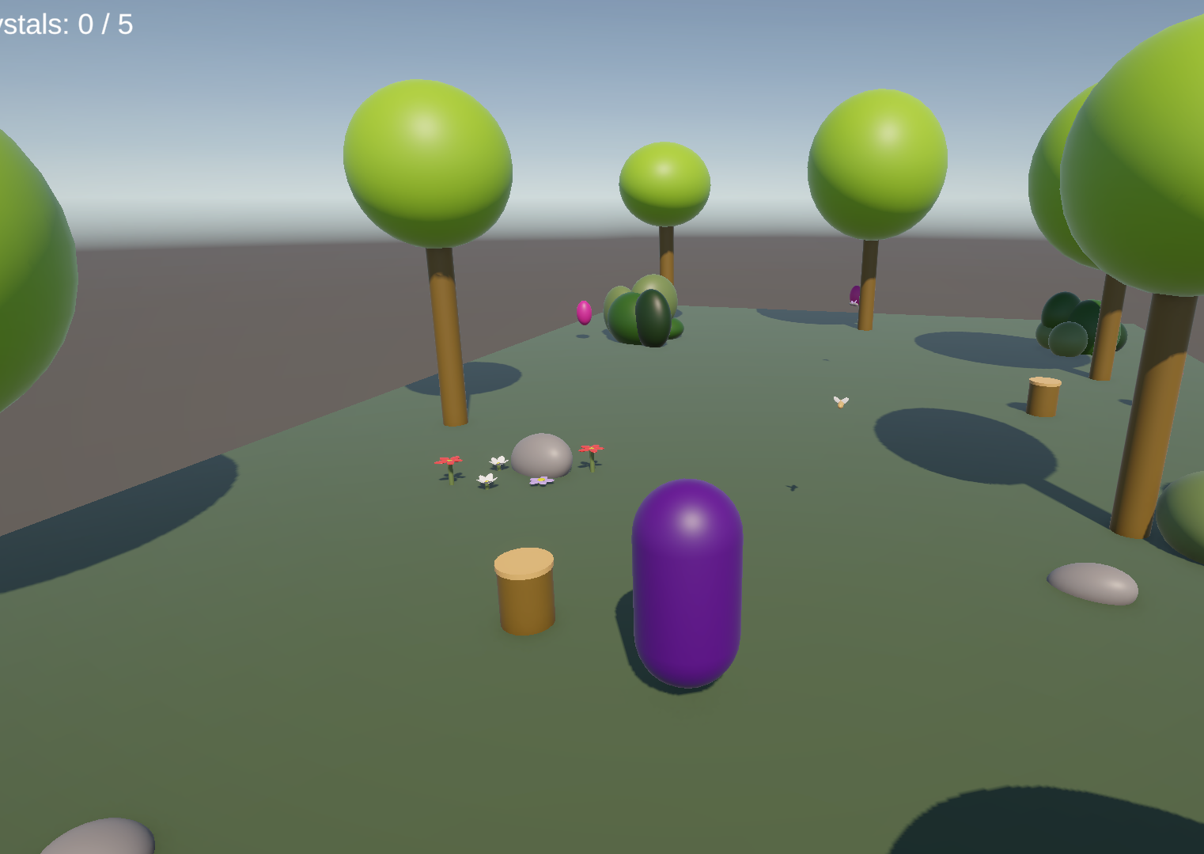
GAME IDEA
Forest Adventure is a small 3D exploration and collecting game set in a magical forest. The player explores the forest, collects five magical crystals and searches for a portal. The portal becomes active after all five crystals have been collected. The main goal is to create a simple but complete gameplay experience with clear controls, visual feedback and a satisfying win condition.

Slide 3
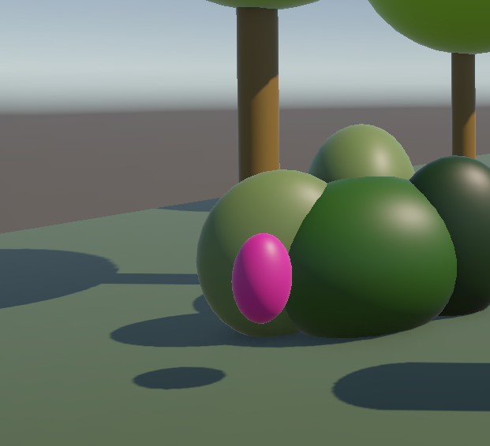






GAMEPLAY & OBJECTIVE
CORE GAMEPLAY
1. Explore the forest.
2. Find and collect 5 magical crystals.
3. Watch the crystal counter increase.
4. Find the magical portal.
5. Enter the portal after all crystals are collected.
6. Complete the game and see the YOU WIN screen.
WIN CONDITION The player wins by collecting all 5 crystals and entering the activated portal.

Slide 4
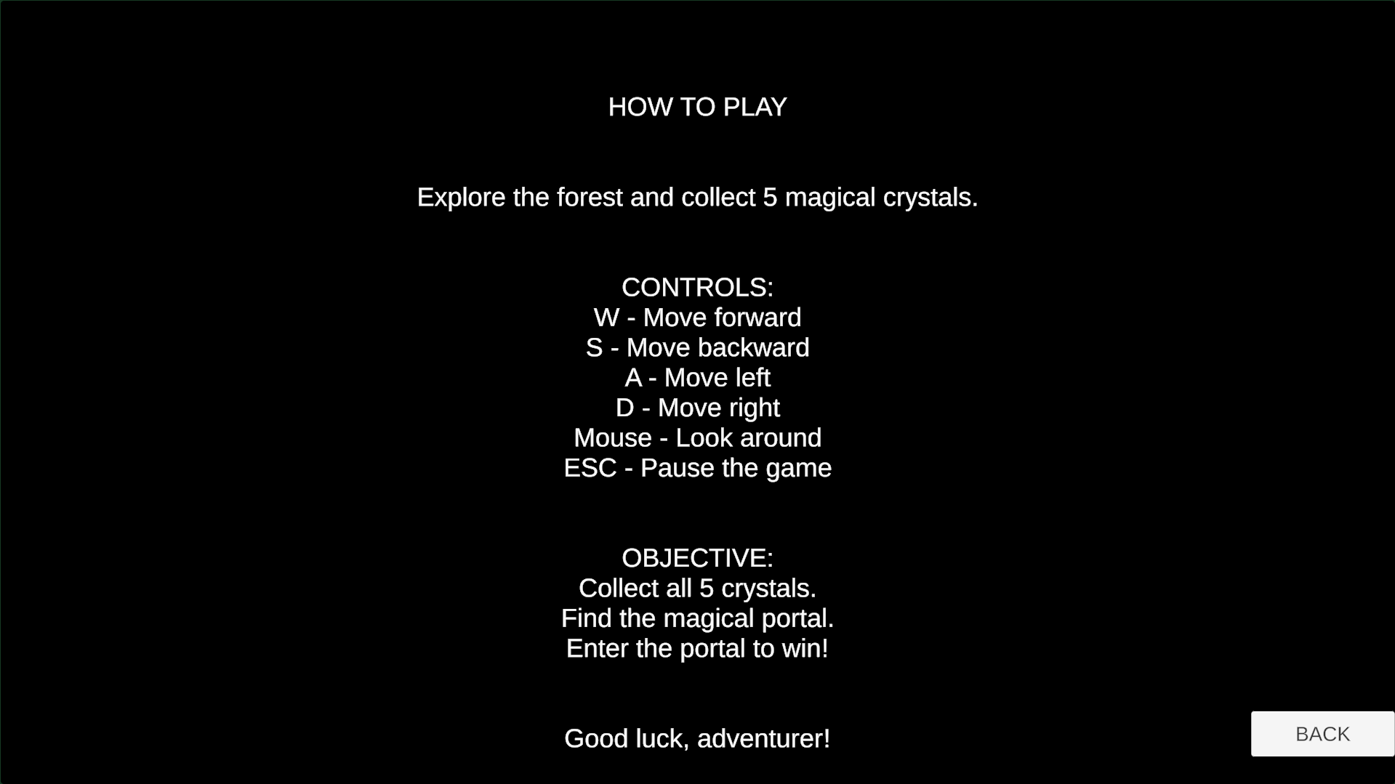
CONTROLS
W / S
Move forward / backward
-----------------------------------
A / D
Move left / right
-----------------------------------
MOUSE
Look around and control the camera
-----------------------------------
ESC
Pause / resume the game

Slide 5

GAME MECHANICS
PLAYER
The player moves through the forest using a Character Controller and a third-person camera.
COLLECTING
Crystals are trigger objects. When the player touches a crystal, it is collected and removed from the scene.
PROGRESSION
The UI counter shows the number of collected crystals: 0 / 5.
PORTAL
The portal remains inactive until all 5 crystals have been collected.
WIN SYSTEM
After entering the activated portal, the game displays the YOU WIN screen.
The crystal counter gives the player clear feedback about their progress.

Slide 6
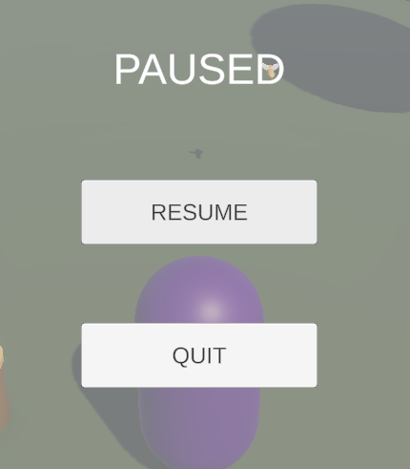
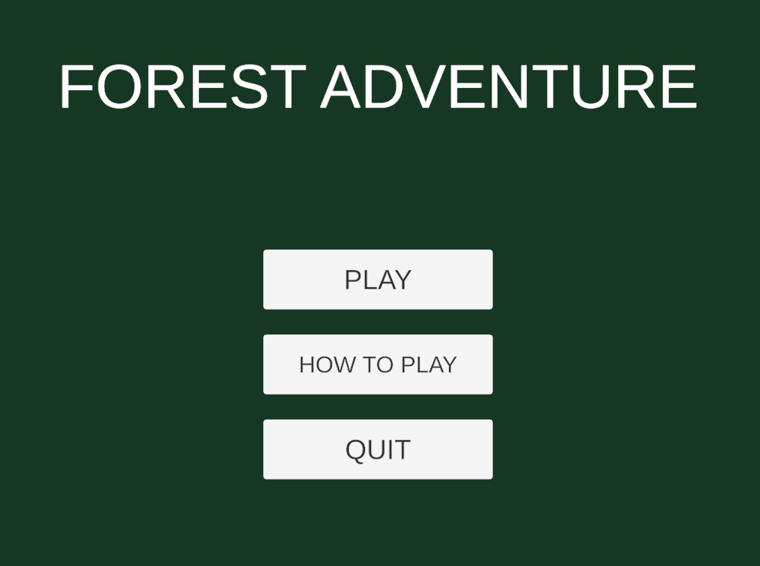
UI & MENUS
PAUSE MENU​
ESC pauses and resumes the game.​
Resume and Quit buttons.​
​
WIN SCREEN​
Displays "YOU WIN!" after completing the objective.​
Restart button allows the player to play again.​
MAIN MENU
Play — starts the game.
How To Play — shows instructions.
Quit — closes the game.
GAMEPLAY UI
Crystal counter displays the player's progress.

Slide 7
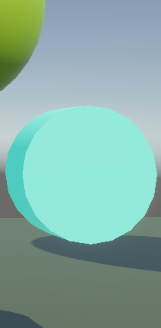
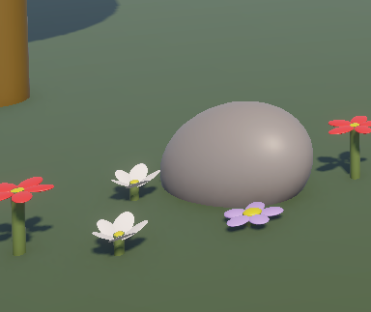
ENVIRONMENT & GAME OBJECTS
FOREST ENVIRONMENT
The game takes place in a stylized
3D forest created in Unity 6.
ENVIRONMENT OBJECTS
Trees — create the forest atmosphere.
Bushes and flowers — add color and detail.
Stones and tree stumps — make the environment more natural.
Grass — covers the ground.
INTERACTIVE OBJECTS
Magical crystals — collectibles that the player must find.
Portal — becomes active after collecting all 5 crystals.
Most environment objects were created using simple 3D shapes and materials in Unity.

Slide 8
AUDIO & VISUAL DESIGN
AUDIO DESIGN
Background music plays continuously during gameplay.
Collecting a crystal triggers a sound effect.
The portal plays a sound when it becomes active.
Audio makes the game more immersive and provides feedback.
VISUAL DESIGN
A colorful, stylized 3D forest environment.
Green grass, trees, bushes and flowers.
Bright blue crystals that are easy to notice.
A magical portal that appears after collecting all crystals.
Simple and readable user interface.

Slide 9
TESTING & FEEDBACK
Player Feedback
Players liked the ending and background music.
Both players found the difficulty appropriate.
Neither player needed additional instructions.
Improvements
Improved player movement relative to the camera.
Added invisible boundaries to prevent falling off the map.
Future improvements: respawn system and more consistent visuals.
Testing
The game was tested by 2 external players.
Feedback was collected using Microsoft Forms.
Average Ratings
Controls: 3.5 / 5
Visual Style: 3.5 / 5
Gameplay: 4.5 / 5

Slide 10
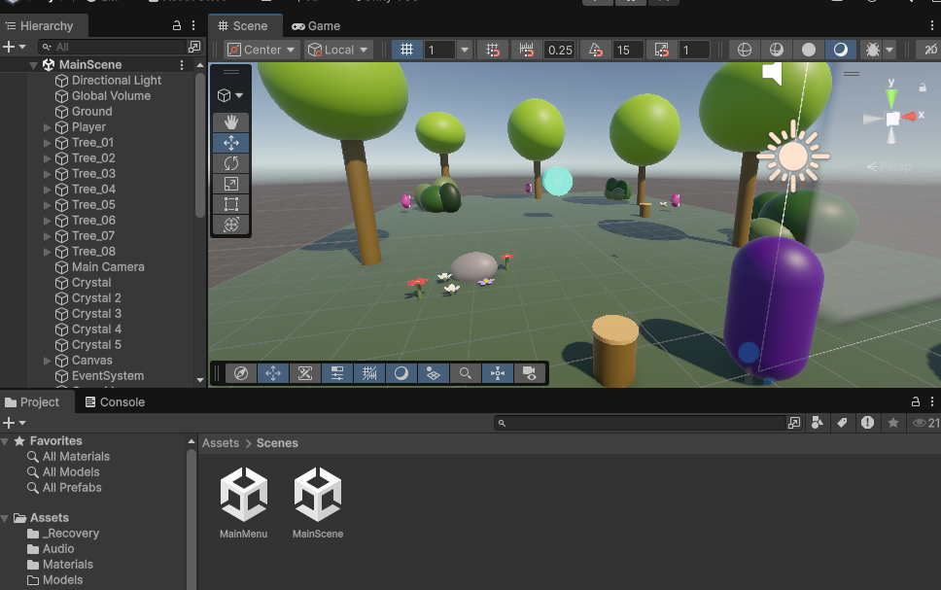
ASSETS & DEVELOPMENT
DEVELOPMENT TOOLS
Unity 6 — game engine and scene creation.
C# — gameplay programming.
Visual Studio — writing and editing scripts.
GitHub and GitHub Desktop — version control and project storage.
PowerPoint and Excel — project documentation.
GAME ASSETS
Trees, bushes, stones and flowers created using Unity 3D primitives.
Simple materials used for the environment and objects.
TextMeshPro used for interface text.
Audio clips used for background music and sound effects.
PROJECT BUILD
Target platform: Windows PC.
The final playable Windows build is stored in the GitHub repository.
AUDIO SOURCES
Music and sound effects were obtained from:
Freesound - https://freesound.org
OpenGameArt — Fantasy Forest resources
https://opengameart.org/art-search?keys=fantasy+forest
External audio resources were used to improve the atmosphere and provide gameplay feedback.

Slide 11
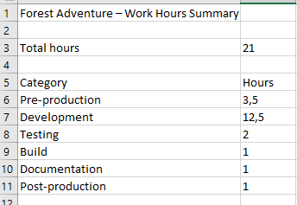
WORK HOURS & FUTURE DEVELOPMENT
WORK HOURS
Development period: 1–3 November
2026
November 1 — 7 hours
November 2 — 9 hours
November 3 — 5 hours
Total: 21 hours (estimated)
Work included planning,
programming, environment
design, testing, building and
documentation.
FUTURE DEVELOPMENT​
Add more levels and larger forest areas.​
Introduce new types of collectibles.​
Improve character models and animations.​
Add puzzles and challenges.​
Improve lighting and environmental effects.​
Add a save system.​

Slide 12
SELF-EVALUATION
SELF-EVALUATION — H4 (PROPOSED)
WHAT I LEARNED
How to create a 3D game using Unity 6.
How to program gameplay mechanics using C#.
How to create menus, UI and sound effects.
How to use GitHub for version control.
How to build and test a Windows game.
WHAT WENT WELL
I completed a playable game with a clear objective.
The crystal collection and portal systems work correctly.
The game includes menus, audio and a win condition.
I successfully created and tested a Windows build.
WHAT I COULD IMPROVE​
Better planning and time management.​
More detailed 3D models and animations.​
More gameplay variety and challenges.​
MY EVALUATION​
I would evaluate my work at level H4 because I completed a functional game and learned to use several development tools. I still have room to improve my programming and game design skills.​
​

