Slide 1
Lesson 8-2: Strings and Random Numbers (in Loops)
Computer Science 46A: Introduction to Programming
San José State University

Slide 2
Announcements
Homework #8 is due by midnight this Sunday (2/26)
Lab #7 is on Friday

Slide 3
Learning Objectives
By the end of this lesson, you should be able to:
Format strings with space “padding”
Generate random integers and doubles
Generate a predictable set of random numbers using a “seed”

Slide 4
A few more string formatting tips

Slide 5
Recall: Formatting doubles with printf
With the printf function, we can format double type numbers in strings with a specified number of decimal places
For example:
System.out.printf(“The square root of 2 is %.4f.”,Math.sqrt(2))
Output:
The square root of 2 is 1.4142.
Number of decimal places

Slide 6
Pop Quiz: Question 1
Which of the following lines would print 3.14?
System.out.printf(“%.1f”, 3.14)
System.out.printf(“%.3f”, 3.14)
System.out.printf(“%.2f”, Math.PI)
System.out.printf(“%.3f”, Math.PI)

Slide 7
Formatting integers with spaces
int number = 3456;
Recall: We can format integers in strings with the %d formatter
e.g. System.out.printf(“%d”, number)
0 | 1 | 2 | 3
3 | 4 | 5 | 6
indices
digits
We can “pad” integers with spaces with a number in the %d formatter
e.g. System.out.printf(“%9d”, number)
0 | 1 | 2 | 3 | 4 | 5 | 6 | 7 | 8
 |  |  |  |  | 3 | 4 | 5 | 6
See example code in IntegerAlignment

Slide 8
Formatting doubles
double number = 3456.789;
Recall: We can format doubles in strings with the %f formatter
e.g. System.out.printf(“%.2f”, number)
 |  |  |  | 0 | 1
3 | 4 | 5 | 6 | 7 | 8
decimal indices
Two decimal places
See example code in DoubleAlignment

Slide 9
Formatting doubles with spaces
double number = 3456.78;
We can “pad” doubles with spaces with a number in the %f formatter
e.g. System.out.printf(“%9.2f”, number)
0 | 1 | 2 | 3 | 4 | 5 | 6 | 7 | 8
 |  | 3 | 4 | 5 | 6 | . | 7 | 8
Two decimal places
Nine possible characters
See example code in DoubleAlignment

Slide 10
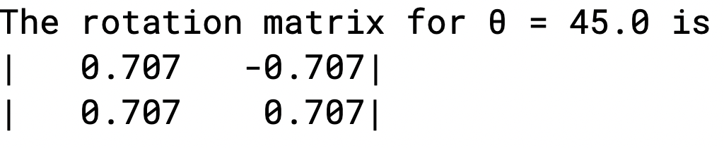

Example: RotationMatrix
In linear algebra, the rotation matrix (R) for an angle $θ$ is:
$$\left[\begin{matrix}cos⁡(θ) & −sin(θ) \\ sin⁡(θ) & cos⁡(θ)\end{matrix}\right]$$
This matrix is used to rotate vectors in a plane

Slide 11
Random Numbers

Slide 12
Random Numbers
Often, we require randomly-generated numbers in our code
Examples:
Encryption, Statistics, Code testing
To generate random numbers we use the Random class
First, we create a generator object:
Random generator = new Random();
Then, we can use the generator to produce our random numbers
generator.nextInt(n);
The nextInt method will provide a random number between 0 and n (exlcusive)

Slide 13
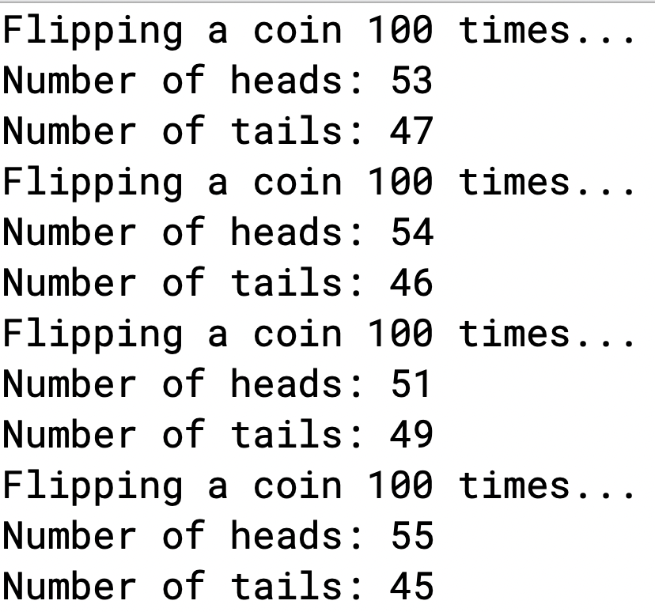
Example: FlippingACoin
Code Description:
Flip a coin a given amount of times, counting the number of heads and tails as you go
If you like stats and programming,
THIS VIDEO is highly recommended!
Output of the FlippingACoin class run 4 times

Slide 14
Pop Quiz: Question 2
We can use generator.nextInt(n) to generate a random number between 0 and n (exclusive).
How can we generate a random number between 7 and 17 (exclusive)?
generator.nextInt(7,17)
7 + generator.nextInt(17)
17 + generator.nextInt(7)
7 + generator.nextInt(10)

Slide 15

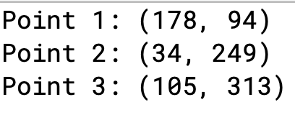
Example: RandomTriangle
Code Description:
Draw a triangle with indices given at random points such that
0 < x < 200
0 < y < 400
Print coordinates to the screen
Output of the RandomTriangle class

Slide 16
A Predictable Set of Random Numbers
Each time you use a generator to produce random numbers, it provides a unique selection of random numbers
Each time you run the code, the random numbers will change
If you want a predictable set of random numbers, construct your generator using a “seed” – an integer value that specifies a specific set of random numbers
int seed = 10; //example
Random generator = new Random(seed);
See example code in RandomTriangle

Slide 17
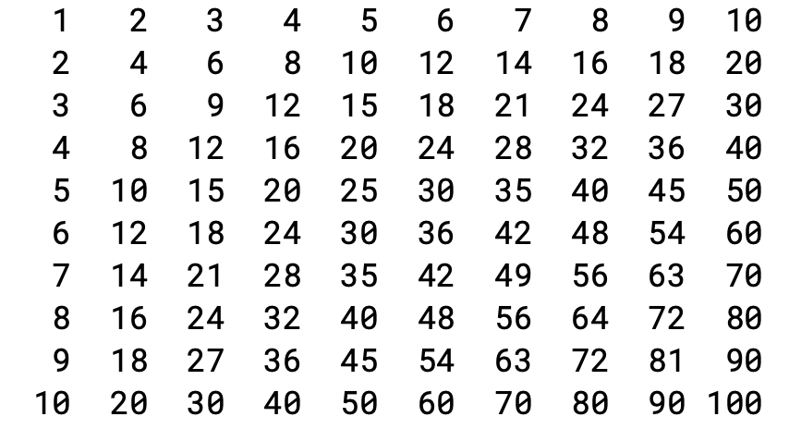
Participation Exercise 8-2a: MultiplicationTable
Goal: Create a multiplication table such as the one displayed at the right
Output of MultiplicationTable
Codecheck Link: HERE and on Canvas

Slide 18

Participation Exercise 8-2b: RandomNumbersWithASeed
Goal: Create a list of random numbers with values between 45 and 55
Use the SEED to ensure your values match the values shown at the right
Output of RandomNumbersWithASeed
Codecheck Link: HERE and on Canvas

